Slide 1



Dig Site 14 Memory Verse
Hide God's Word in Your Heart!
This activity will help you memorize your Bible verse for the week. Each slide removes more words from the verse. Click your mouse or spacebar to fill in the blanks one at a time but try to say it out loud with the missing words yourself before clicking. Don't forget to practice the reference at the top.

Slide 2

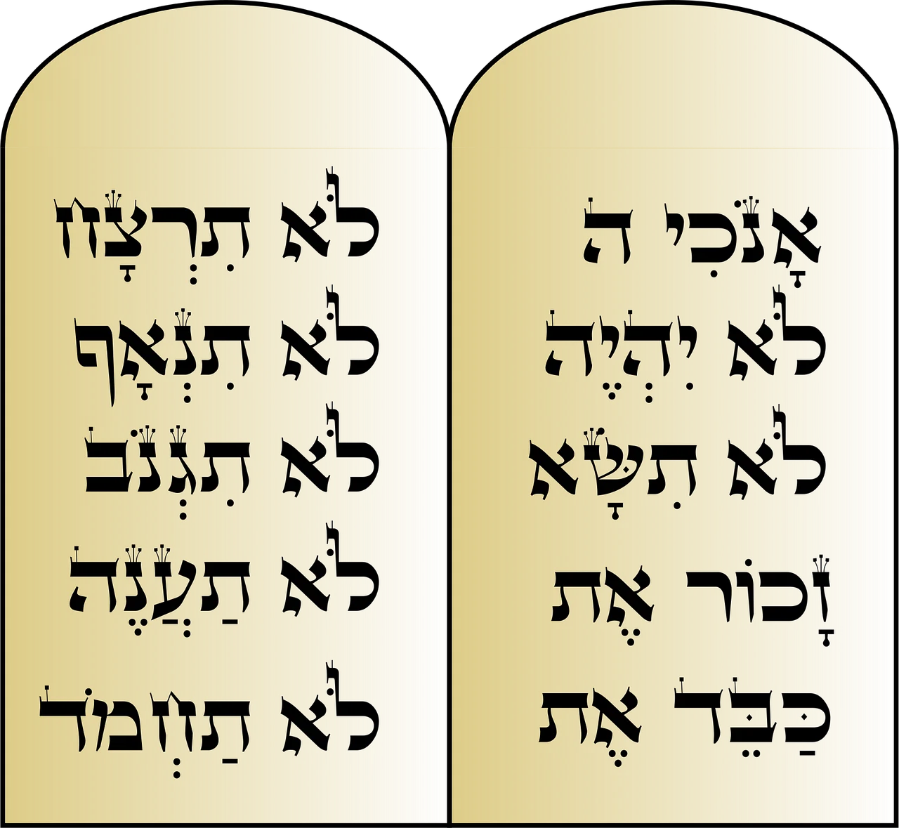

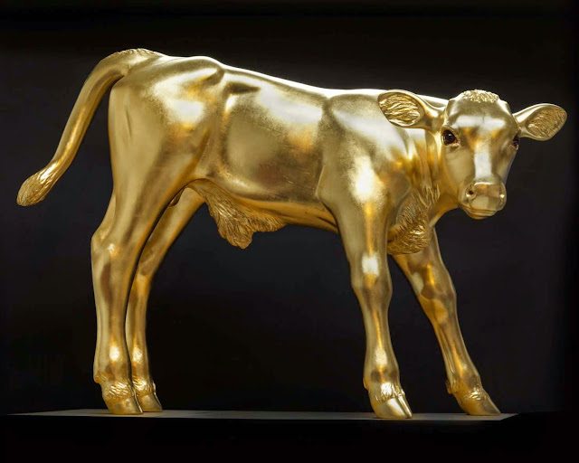
Exodus 20:3-4
"'You shall have no other gods before me. You shall not make for yourselves an image in the form of anything in heaven above or on the earth beneath or in the waters below.'"
Notes:
Image Source – Free download from Pixabay - https://pixabay.com/vectors/commandments-moses-hebrew-religion-49012/
1 - This Photo by Unknown Author is licensed under CC BY
Calf - This Photo by Unknown Author is licensed under CC BY-SA-NC

Slide 3
Exodus 20:3-4
"'You shall have no other gods before me. You shall not make for yourselves an image in the form of anything in heaven above or on the earth beneath or in the waters below.'"
What Does It Mean?
God (Yahweh) is the only true God, and we should only worship Him! Everything else humans are tempted to make more important than God are idols (false gods). We may not worship statues like the people in Moses' time, but humans are still tempted to trust in things besides God. Can you think of examples?
Notes:
Image Source – Free download from Pixabay - https://pixabay.com/vectors/commandments-moses-hebrew-religion-49012/
1 - This Photo by Unknown Author is licensed under CC BY
Calf - This Photo by Unknown Author is licensed under CC BY-SA-NC

Slide 4
Exodus ___:3-4
"'You shall have __ other ____ before ___. You shall not ____ for yourselves an ______ in the form of anything in _______ above or on the _____ beneath or in the ______ below.'"
20
no
gods
me
make
image
heaven
earth
waters
Notes:
Image Source – Free download from Pixabay - https://pixabay.com/vectors/commandments-moses-hebrew-religion-49012/
1 - This Photo by Unknown Author is licensed under CC BY
Calf - This Photo by Unknown Author is licensed under CC BY-SA-NC

Slide 5
_______ ___:3-4
"'___ shall have __ _____ ____ before ___. You ____ ___ ____ for yourselves an ______ in the ____ of ________ in _______ _____ or __ the _____ beneath or in ___ ______ ______.'"
Exodus
20
You
no
other
gods
me
shall
not
make
image
form
anything
heaven
above
on
earth
the
waters
below
Notes:
Image Source – Free download from Pixabay - https://pixabay.com/vectors/commandments-moses-hebrew-religion-49012/
1 - This Photo by Unknown Author is licensed under CC BY
Calf - This Photo by Unknown Author is licensed under CC BY-SA-NC

Slide 6
_______ ___:____
"'___ _____ ____ __ _____ ____ ______ ___. ___ ____ ___ _____ __ __________ __ ______ __ ___ ____ __ ________ __ _______ _____ __ __ ___ _____ _______ __ __ ___ ______ ______.'"
Exodus
20
3-4
You
shall
no
other
have
gods
before
me
You
shall
not
make
for
yourselves
an
in
of
image
the
form
in
anything
heaven
above
or
on
the
earth
beneath
or
in
below
the
waters
Notes:
Image Source – Free download from Pixabay - https://pixabay.com/vectors/commandments-moses-hebrew-religion-49012/
1 - This Photo by Unknown Author is licensed under CC BY
Calf - This Photo by Unknown Author is licensed under CC BY-SA-NC

