Slide 1
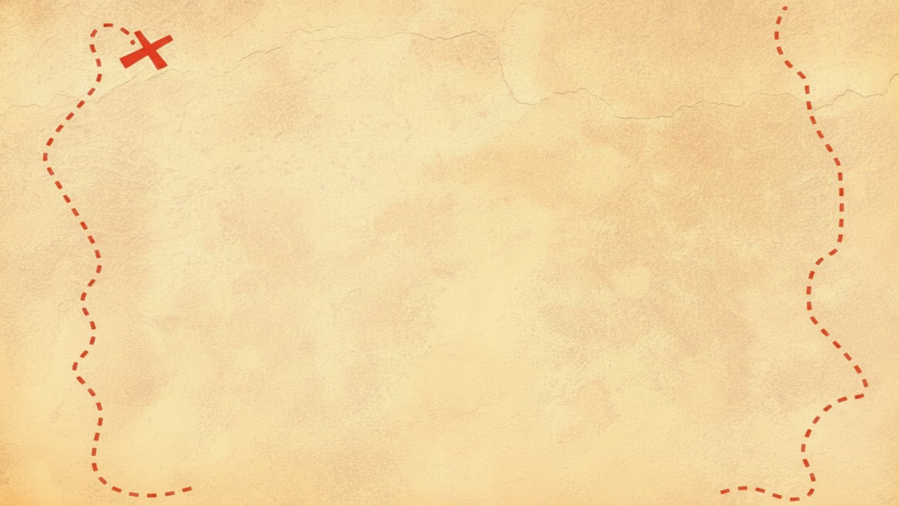


Dig Site 13 Memory Verse
Hide God's Word in Your Heart!
This activity will help you memorize your Bible verse for the week. Each slide removes more words from the verse. Click your mouse or spacebar to fill in the blanks one at a time but try to say it out loud with the missing words yourself before clicking. Don't forget to practice the reference at the top.

Slide 2
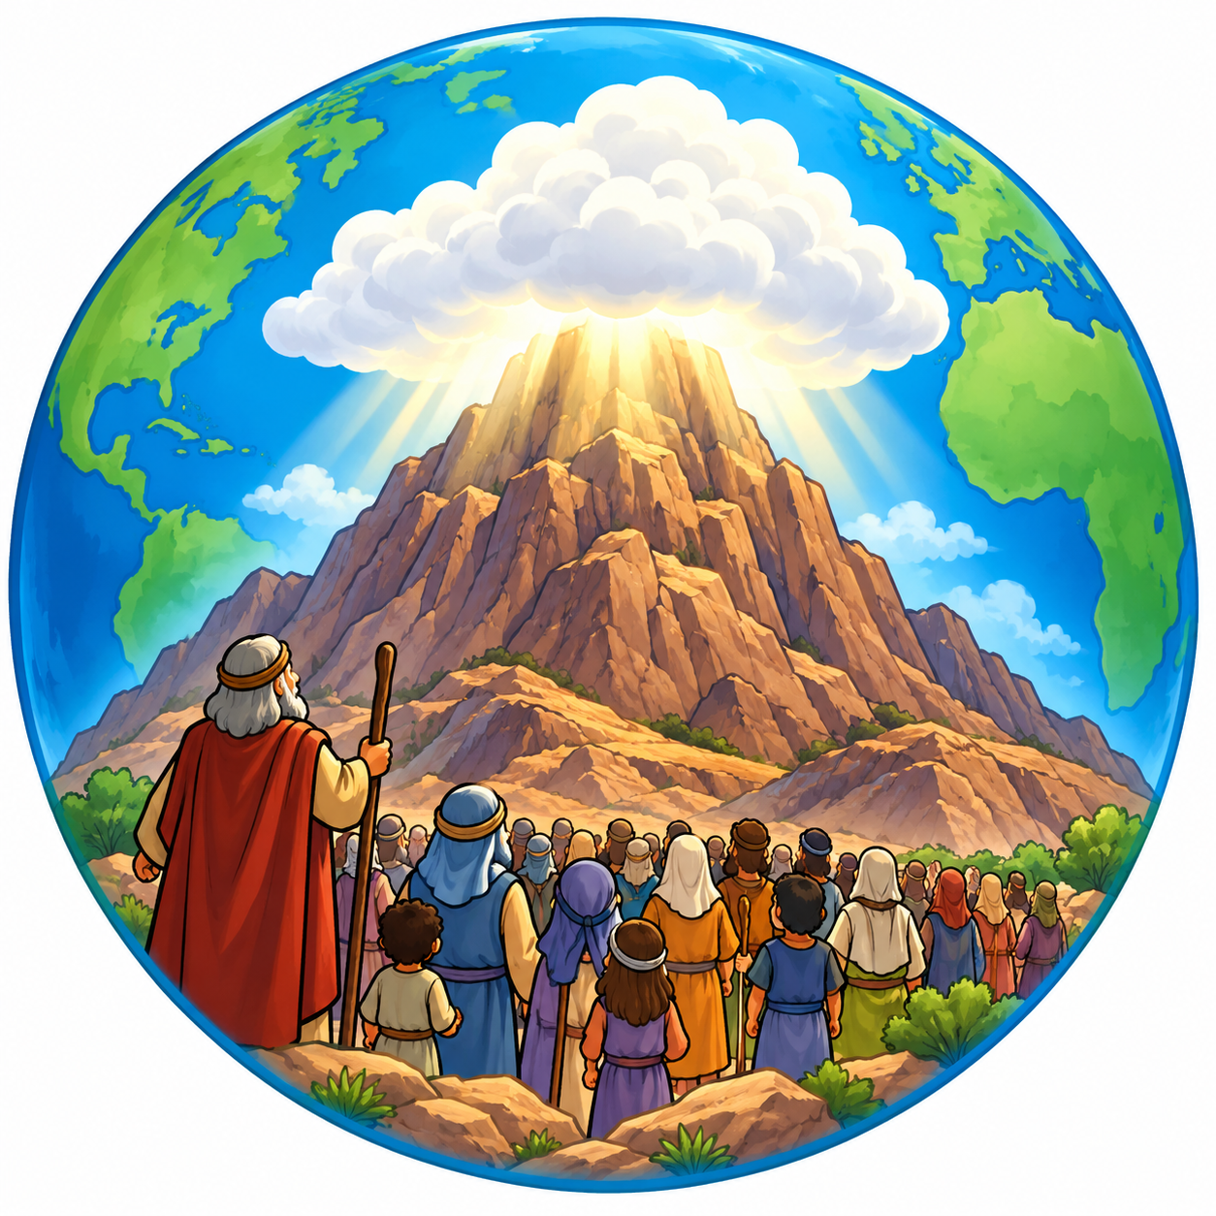
Exodus 19:5-6a
Now if you obey me fully and keep my covenant, then out of all nations you will be my treasured possession. Although the whole earth is mine, you will be for me a kingdom of priests and a
holy nation.
Notes:
Image created with Chat GPT

Slide 3
Exodus 19:5-6a
Now if you obey me fully and keep my covenant, then out of all nations you will be my treasured possession. Although the whole earth is mine, you will be for me a kingdom of priests and a
holy nation.
What Does It Mean?
God had brought the Israelites back to Sinai (Horeb) just as He had told Moses. God tells them they are special to Him, but He also gives them an important job. Just as a priest serves as a "go-between" for God and the people, the Israelites were to show the whole world God's holiness. Now Jesus is our priest and all who follow Him are to show God's holiness and love to the whole world!

Slide 4
_______ 19:5-6a
Now if you ____ me fully and ____ my covenant, then out of all _______ you will be my __________ possession. Although the whole _____ is mine, ____ will be for ___ a kingdom of ______ and a
____ nation.
Exodus
obey
keep
nations
treasured
earth
you
me
priests
holy
Notes:
Image created with Chat GPT

Slide 5
_______ __:5-6a
Now _ you ____ me ___ and ____ my ________, then out __ __ _______ you will __ my __________ __________. Although the _____ _____ is ____, ____ will be __ ___ a ________ of ______ and a
____ ______.
Exodus
19
if
obey
fully
keep
covenant
of
all
nations
be
treasured
possession
whole
earth
mine
you
for
me
kingdom
priests
holy
nation
Notes:
Image created with Chat GPT

Slide 6
_______ __:____
____ _ ___ ____ __ ___ ___ ____ __ ________, ____ ___ __ __ ______ ___ ___ __ __ __________ __________. _______ ___ _____ ____ __ ____, ____ ___ __ __ ___ _ ________ __ ______ ___ _
____ ______.
Exodus
19
5-6a
Now
if
you
obey
me
fully
and
keep
covenant
out
my
then
of
will
all
nations
you
be
my
treasured
possession
Although
the
is
whole
earth
be
will
for
a
mine
you
me
kingdom
of
priests
and
a
holy
nation
Notes:
Image created with Chat GPT

