Slide 1
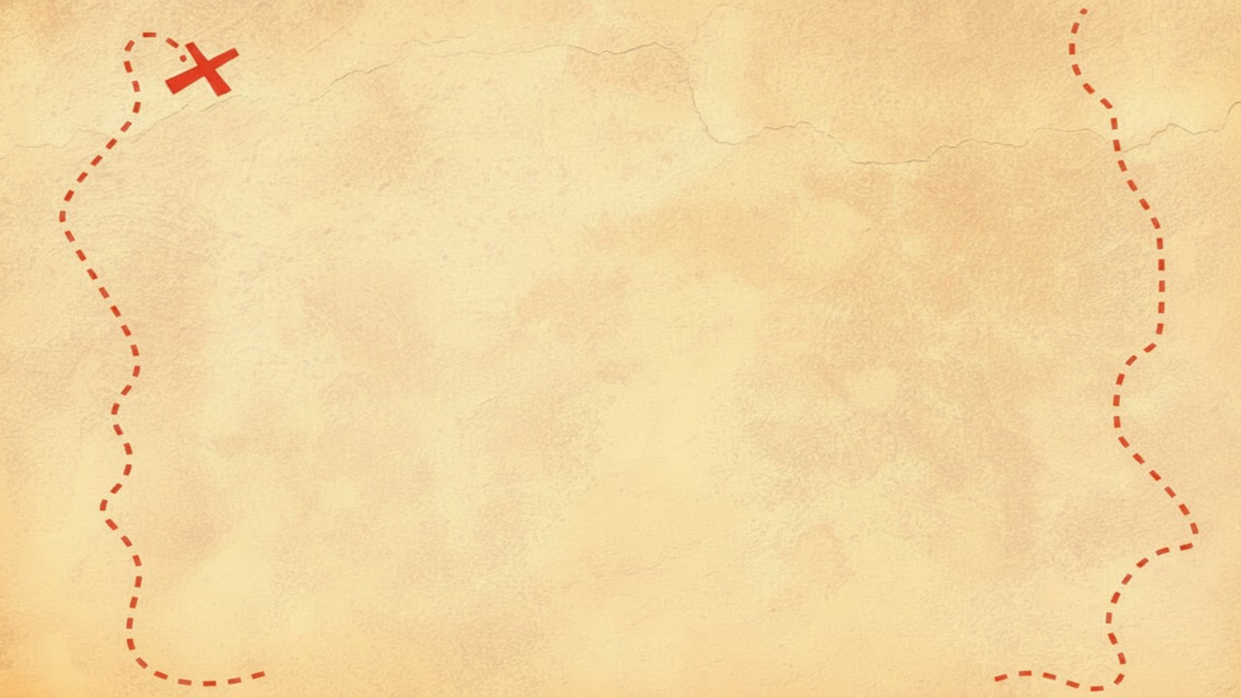


Dig Site 12 Memory Verse
Hide God's Word in Your Heart!
This activity will help you memorize your Bible verse for the week. Each slide removes more words from the verse. Click your mouse or spacebar to fill in the blanks one at a time but try to say it out loud with the missing words yourself before clicking. Don't forget to practice the reference at the top.

Slide 2

Exodus 15:11
Who among the gods is like you, LORD?
Who is like you—
majestic in holiness,
awesome in glory,
working wonders?

Slide 3
Exodus 15:11
Who among the gods is like you, LORD?
Who is like you—
majestic in holiness,
awesome in glory,
working wonders?
What Does It Mean?
This is the 3rd memory verse that comes from the song that was sung after the Red Sea crossing. Majestic and awesome both mean that something is amazing. It is not actually asking IF God is like this, but it is declaring it as true and making it known that God deserves worship!

Slide 4
15
Exodus __:11
Who among the ____ is like you, ______?
Who is ____ you—
majestic in _________,
awesome in _____,
working _________?
gods
LORD
like
holiness
glory
wonders

Slide 5
Exodus
15
_______ __:11
____ among the ____ is ____ you, ______?
____ is ____ you—
majestic __ _________,
awesome __ _____,
_______ _________?
Who
gods
like
LORD
Who
like
in
holiness
in
glory
working
wonders

Slide 6
Exodus
15
11
_______ __:__
____ ______ ___ ____ __ ____ ___, ______?
____ __ ____ ___—
________ __ _________,
_________ __ _____,
_______ _________?
Who
among
the
gods
is
like
you
LORD
Who
is
like
you
majestic
in
holiness
awesome
in
glory
working
wonders

