Slide 1

Dig Site #14
R-E-S-P-E-C-T!

Slide 2
Memory Verse
You shall have no other gods before me. You shall not make for yourself an image in the form of anything in heaven above or on the earth beneath or in the waters below.
Exodus 20:3-4
Lesson #14

Slide 3
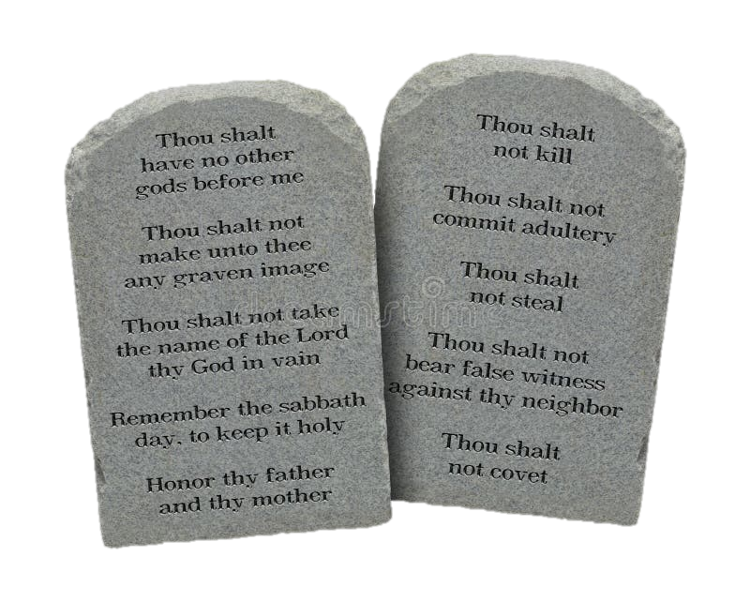
Exodus 20:1-21
R-E-S-P-E-C-T
Notes:
Tablets: https://www.dreamstime.com/photos-images/ten-commandments-tablets.html

Slide 4
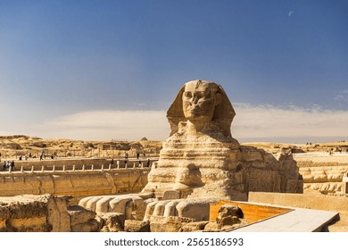
And God spoke all these words:
Exodus 20:1-2

Slide 5
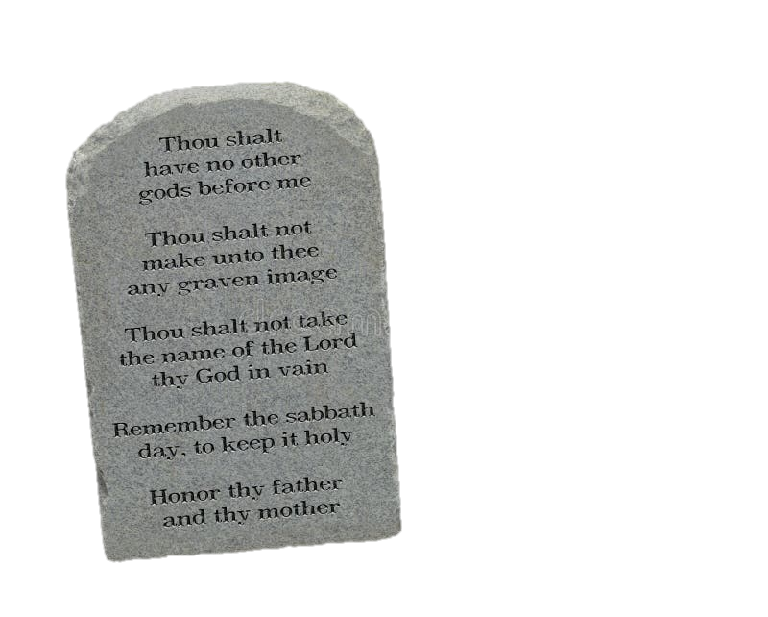
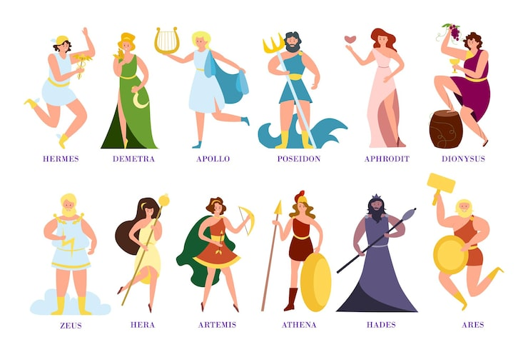
^{Exodus 20:3}
1
Notes:
Pic:https://www.magnific.com/free-photos-vectors/greek-gods

Slide 6
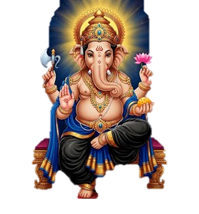

Exodus 20:4-6
2
Notes:
Pic: https://www.shutterstock.com/search/hindu-gods-gods

Slide 7

Exodus 20:7
3
Did You Know?
This commandment is much more than just not using God's name as a bad word. It also means that God's people (that's us!) should live in a way that brings honor and respect to His name! We should always remember that we are God's representatives to the world, and what we do and say affects how people see God.

Slide 8

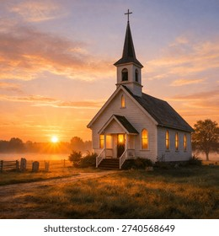
Exodus 20:8-10
4
work
work
work
work
work
Sabbath
Think About It!
This commandment to rest was a gift to people who had been living in slavery and couldn't rest. Do you see the Sabbath as a gift or just a day you can't do certain things? How do you think God wants us to see it?

Slide 9
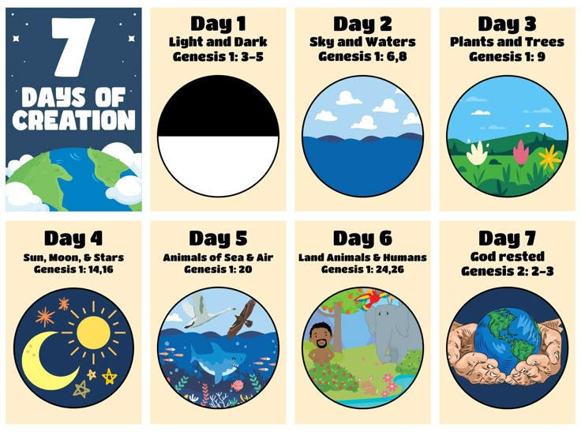
Exodus 20:11

Slide 10

Exodus 20:12
5
Notes:
Pic: https://christiancliparts.net/viewillust.php?id=w15003

Slide 11

6
Exodus 20:13
Take Note:
Read Matthew 5:21-22 and discuss how this commandment is about much more than actually killing someone.

Slide 12

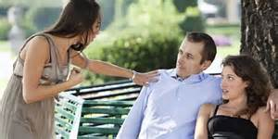
Exodus 20:14
7

Slide 13
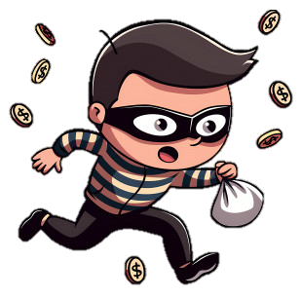
Exodus 20:15
8

Slide 14

Exodus 20:16
I don’t like her!
She always steals from me and I heard she even killed someone!
9

Slide 15
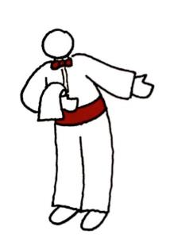


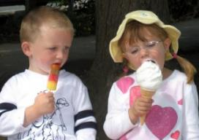
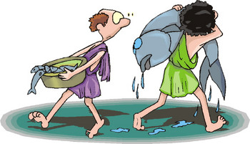
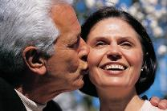
Exodus 20:17
10
Take Note: Instead of wanting what other people have, God wants us to be content and thankful for what we do have!

Slide 16
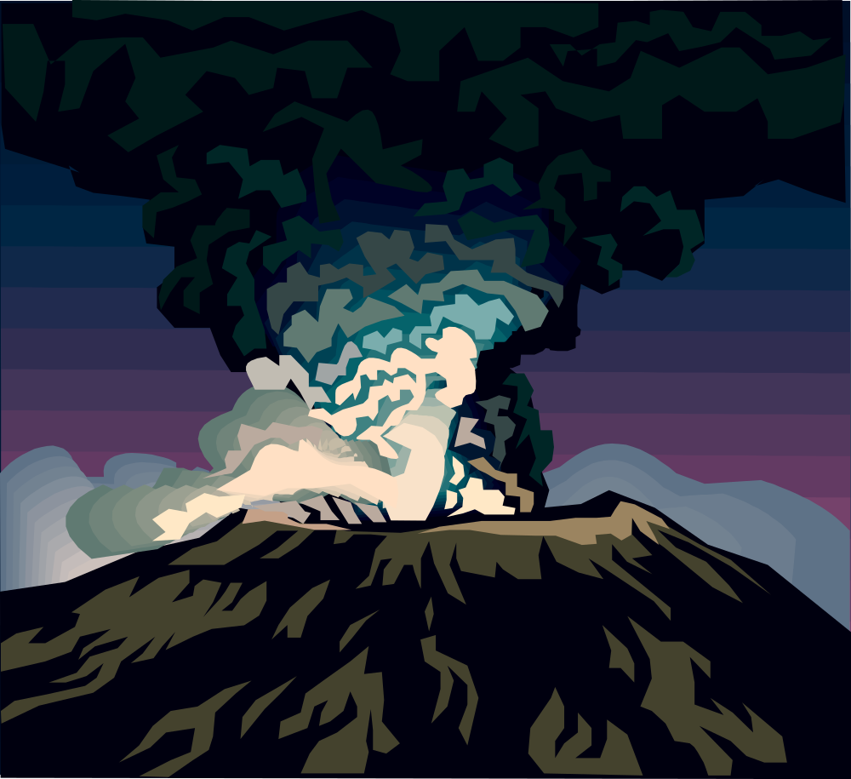

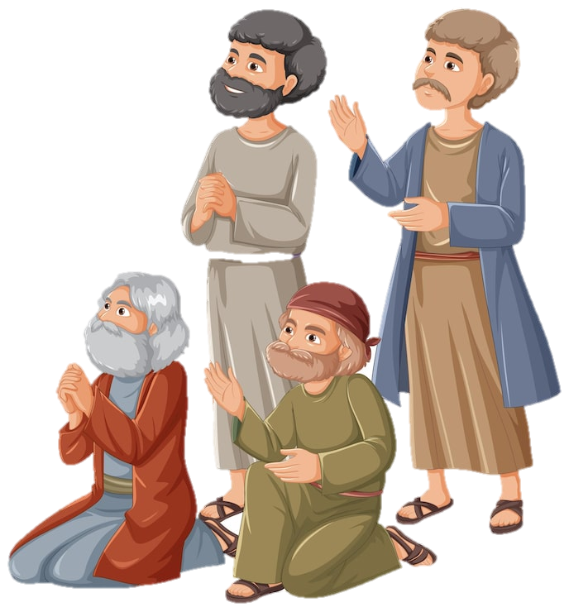
Exodus 20:18

Slide 17
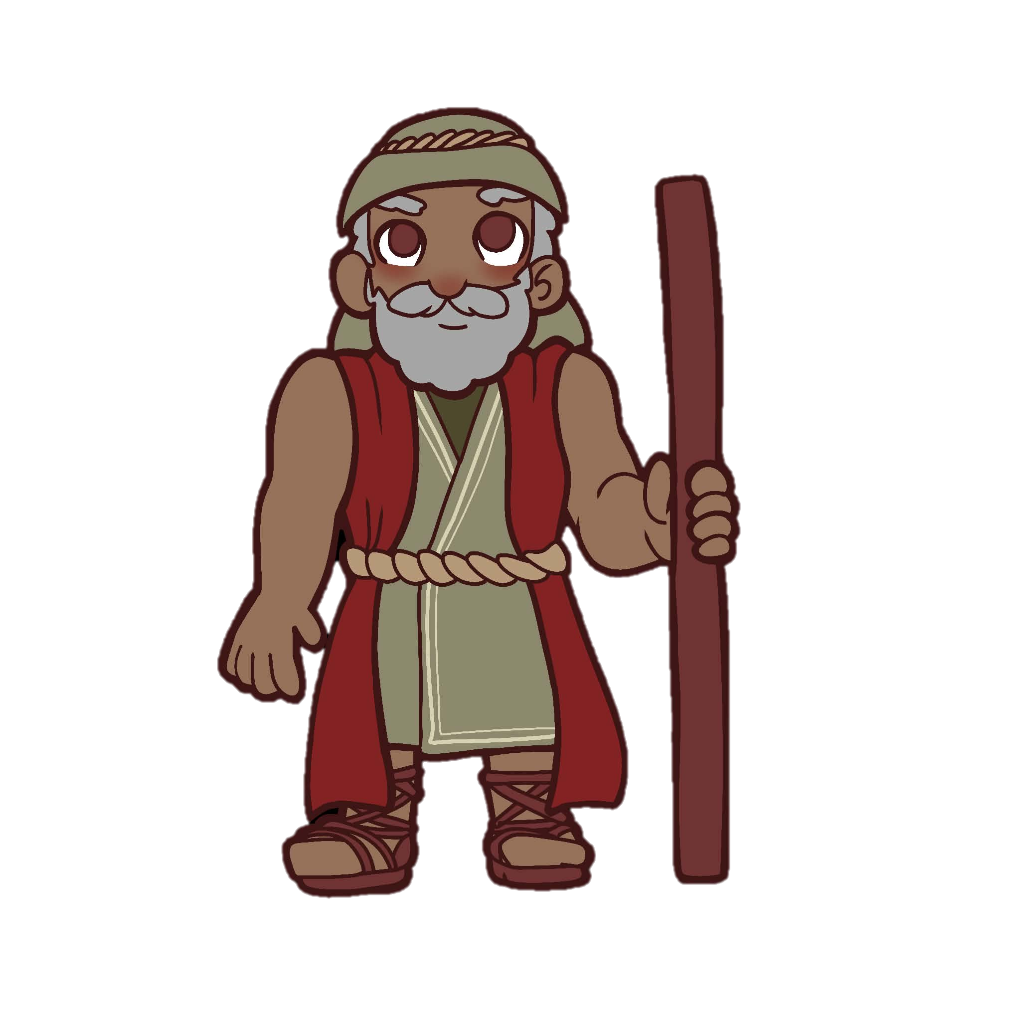
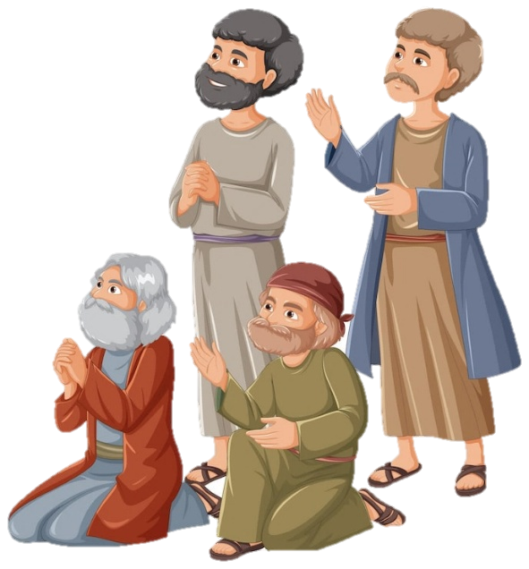
They stayed at a distance and said to Moses,
Exodus 20:19

Slide 18
Exodus 20:20

Slide 19
Exodus 20:21

