Slide 1
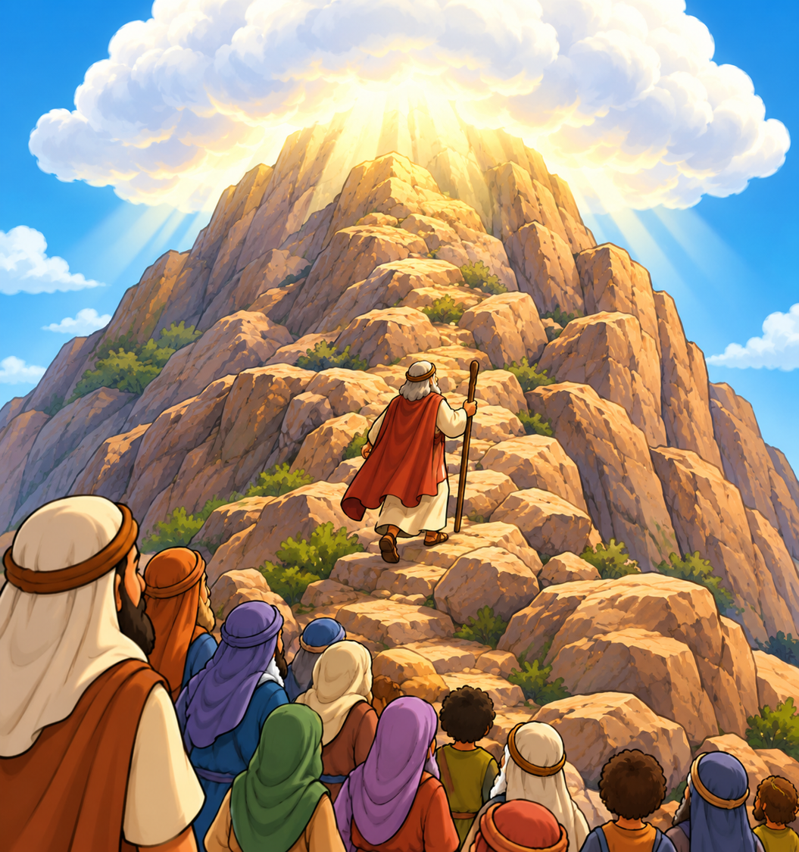
Moses on the Mountain
Exodus 19:1-25
Lesson #13

Slide 2

Read: Exodus 19:1
1st
^{Day}
3rd
^{Month}

Slide 3
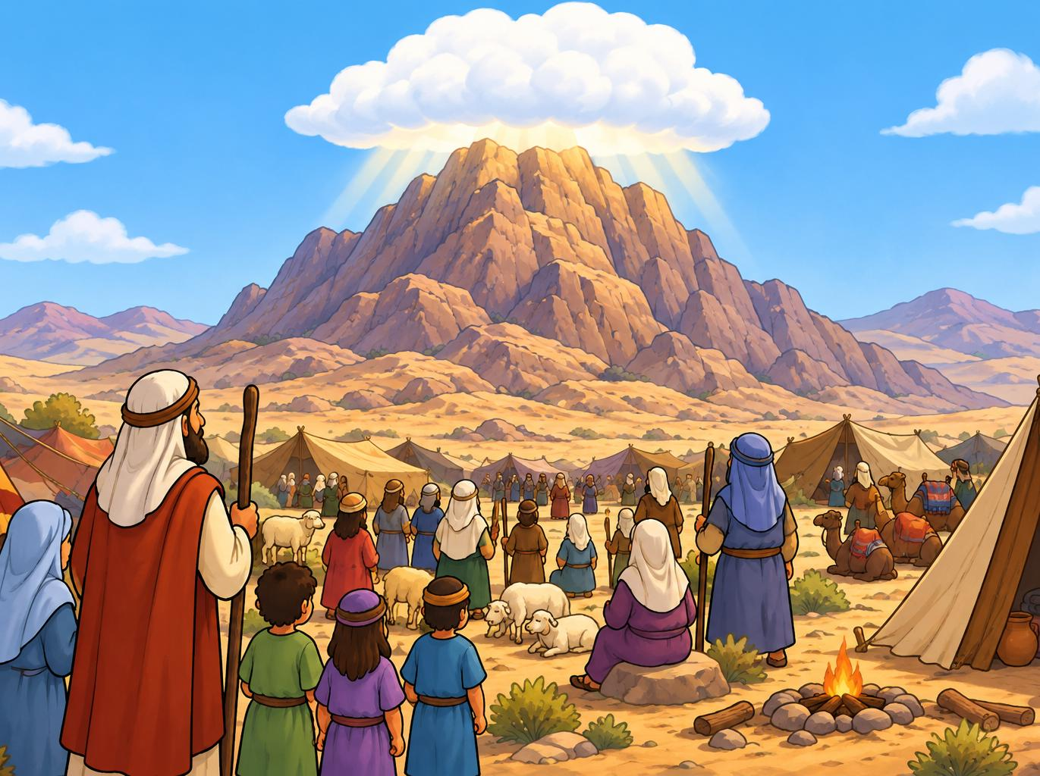
Read:
Exodus
19:2
Take Note:
Do you remember God told Moses he would come back to the same mountain he was on when God called him from the burning bush (3:12)? It was called Horeb there and Sinai here, but it is the same place!
Notes:
Image created with Chat GPT

Slide 4

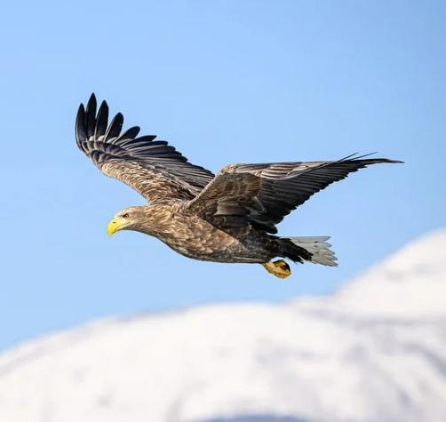
Read:
Exodus
19:3-4
Notes:
Image created with Chat GPT
Eagle – free download from Pixaby with general permission to use

Slide 5
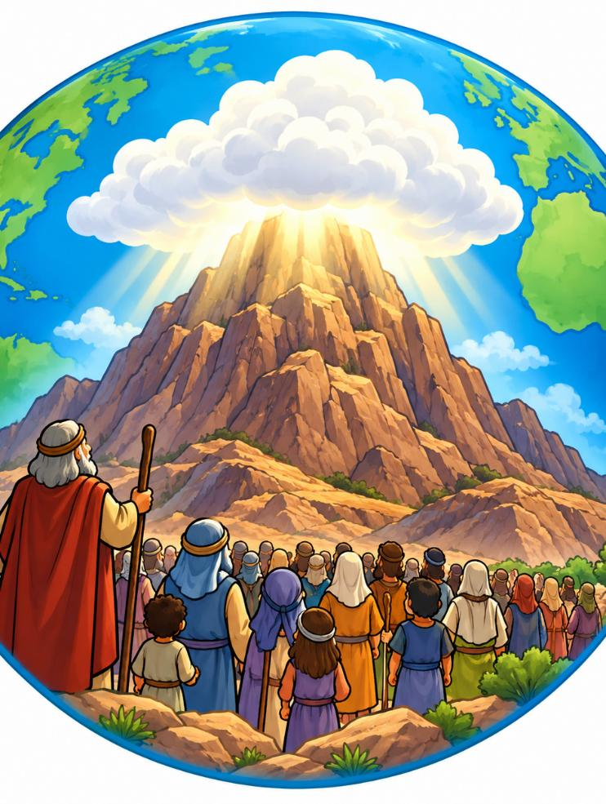
Exodus 19:5-6a
Now if you obey me fully and keep my covenant, then out of all nations you will be my treasured possession. Although the whole earth is mine, you will be for me a kingdom of priests and a holy nation.
Notes:
Image created with Chat GPT

Slide 6
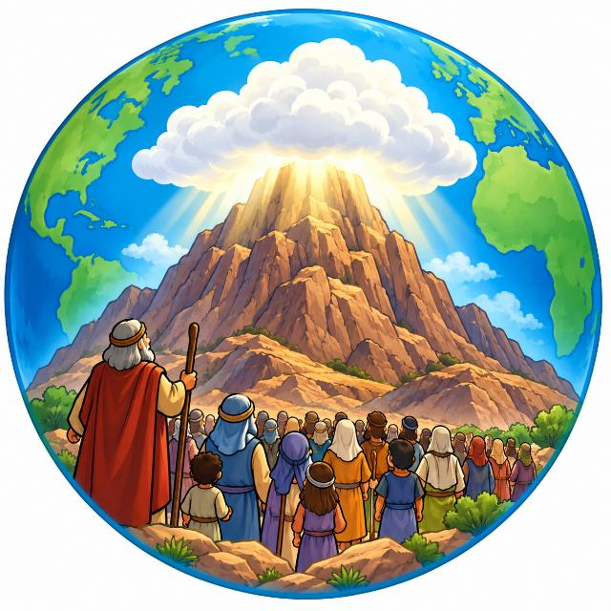
Exodus 19:5-6a
Now if you obey me fully and keep my covenant, then out of all nations you will be my treasured possession. Although the whole earth is mine, you will be for me a kingdom of priests and a holy nation.
What Does It Mean?
God had brought the Israelites back to Sinai (Horeb) just as He had told Moses. God tells them they are special to Him, but He also gives them an important job. Just as a priest serves as a "go-between" for God and the people, the Israelites were to show the whole world God's holiness. Now Jesus is our priest and all who follow Him are to show God's holiness and love to the whole world!

Slide 7
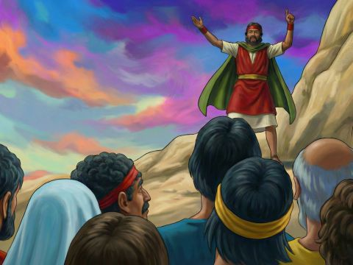
Read:
Exodus 19:6b-8

Slide 8
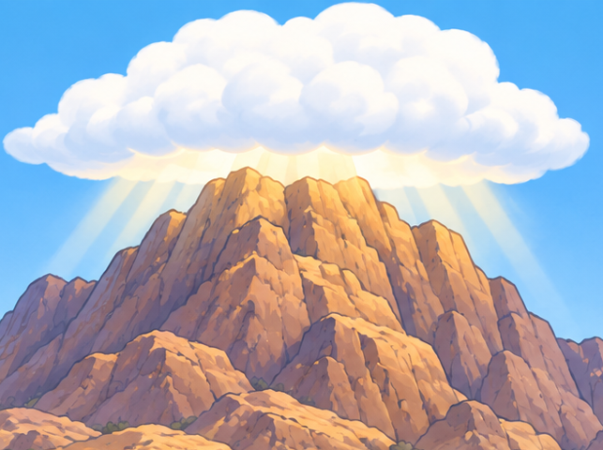
Read: Exodus 19:9

Slide 9
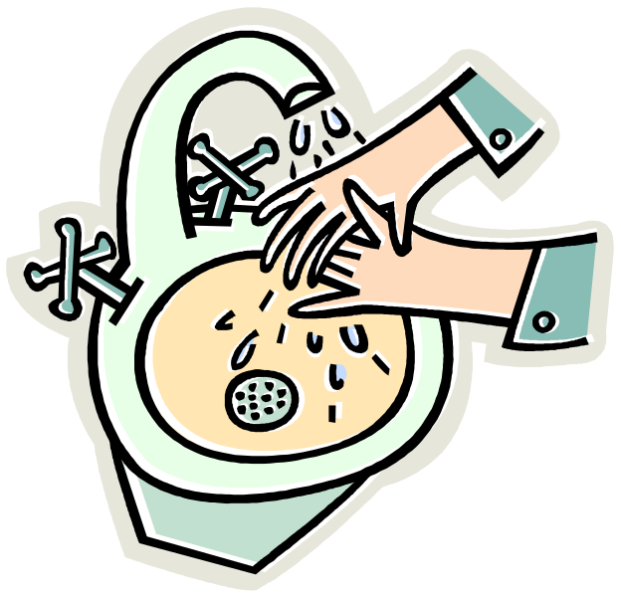

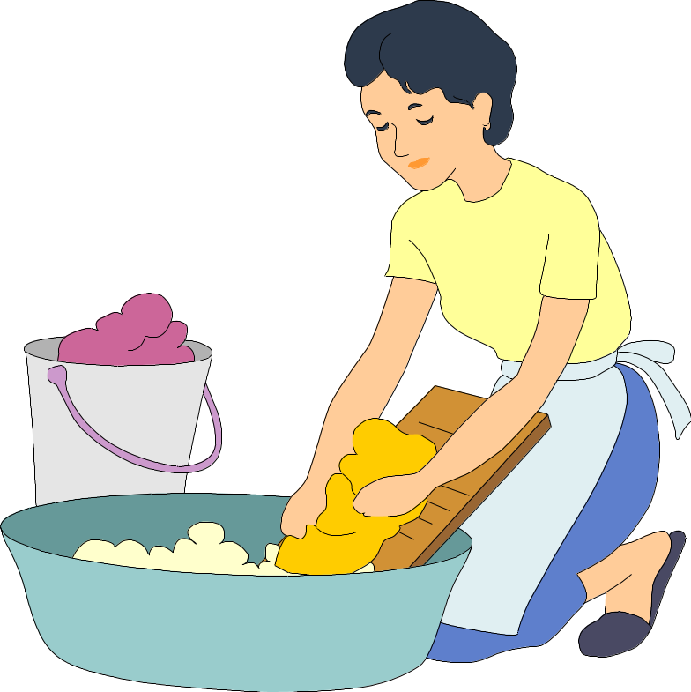
Read: Exodus 19:10-11

Slide 10
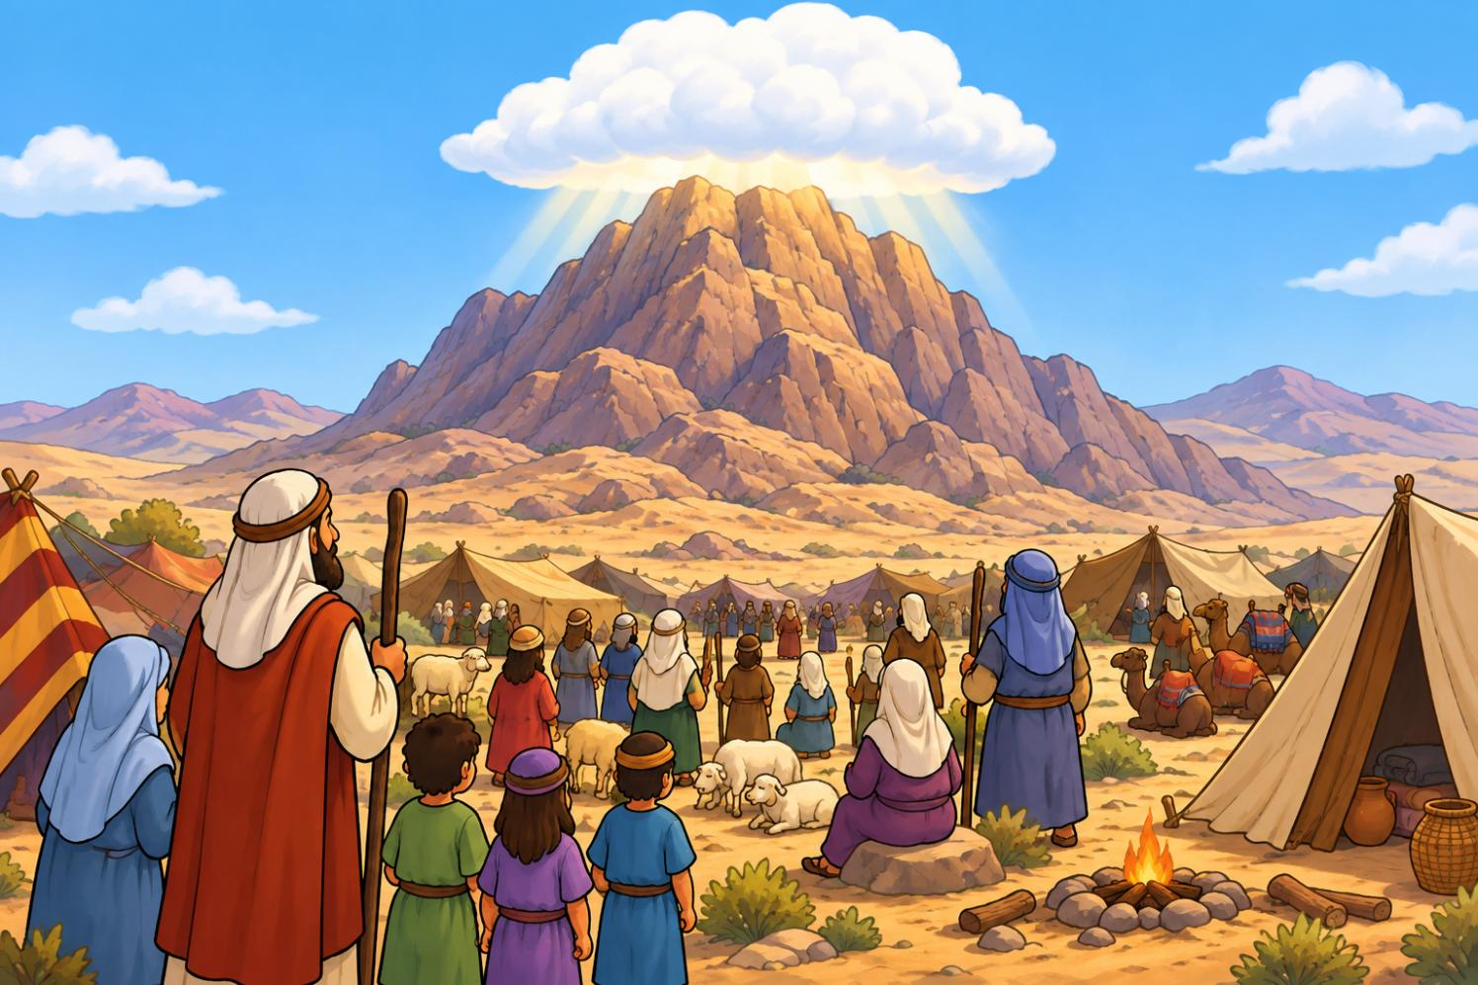


Read: Exodus 19:12-13
STOP

Slide 11
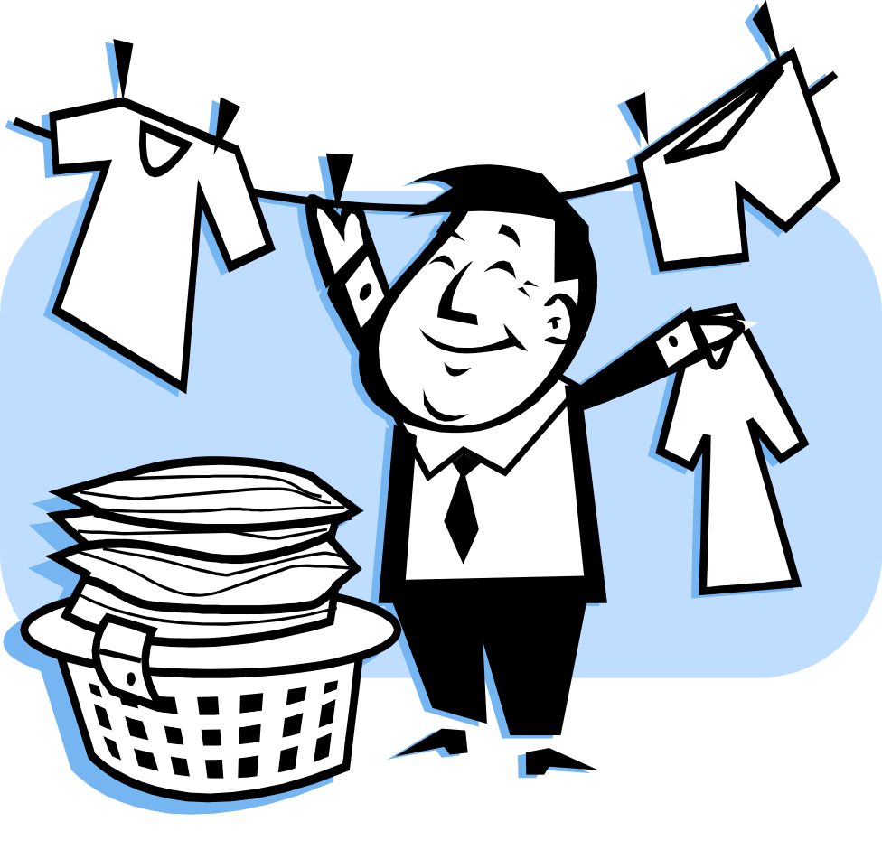
Read: Exodus 19:14-15

Slide 12
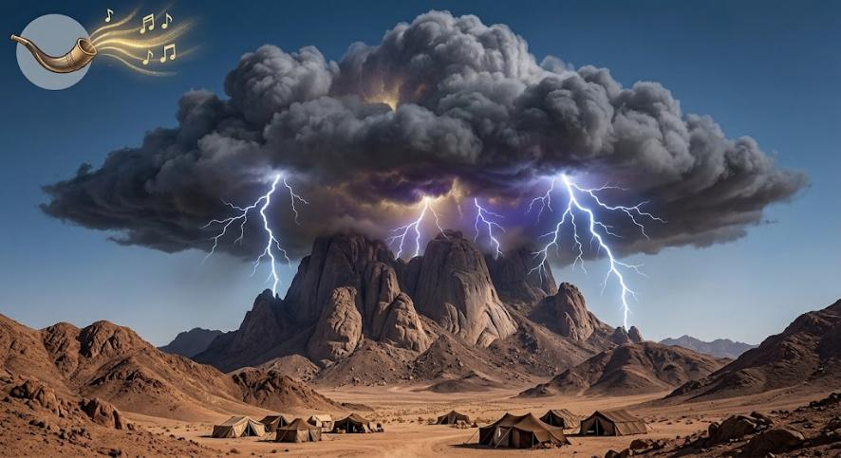
Read: Exodus 19:16-19
Notes:
Image created with Gemini

Slide 13
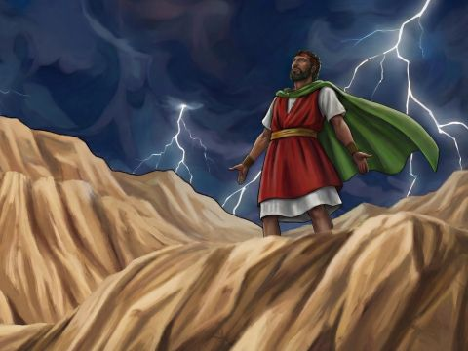
Read: Exodus 19:20-22
Notes:
https://www.freebibleimages.org/illustrations/spi-moses-sinai/

Slide 14
Read: Exodus 19:23
STOP

Slide 15
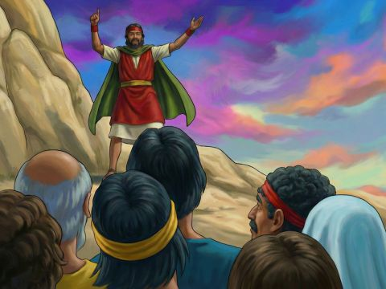
Read:
Exodus 19:24-25
Notes:
https://www.freebibleimages.org/illustrations/spi-moses-sinai/

