Slide 1
God Provides!
Exodus 16:1-31,17:1-7
Lesson #12

Slide 2

Exodus 15:11
Who among the gods is like you, LORD?
Who is like you—
majestic in holiness,
awesome in glory,
working wonders?

Slide 3
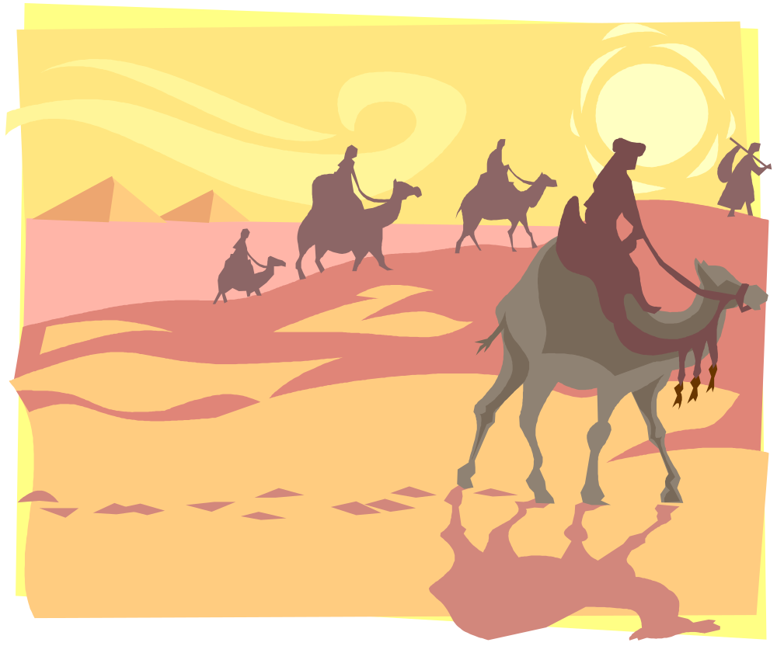
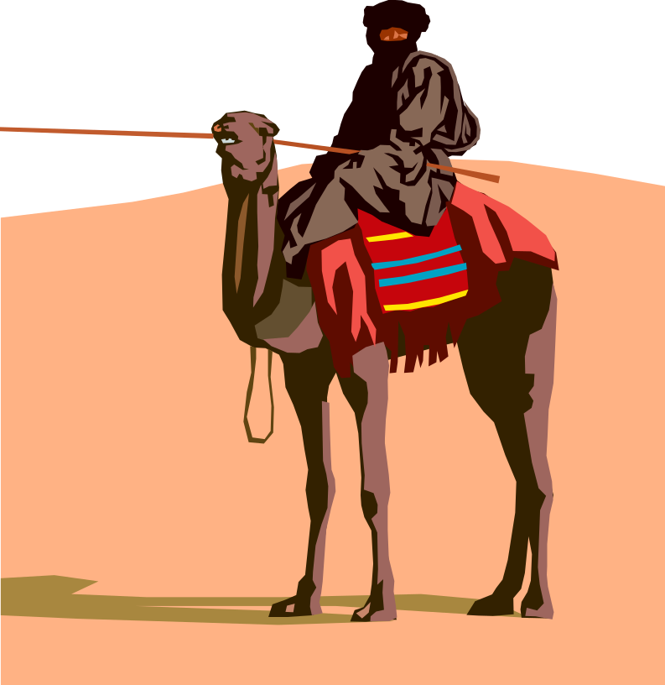
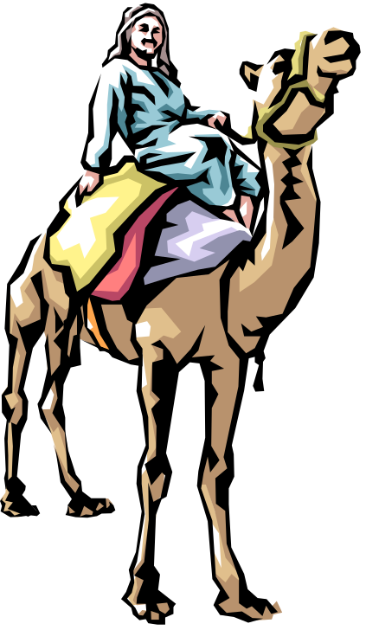
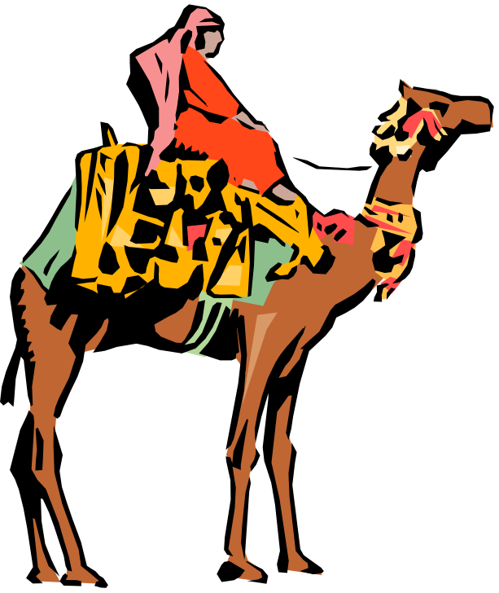
Read Exodus 16:1
ELIM
SIN

Slide 4




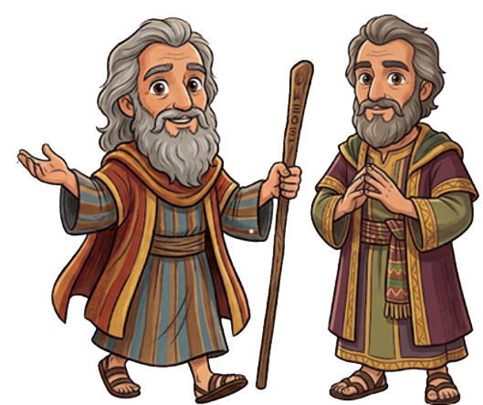

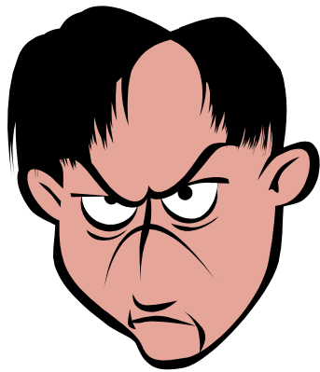


Read Exodus 16:2
Notes:
Moses and Aaron images created with Chat GPT

Slide 5
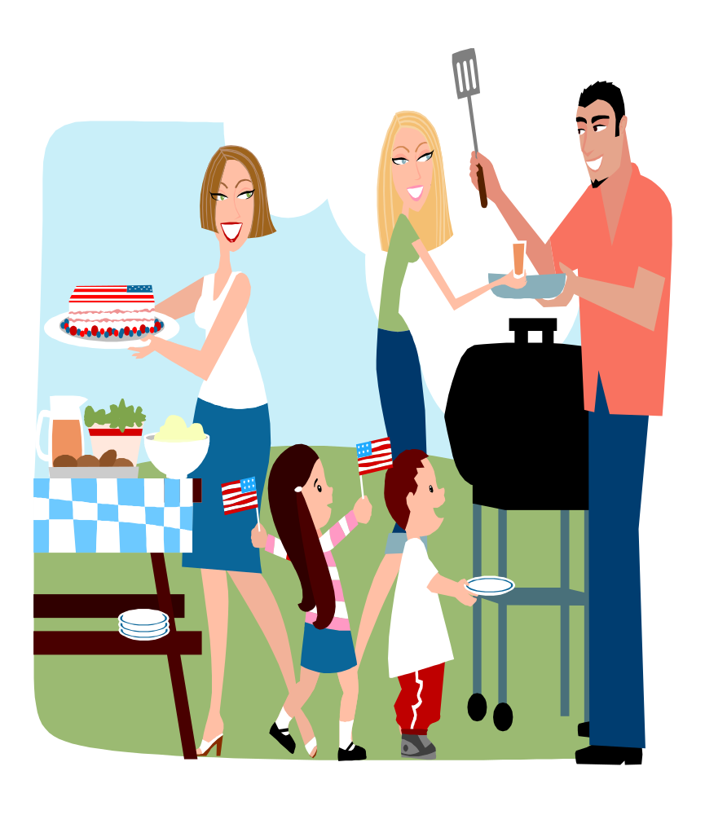
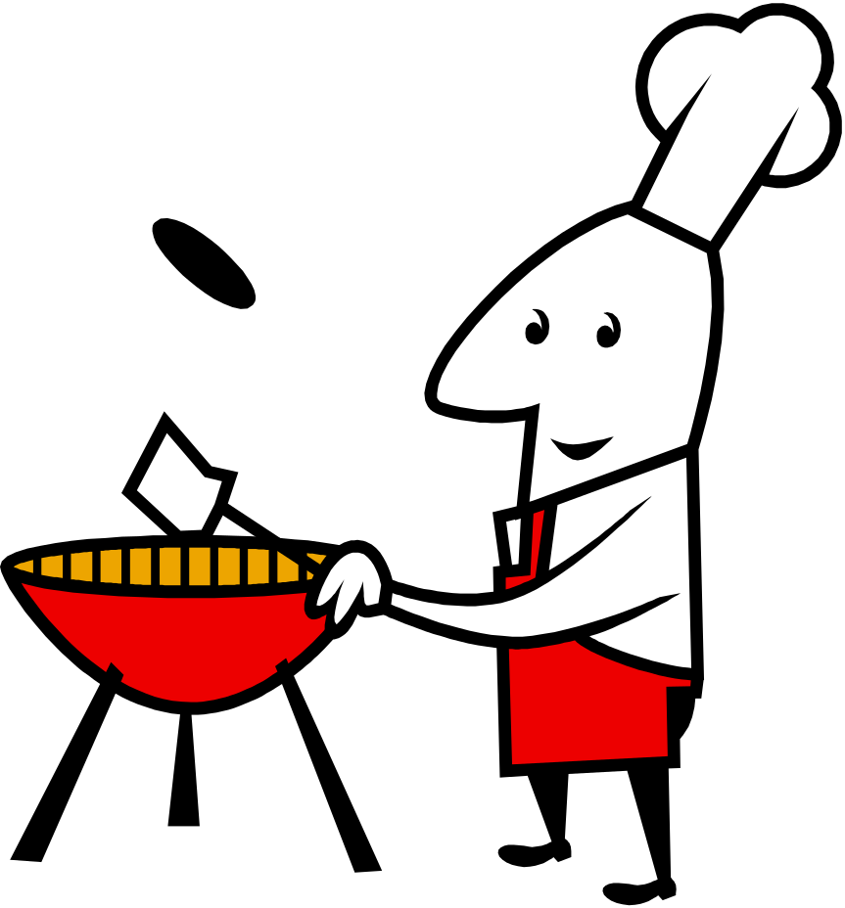
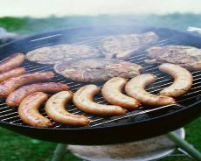
Read Exodus 16:3

Slide 6





Read Exodus 16:4

Slide 7
Read Exodus 16:5
1st 2nd 3rd 4th 5th 6th
Take Note: Gathering twice as much on the 6th day allowed them to rest on the 7th day! God had not given them the 10 Commandments yet, but He was already preparing the people for them.

Slide 8

Read Exodus 16:6

Slide 9

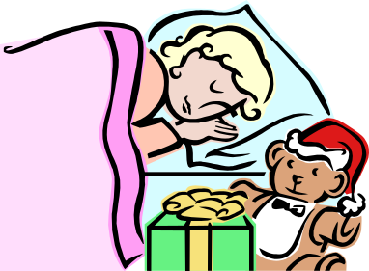
Moses also said,
Read Exodus 16:7-8
PM
AM
Take Note: The people thought they were just complaining about Moses and Aaron, their leaders, but they were actually complaining about God! That should make us think before we complain!

Slide 10
Then Moses told Aaron,
Exodus 16:9

Slide 11
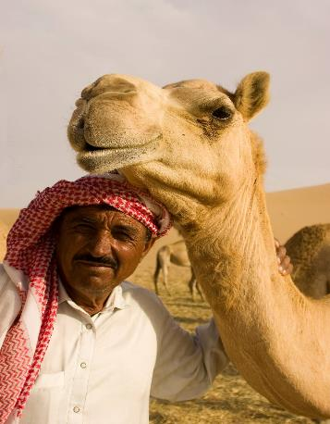
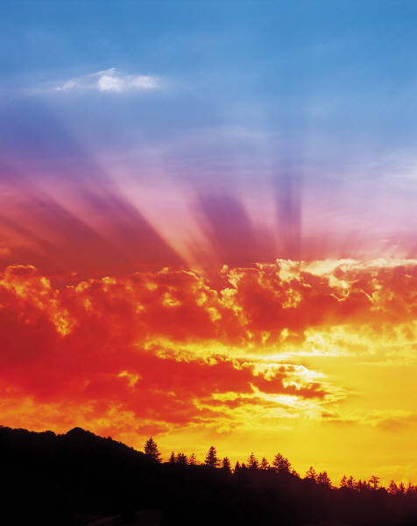
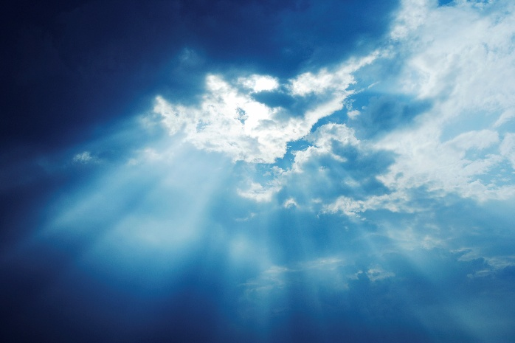
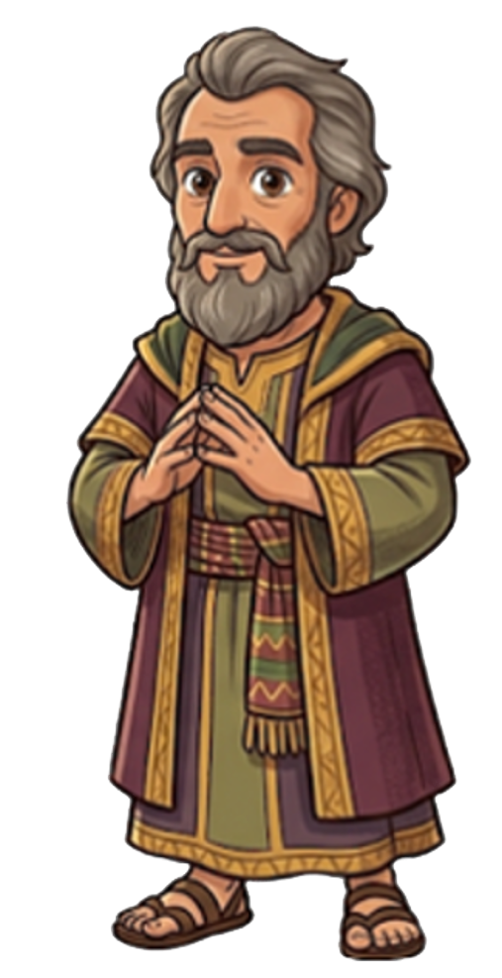
Read Exodus 16:10

Slide 12
Read Exodus 16:11-12

Slide 13
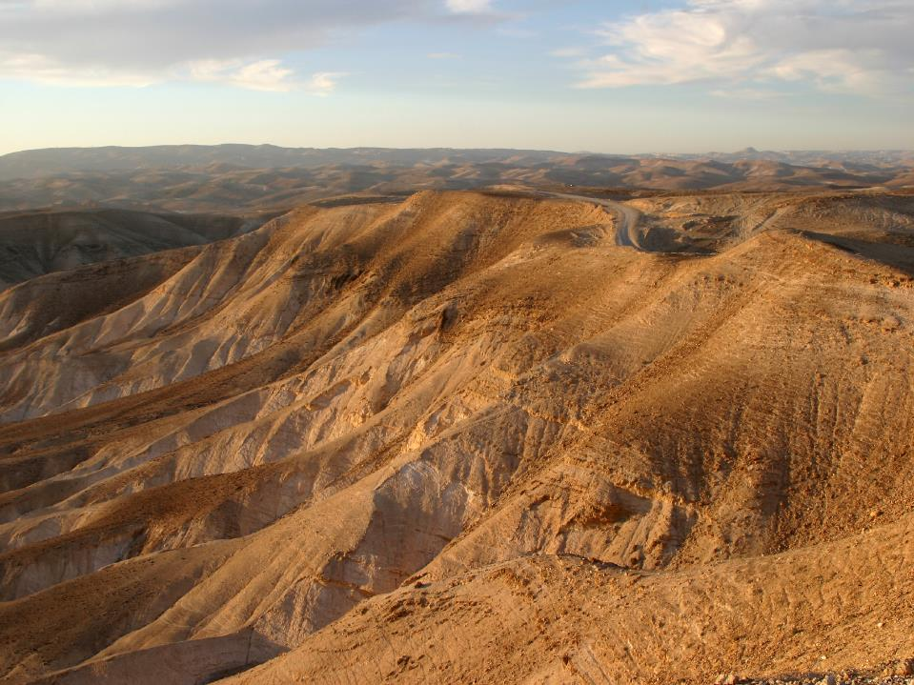

Read Exodus 16:13a

Slide 14



Read Exodus 16:14

Slide 15
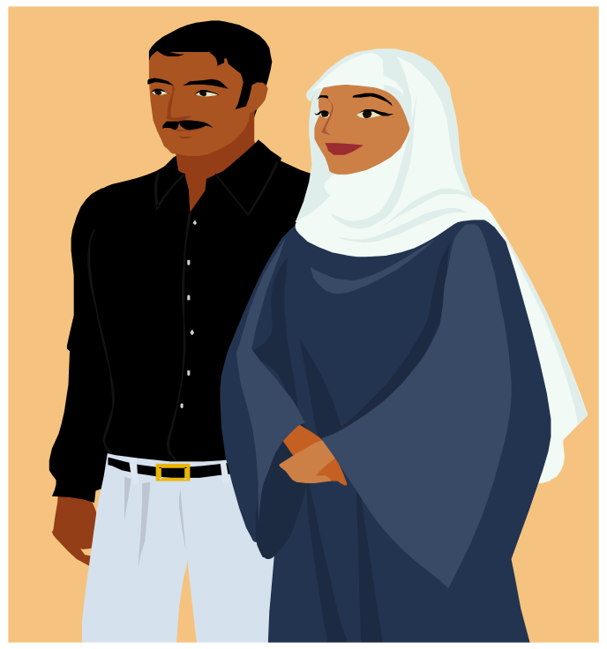
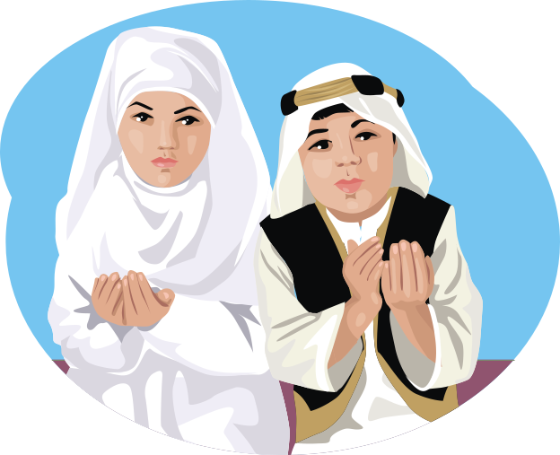
Read Exodus 16:15a
What’s that?
The Hebrew word for “What’s that?” is “manna”. So, this bread from heaven was called manna. We will learn next year that God rained down manna from heaven every day until the Israelites could grow their own food in Canaan.

Slide 16

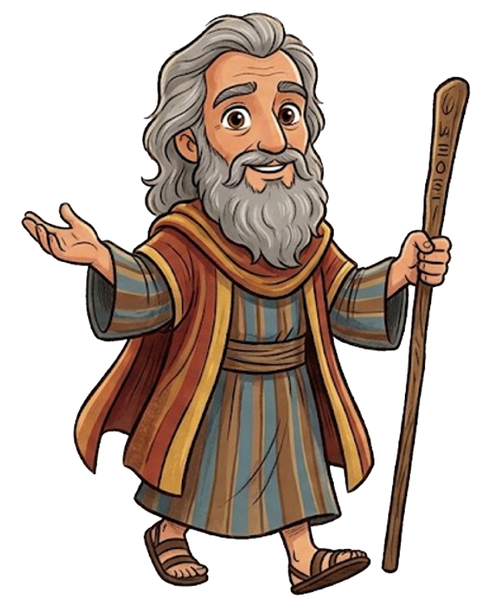
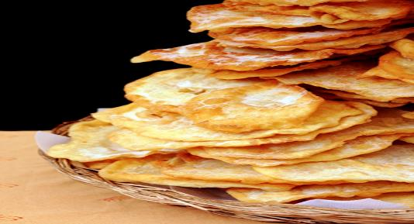
Exodus 16:15b

Slide 17

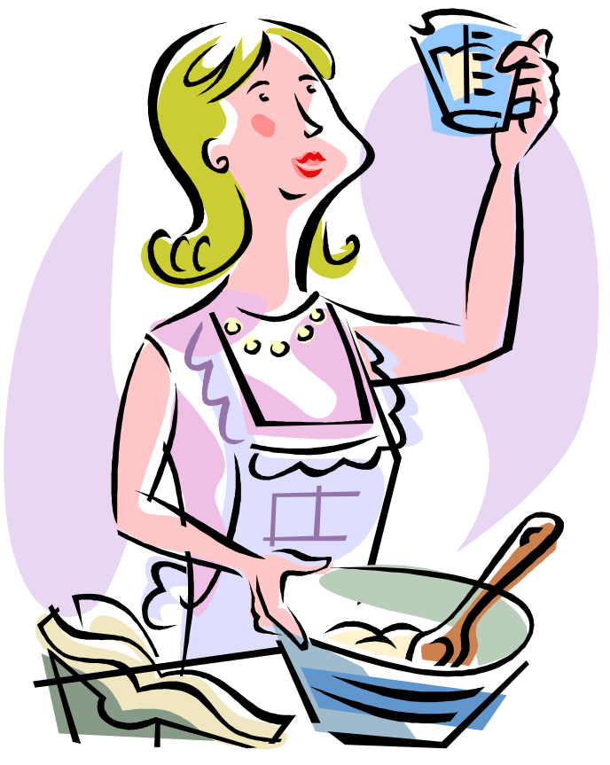
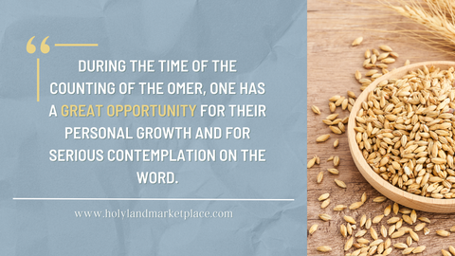
Read Exodus 16:16
An omer was just the right amount for a grown up to eat in one day. It was about 3 cups.

Slide 18
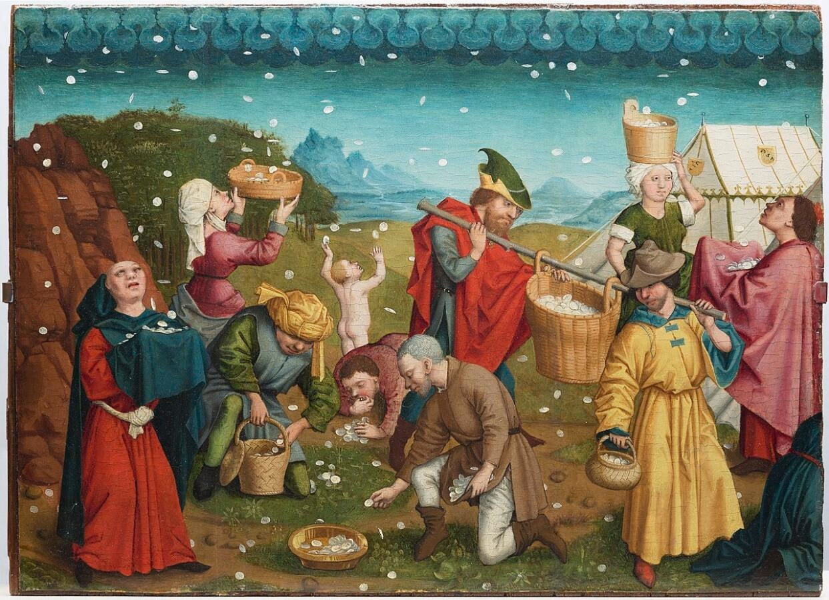
Read Exodus 16:16
Notes:
https://www.myjewishlearning.com/article/manna-for-the-soul/

Slide 19
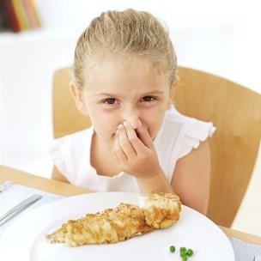

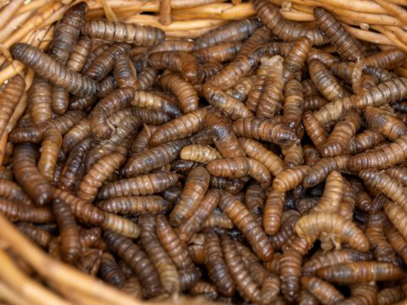

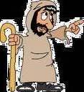
Read Exodus 16:19-20
Notes:
https://www.pngitem.com/middle/TxhRJiw_emoji-png-angry-transparent-png/#google_vignette
Maggot picture: https://www.freebibleimages.org/photos/lumo-quail-manna/

Slide 20
Read Exodus 16:21

Slide 21
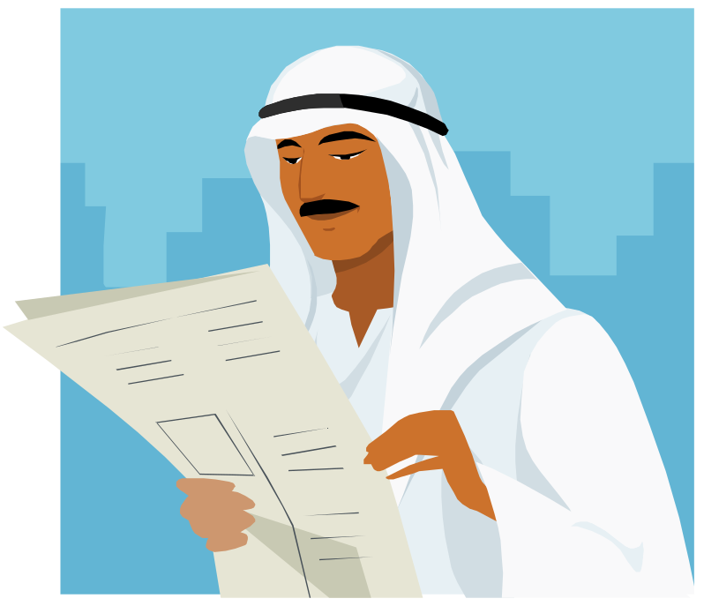

Read Exodus 16:22

Slide 22
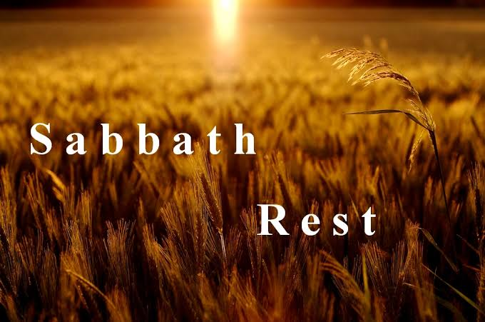
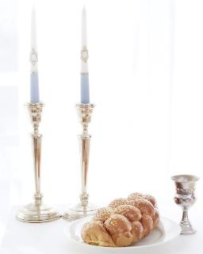
Exodus 16:23

Slide 23

Read Exodus 16:24
Notes:
https://www.pngitem.com/middle/TxhRJiw_emoji-png-angry-transparent-png/#google_vignette

Slide 24

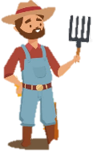
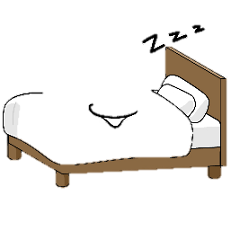
Exodus 16:25-26
1
2
3
4
5
6
7

Slide 25

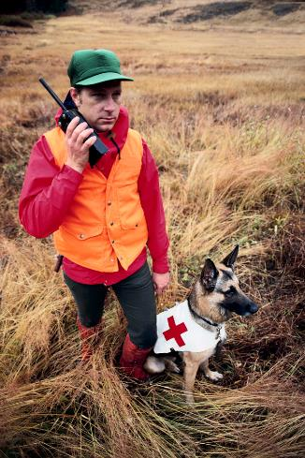
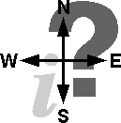
Exodus 16:27

Slide 26
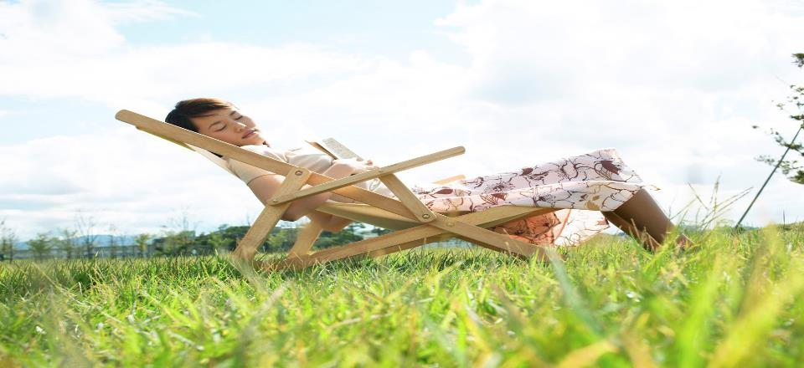
Exodus 16:28-30

Slide 27

Exodus 16:31

Slide 28

Read Exodus 17:1

Slide 29
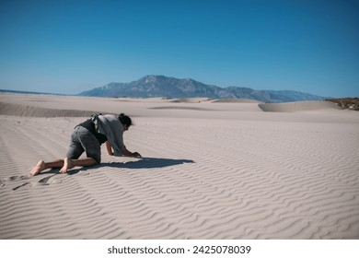

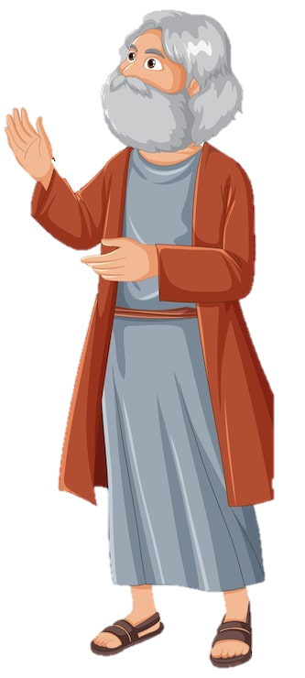

?
Exodus 17:2
water !!

Slide 30

Exodus 17:3

Slide 31
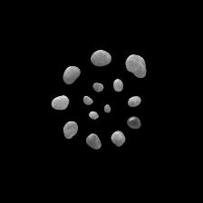
Then Moses cried out to the LORD,
Exodus 17:4

Slide 32

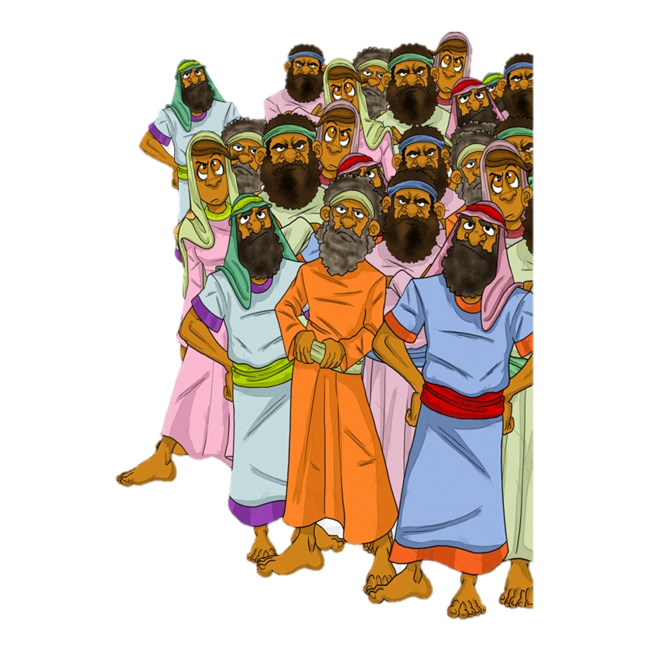

Exodus 17:5
Notes:
pngfind.com/mpng/hJwmbJi_israelites-grumbled-against-moses-hd-png-download/ (crowd)

Slide 33
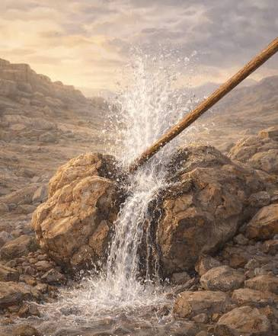
Exodus 17:6

Slide 34

Exodus 17:7
Massah
Meribah

