Slide 1
Exodus Dig Site 7

Slide 2
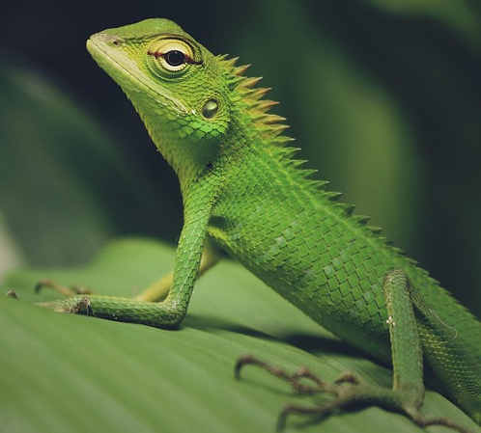
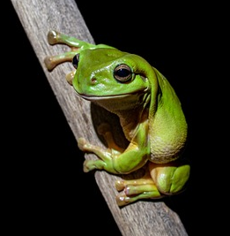
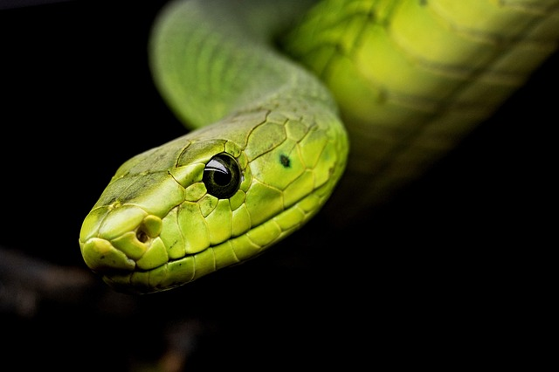
7 days after the Lord struck the Nile and turned the water to blood, Moses went to talk to Pharaoh again. What would cover the whole country if Pharaoh would not let the Israelites go?
Clap your hands for:
Stomp your feet for:
Pat your legs for:

Slide 3
7 days after the Lord struck the Nile and turned the water to blood, Moses went to talk to Pharaoh again. What would cover the whole country if Pharaoh would not let the Israelites go?
Stomp your feet for:

Slide 4
Where would frogs come during the plague of frogs?
Shout it out as you see it!

Slide 5
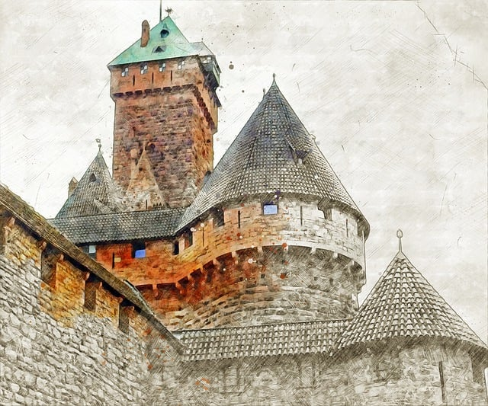

Where would frogs come during the plague of frogs?
Shout it out as you see it!
Pharaoh’s Palace

Slide 6

Where would frogs come during the plague of frogs?
Shout it out as you see it!
Pharaoh’s Palace
Houses of the officials

Slide 7
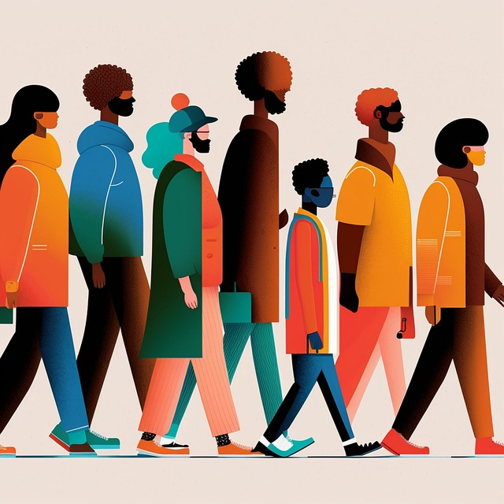
Where would frogs come during the plague of frogs?
Shout it out as you see it!
Pharaoh’s Palace
People
Houses of the officials

Slide 8

Where would frogs come during the plague of frogs?
Shout it out as you see it!
Pharaoh’s Palace
People
Ovens
Houses of the officials

Slide 9
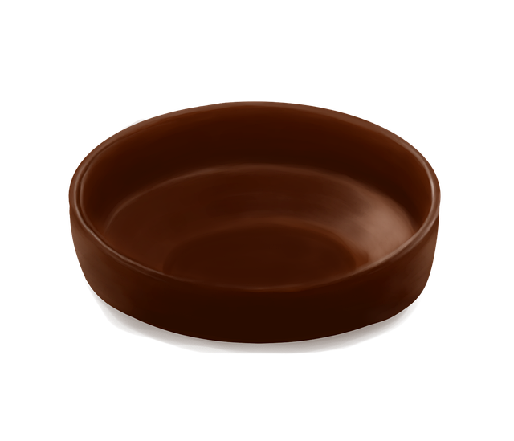
Where would frogs come during the plague of frogs?
Shout it out as you see it!
Pharaoh’s Palace
People
Ovens
Kneading troughs
Houses of the officials

Slide 10


Did Pharaoh let the people go?

Slide 11
Did Pharaoh let the people go?

Slide 12
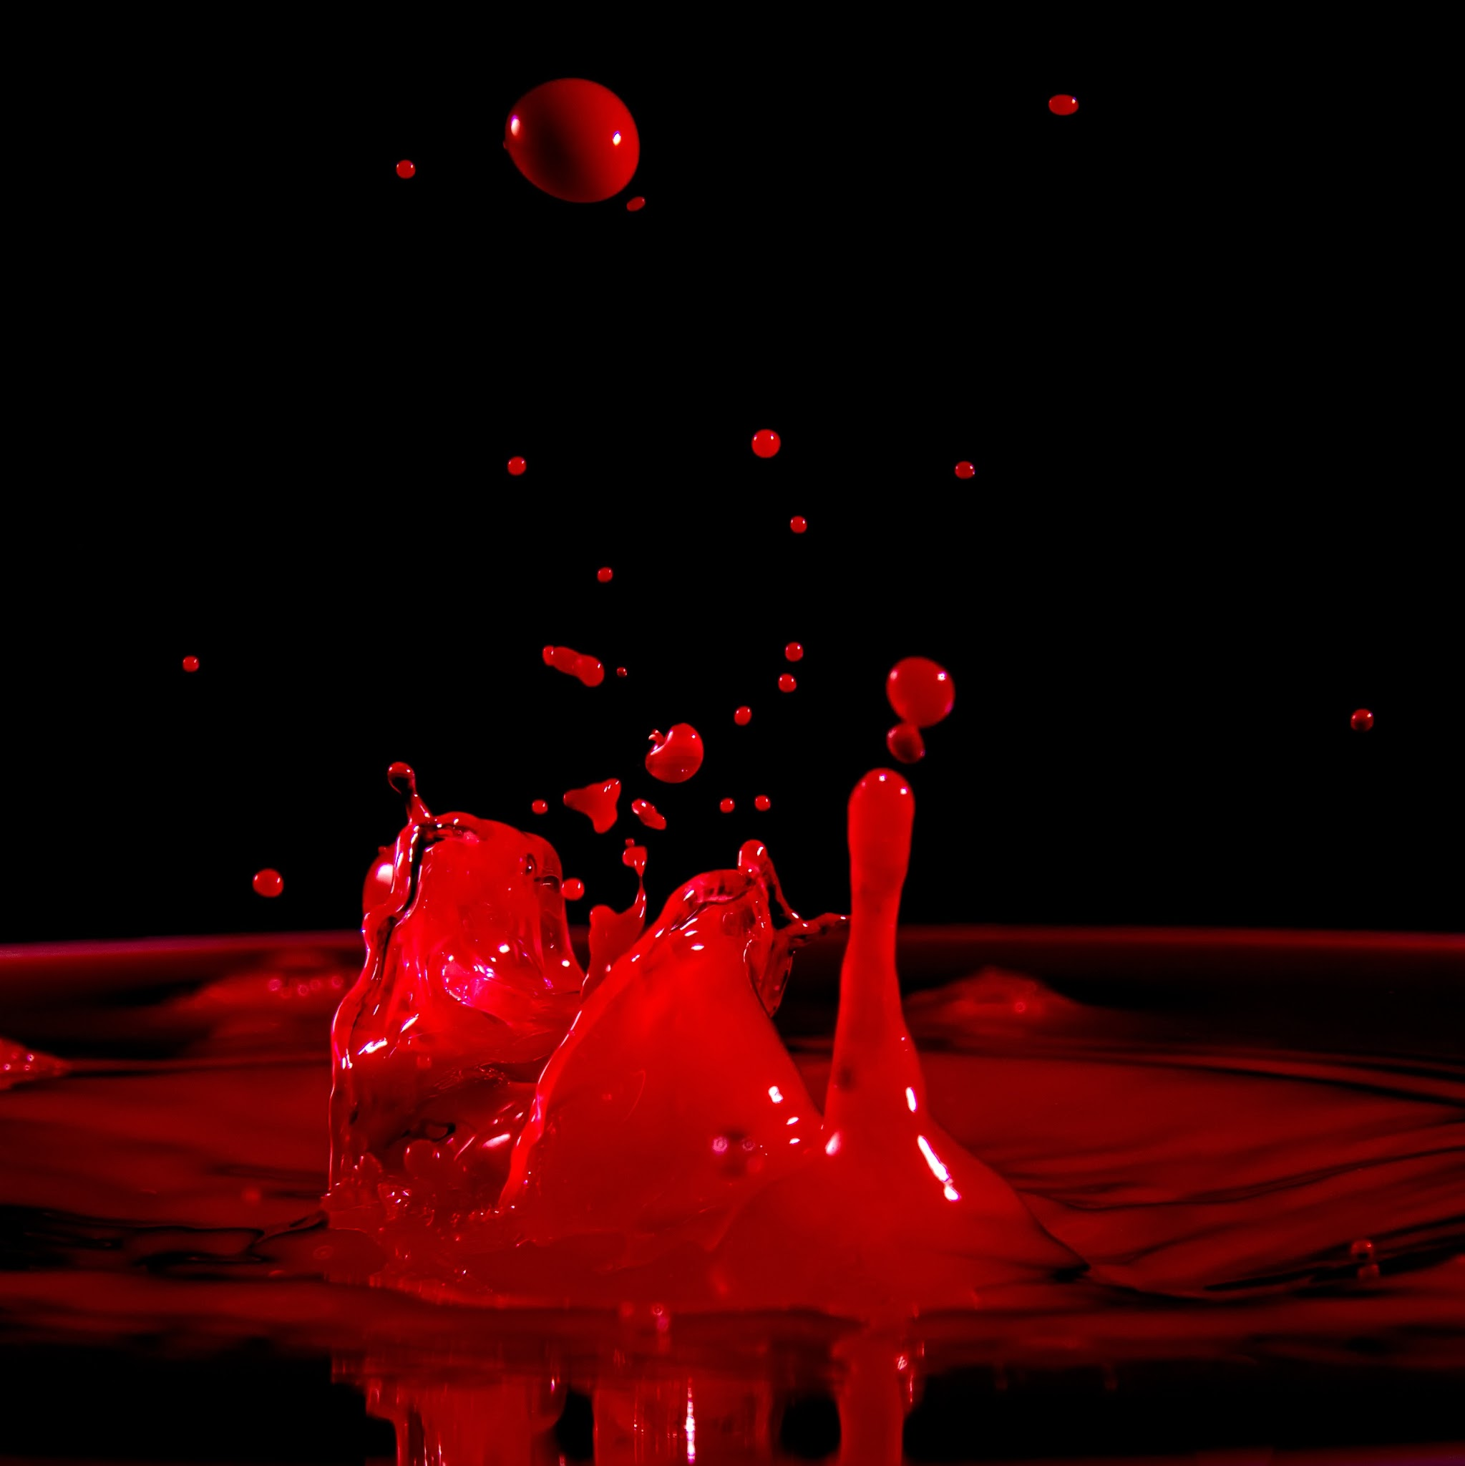
What happened when Aaron stretched out his hand over the water?
Jumping jacks for:
Toe touches for:

Slide 13
What happened when Aaron stretched out his hand over the water?
Jumping jacks for:
Frogs came up and covered the land

Slide 14
Were Pharaoh’s magicians also able to bring frogs upon Egypt with their secret arts?

Slide 15
Were Pharaoh’s magicians also able to bring frogs upon Egypt with their secret arts?

Slide 16
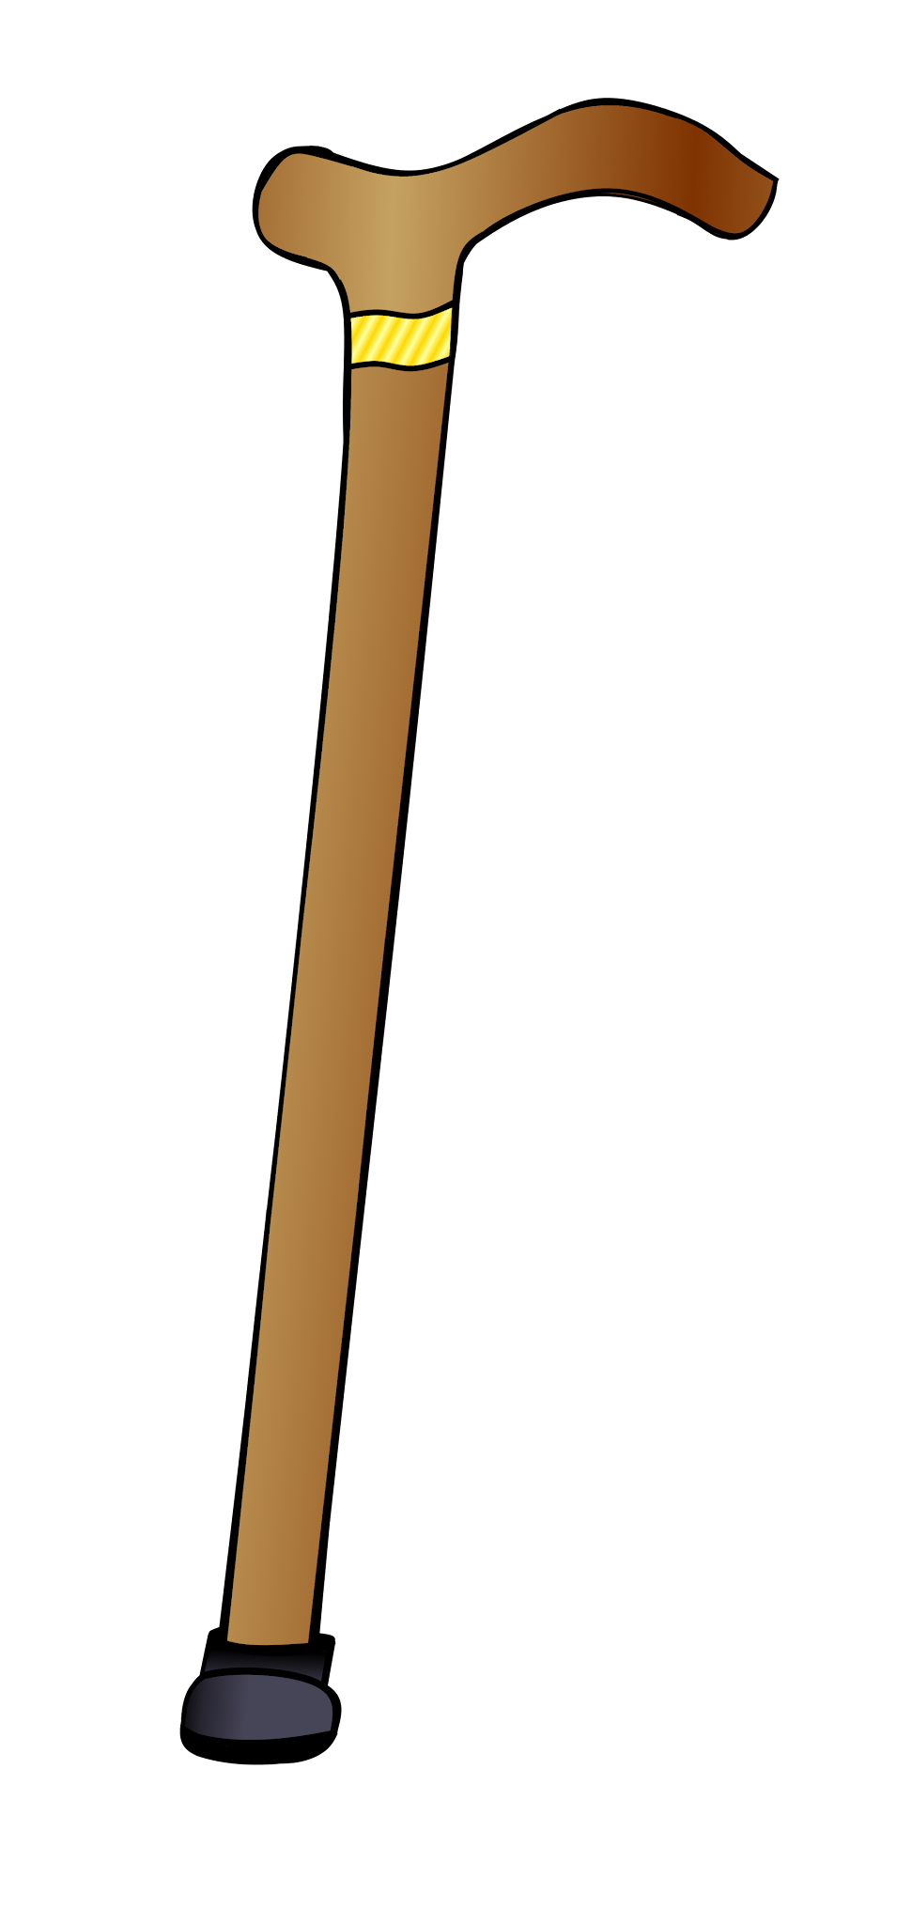

Pharaoh summoned Moses and Aaron. What did he tell them to do?
Stand on one foot for:
Sit down for:
Pray for the frogs to turn into staffs
Pray for the frogs to leave

Slide 17
Pharaoh summoned Moses and Aaron. What did he tell them to do?
Stand on one foot for:
Pray to the Lord to take the frogs away

Slide 18
Moses cried out to the Lord to take the frogs away. Did the Lord do as Moses asked?

Slide 19
Moses cried out to the Lord to take the frogs away. Did the Lord do as Moses asked?
The Lord listened to Moses and the frogs all died.

Slide 20
What happened when the frogs died?
Cover your mouth for:
Plug your nose for:
The frogs suddenly vanished and were nowhere to be seen.
The frogs were piled in heaps and the land of Egypt reeked of them.

Slide 21
What happened when the frogs died?
Plug your nose for:
The frogs were piled in heaps and the land of Egypt reeked of them.

Slide 22
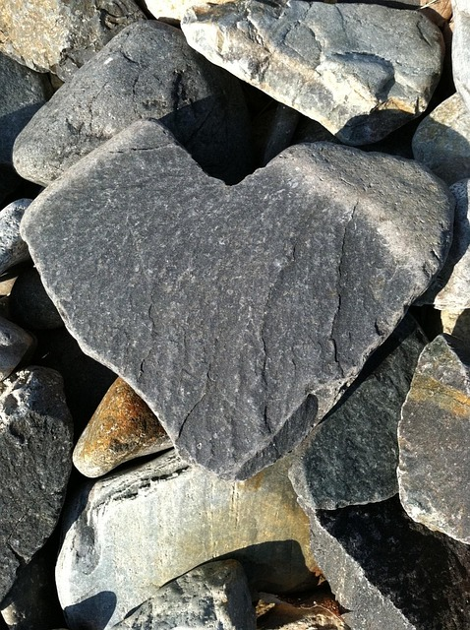

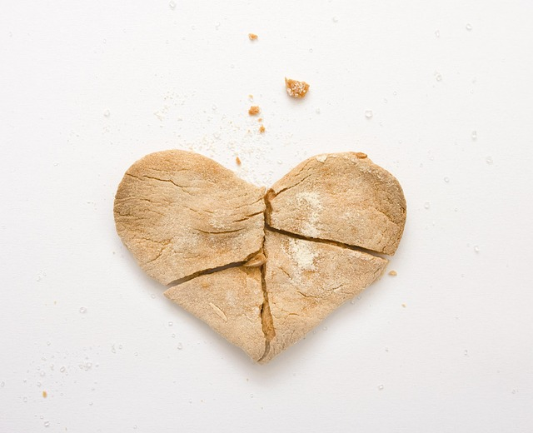
What happened to Pharaoh’s heart when he saw that there was relief from the frogs?
Rock for:
Paper for:
Scissors for:
It was hard
It was soft
It was broken

Slide 23
What happened to Pharaoh’s heart when he saw that there was relief from the frogs?
Rock for:
His heart was hardened, just like the Lord said it would be.
It was hard

Slide 24
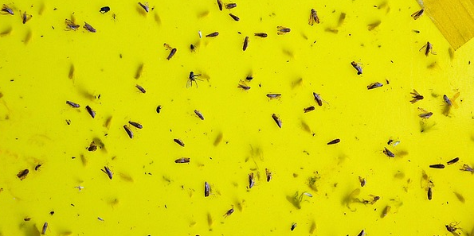
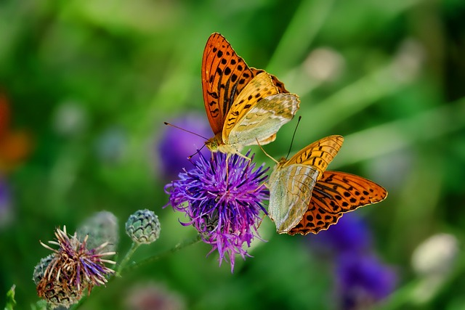
What did the Lord say the dust was going to become when Aaron struck the ground with his staff?
One hand for:
Two hands for:
Gnats
Butterflies

Slide 25
What did the Lord say the dust was going to become when Aaron struck the ground with his staff?
One hand for:
Gnats

Slide 26
When Aaron struck the ground with his staff, did all the dust become gnats?

Slide 27
When Aaron struck the ground with his staff, did all the dust become gnats?

Slide 28
Were Pharaoh’s magicians also able to bring gnats upon Egypt with their secret arts?

Slide 29
Were Pharaoh’s magicians also able to bring gnats upon Egypt with their secret arts?
The magicians told Pharaoh, “This is the finger of God.”

Slide 30
What happened to Pharaoh’s heart when the magicians told him the gnats were the finger of God?
Rock for:
Paper for:
Scissors for:
It was hard
It was soft
It was broken

Slide 31
What happened to Pharaoh’s heart when the magicians told him the gnats were the finger of God?
Rock for:
His heart was hardened, just like the Lord said it would be.
It was hard

Slide 32
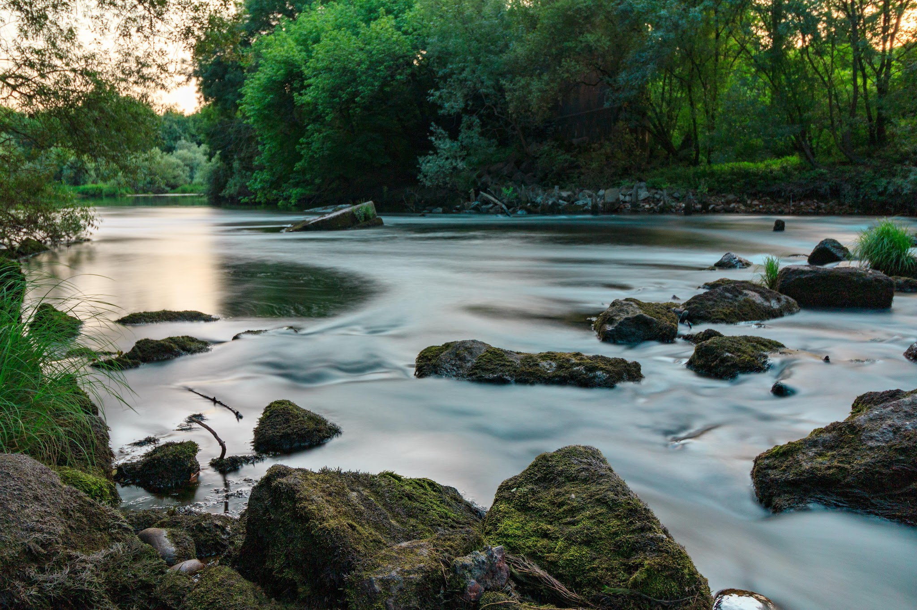
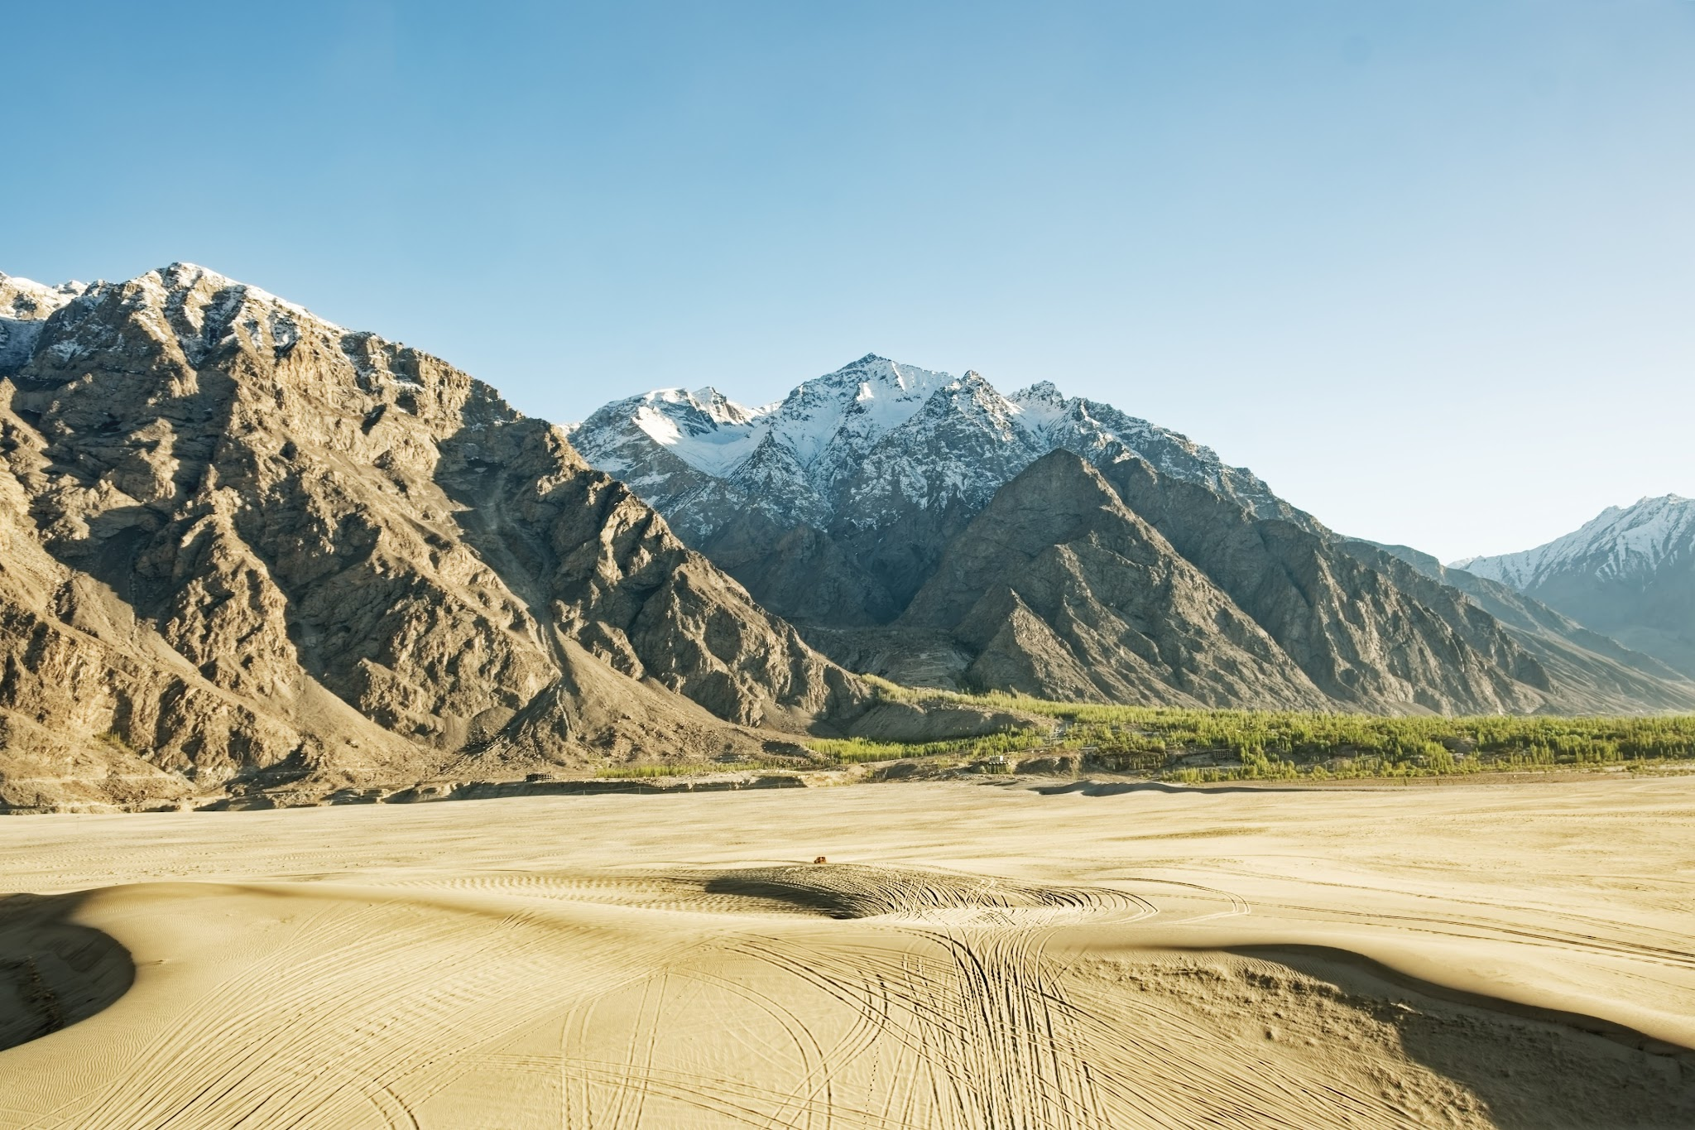
Next the Lord told Moses to get up early in the morning and confront Pharaoh as he went where?
Spin around for:
Jump up and down for:

Slide 33
Next the Lord told Moses to get up early in the morning and confront Pharaoh as he went where?
Spin around for:
The river

Slide 34
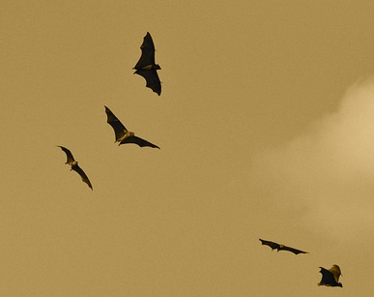
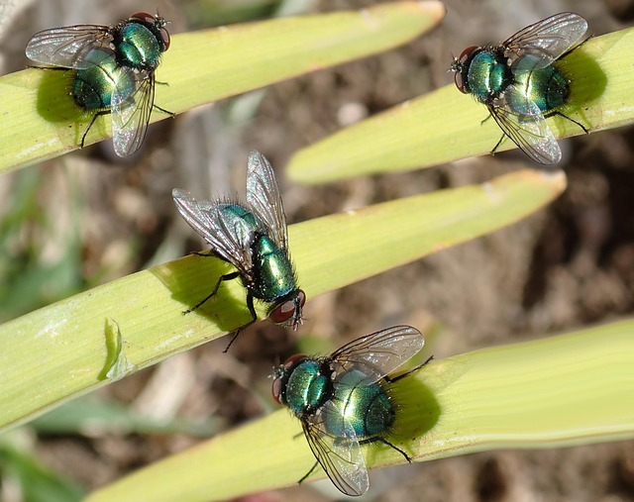
Moses told Pharaoh that if he did not let the people go, the Lord would send swarms of what to Egypt?
Flap your arms for:
Wiggle your fingers for:

Slide 35
Moses told Pharaoh that if he did not let the people go, the Lord would send swarms of what to Egypt?
Wiggle your fingers for:
Flies would swarm Egypt, but not Goshen, where the Lord’s people lived. This was so that Pharaoh would know that the Lord was in that Land.

Slide 36
Did Pharaoh let the people go?

Slide 37
Did Pharaoh let the people go?

Slide 38
Flies swarmed the land and Pharaoh summoned Moses and Aaron. He told them to offer a sacrifice where?
Clap your hands for:
Stomp your feet for:
Egypt
The Promised Land

Slide 39
Flies swarmed the land and Pharaoh summoned Moses and Aaron. He told them to offer a sacrifice where?
Pharaoh wanted them to offer a sacrifice to God in Egypt, but Moses said that it would not be right for them to do so in Egypt.
Clap your hands for:
Egypt

Slide 40
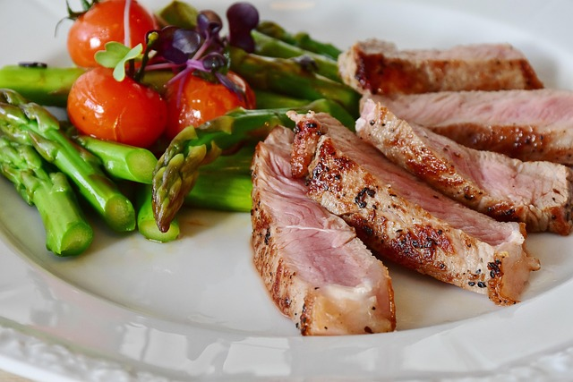
Pharaoh did allow them to offer sacrifices to the Lord in the wilderness but told them not to go very far. What else did he ask for them to do?
Shout “yummy” for:
Shout “amen” for:
Pray for him
Bring him some of the meat

Slide 41
Pharaoh did allow them to offer sacrifices to the Lord in the wilderness but told them not to go very far. What else did he ask for them to do?
Shout “amen” for:
Pray for him

Slide 42
Moses left Pharaoh and prayed to the Lord to take away the flies. Did the Lord do what Moses asked?

Slide 43
Moses left Pharaoh and prayed to the Lord to take away the flies. Did the Lord do what Moses asked?
Not a fly remained in Egypt

Slide 44
What happened to Pharaoh’s heart when the flies were gone?
Rock for:
Paper for:
Scissors for:
It was hard
It was soft
It was broken

Slide 45
What happened to Pharaoh’s heart when the flies were gone?
Rock for:
His heart was hardened, just like the Lord said it would be.
It was hard

Slide 46
Did Pharaoh let the people go?

Slide 47
Did Pharaoh let the people go?

