Slide 1
Exodus Dig Site 6

Slide 2

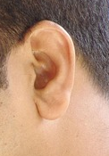
The Lord told Moses to tell the Pharaoh all he told him. Moses said what part of him was faltering?
Point to the right one on your own face

Slide 3
The Lord told Moses to tell the Pharaoh all he told him. Moses said what part of him was faltering?
Point to the right one on your own face
Moses said he spoke with faltering lips, so why would Pharaoh listen to him? But the Lord told Moses he had made Moses like God to Pharaoh.

Slide 4


Aaron was to be Moses’ prophet. Aaron was to tell Pharaoh to let the Israelites go. Would Pharaoh do it?

Slide 5
Aaron was to be Moses’ prophet. Aaron was to tell Pharaoh to let the Israelites go. Would Pharaoh do it?
Pharaoh’s heart would be hardened.The Lord would do many signs and wonders but Pharaoh would not listen.

Slide 6

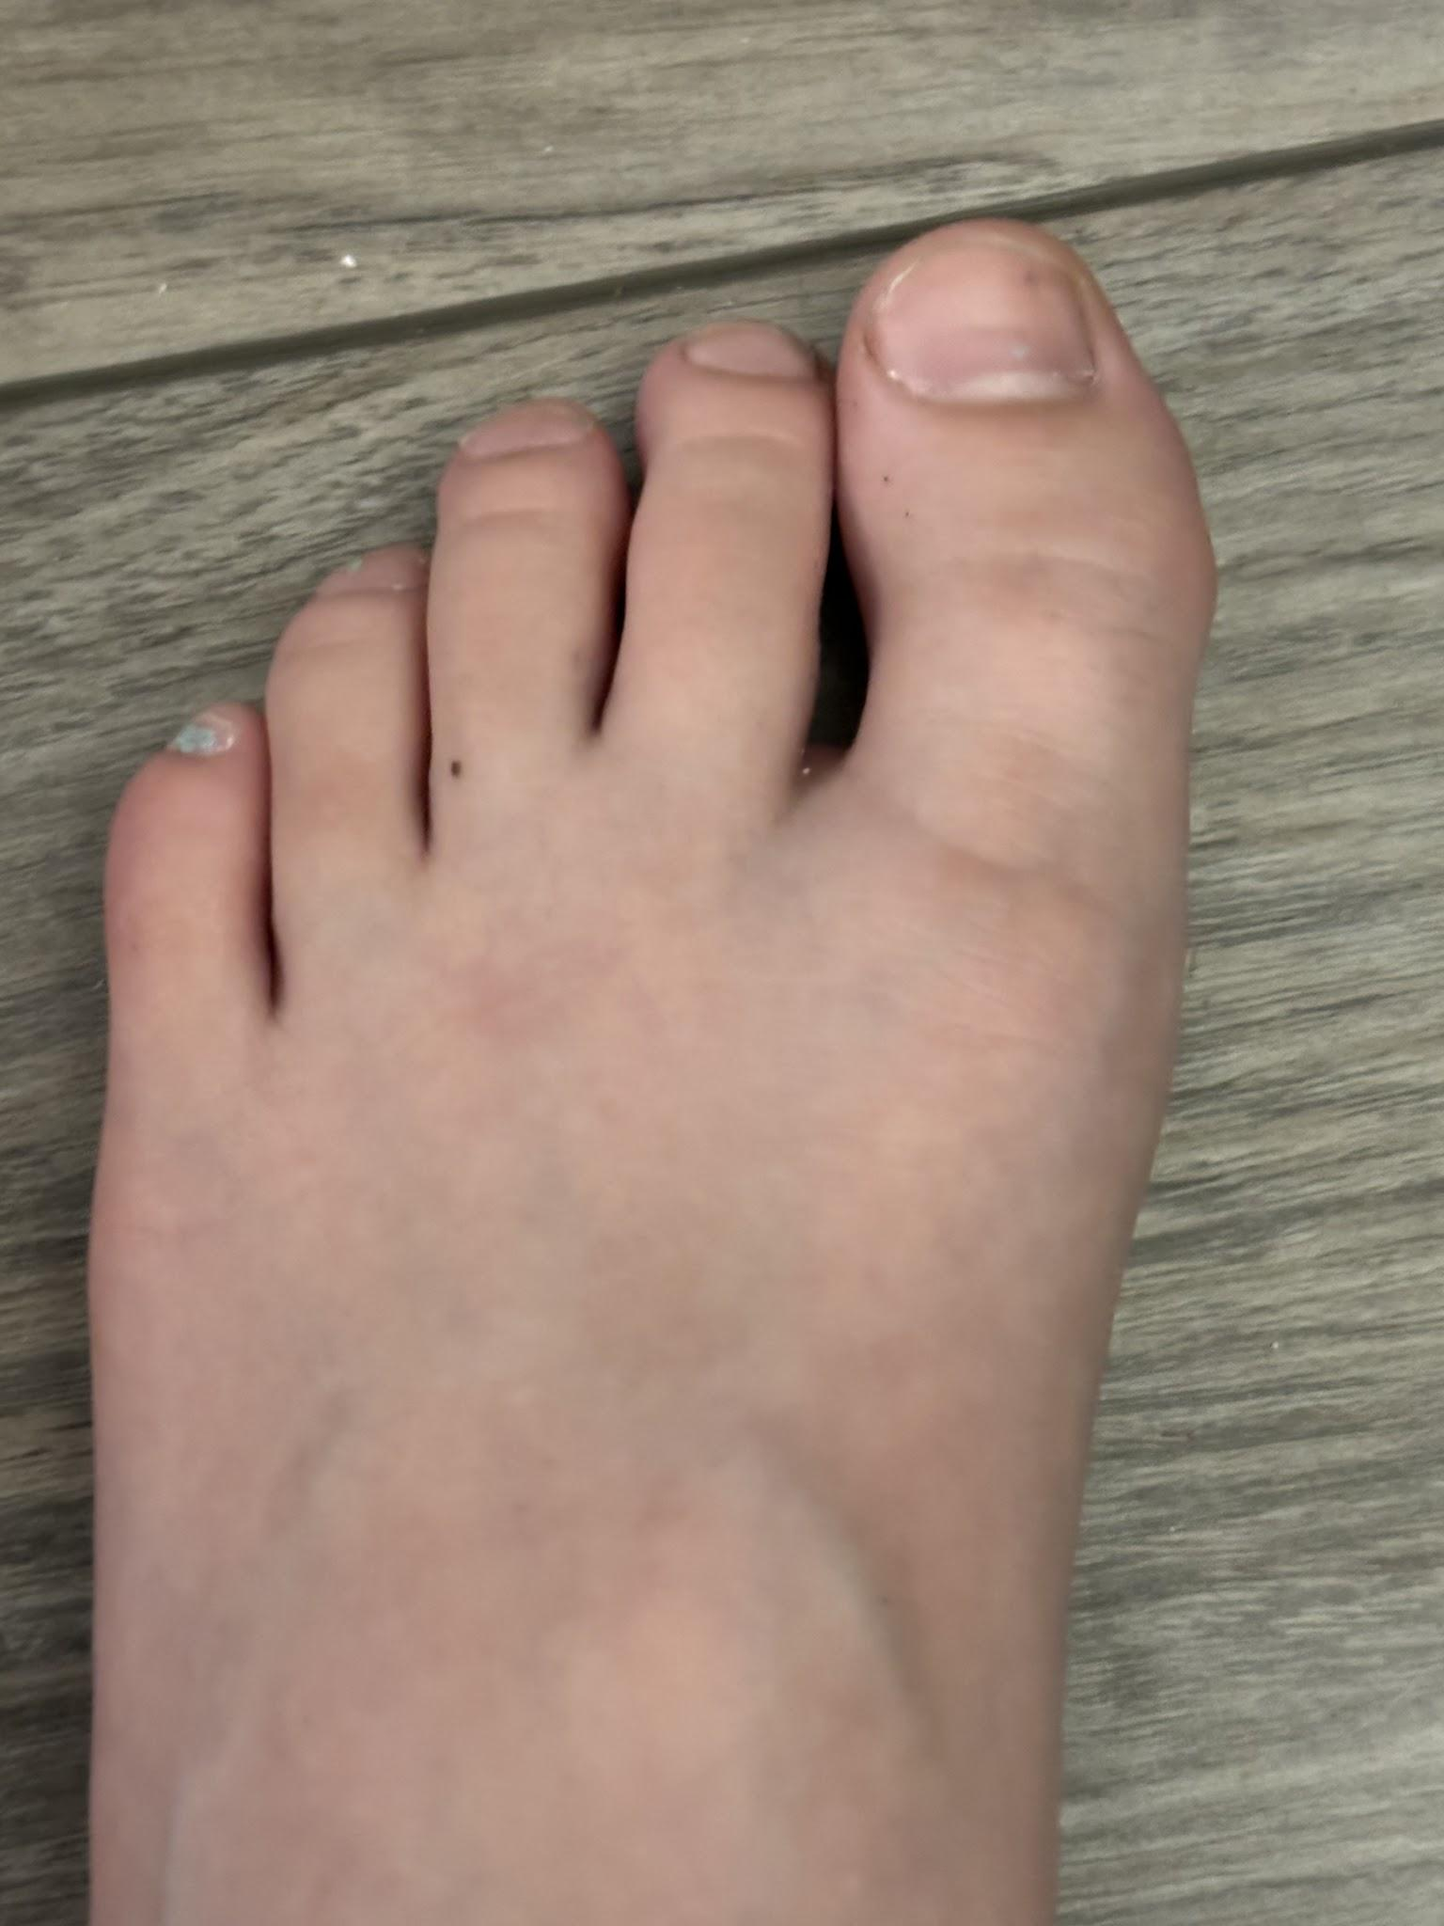
God said the Egyptians would know he is the Lord when he stretched out what against Egypt?
Raise your hand for:
Stomp your feet for:

Slide 7
God said the Egyptians would know he is the Lord when he stretched out what against Egypt?
Raise your hand for:
The Lord would stretch out his hand against Egypt and pull the Israelites out of it.

Slide 8
How old was Moses when he spoke to Pharaoh?
Tell me when to stop!

Slide 9
How old was Moses when he spoke to Pharaoh?
Tell me when to stop!
75

Slide 10
How old was Moses when he spoke to Pharaoh?
Tell me when to stop!
75 76

Slide 11
How old was Moses when he spoke to Pharaoh?
Tell me when to stop!
75 76 77

Slide 12
How old was Moses when he spoke to Pharaoh?
Tell me when to stop!
75 76 77 78

Slide 13
How old was Moses when he spoke to Pharaoh?
Tell me when to stop!
75 76 77 78 79

Slide 14
How old was Moses when he spoke to Pharaoh?
Tell me when to stop!
75 76 77 78 79 80

Slide 15
How old was Moses when he spoke to Pharaoh?
Tell me when to stop!
75 76 77 78 79 80
STOP!

Slide 16
How old was Moses when he spoke to Pharaoh?
Tell me when to stop!
Moses
75 76 77 78 79 80
STOP!
Moses was 80 years old when he spoke to Pharaoh

Slide 17
How old was Aaron when he spoke to Pharaoh?
Tell me when to stop!
Moses
75 76 77 78 79 80

Slide 18
How old was Aaron when he spoke to Pharaoh?
Tell me when to stop!
Moses
75 76 77 78 79 80
81

Slide 19
How old was Aaron when he spoke to Pharaoh?
Tell me when to stop!
Moses
75 76 77 78 79 80
81 82

Slide 20
How old was Aaron when he spoke to Pharaoh?
Tell me when to stop!
Moses
75 76 77 78 79 80
81 82 83
STOP!

Slide 21
How old was Aaron when he spoke to Pharaoh?
Tell me when to stop!
Moses
75 76 77 78 79 80
81 82 83
Aaron was 83 years old when he spoke to Pharaoh
Aaron
STOP!

Slide 22
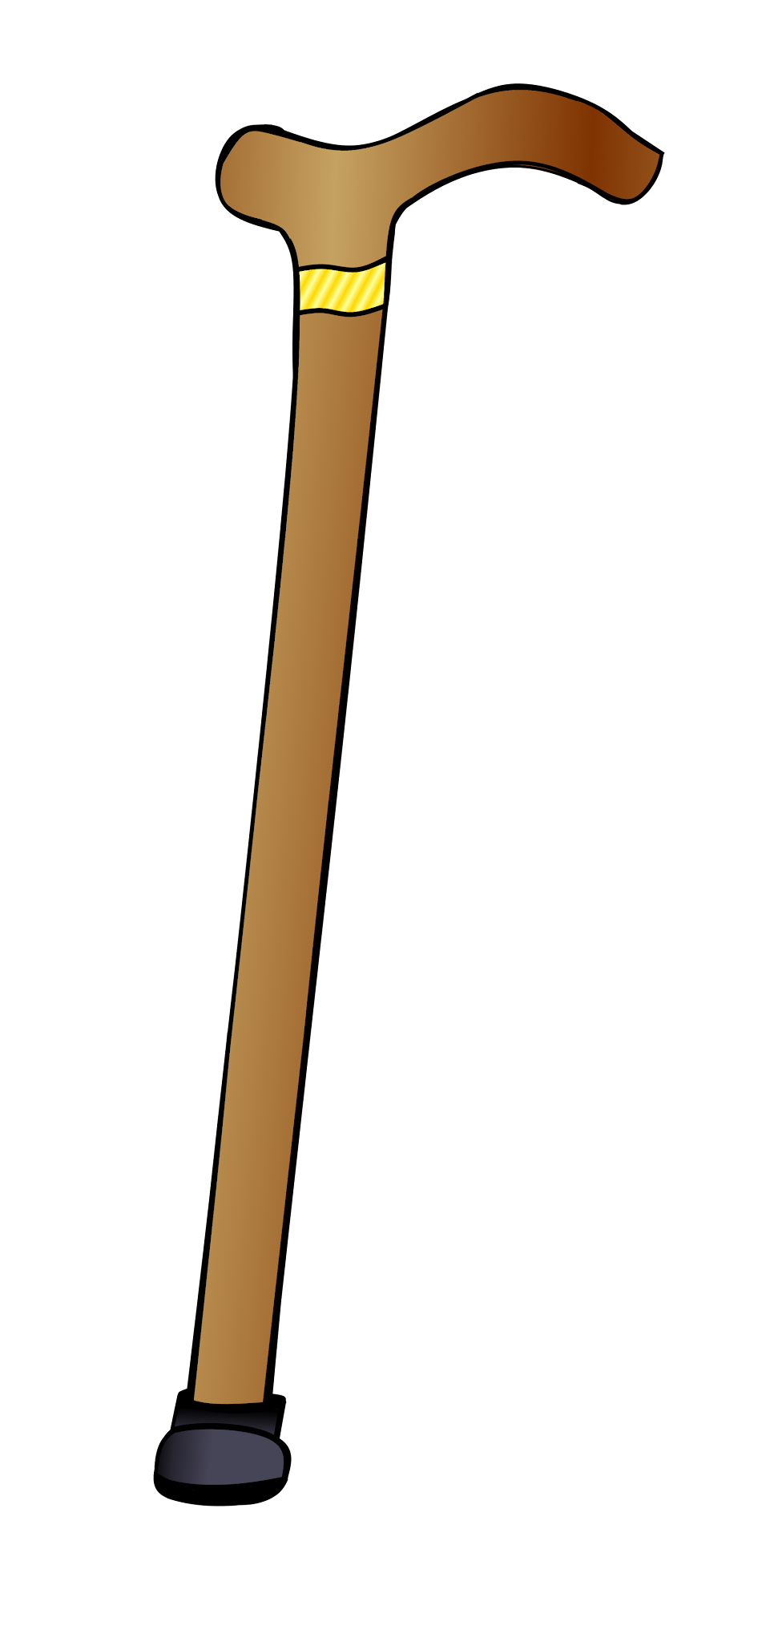
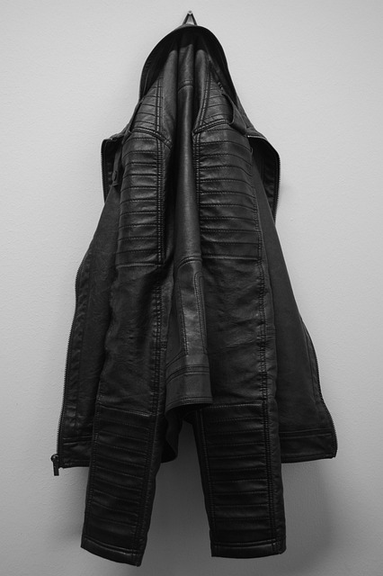
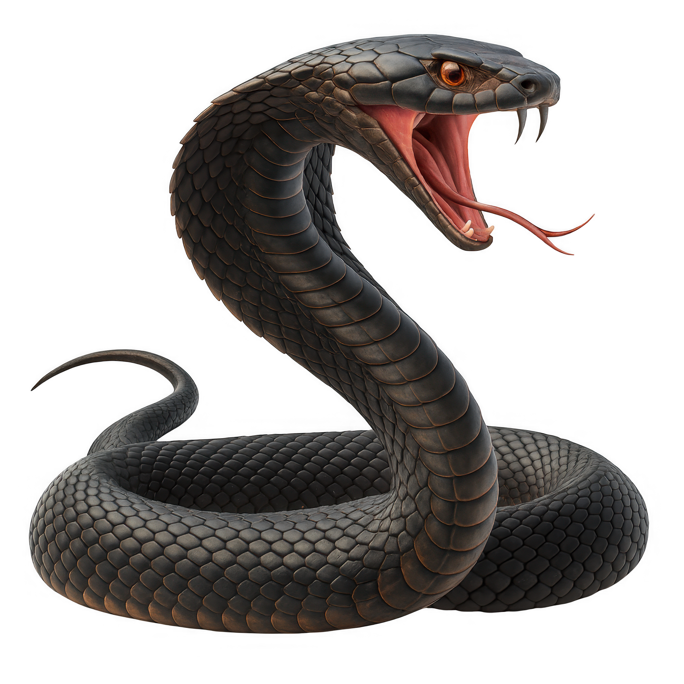
Pharaoh asked Moses and Aaron to perform a miracle. What did Aaron do?
Jumping Jacks for:
Toe touches for:
Turned into
Turned into

Slide 23
Pharaoh asked Moses and Aaron to perform a miracle. What did Aaron do?
Jumping Jacks for:
He threw down his staff and it turned into a snake
Turned into

Slide 24
Pharaoh summoned his wise men and sorcerers to do the same thing. Were they able to make their staffs snakes too?

Slide 25
Pharaoh summoned his wise men and sorcerers to do the same thing. Were they able to make their staffs snakes too?
Yes, the magicians’ staffs also became snakes.

Slide 26
What did Aaron’s staff do to the magicians’ snakes?
One hand for:
Two hands for:
No hands for:
It scared them away
It swallowed them up
It joined together with their snakes

Slide 27
What did Aaron’s staff do to the magicians’ snakes?
Two hands for:
It swallowed them up

Slide 28
Did this sign cause Pharaoh to listen to Moses and Aaron?

Slide 29
Did this sign cause Pharaoh to listen to Moses and Aaron?
Pharaoh’s heart became hard and he didn’t listen to them, just as the Lord had said.

Slide 30
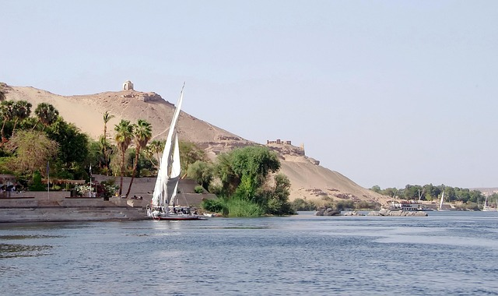
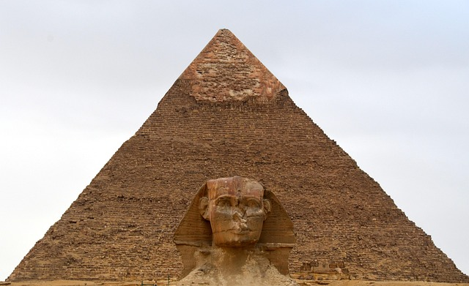
Next, God told Moses to take his staff and meet Pharaoh where?
Stand up for:
Lay down for:
The Nile River
The Great Pyramid

Slide 31
Next, God told Moses to take his staff and meet Pharaoh where?
Stand up for:
Moses told Pharaoh,
“The Lord sent me to say to you: ‘Let my people go, so that they may worship me in the wilderness.’”
The Nile River

Slide 32
Did Pharaoh let the people go?

Slide 33
Did Pharaoh let the people go?

Slide 34

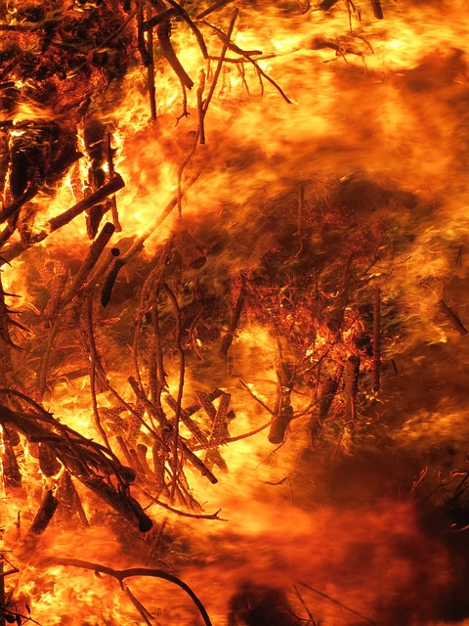
When Pharaoh did not listen, Aaron stretched out his staff over the Nile. What did the water become?
Spin around for:
Hop on one foot for:

Slide 35
When Pharaoh did not listen, Aaron stretched out his staff over the Nile. What did the water become?
The waters turned to blood
Hop on one foot for:

Slide 36
What happened when the water turned to blood?
Shout it out

Slide 37
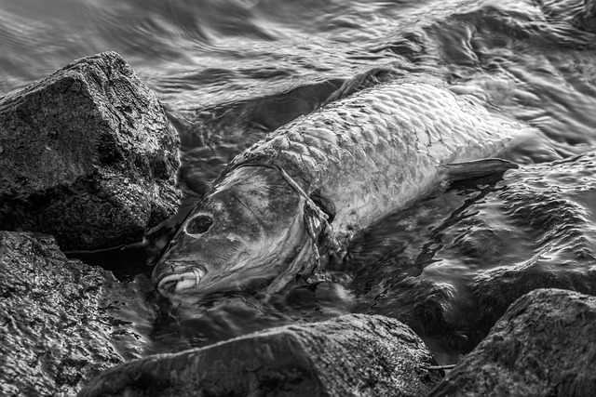
What happened when the water turned to blood?
Shout it out
The fish died

Slide 38

What happened when the water turned to blood?
Shout it out
The fish died
The river was stinky

Slide 39

What happened when the water turned to blood?
Shout it out
The people could not drink the water
The fish died
The river was stinky

Slide 40

What happened when the water turned to blood?
Shout it out
The people could not drink the water
The fish died
The river was stinky
Blood was even in vessels of wood and stone

Slide 41
Pharaoh again summoned his magicians. Were they able to do the same thing?

Slide 42
Pharaoh again summoned his magicians. Were they able to do the same thing?
The magicians did the same thing by their secret arts, and Pharaoh’s heart became hard.

Slide 43
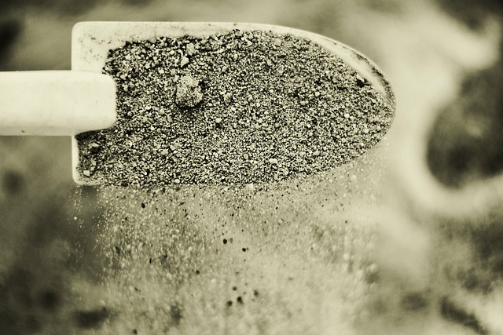
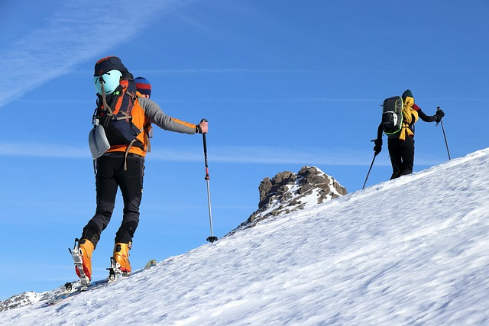
Since the Egyptians could not get water from the Nile, what did they do?
Stomp for:
Clap for:
Climbed a mountain to gather snow to melt for drinking water
Dug along the Nile for drinking water

Slide 44
Since the Egyptians could not get water from the Nile, what did they do?
Stomp for:
Dug along the Nile for drinking water

