Slide 1
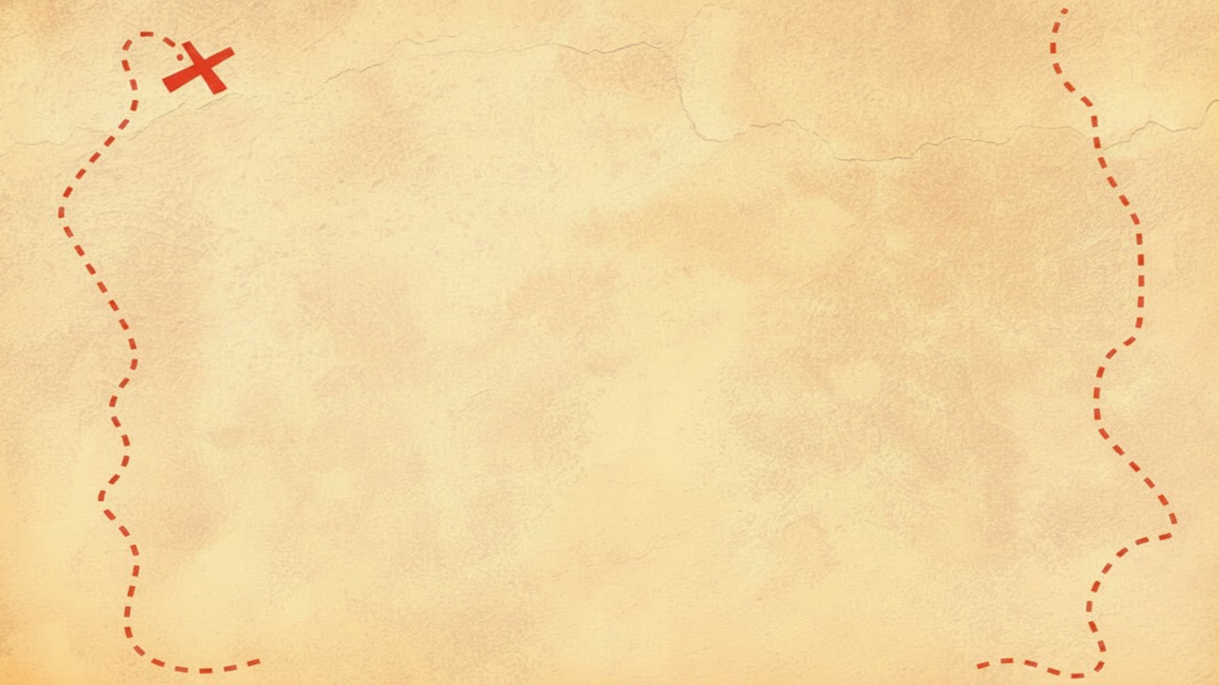


Dig Site 11 Memory Verse
Hide God's Word in Your Heart!
This activity will help you memorize your Bible verse for the week. Each slide removes more words from the verse. Click your mouse or spacebar to fill in the blanks one at a time but try to say it out loud with the missing words yourself before clicking. Don't forget to practice the reference at the top.

Slide 2
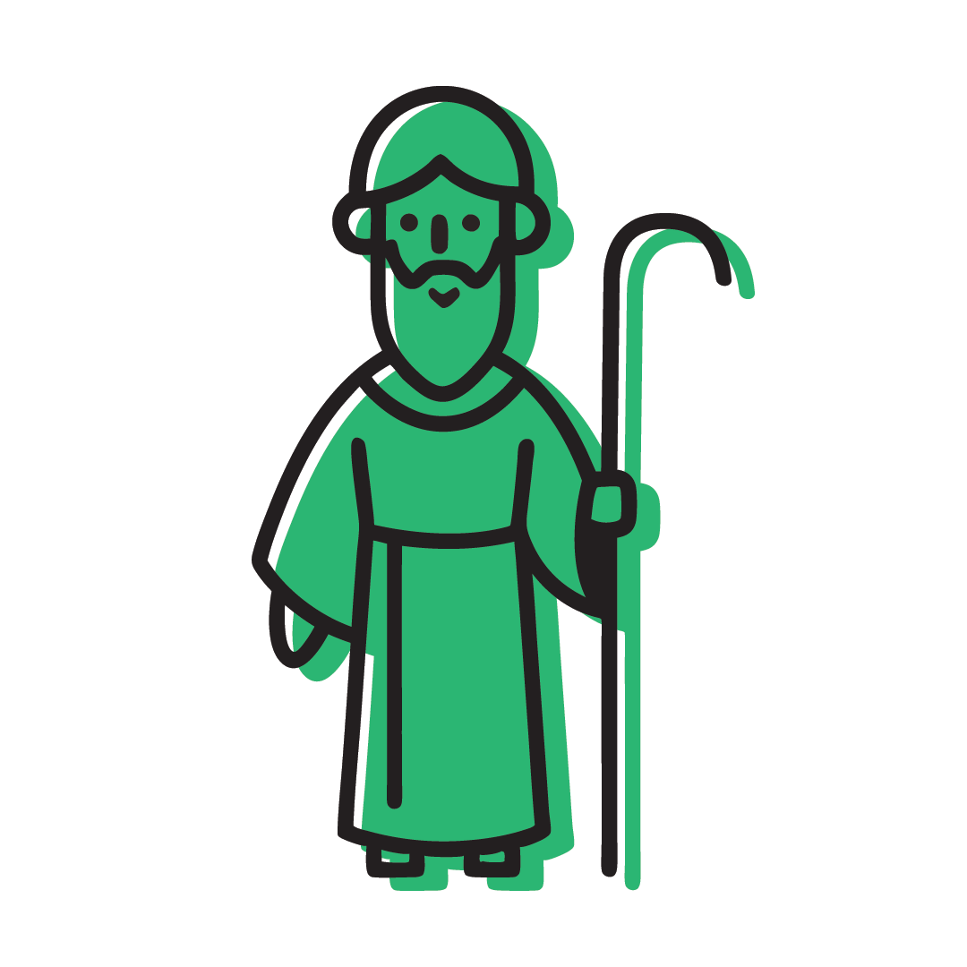

Exodus 14:14
The LORD will fight for you;
you need only to be still.

Slide 3
Exodus 14:14
The LORD will fight for you;
you need only to be still.
What Does It Mean?
After everything the Israelites had seen God do for them, they still struggled to believe that God was powerful enough to protect them and save them from the Egyptians! They kept complaining and doubting, but Moses assured the Israelites that God is faithful and He would take care of them. We can trust that God will help us in difficult times as well.

Slide 4
Exodus __:14
The ____ will ____ for you;
___ need ____ to be ____.
14
LORD
fight
you
only
still

Slide 5
Exodus __:__
The ____ ___ ____ for ___;
___ need ____ to __ ____.
14
14
LORD
will
fight
you
you
only
be
still

Slide 6
______ __:__
___ ____ ___ ____ ___ ___;
___ ____ ____ __ __ ____.
Exodus
14
14
The
LORD
will
fight
for
you
you
need
only
to
be
still

