Slide 1



Dig Site 9 Memory Verse
Hide God's Word in Your Heart!
This activity will help you memorize your Bible verse for the week. Each slide removes more words from the verse. Click your mouse or spacebar to fill in the blanks one at a time but try to say it out loud with the missing words yourself before clicking. Don't forget to practice the reference at the top.

Slide 2
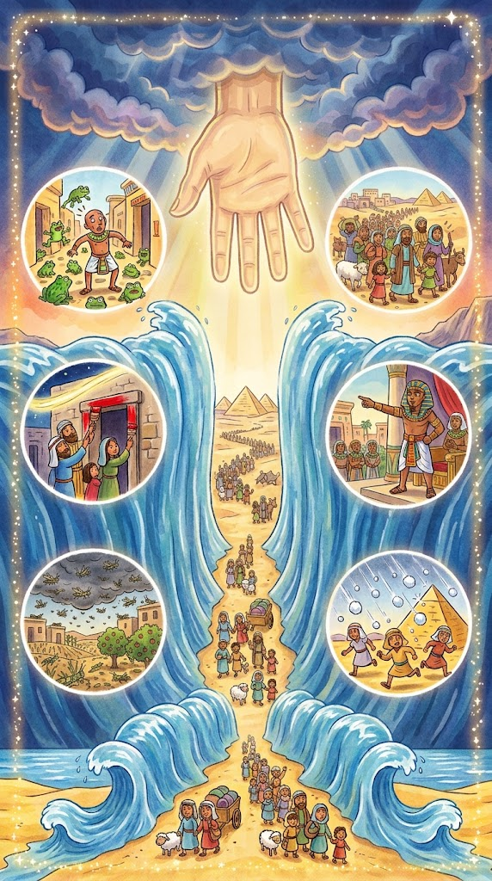
Exodus 15:6
"Your right hand, LORD, was majestic in power. Your right hand, LORD, shattered the enemy."
Notes:
Scripture quotations taken from The Holy Bible, New International Version®, NIV®. Copyright © 1973, 1978, 1984, 2011 by Biblica, Inc.
Image created with ChatGPT
Image source: https://www.freebibleimages.org/illustrations/spi-moses-burning-bush/

Slide 3
Exodus 15:6
"Your right hand, LORD, was majestic in power. Your right hand, LORD, shattered the enemy."
What Does it Mean?
This verse comes from a chapter we don’t directly quiz over, but we do have three memory verses from it! Chapter 15 contains a song of praise that Moses, Miriam (Moses' sister who is called a prophet), and the Israelites sing to God after He brought them safely through the Red Sea. Praise and worship songs are not a new idea! What can you praise God for today?
Notes:
Scripture quotations taken from The Holy Bible, New International Version®, NIV®. Copyright © 1973, 1978, 1984, 2011 by Biblica, Inc.
Image created with ChatGPT
Image source: https://www.freebibleimages.org/illustrations/spi-moses-burning-bush/

Slide 4
_______ 15:6
"Your right _____, LORD, was majestic in ______. Your right hand, ______, shattered the ______."
Exodus
hand
power
LORD
enemy
Notes:
Scripture quotations taken from The Holy Bible, New International Version®, NIV®. Copyright © 1973, 1978, 1984, 2011 by Biblica, Inc.
Image created with ChatGPT
Image source: https://www.freebibleimages.org/illustrations/spi-moses-burning-bush/

Slide 5
15
_______ __:6
"Your _____ _____, LORD, was _________ in ______. ____ right _____, ______, shattered ___ ______."
Exodus
right
hand
majestic
power
Your
hand
LORD
the
enemy
Notes:
Scripture quotations taken from The Holy Bible, New International Version®, NIV®. Copyright © 1973, 1978, 1984, 2011 by Biblica, Inc.
Image created with ChatGPT
Image source: https://www.freebibleimages.org/illustrations/spi-moses-burning-bush/

Slide 6
15
6
_______ __:_
"____ _____ _____, _____, ____ _________ __ ______. ____ ____ _____, ______, _________ ___ ______."
Exodus
Your
right
hand
LORD
was
majestic
in
power
Your
right
hand
LORD
shattered
the
enemy
Notes:
Scripture quotations taken from The Holy Bible, New International Version®, NIV®. Copyright © 1973, 1978, 1984, 2011 by Biblica, Inc.
Image created with ChatGPT
Image source: https://www.freebibleimages.org/illustrations/spi-moses-burning-bush/

