Slide 1
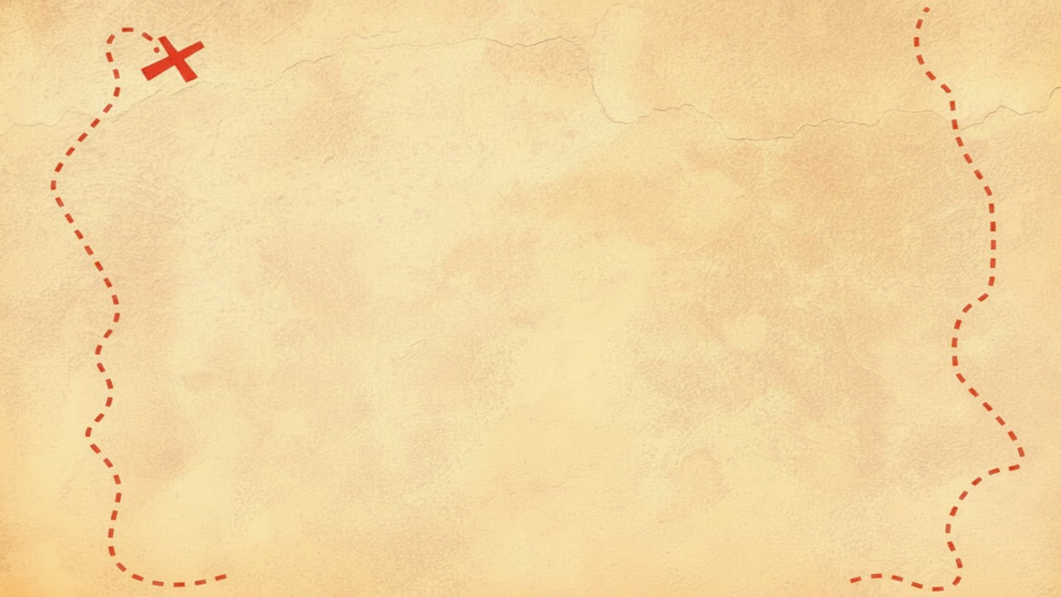


Dig Site 8 Memory Verse
Hide God's Word in Your Heart!
This activity will help you memorize your Bible verse for the week. Each slide removes more words from the verse. Click your mouse or spacebar to fill in the blanks one at a time but try to say it out loud with the missing words yourself before clicking. Don't forget to practice the reference at the top.

Slide 2
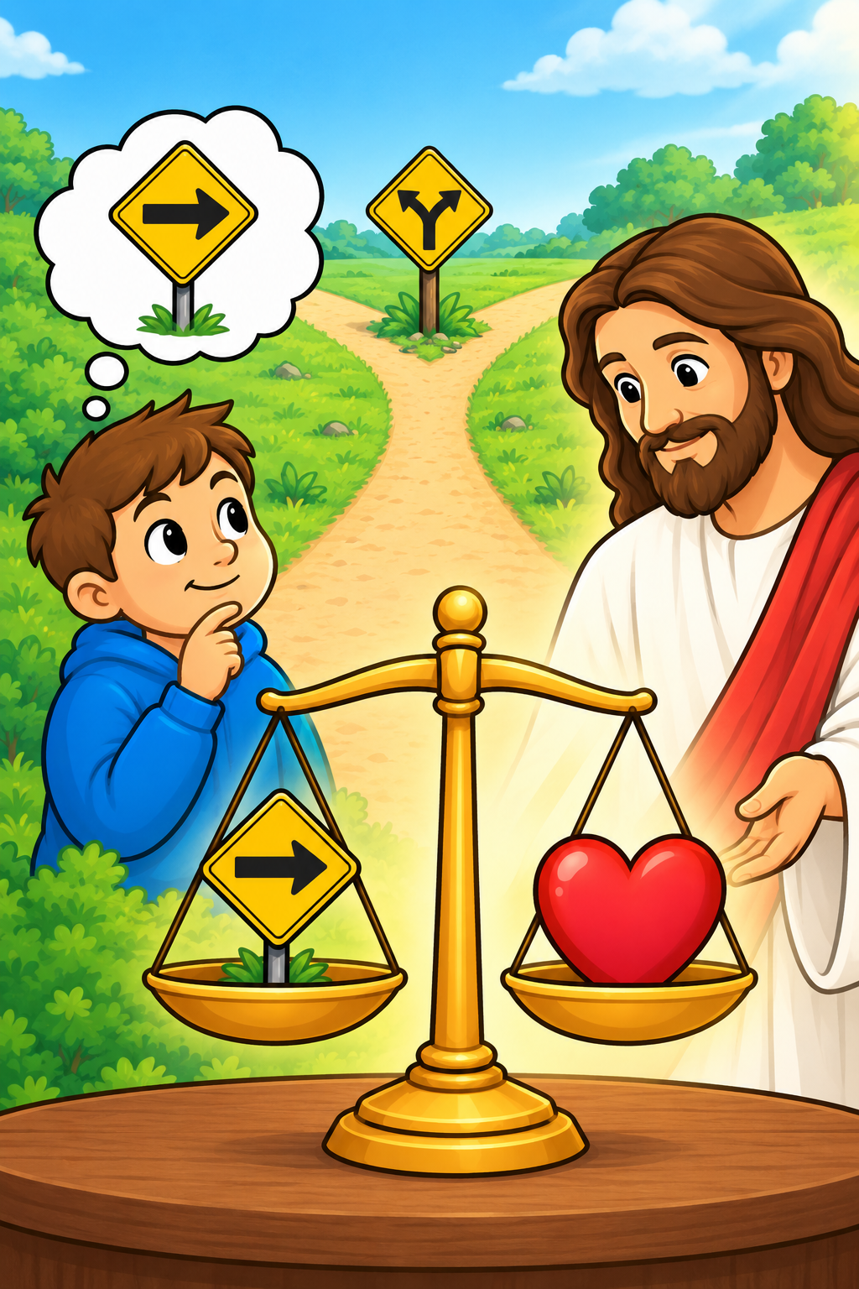
Proverbs 21:2
"A person may think their own ways are right, but the LORD weighs the heart."
Notes:
Scripture quotations taken from The Holy Bible, New International Version®, NIV®. Copyright © 1973, 1978, 1984, 2011 by Biblica, Inc.
Image created with ChatGPT
Image source: https://www.freebibleimages.org/illustrations/spi-moses-burning-bush/

Slide 3
Proverbs 21:2
"A person may think their own ways are right, but the LORD weighs the heart."
What Does It Mean?
Sometimes we want to make decisions based on what we want or what we think is best for ourselves, but God knows what is in our hearts and what is really motivating us. He knows if we are doing something to make ourselves look good, or if we are doing it because we love God.
Notes:
Scripture quotations taken from The Holy Bible, New International Version®, NIV®. Copyright © 1973, 1978, 1984, 2011 by Biblica, Inc.
Image created with ChatGPT
Image source: https://www.freebibleimages.org/illustrations/spi-moses-burning-bush/

Slide 4
2
Proverbs 21:__
"A ______ may think their ____ ways are right, ___ the _____ weighs the _____."
person
own
but
LORD
heart
Notes:
Scripture quotations taken from The Holy Bible, New International Version®, NIV®. Copyright © 1973, 1978, 1984, 2011 by Biblica, Inc.
Image created with ChatGPT
Image source: https://www.freebibleimages.org/illustrations/spi-moses-burning-bush/

Slide 5
Proverbs
2
_________ 21:__
"A ______ may ____ their ____ ____ are ____, ___ the _____ ______ the _____."
person
think
own
ways
right
but
LORD
weighs
heart
Notes:
Scripture quotations taken from The Holy Bible, New International Version®, NIV®. Copyright © 1973, 1978, 1984, 2011 by Biblica, Inc.
Image created with ChatGPT
Image source: https://www.freebibleimages.org/illustrations/spi-moses-burning-bush/

Slide 6
Proverbs
21
2
_________ __:__
"__ _____ ____ ____ ____ ____ ____ ___ ____, ___ ___ _____ ______ ___ _____."
A
person
may
think
their
own
ways
are
right
but
the
LORD
weighs
the
heart
Notes:
Scripture quotations taken from The Holy Bible, New International Version®, NIV®. Copyright © 1973, 1978, 1984, 2011 by Biblica, Inc.
Image created with ChatGPT
Image source: https://www.freebibleimages.org/illustrations/spi-moses-burning-bush/

