Slide 1



Dig Site 7 Memory Verse
Hide God's Word in Your Heart!
This activity will help you memorize your Bible verse for the week. Each slide removes more words from the verse. Click your mouse or spacebar to fill in the blanks one at a time but try to say it out loud with the missing words yourself before clicking. Don't forget to practice the reference at the top.

Slide 2
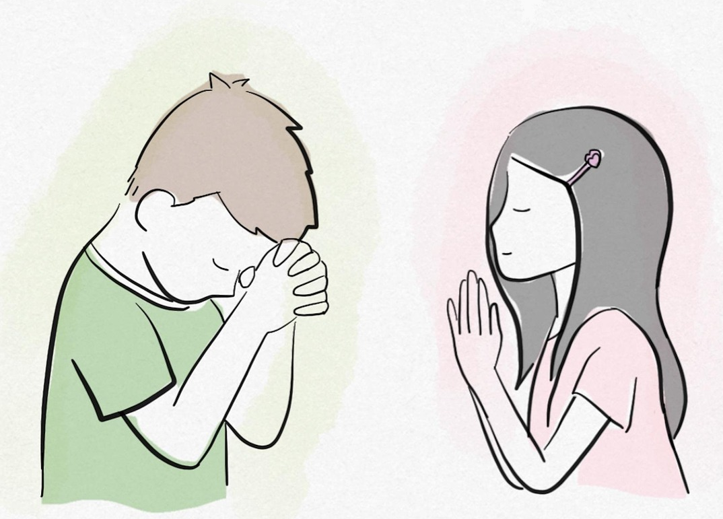
Psalm 4:3
"Know that the LORD has set apart his faithful servant for himself; the LORD hears when I call to him."
Notes:
https://pixabay.com/illustrations/children-balloons-hoping-dreams-7303553/

Slide 3
Psalm 4:3
"Know that the LORD has set apart his faithful servant for himself; the LORD hears when I call to him."
What Does It Mean?
When we follow Jesus with all our heart, we have a special place in God's heart! He wants us to come to Him in prayer, and we can know for sure that He will hear us.
*Take a minute to read all of Psalm 4 and notice how it ends.
Notes:
https://pixabay.com/illustrations/children-balloons-hoping-dreams-7303553/

Slide 4
Psalm __:3
"Know that the _____ has set ______ his ________ servant for himself; the ______ hears when I ____ to him."
4
LORD
apart
faithful
LORD
call
Notes:
https://pixabay.com/illustrations/children-balloons-hoping-dreams-7303553/

Slide 5
Psalm
______ __:3
"_____ that the _____ has ___ ______ his ________ _______ for _______; the ______ _____ when I ____ to ___."
4
Know
LORD
set
apart
faithful
servant
himself
LORD
hears
call
him
Notes:
https://pixabay.com/illustrations/children-balloons-hoping-dreams-7303553/

Slide 6
Psalm
3
______ __:__
"_____ ____ ___ _____ ___ ___ ______ ___ _______ _______ ___ _______; ___ ______ _____ ____ _ ____ __ ___."
4
Know
that
the
LORD
has
set
apart
his
faithful
servant
for
himself
the
LORD
hears
when
I
call
to
him
Notes:
https://pixabay.com/illustrations/children-balloons-hoping-dreams-7303553/

