Slide 1
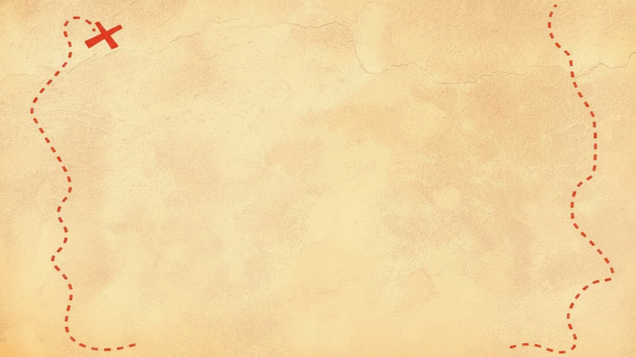


Dig Site 6 Memory Verse
Hide God's Word in Your Heart!
This activity will help you memorize your Bible verse for the week. Each slide removes more words from the verse. Click your mouse or spacebar to fill in the blanks one at a time but try to say it out loud with the missing words yourself before clicking. Don't forget to practice the reference at the top.

Slide 2
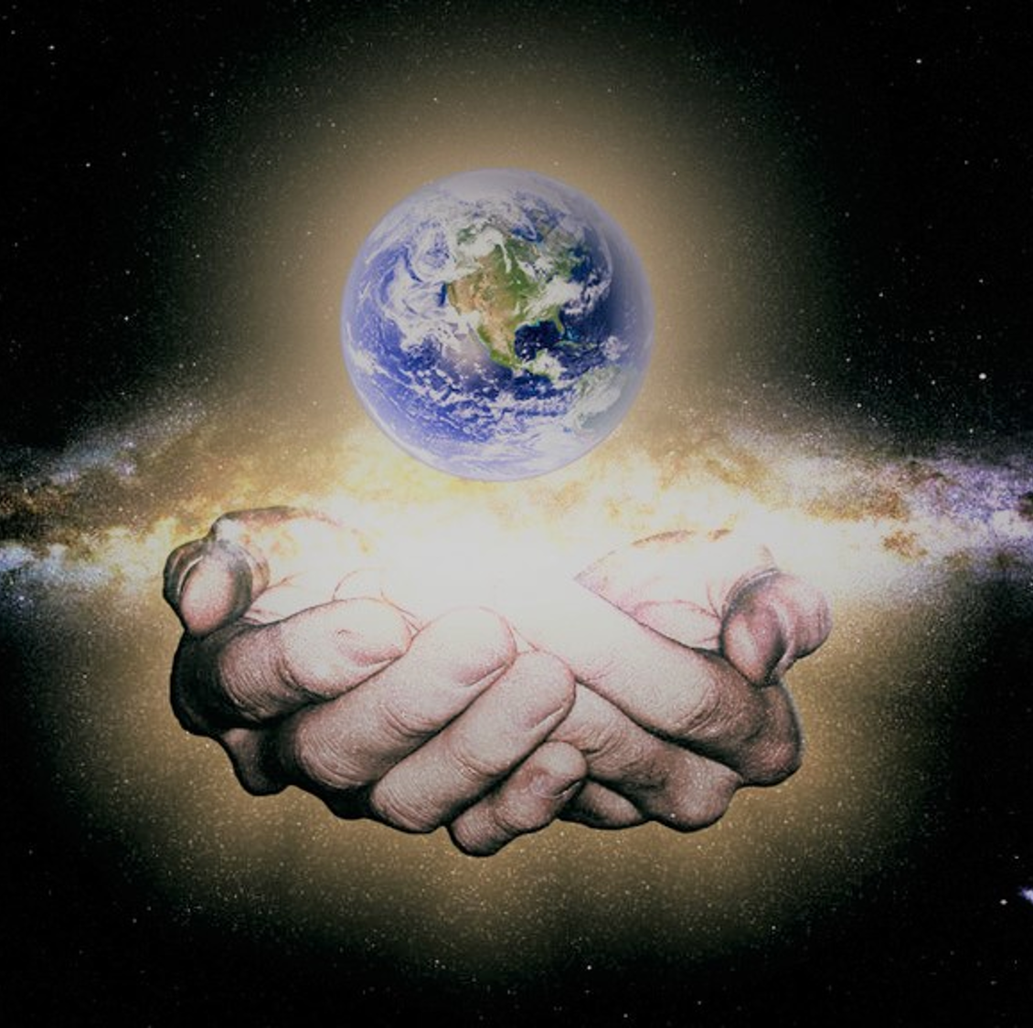
Psalm 24:1
The earth is the LORD's, and everything in it, the world, and all who live in it.

Slide 3

What does it mean?
Do you remember Genesis 1? God created the whole world – the sky, seas, land, plants, animals of all kinds, and humans! Everything and everyone belongs to Him because He made us all.
Psalm 24:1
The earth is the LORD's, and everything in it, the world, and all who live in it.

Slide 4
_____ 24:1
Psalm
The ____ is the LORD's, and _________ in it, the ____, and all who ___ in it.
earth
everything
world
live

Slide 5
_____ 24:_
1
Psalm
The ____ is the ______, and ________ in _, the ____, and __ who __ in _.
earth
LORD's
everything
it
world
all
live
it

Slide 6
_____ __:_
Psalm
24
1
___ ____ _ ___ ______, ___ ________ __ _, ___ ____, ___ __ ___ ___ __ _.
The
earth
is
the
LORD's
and
everything
in
it
the
world
and
all
who
live
in
it

