Slide 1
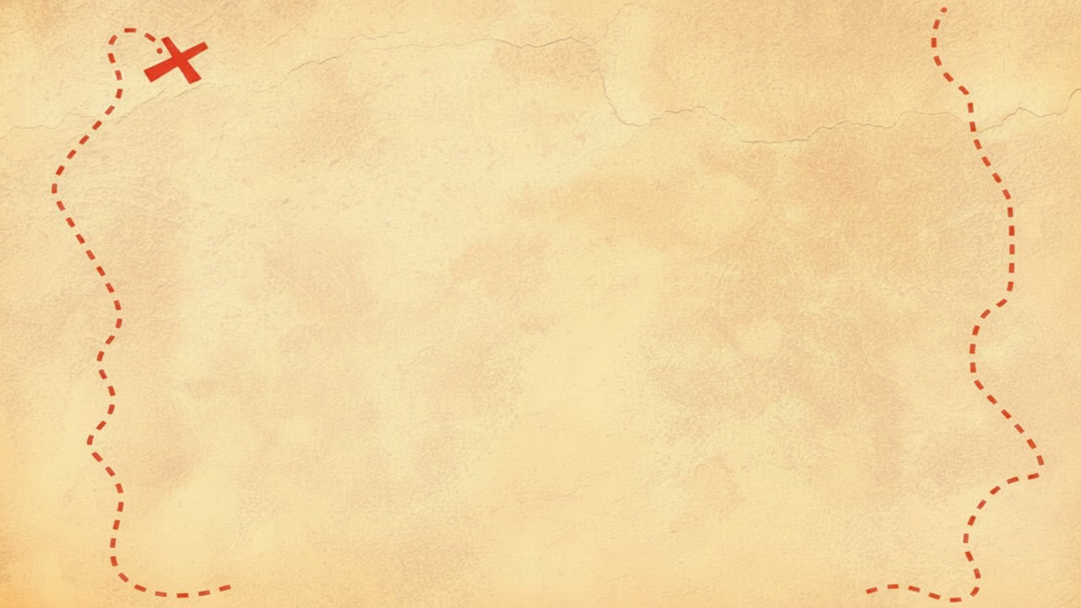


Dig Site 5 Memory Verse
Hide God's Word in Your Heart!
This activity will help you memorize your Bible verse for the week. Each slide removes more words from the verse. Click your mouse or spacebar to fill in the blanks one at a time but try to say it out loud with the missing words yourself before clicking. Don't forget to practice the reference at the top.

Slide 2
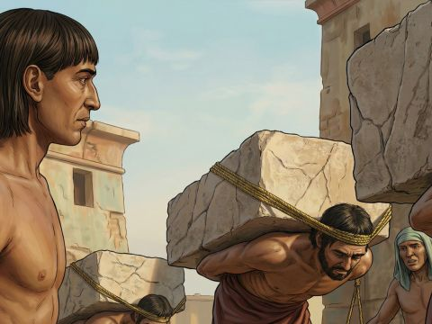
Exodus 6:5
"'Moreover, I have heard the groaning of the Israelites, whom the Egyptians are enslaving, and I have remembered my covenant.'"

Slide 3
Exodus 6:5
"'Moreover, I have heard the groaning of the Israelites, whom the Egyptians are enslaving, and I have remembered my covenant.'"
What does it mean?
Think of a time when you were miserable. Maybe you were sick, hurt, or very sad. Can we all try making a moaning sound you would use in those situations together?
God heard the Israelites when they were suffering as slaves and being treated badly. It says God remembered His covenant, but that does not mean He ever forgot it! When the Bible says God remembered His covenant, it actually means he has never forgotten the promises He made to Abraham and He now intends to put those promises into action!

Slide 4
5
Exodus 6:_
"'Moreover, _ have _____ the groaning of the _________, whom the _________ are enslaving, and _ have ____________ my covenant.'"
I
heard
Israelites
Egyptians
I
remembered

Slide 5
Exodus
5
_______ 6:_
"'_________, _ have _____ the ________ of the _________, whom ___ _________ are _________, and _ have ____________ my _________.'"
Moreover
I
heard
groaning
Israelites
the
Egyptians
enslaving
I
remembered
covenant

Slide 6
Exodus
6
5
_______ _:_
"'_________, _ ____ _____ ___ ________ __ ___ _________, _____ ___ _________ ___ _________, ____ _ ____ ____________ ___ _________.'"
Moreover
I
have
heard
the
groaning
of
the
Israelites
whom
the
Egyptians
are
enslaving
and
I
have
remembered
my
covenant

