Slide 1



Dig Site 4 Memory Verse
Hide God's Word in Your Heart!
This activity will help you memorize your Bible verse for the week. Each slide removes more words from the verse. Click your mouse or spacebar to fill in the blanks one at a time but try to say it out loud with the missing words yourself before clicking. Don't forget to practice the reference at the top.

Slide 2
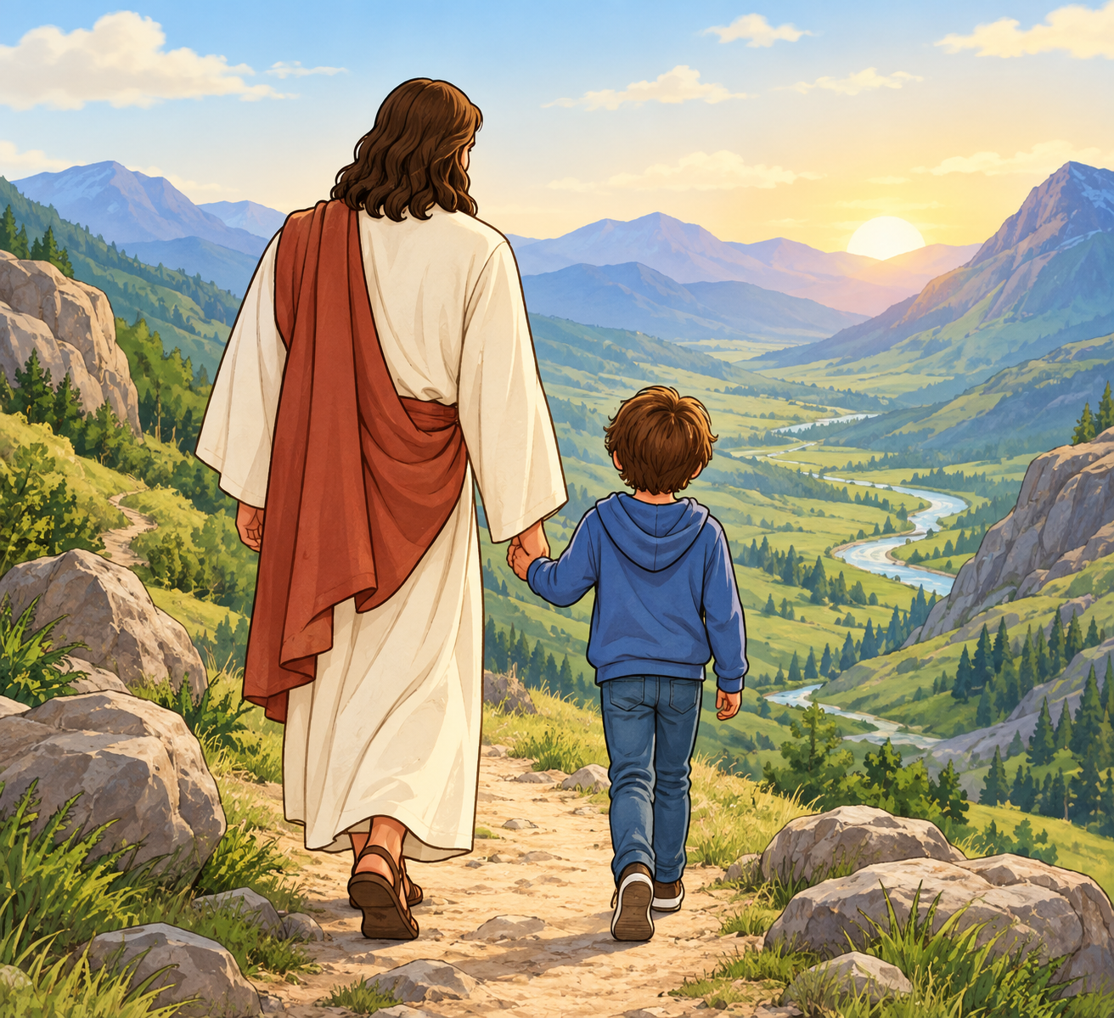
Psalm 9:10
"Those who know your name trust in you, for you, LORD, have never forsaken those who seek you."
I AM
WHO
I AM
Notes:
Scripture quotations taken from The Holy Bible, New International Version®, NIV®. Copyright © 1973, 1978, 1984, 2011 by Biblica, Inc.
Image source: https://www.freebibleimages.org/illustrations/spi-moses-burning-bush/

Slide 3
Psalm 9:10
"Those who know your name trust in you, for you, LORD, have never forsaken those who seek you."
What Does It Mean?
As Christians, we know that Jesus is God, and we have faith in His name because he died for our sins. Jesus is always with us and cares for us! We do not have to look for Him in the same way we do when we play hide-and-seek with our friends. He does not hide from us! All we have to do to seek Him is pray, read our Bibles, worship, walk through nature, or spend time with others in God's family.
I AM
Yahweh
Jesus
Notes:
Scripture quotations taken from The Holy Bible, New International Version®, NIV®. Copyright © 1973, 1978, 1984, 2011 by Biblica, Inc.
Image source: https://www.freebibleimages.org/illustrations/spi-moses-burning-bush/

Slide 4
______ 9:10
"Those who ____ your _____ trust in you, for you, _______, have _____ forsaken those who ____ you."
Psalm
I AM
WHO
I AM
know
name
LORD
never
seek
Notes:
Scripture quotations taken from The Holy Bible, New International Version®, NIV®. Copyright © 1973, 1978, 1984, 2011 by Biblica, Inc.
Image source: https://www.freebibleimages.org/illustrations/spi-moses-burning-bush/

Slide 5
______ 9:__
"______ who ____ your _____ ____ in you, for ___, _______, have _____ forsaken _____ who ____ ___."
Psalm
10
I AM
WHO
I AM
Those
know
name
trust
you
LORD
never
those
seek
you
Notes:
Scripture quotations taken from The Holy Bible, New International Version®, NIV®. Copyright © 1973, 1978, 1984, 2011 by Biblica, Inc.
Image source: https://www.freebibleimages.org/illustrations/spi-moses-burning-bush/

Slide 6
______ _:__
"______ ____ ____ ____ _____ ____ __ ___, ___ ___, _______, _____ _____ ________ _____ ____ ____ ___."
Psalm
9
10
I AM
WHO
I AM
Those
who
know
your
name
trust
in
you
for
you
LORD
have
never
forsaken
those
who
seek
you
Notes:
Scripture quotations taken from The Holy Bible, New International Version®, NIV®. Copyright © 1973, 1978, 1984, 2011 by Biblica, Inc.
Image source: https://www.freebibleimages.org/illustrations/spi-moses-burning-bush/

