Slide 1



Dig Site 3 Memory Verse
Hide God's Word in Your Heart!
This activity will help you memorize your Bible verse for the week. Each slide removes more words from the verse. Click your mouse or spacebar to fill in the blanks one at a time but try to say it out loud with the missing words yourself before clicking. Don't forget to practice the reference at the top.

Slide 2
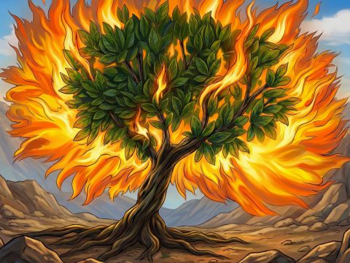
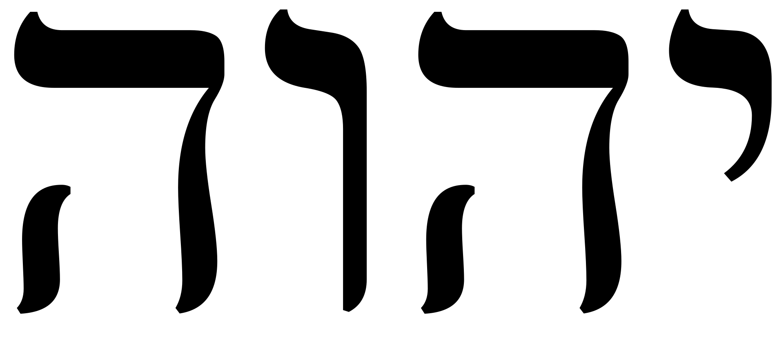
Exodus 3:14
"God said to Moses,
'I AM WHO I AM. This is what you are to say to the Israelites: "I AM has sent me to you."'"
YHWH
Notes:
Scripture quotations taken from The Holy Bible, New International Version®, NIV®. Copyright © 1973, 1978, 1984, 2011 by Biblica, Inc.
Image source: https://www.freebibleimages.org/illustrations/spi-moses-burning-bush/

Slide 3
Exodus 3:14
"God said to Moses,
'I AM WHO I AM. This is what you are to say to the Israelites: "I AM has sent me to you."'"
What Does It Mean?
God told Moses His name: "I AM WHO I AM". The Hebrew letters are written as "YHWH" in English, and we say it as "Yahweh". (When we see "LORD" in all capital letters in the Bible, it signals that "YHWH" was actually used there.) God is eternal, unchanging, and shows us more about who He is by what He does in the Bible. What words can you think of to describe God?

Slide 4
Exodus 3:___
"God said to ______,
'I AM WHO _ ___. This is _____ you are to ___ to the ________: "I AM has ____ me to you."'"
14
Moses
YHWH
I
AM
what
say
Israelites
sent
Notes:
Scripture quotations taken from The Holy Bible, New International Version®, NIV®. Copyright © 1973, 1978, 1984, 2011 by Biblica, Inc.

Slide 5
Exodus __:___
"____ said to ______,
'_ ___ WHO _ ___. This is _____ ____ ___ to ___ to ___ ________: "_ ___ has ____ me to ____."'"
14
3
God
Moses
YHWH
I
AM
I
AM
what
you
are
say
the
Israelites
I
AM
sent
you

Slide 6
________ __:___
"____ ____ __ ______,
'_ ___ _____ _ ___. ____ __ _____ ___ ___ __ ___ __ ___ ________: "_ ___ ___ ____ ___ __ ___."'"
Exodus
3
14
God
said
to
Moses
YHWH
AM
I
I
AM
WHO
This
say
you
are
to
what
is
I
AM
Israelites
the
to
has
sent
me
to
you

