Slide 1
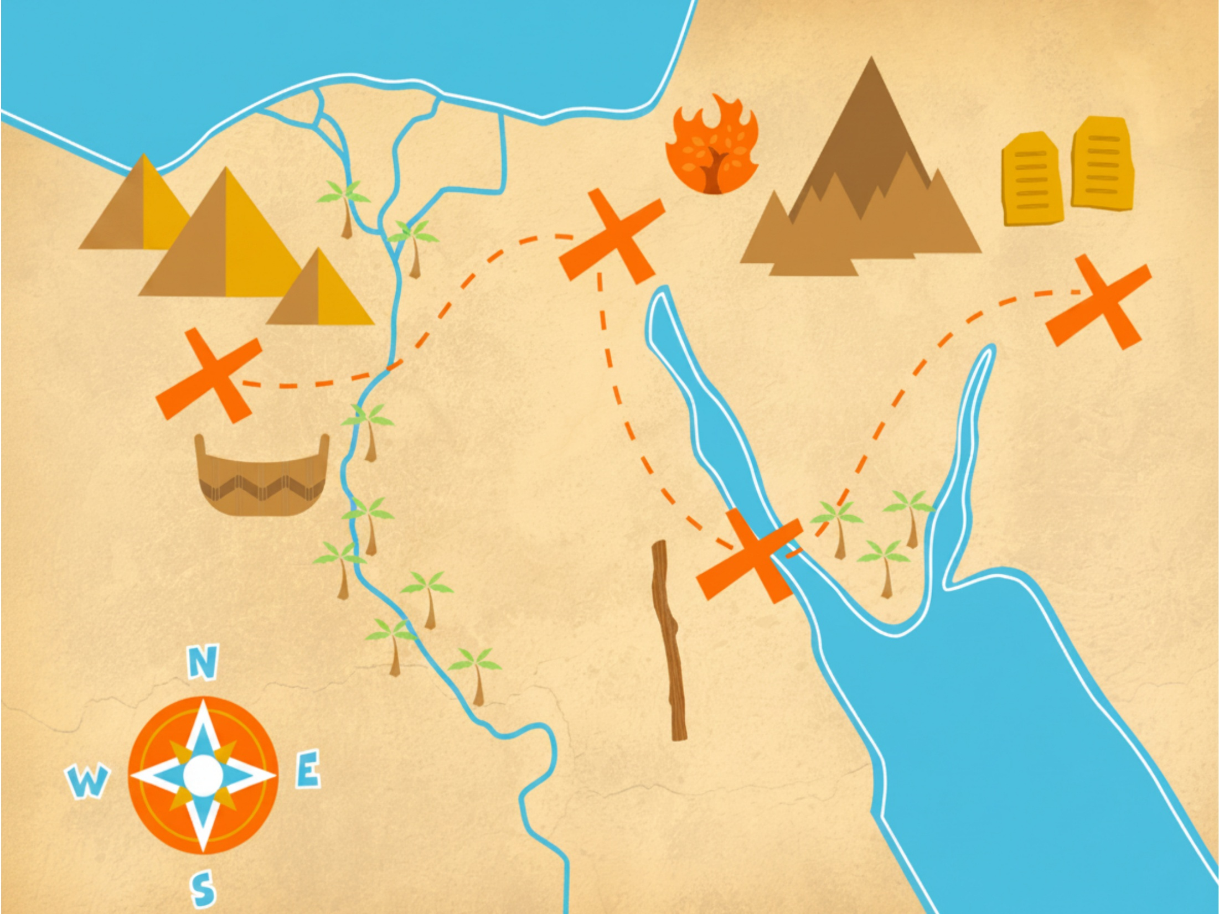

Lesson #11
Exodus 13:17 – 14:31
God Parts the Sea

Slide 2

Memory
Verse
The Lord will fight for you;
you need only to be still.
Exodus 14:14

Slide 3

Read: Exodus 13:17a
NO!
Philistine Country

Slide 4
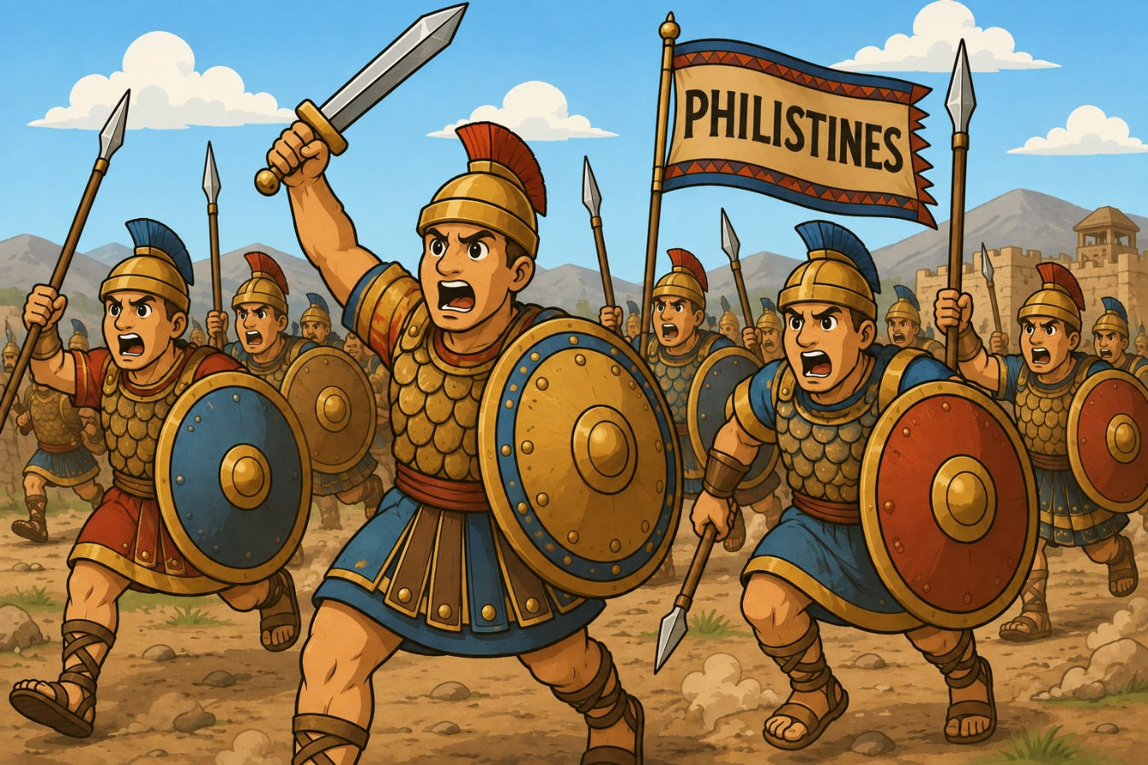
Read: Exodus 13:17b
Egypt
Notes:
Image created with ChaptGPT

Slide 5

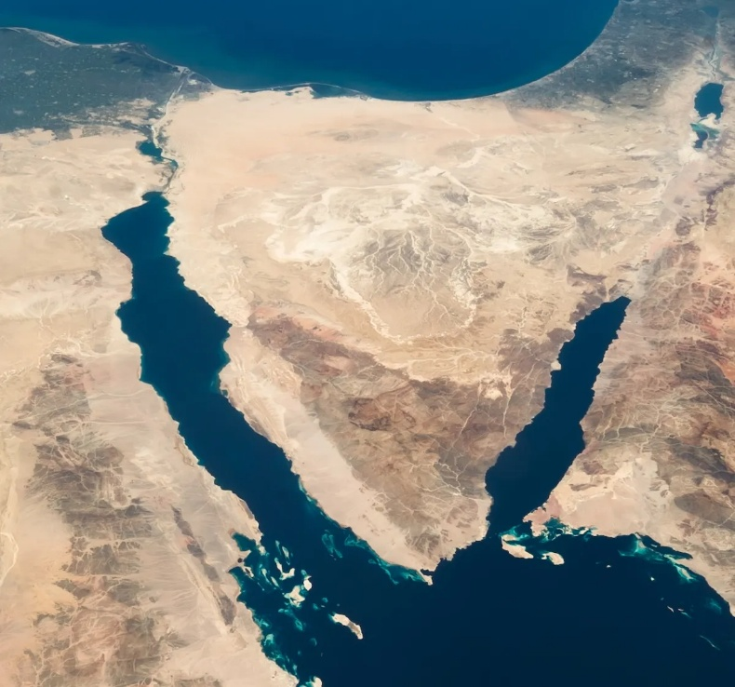
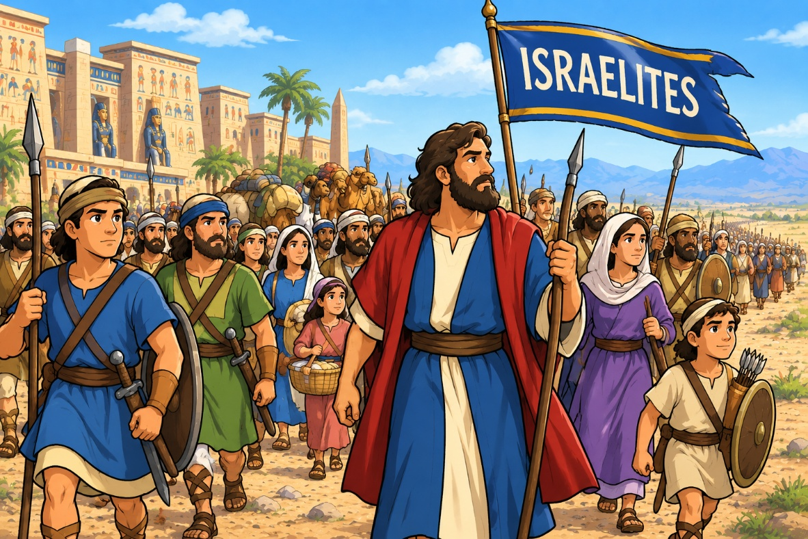
Read: Exodus 13:18
Notes:
https://anetoday.org/sinai-ten-maps/
ChatGPT generated image of Israelites ready for battle

Slide 6
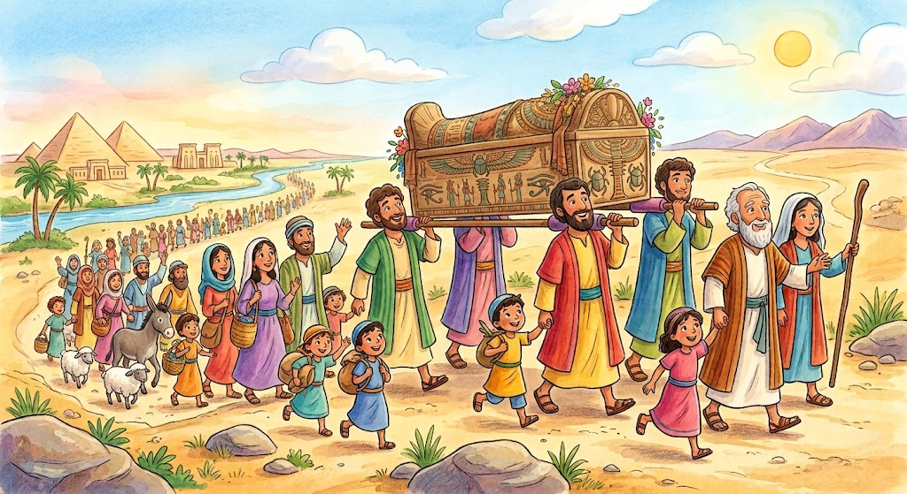
Read: Exodus 13:19
Take Note:
You may remember the memory verse Genesis 50:24b from last year. Take a moment to review that and then read verse 25. What do you notice?
Notes:
Image created with Google Gemini

Slide 7
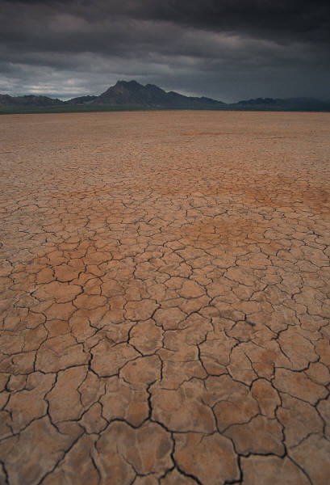



Read: Exodus 13:20
Etham
Succoth

Slide 8
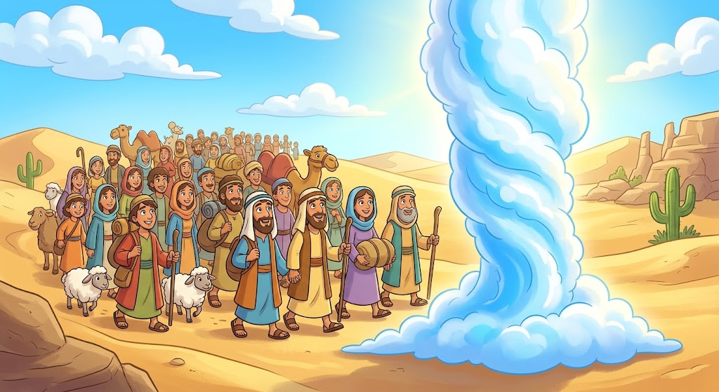
Read: Exodus 13:21a
Notes:
Image created with Gemini

Slide 9
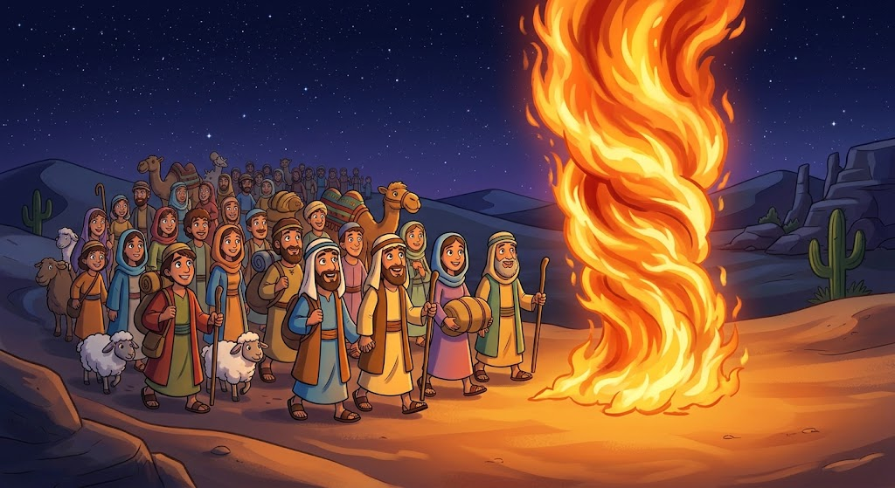
Read: Exodus 13:21b
Notes:
Image created with Gemini

Slide 10
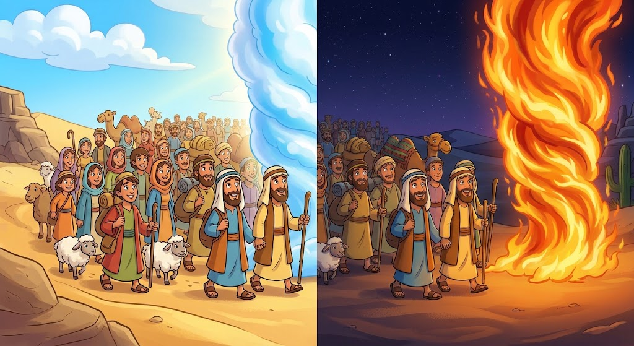
Read: Exodus 13:22
Notes:
Image created with Gemini

Slide 11
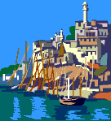
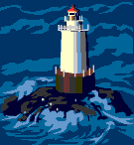
MIGDOL
the sea
Read:
Exodus 14:1-2
Pi Hahiroth
Baal Zephon

Slide 12
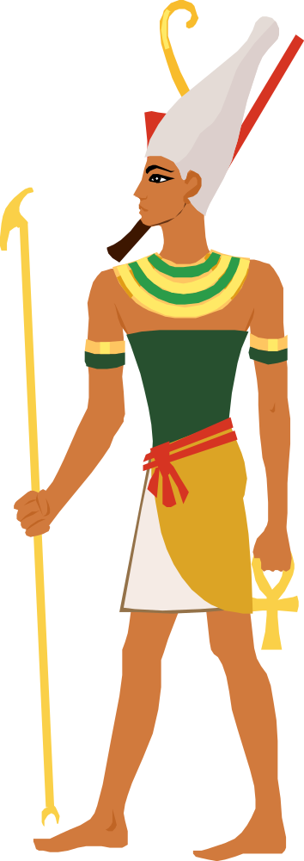
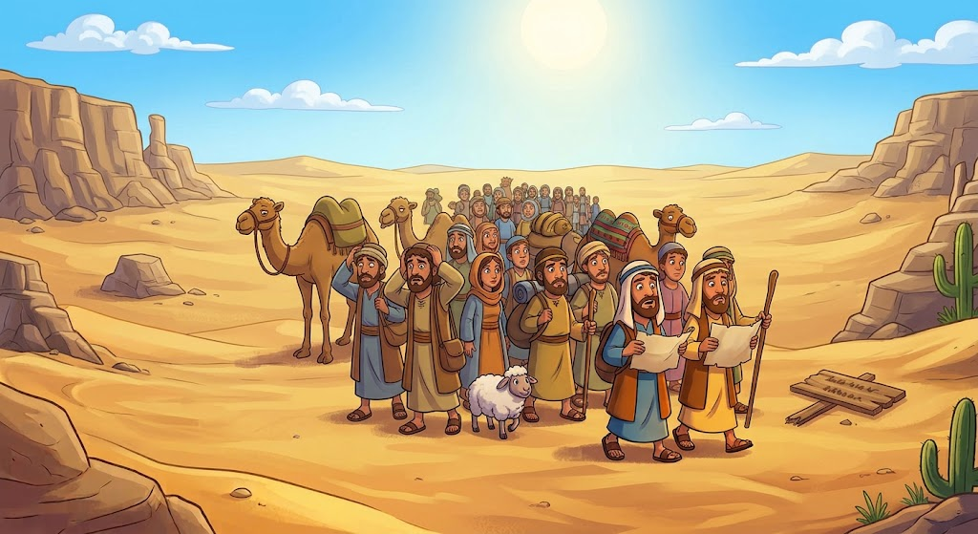
Read: Exodus 14:3

Slide 13
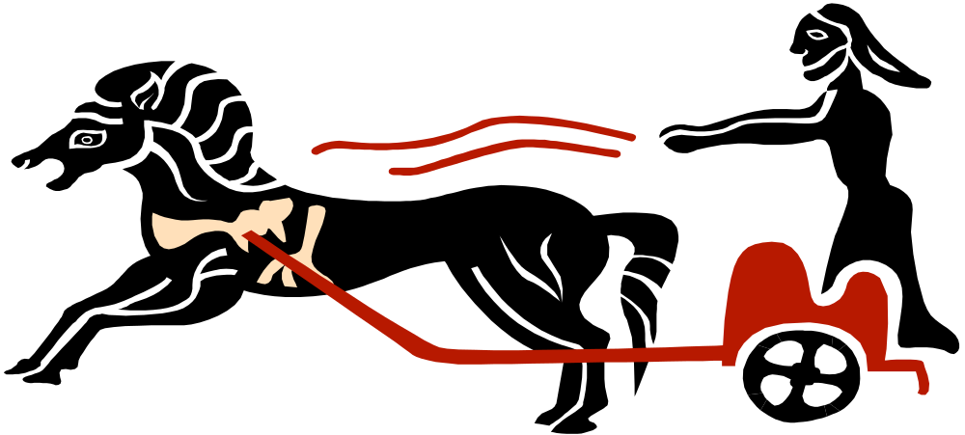


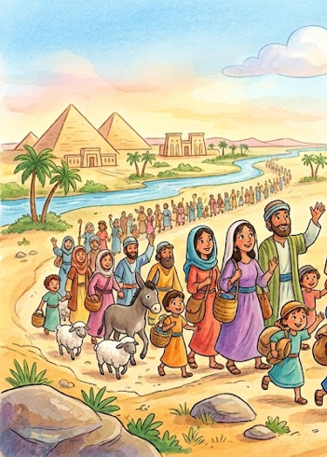
Glory
to God
in the
Highest!
Read: Exodus 14:4

Slide 14
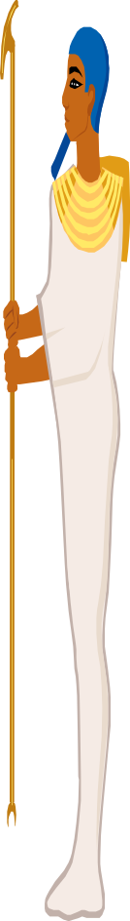
Read:
Exodus 14:5

Slide 15
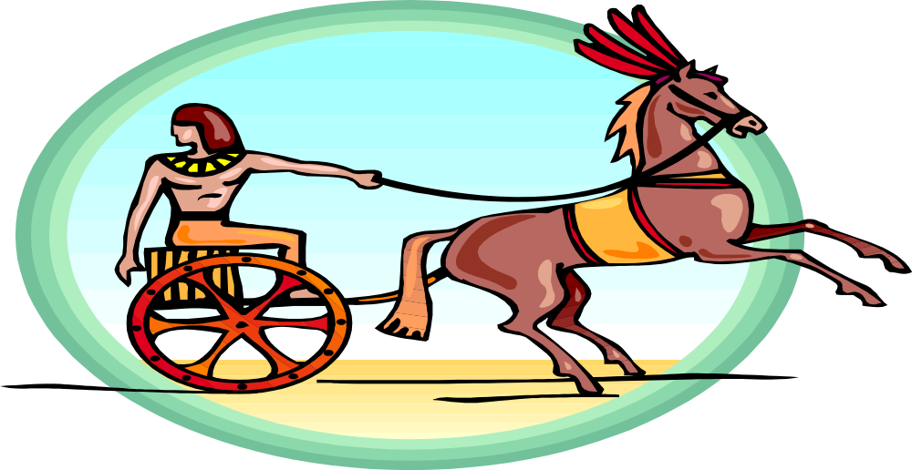
Read: Exodus 14:6-7
100
200
300
400
500
600

Slide 16

Take Note:
A hard heart means Pharaoh was stubborn and would not listen to God. God only hardened Pharaoh's heart after Pharaoh had chosen to harden his own heart.
Read: Exodus 14:8

Slide 17
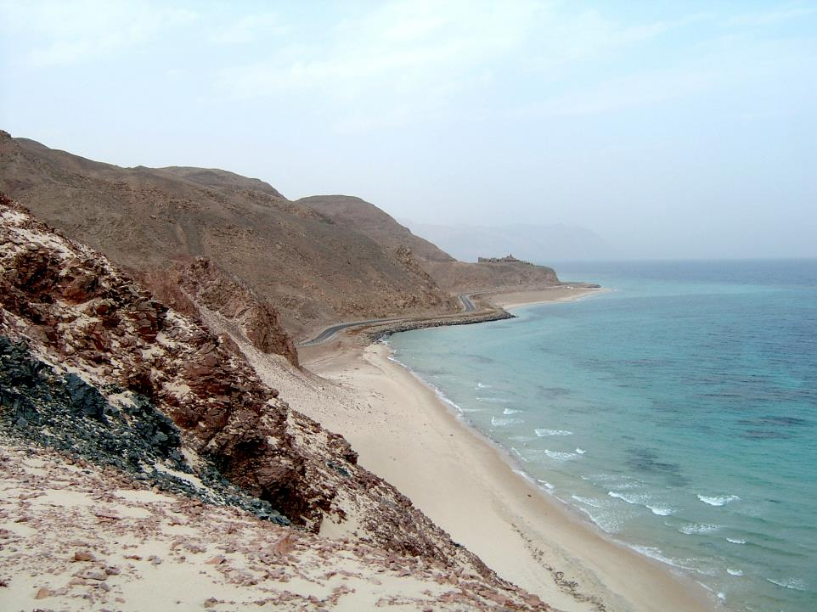
Read: Exodus 14:9

Slide 18
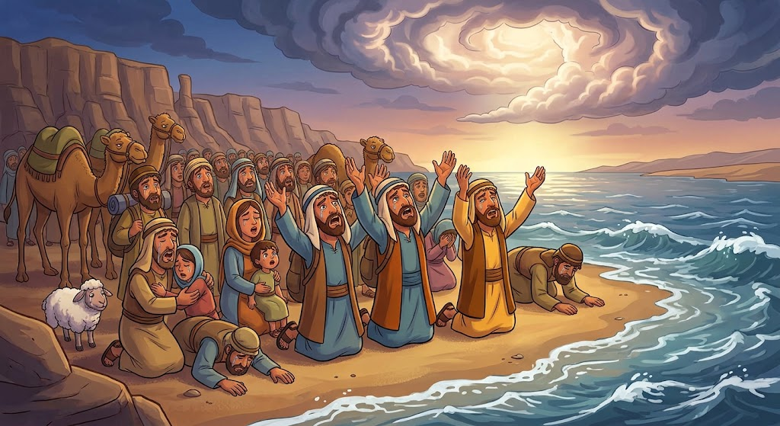
Read: Exodus 14:10
Lord,
help Us!!!!
Lord,
help Us!!!!
Lord,
help Us!!!!
Notes:
Image created with Gemini

Slide 19
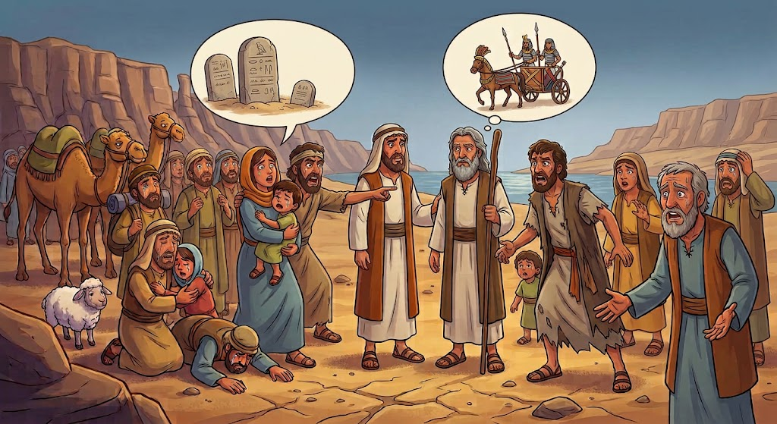
Read: Exodus 14:11-12
Notes:
Image created with Gemini

Slide 20
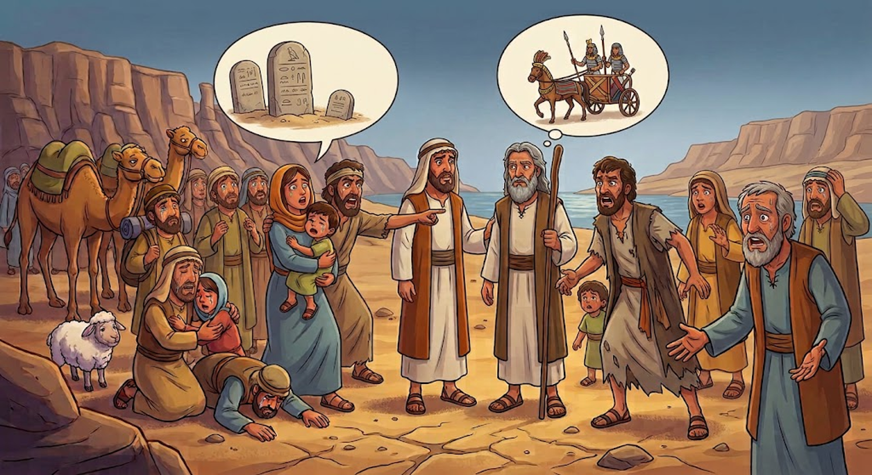
Read: Exodus 14:13
Notes:
Image created with Gemini

Slide 21
Memory
Verse
The Lord will fight for you;
you need only to be still.
Exodus 14:14

Slide 22
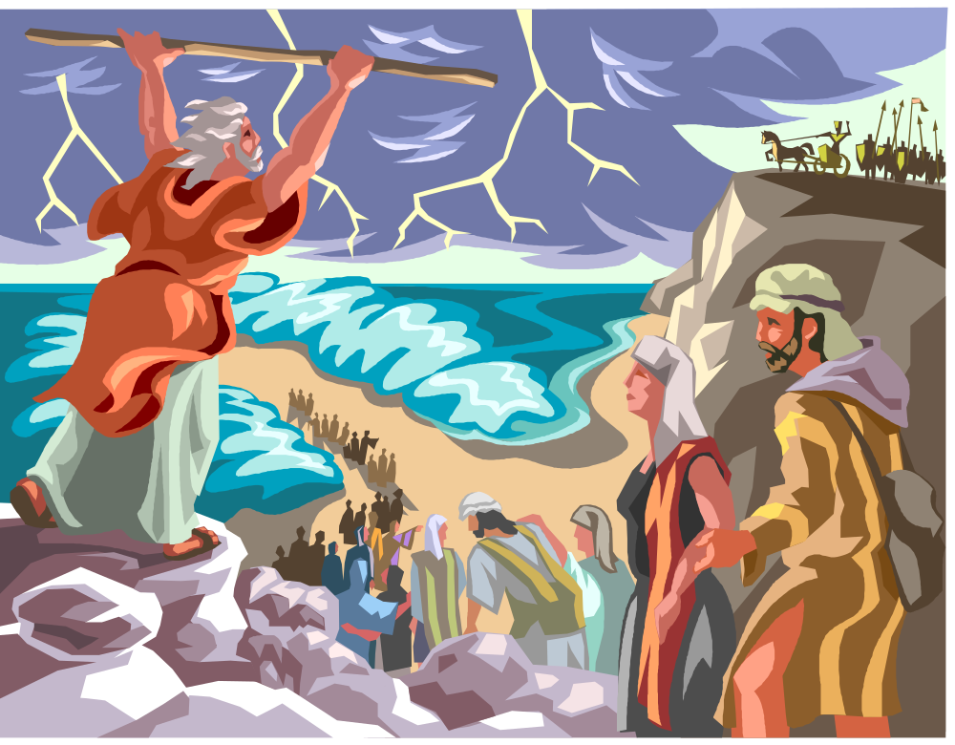
Read:
Exodus 14:15-18

Slide 23
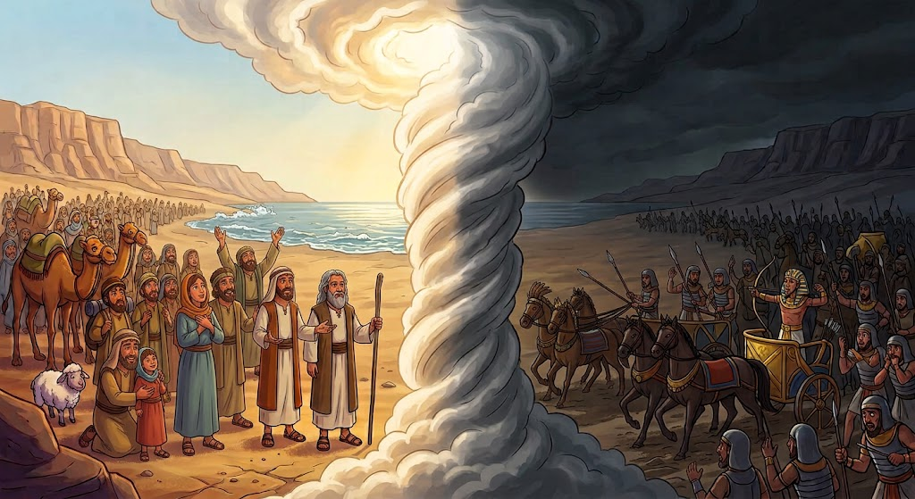
Read: Exodus 14:19-20
Notes:
Image created with Gemini

Slide 24

Read:
Exodus 14:21a

Slide 25
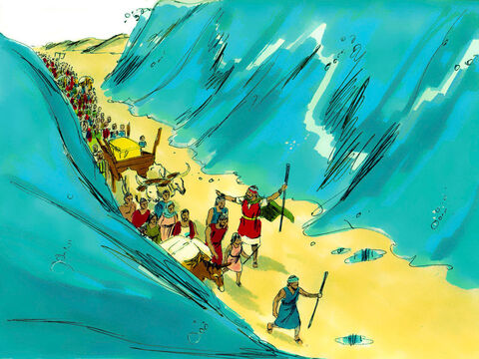
Read:
Exodus 14:21b-22
Notes:
https://www.freebibleimages.org/illustrations/moses-red-sea/

Slide 26
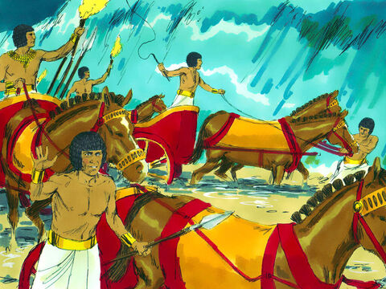
Read: Exodus 14:23
Notes:
https://www.freebibleimages.org/illustrations/moses-red-sea/

Slide 27

Read: Exodus 14:24

Slide 28

Read: Exodus 14:25

Slide 29
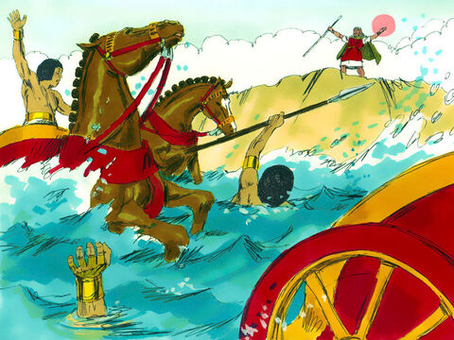
Read:
Exodus 14:26-27
Notes:
https://www.freebibleimages.org/illustrations/moses-red-sea/

Slide 30
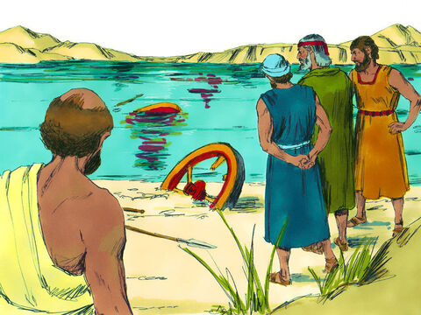
Read: Exodus 14:28
Notes:
https://www.freebibleimages.org/illustrations/moses-red-sea/

Slide 31
Read:
Exodus 14:29
Notes:
https://www.freebibleimages.org/illustrations/moses-red-sea/

Slide 32
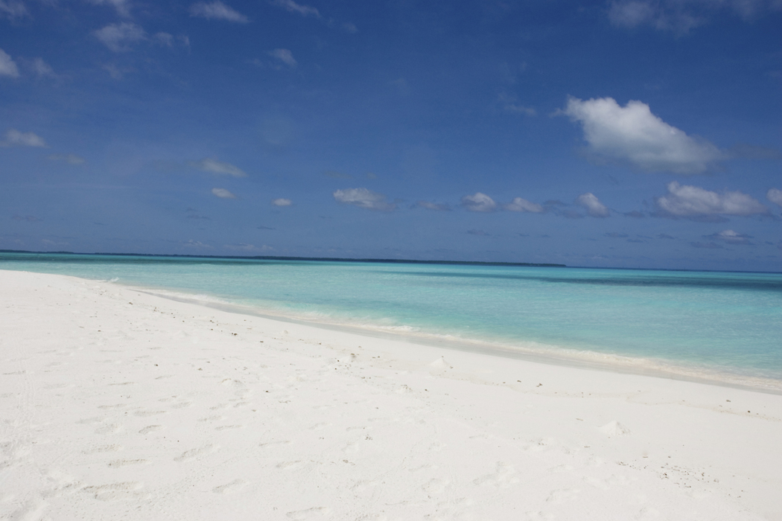
Read: Exodus 14:30-31

Slide 33
God is Faithful
The Israelites saw God's power in Egypt. They knew He rescued them, and they experienced His leading them with the pillars of cloud and fire. However, they continued to struggle to trust God when life got tough, and this won't be the last time they complain and doubt God. God is always faithful to His promises! He rescued the Israelites even though they doubted. Have you ever doubted God? Do you think God still rescues and helps people today?

