Slide 1

Exodus 12:1 - 42 Dig Site 10
Free at Last!

Slide 2
Memory Verse
The Lord is my strength
and my defense;
he has become my salvation.
He is my God,
and I will praise him,
my father’s God,
and I will exalt him.
Exodus 15:2

Slide 3
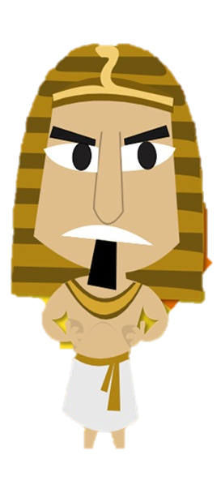
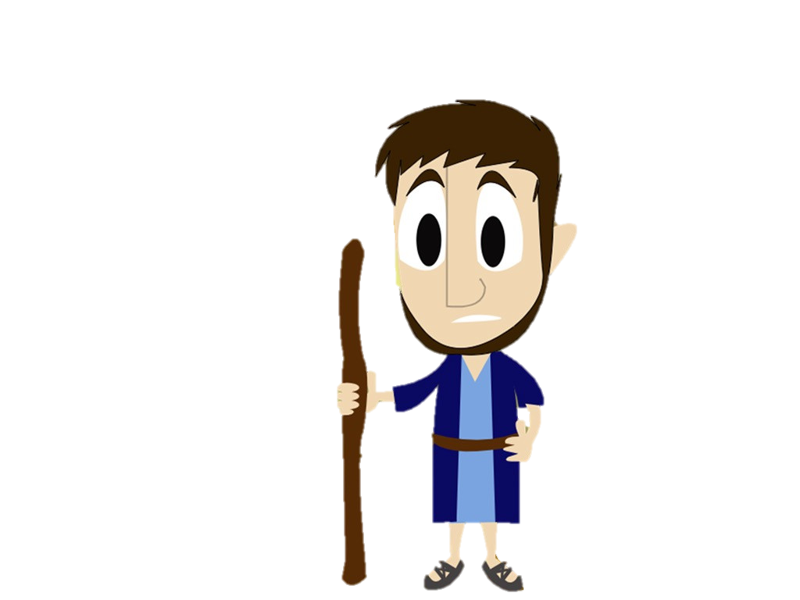
Previously on
The Ten Plagues
God sent Moses to tell Pharoah to let God’s people go into the dessert for three days so they could worship him. Pharoah hardened his heart against God and refused to listen. So God sent 9 plagues to Egypt to get Pharoah to listen. With each plague, Pharoah’s heart grew harder and harder. He REFUSED to let God’s people God. So, God was going to bring one more terrible plague to break Pharoah’s hard heart. Will Pharoah finally listen and do what God said to do?

Slide 4
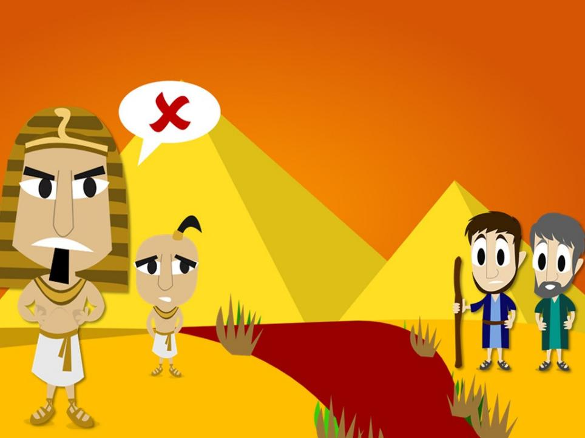
The Ten Plagues
1. Blood
Notes:
So God decided to send plagues on Egypt to show that He is the all powerful God. He told Aaron to hold his staff over the River Nile and all the water in the land became blood red. The fish died and the water stank. But Pharaoh refused to let the Hebrew slaves go.

Slide 5
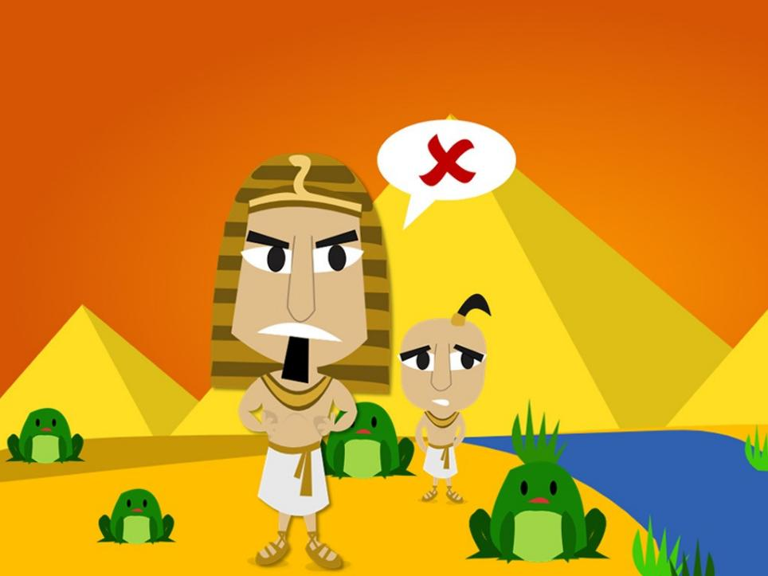
The Ten Plagues
2. Frogs
Notes:
So God sent a plague of frogs. There were frogs jumping around everywhere. But Pharaoh refused to let the Hebrew slaves go.

Slide 6
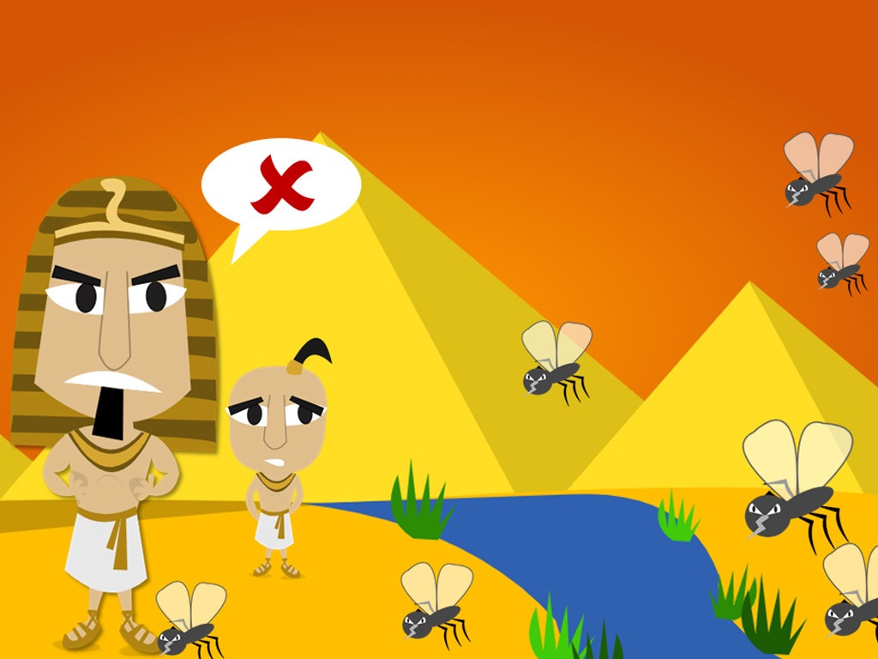
The Ten Plagues
3. Gnats
Notes:
Next God sent lots of small insects called gnats to cover the land like dust. Even Pharaoh’s magicians knew only God had the power to do this. But Pharaoh still refused to let the Hebrew slaves go.

Slide 7
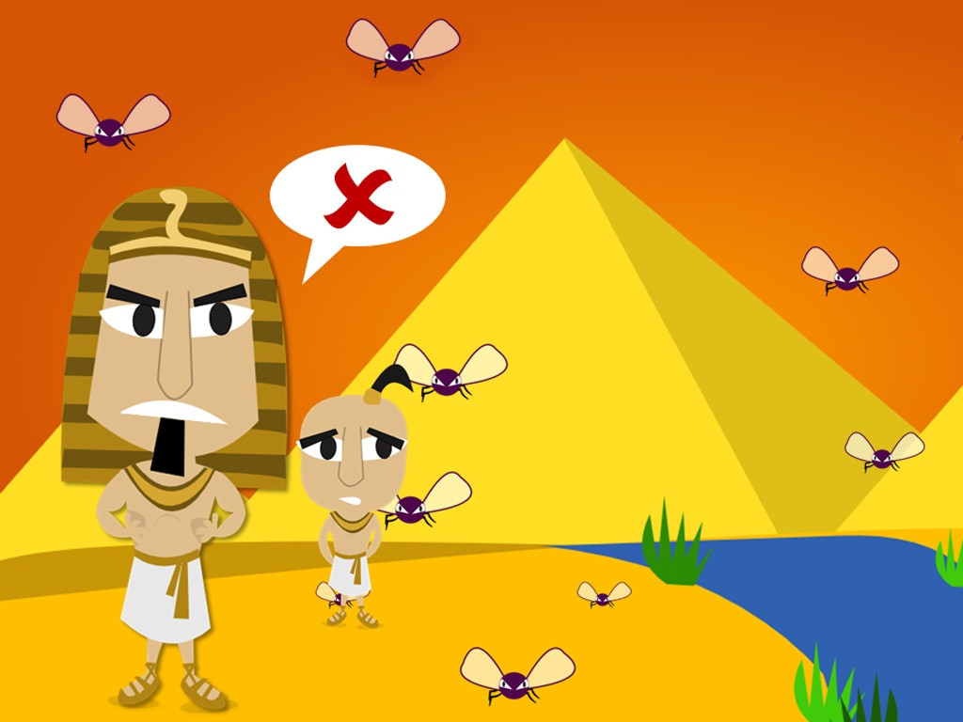
The Ten Plagues
4. Flies
Notes:
So God sent a fourth plague – flies! Flies swarmed around Pharaoh’s palace and the Egyptians but not around the Hebrew slaves. But would he let the Hebrew slaves go? No.

Slide 8
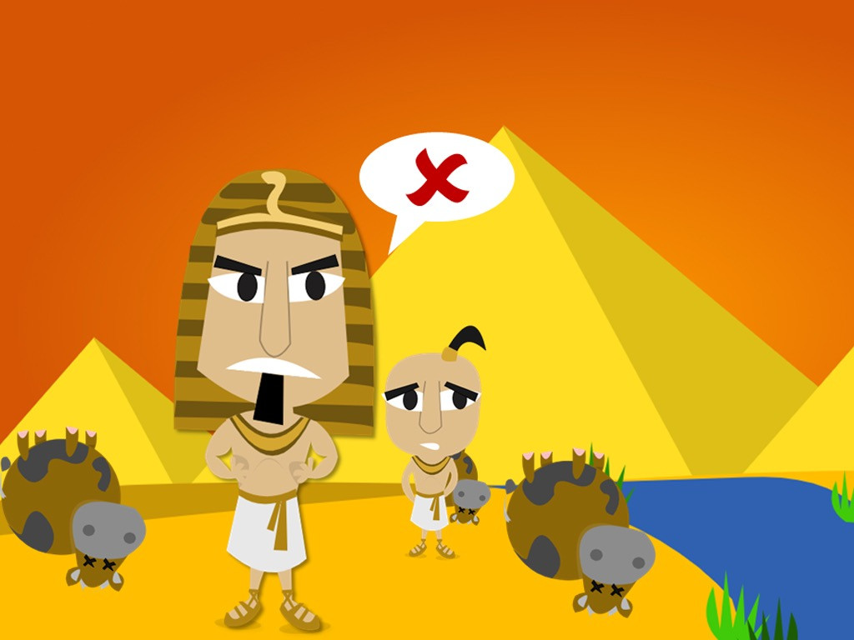
The Ten Plagues
5. Dead Livestock
Notes:
So God sent a plague on the horses, donkeys camels, cattle, sheep and goats belonging to the Egyptians. But the animals belonging to the Hebrew slaves were spared. But Pharaoh still refused to let the Hebrew slaves go.

Slide 9
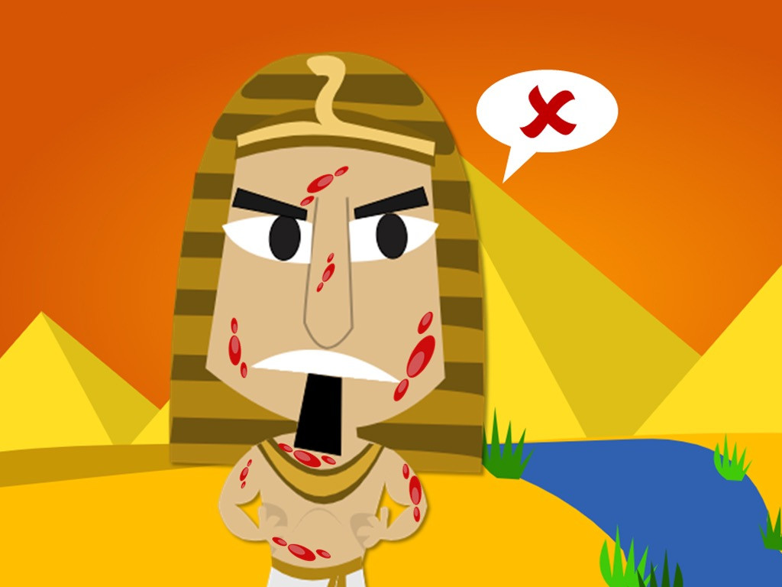
The Ten Plagues
6. Boils
Notes:
Next God sent a plague of horrible, festering boils that broke out on the skin of people and animals. But Pharaoh still refused to let the Hebrew slaves go.

Slide 10
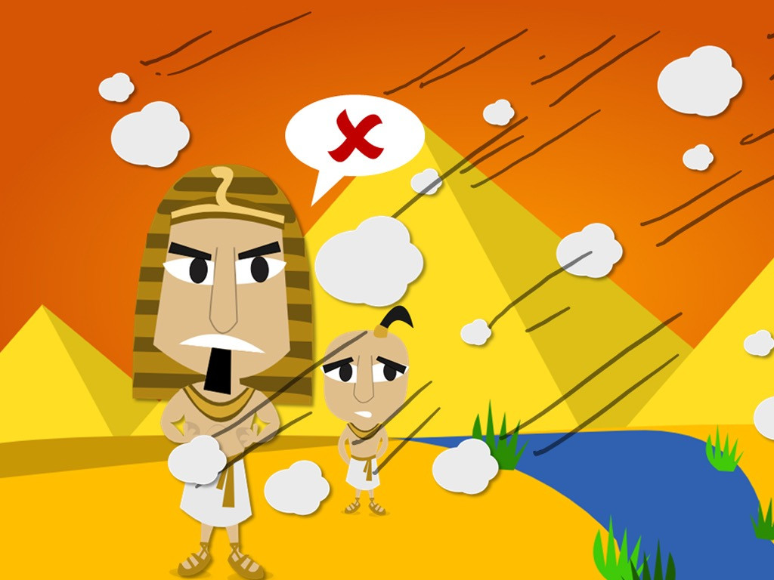
The Ten Plagues
7. Hail
Notes:
Even when God sent the worst thunder and hailstorm Egypt had ever seen, Pharaoh would not let the Hebrew slaves go.

Slide 11
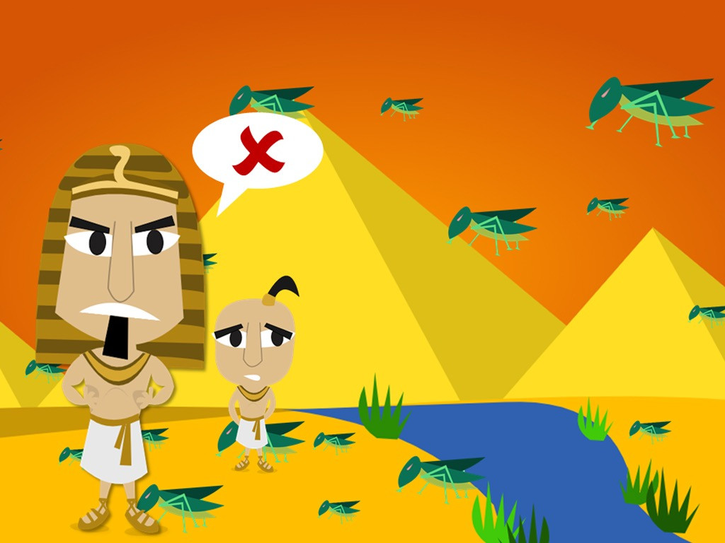
The Ten Plagues
8. Locusts
Notes:
So God sent an east wind that brought in a plague of locusts that covered the ground and ate all the crops that were growing.
But rather than obey God Pharaoh hardened his heart and refused to let the Hebrew slaves go.

Slide 12
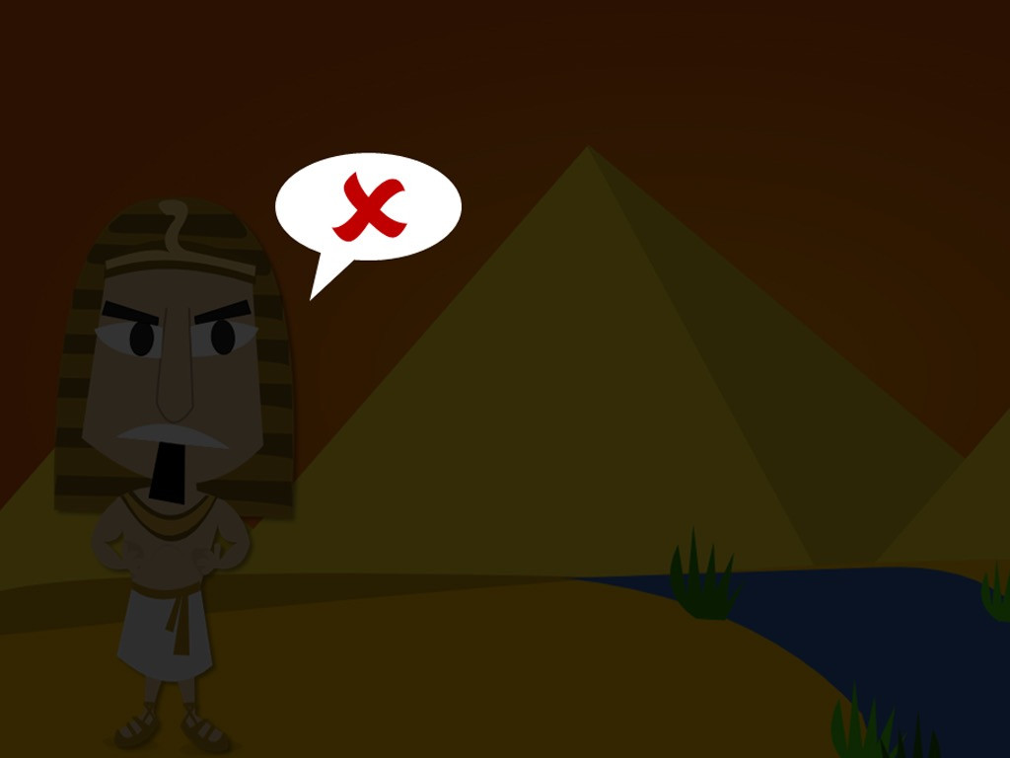
The Ten Plagues
9. Darkness
Notes:
Even when God put the Egyptians in darkness for three days while the Hebrew slaves had light, Pharaoh still refused to let the Hebrew slaves go.

Slide 13
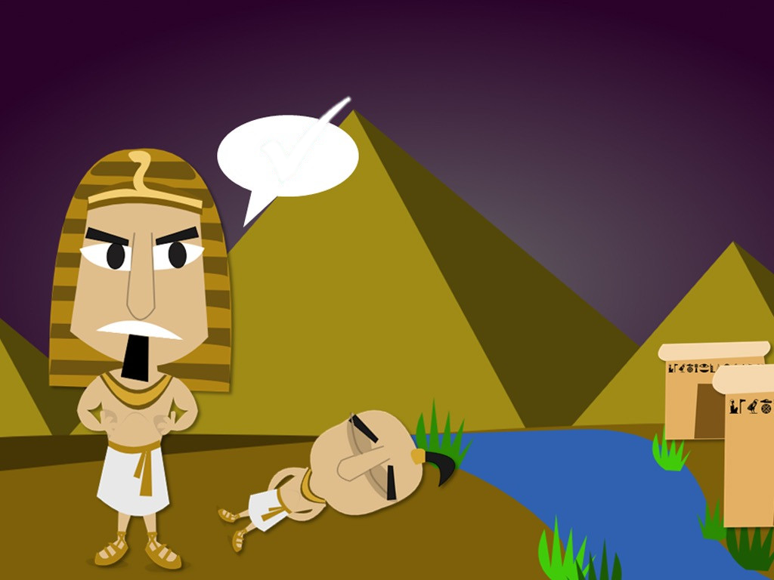
The Ten Plagues
?
10.???
Notes:
That night the Angel carrying out God’s command passed over all the houses with the blood around the door. But there was weeping and wailing all over Egypt as the first born sons of all the Egyptians were found dead.
At last Pharaoh knew he did not have the power to keep saying no to God. He told Moses that the Hebrew slaves could be set free.

Slide 14
The Passover and the
Festival of Unleavened Bread

Slide 15


Exodus 12:1-2
1st month,
1st month of your year.

Slide 16
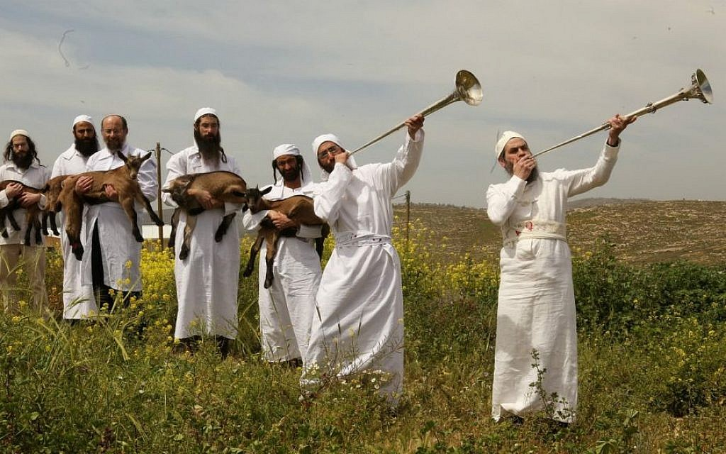
1st month,
1st month of your year.
Exodus 12:3

Slide 17


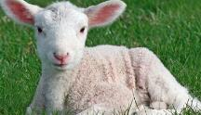

Exodus 12:4

Slide 18
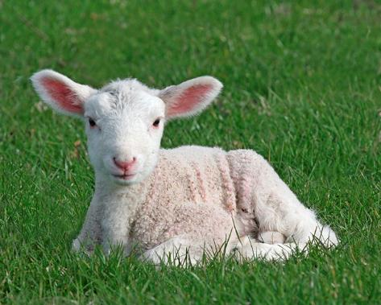
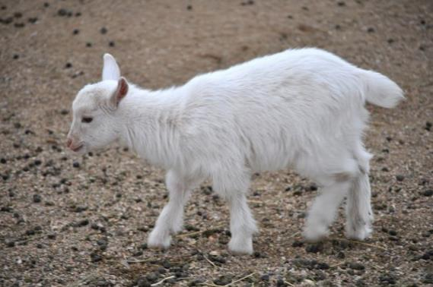
Exodus 12:5

Slide 19
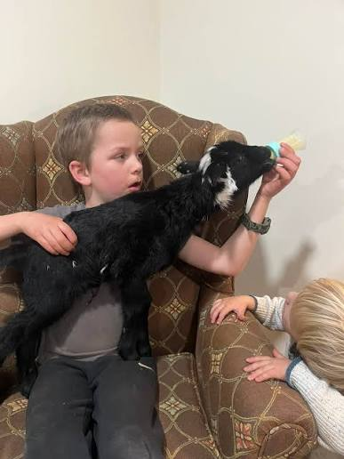
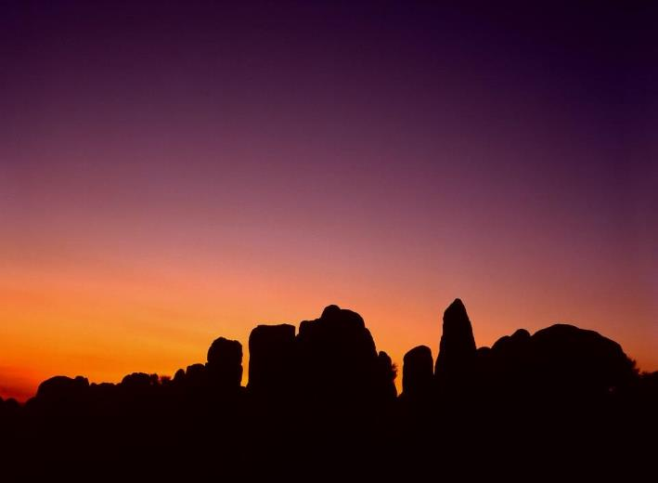

Exodus 12:6

Slide 20
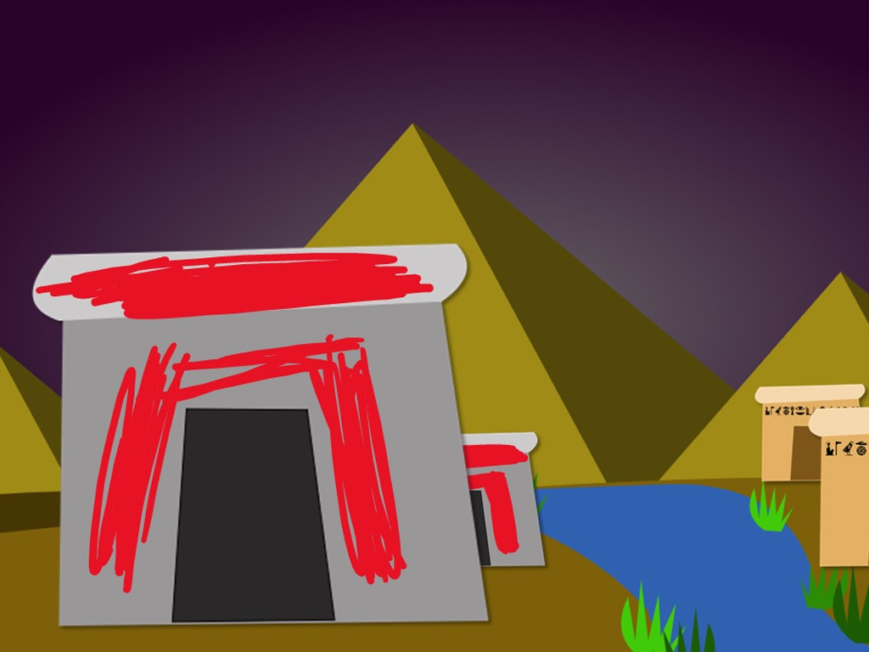
Exodus 12:7
Notes:
So God decided to send a last and terrible plague. At midnight the first born son of every family would die. The same would happen to cattle. But God told the Hebrews to sacrifice a lamb and paint its blood around their doors. All those living in houses covered by the blood would live.

Slide 21
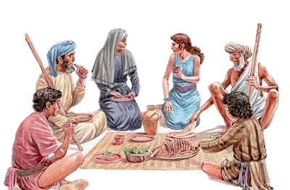
^{Exodus 12:8-10}

Slide 22
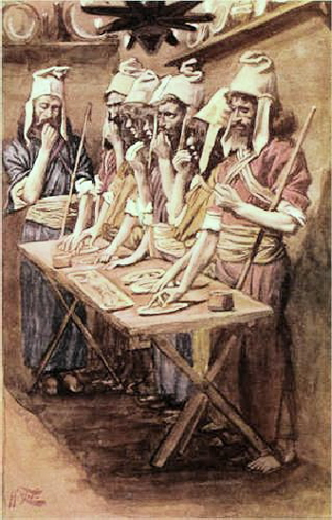
3
Exodus 12:11
1
4
2

Slide 23
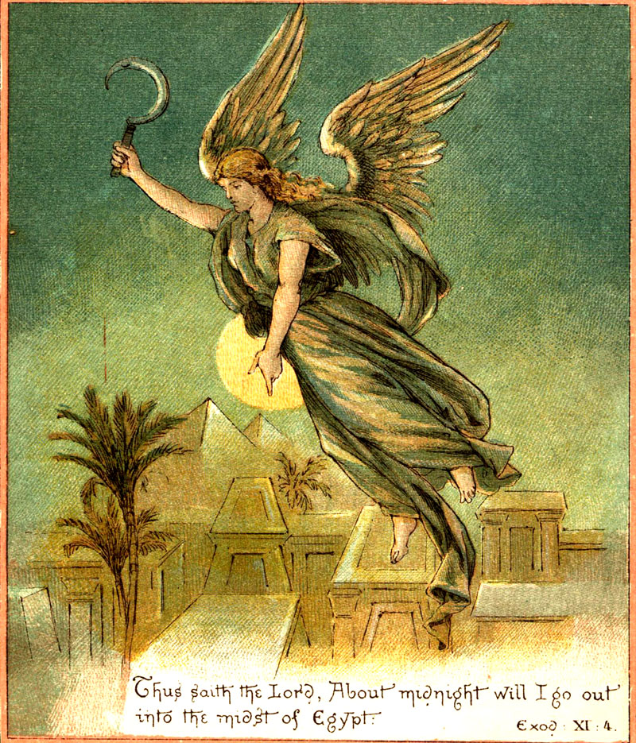
Exodus 12:12

Slide 24
Did You Know?
This became known as Passover, because God passed over and spared the Israelites' sons who put the blood of the lamb on their doors. Many years later, Jesus died on the cross during the time of Passover. He is called the Lamb of God, and it is His blood on the cross that saves us from our sins.
Exodus 12:13

Slide 25
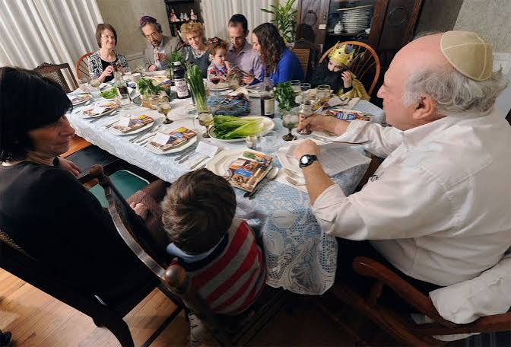
Exodus 12:14

Slide 26
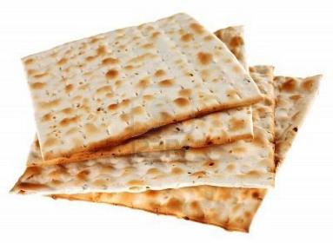
Exodus 12:15
7days

Slide 27
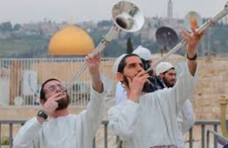
Exodus 12:16
Day 1
work
Day 7

Slide 28
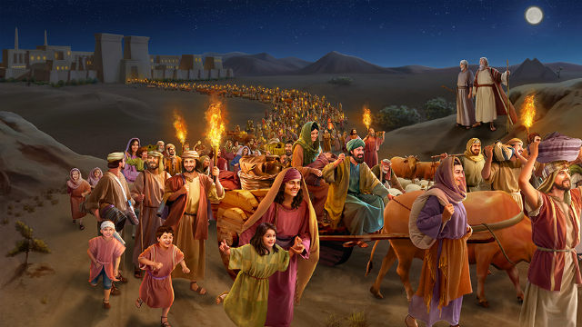
Exodus12:17

Slide 29

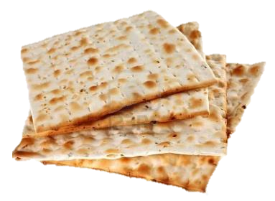
Exodus 12:18-20

Slide 30
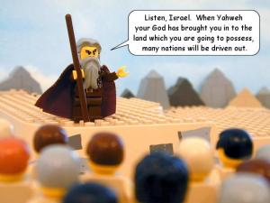
Exodus 12:21
Notes:
Picture: https://pursuingveritas.com/2015/07/22/did-god-command-genocide-part-iv/

Slide 31


Exodus 12:22-23

Slide 32
Exodus 12:24

Slide 33
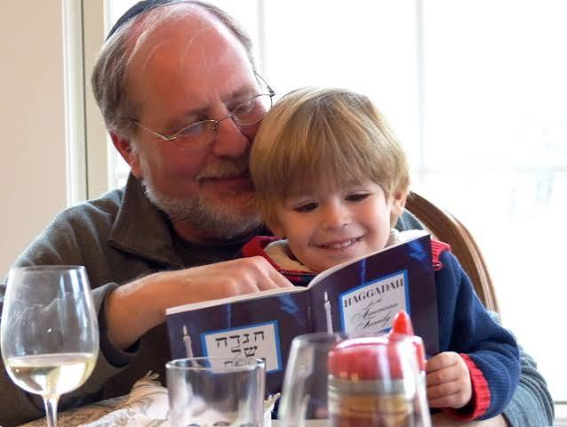
Exodus
12:25-27a

Slide 34
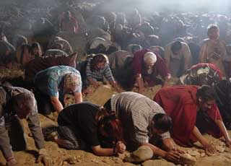
Exodus 12:27b-28

Slide 35

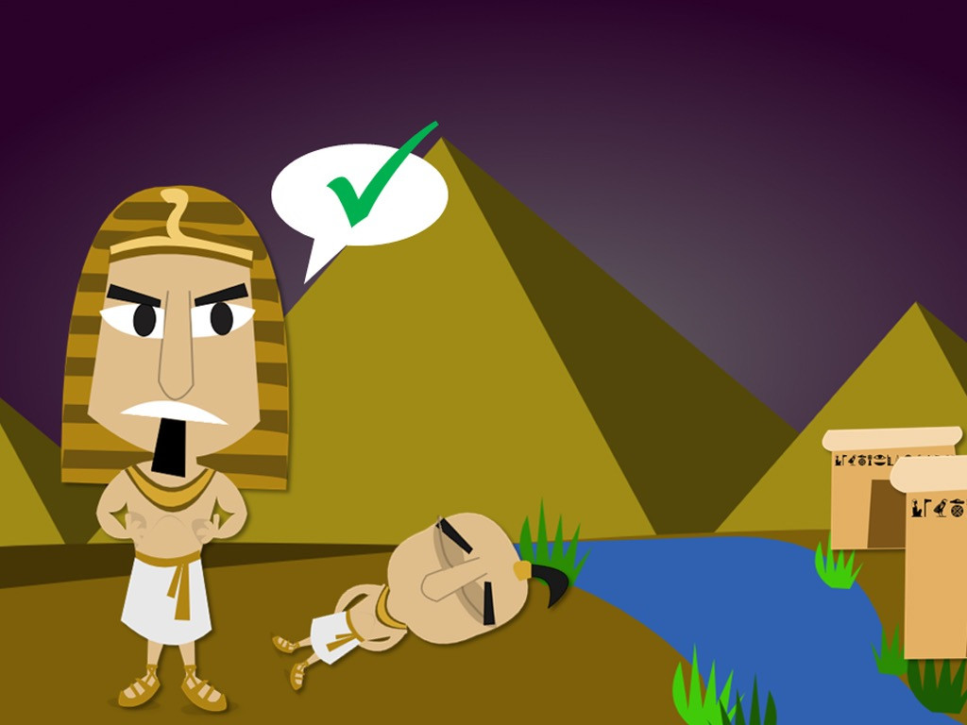
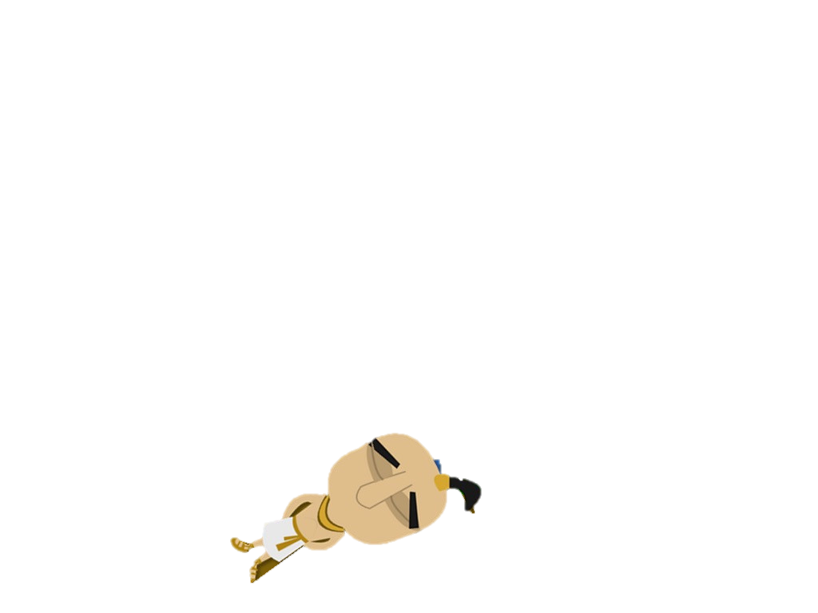


Exodus 12:29
Notes:
That night the Angel carrying out God’s command passed over all the houses with the blood around the door. But there was weeping and wailing all over Egypt as the first born sons of all the Egyptians were found dead.
At last Pharaoh knew he did not have the power to keep saying no to God. He told Moses that the Hebrew slaves could be set free.

Slide 36
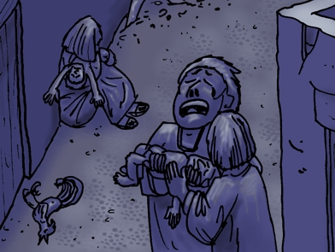

Exodus 12:30

Slide 37
The Exodus

Slide 38
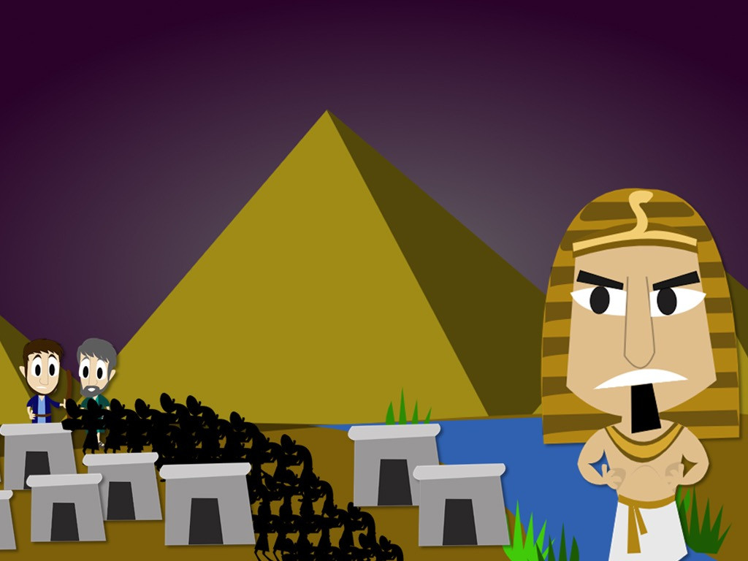
Exodus 12:31-32
Notes:
The Hebrew slaves were ready and waiting to leave. The Egyptians even gave them gifts to send them on their way. So they headed off to the land God had promised to give them.

Slide 39
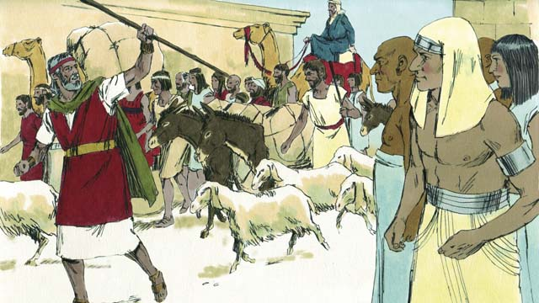
Exodus 12:33

Slide 40
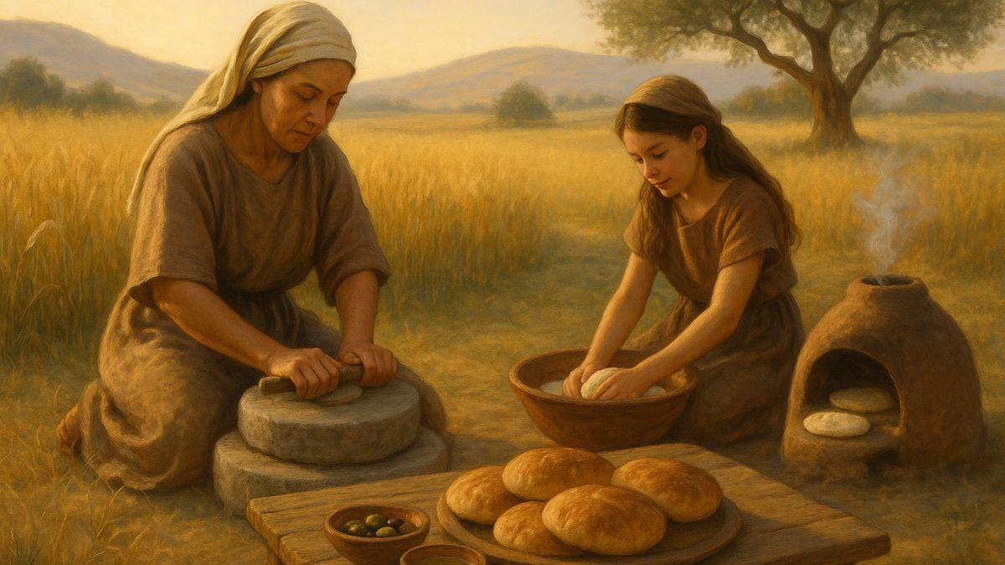
Exodus 12:34
their dough before
the yeast was added,
and carred it on
their shoulders
in kneading troughs
wrapped in clothing.

Slide 41
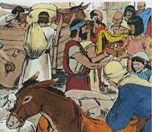
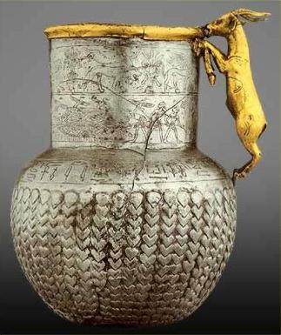

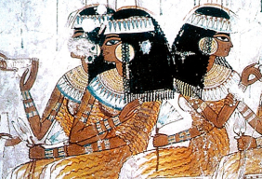

Exodus 12:35-36

Slide 42
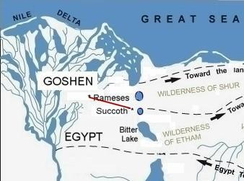
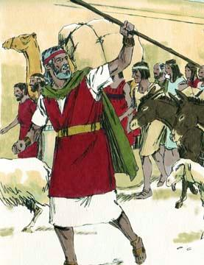
Exodus 12:37
Exodus 12:38

Slide 43
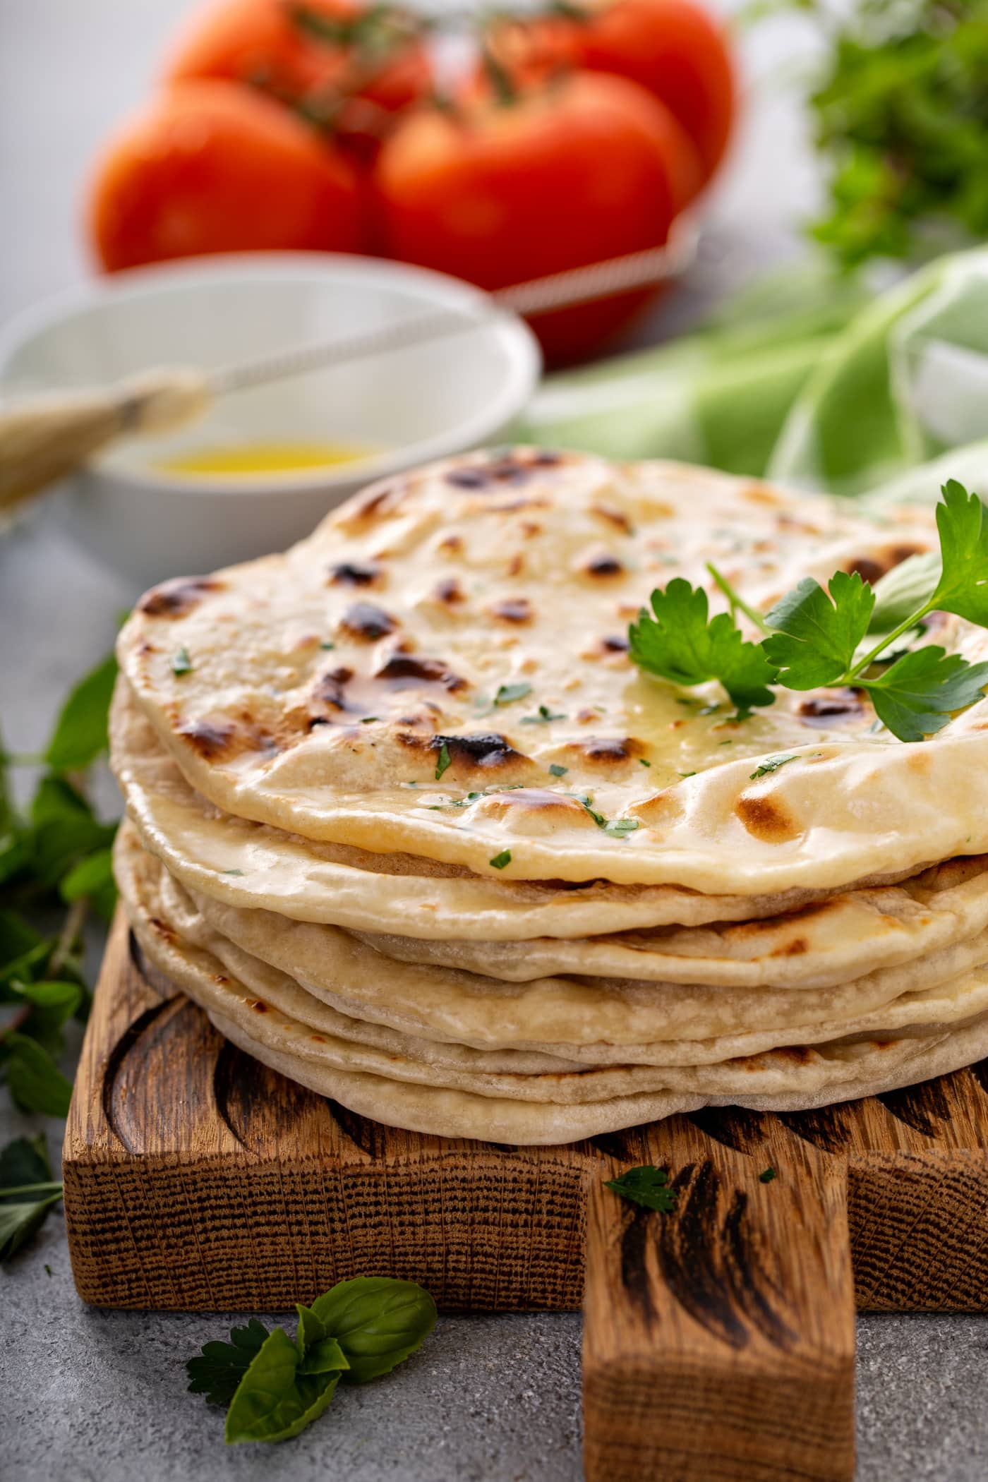
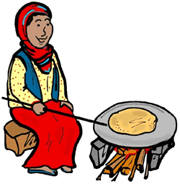
Exodus 12:39

Slide 44
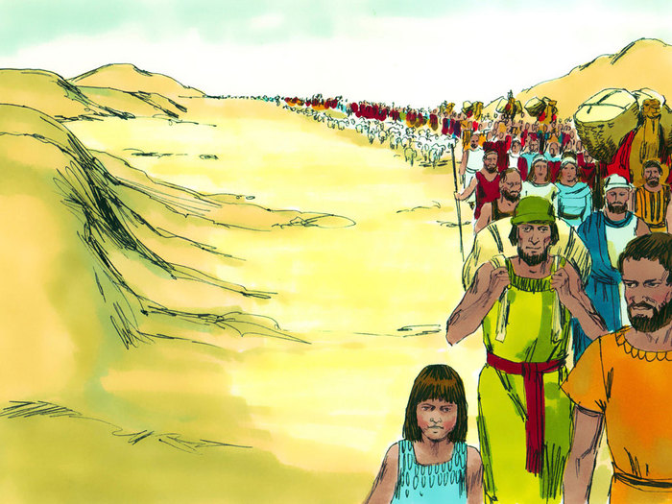
Exodus 12:40-41

Slide 45
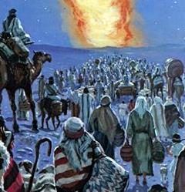
Exodus 12:42

