Slide 1
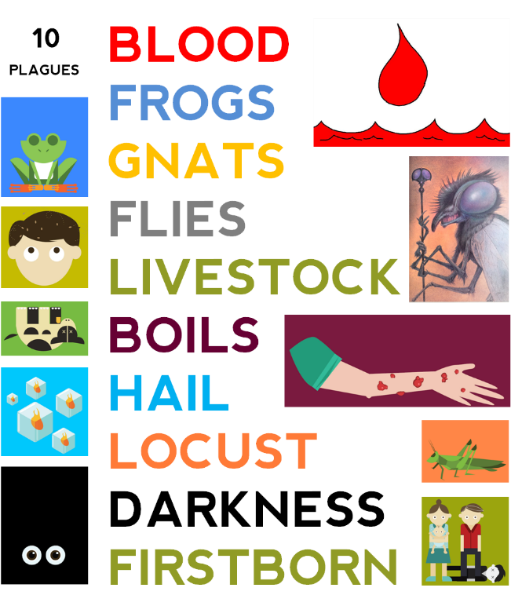
Dig Site 9
Exodus 10:1–11:10
Egypt
is Ruined!

Slide 2






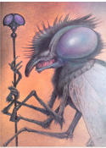


Previously on
The Ten Plagues
God sent Moses to tell Pharoah to let God’s people go into the dessert for three days so they could worship him. Pharoah hardened his heart against God and refused to listen. Moses repeatedly warned Pharoah that bad things would happen if he did not listen but Pharoah did not care. So, God started sending plagues on Egypt to change Pharoah’s mind. First, He changed all the water in Egypt to blood. Second, he sent frogs EVERYWHERE. Third, came gnats (little insects to really bug the Egyptians). Next, God upped the game by sending flies. God did all of this to get Pharoah to listen and let His people go. But Pharoah absolutely refused. So, God killed off the Egyptian livestock, infected the Egyptians with boils, and sent a hailstorm the likes of which had never been seen in Egypt before. But none of these plagues touched the land of Goshen where the Israelites lived. God protected His people.

Slide 3
Memory verse
Exodus 15:6
Your right hand, Lord,
was majestic in power.
Your right hand, Lord,
shattered the enemy.

Slide 4

The Plague of Locusts (#8)

Slide 5

Then the LORD said to Moses
Exodus 10:1-2

Slide 6
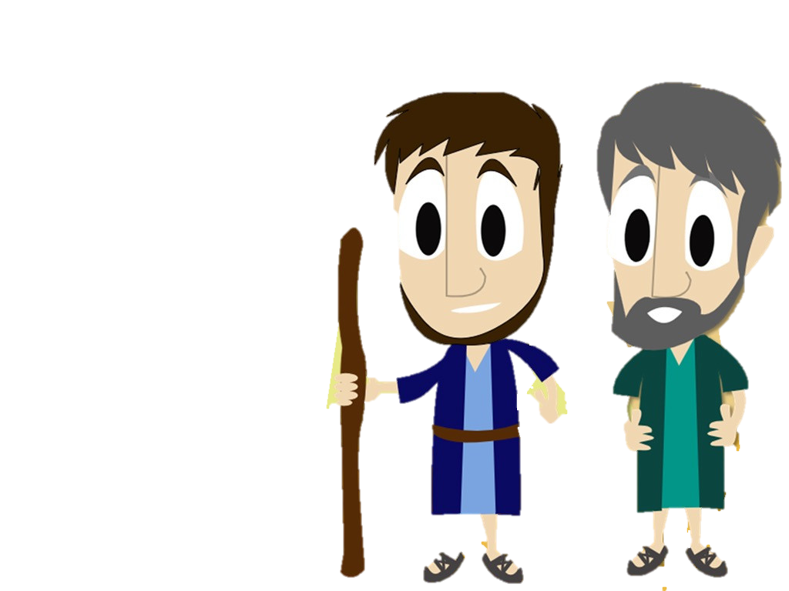
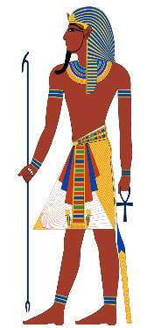
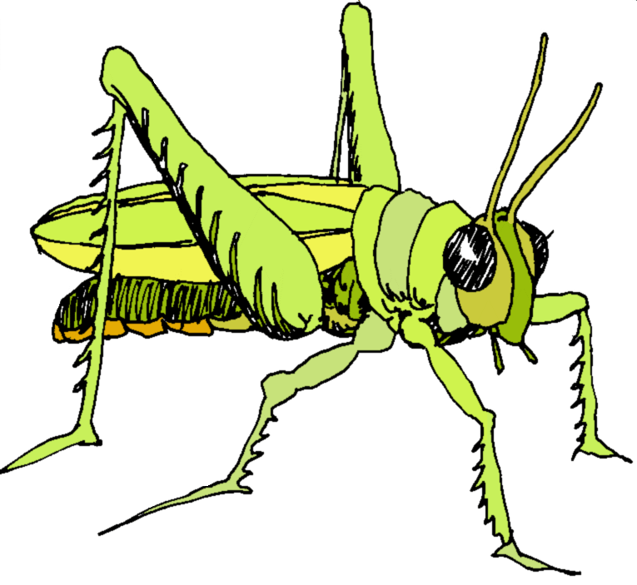
So Moses and Aaron went
to Pharaoh and said to him,
Exodus 10:3

Slide 7
So Moses and Aaron went
to Pharaoh and said to him,
Exodus 10:4

Slide 8
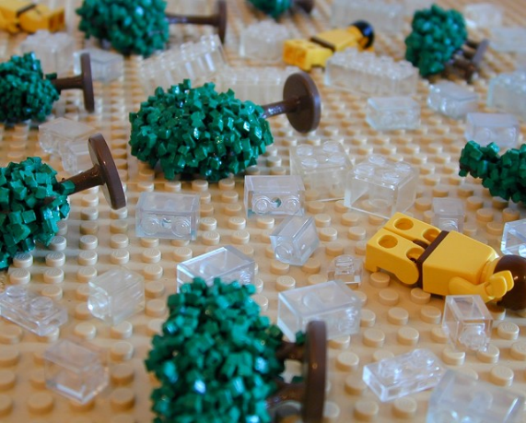
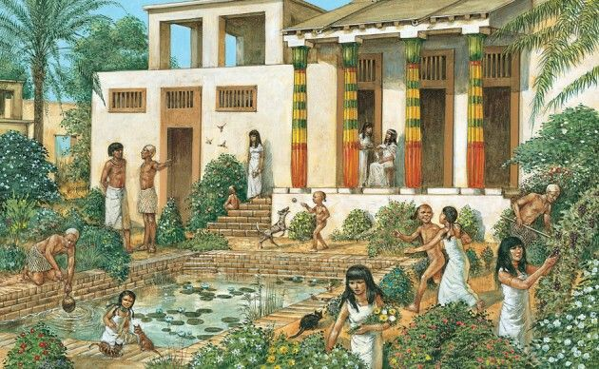
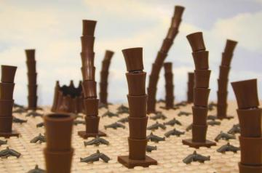
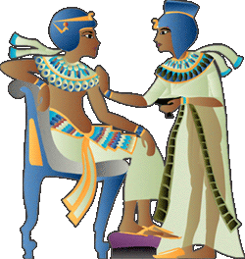
Exodus 10:5-6

Slide 9
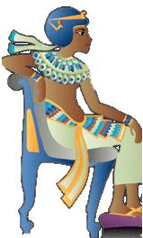
Exodus 10:7

Slide 10

Exodus 10:8
?

Slide 11
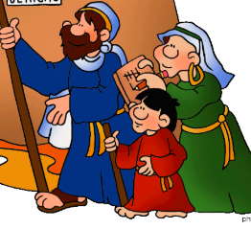
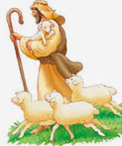

Moses answered,
Exodus 10:9
Notes:
Moses was still too afraid to go to Pharaoh and made the excuse he was not very good at speaking. So God said he should take his brother Aaron with him.

Slide 12

Pharaoh said,
Exodus 10:10
No!
Exodus 10:11a

Slide 13
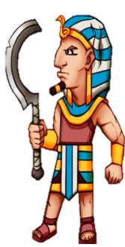
Exodus 10:11b

Slide 14
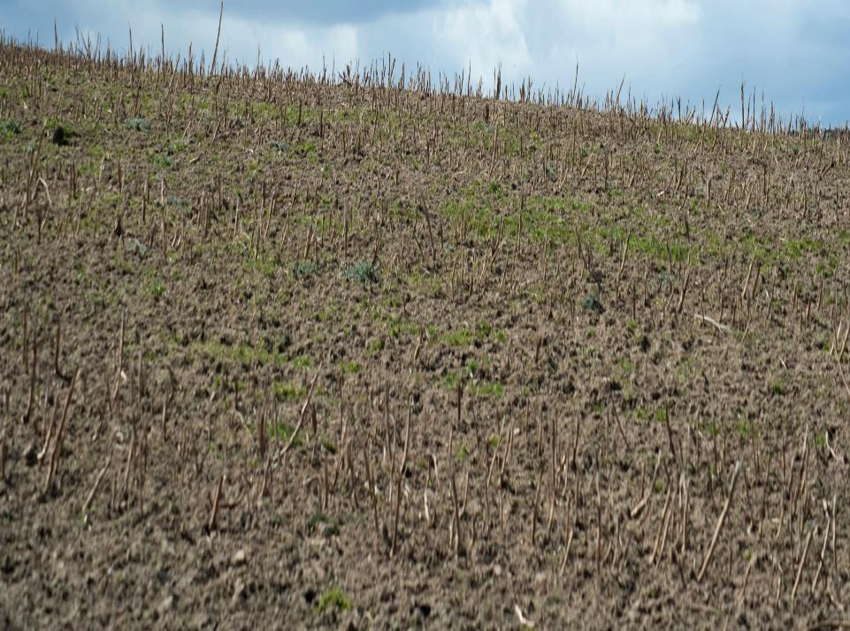
Exodus 10:12

Slide 15
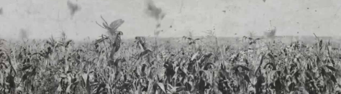
Exodus 10:13-14

Slide 16
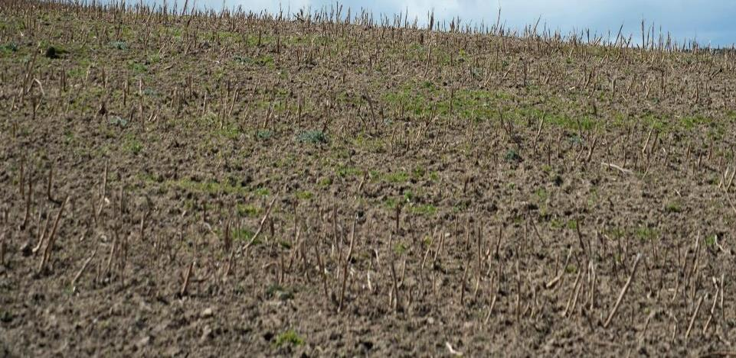

Exodus 10:15
Notes:
Locust: https://www.google.com/search?q=simple+locust+drawing+free&sca_esv=1f9121a7cdf920c7&rlz=1C1HKFL_enUS1228US1228&udm=2&biw=1536&bih=639&sxsrf=APpeQnuBT8_h2q-ZmdZRaJp9SGIP-o9KOQ%3A1789046820814&ei=JLCiasmnMa-hiLMPqsuAwQI&ved=2ahUKEwjJyfbhjuSWAxWvEGIAHaolICgQ4dUDegQIBhAN&uact=5&oq=simple+locust+drawing+free&gs_lp=Egtnd3Mtd2l6LWltZyIac2ltcGxlIGxvY3VzdCBkcmF3aW5nIGZyZWVI7BRQngRYow1wAXgAkAEAmAFWoAHUAqoBATW4AQPIAQD4AQGYAgOgArYBwgIGEAAYHhgKmAMAiAYBkgcBM6AHsAOyBwEyuAevAcIHBTAuMS4yyAcNgAgB&sclient=gws-wiz-img#ip=1&sv=CAMSURoyKhBlLWdkTDYtNjJMWF9xSVdNMg5nZEw2LTYyTFhfcUlXTToOSzRsOXQ2QkNGdWJobU0gBCoXCgFzEhBlLWdkTDYtNjJMWF9xSVdNGAEwARgHIMW85YsFSggQARgBIAEoAQ

Slide 17
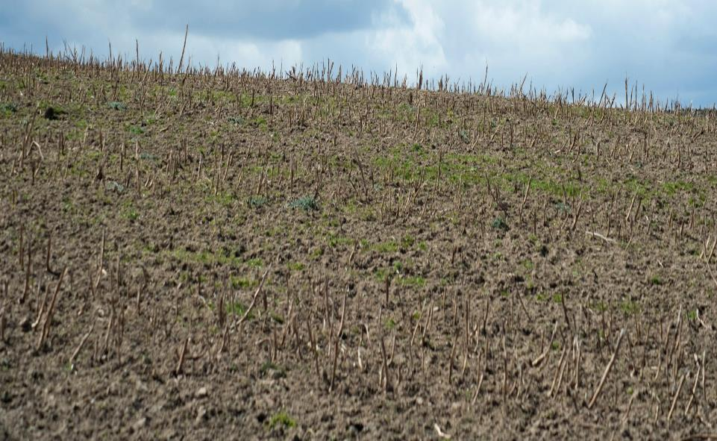

Exodus 10:16-17

Slide 18

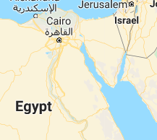
Exodus 10:18-19a

Slide 19

Exodus 10:19b

Slide 20
#9 The Plague of Darkness

Slide 21

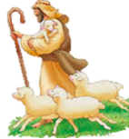
Exodus 10:21-23

Slide 22

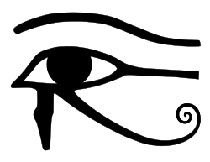

Exodus 10:24
Exodus 10:25-26

Slide 23
Exodus 10:27-28
Exodus 10:29

Slide 24

The Plague of the Firstborn

Slide 25

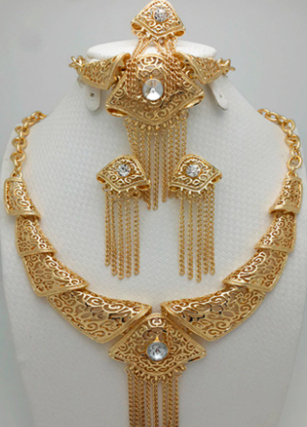



Exodus 11:1-3

Slide 26

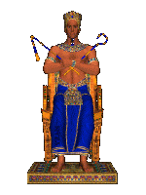
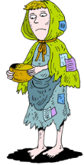

Exodus 11:4-5

Slide 27
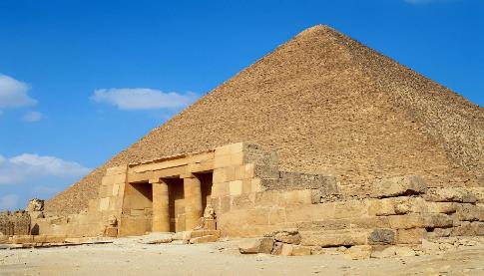


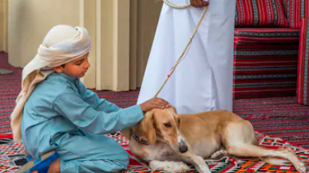
EGYPT
GOSHEN
Exodus 11:6-7

Slide 28
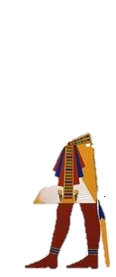
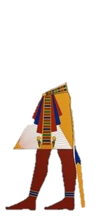
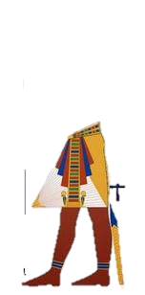
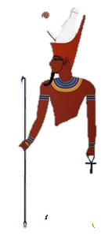
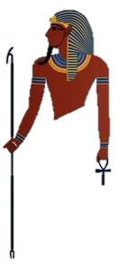
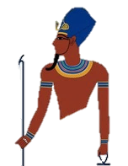
Exodus 11:8

Slide 29

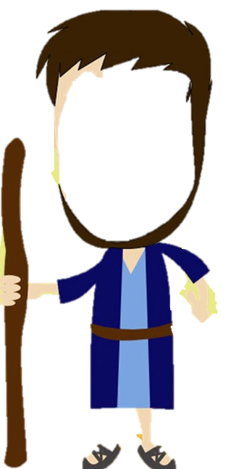






Exodus 11:9-10
Blood
Frogs
Gnats
Flies
livestock
Boils
Hail
Locust
Darkness
firstborn

Slide 30

What can we learn about God?
When we read about the plagues, sometimes it is hard to imagine our loving God would punish people so harshly, especially when people die. However, we can see God's grace and mercy when we realize that He gave Pharaoh chance after chance to listen and obey. He even gave the Egyptians the opportunity to avoid some of the plagues if they followed His instructions. God does love each person, but He is also a God of justice. Sometimes that means people suffer consequences that are not pleasant, but He also gives people plenty of chances to ask for forgiveness and worship Him. (That does not mean all bad things that happen to someone are because they sinned.) As we will soon see, it took a lot of death and destruction for Pharaoh to finally admit that Yahweh was more powerful than he was and to set the Israelites free.

