Slide 1
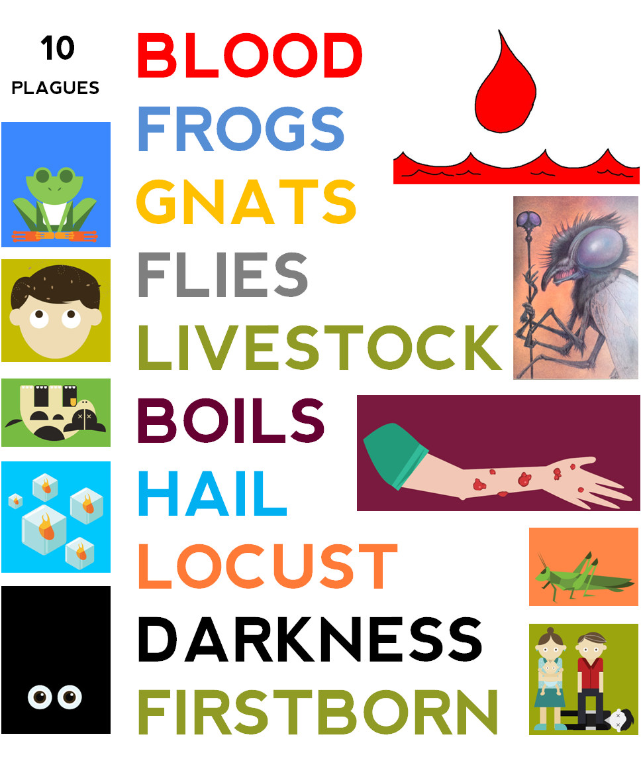
Dig Site #8
The Ten Plagues (5-7)
Livestock, Boils, and Hail
Exodus 9:1-35

Slide 2



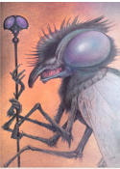


Previously on
The Ten Plagues
God told sent Moses to tell Pharoah to let God’s people go into the dessert for three days so they could worship him. Pharoah hardened his heart against God and refused to listen. Moses repeatedly warned Pharoah that bad things would happen if he did not listen, but Pharoah did not care. So, God started sending plagues on Egypt to change Pharoah’s mind. First, He changed all the water in Egypt to blood. Second, he sent frogs EVERYWHERE. Third, came gnats (little insects to really bug the Egyptians). Next, God upped the game by sending flies. God did all of this to get Pharoah to listen and let His people go. But Pharoah absolutely refused.

Slide 3
Memory Verse
A person may think their own ways are right,
but the Lord weighs
the heart.
Proverbs 21:2

Slide 4
Read Exodus 9:1

Slide 5






Exodus 9:2-3

Slide 6












Exodus 9:4
Egyptian
Israelite

Slide 7


Exodus 9:5

Slide 8
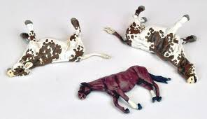
Exodus 9:6-7a
Egyptian
Israelite

Slide 9

Exodus 9:7b

Slide 10
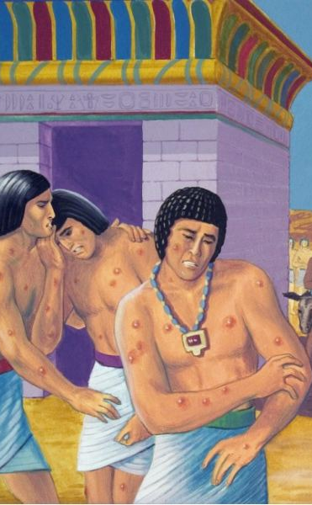
The Plague of Boils

Slide 11
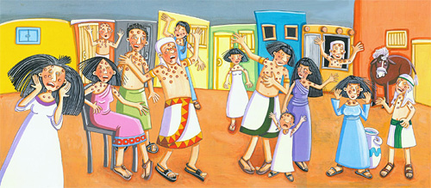
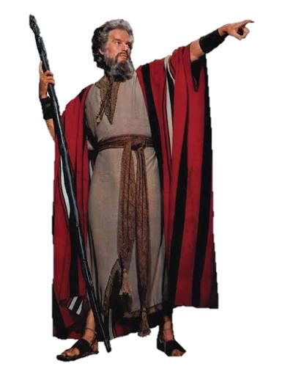
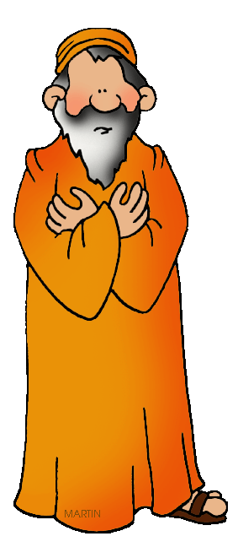
Exodus 8-10
Notes:
https://www.pngkey.com/detail/u2e6a9t4q8o0t4q8_charlton-heston-moses-staff/ (moses)

Slide 12

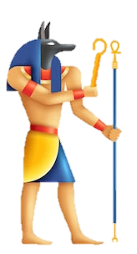
Exodus 9:11

Slide 13
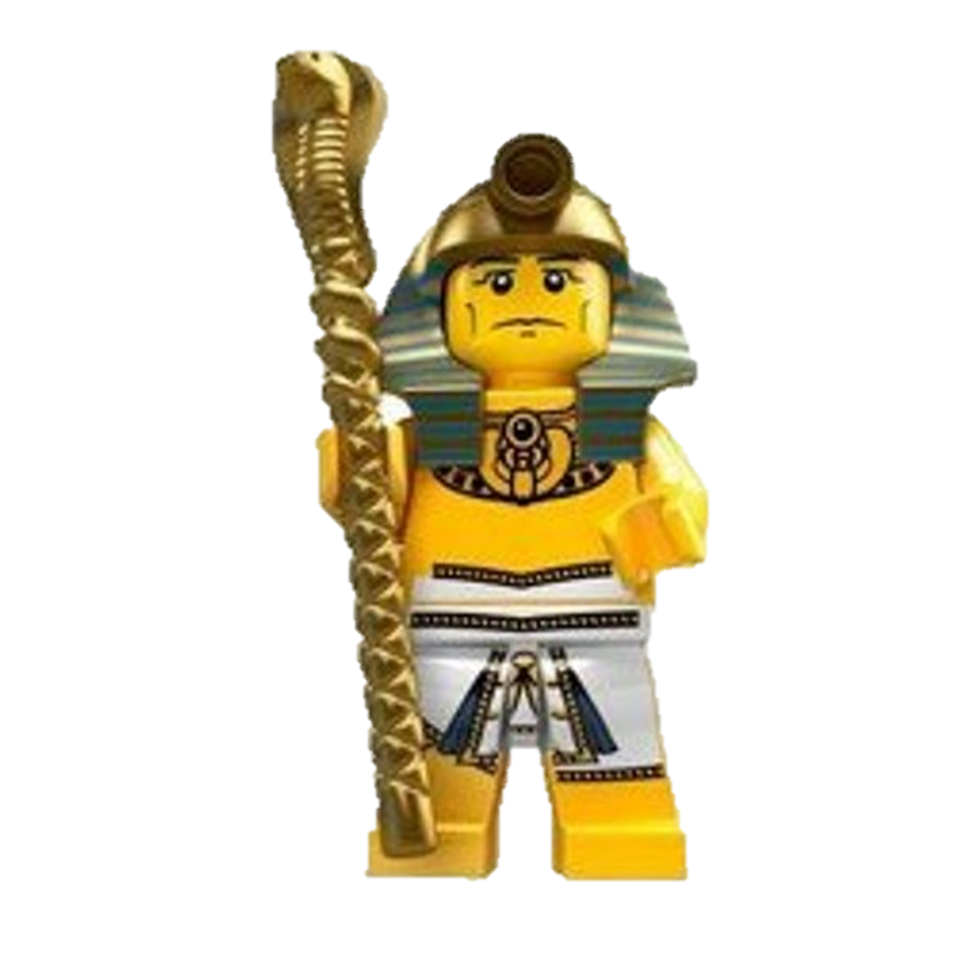

Exodus 9:12

Slide 14
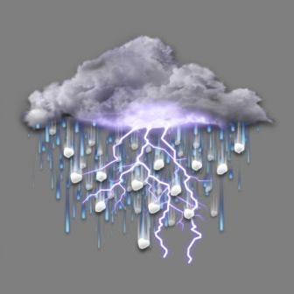
The Plague of Hail

Slide 15

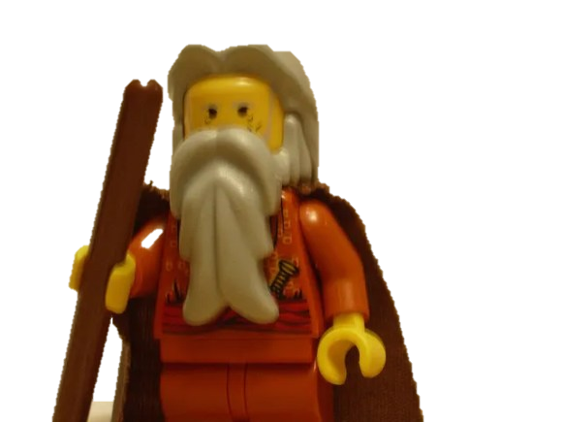
Then the LORD said to Moses,
Exodus 9:13-14

Slide 16

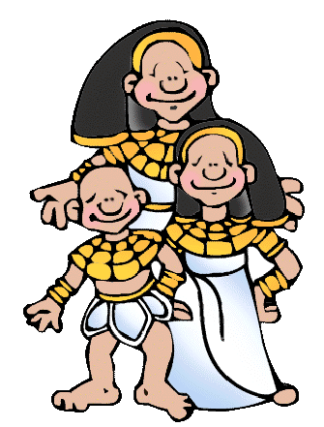
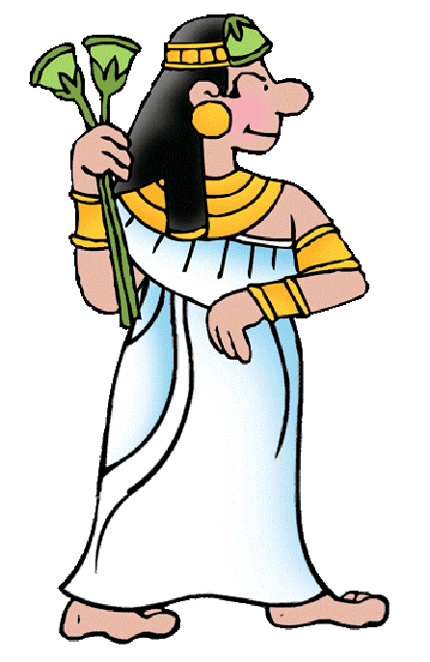


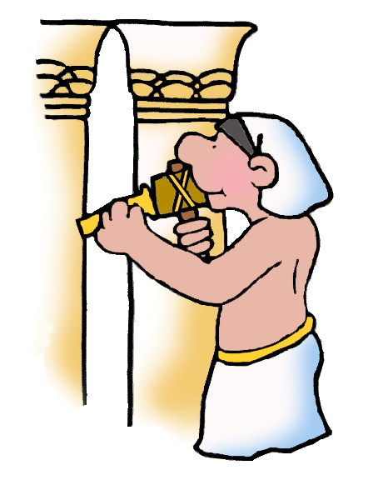
Exodus 9:15

Slide 17
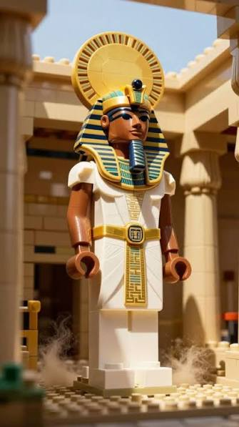
Exodus 9:16-17

Slide 18

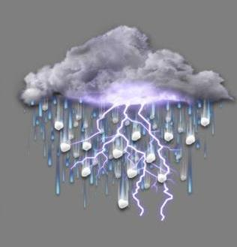

Exodus 9:18

Slide 19






Exodus 9:19

Slide 20
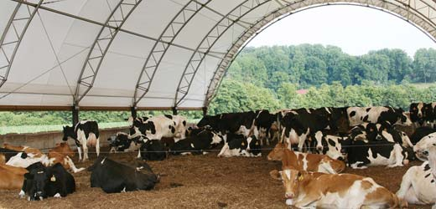
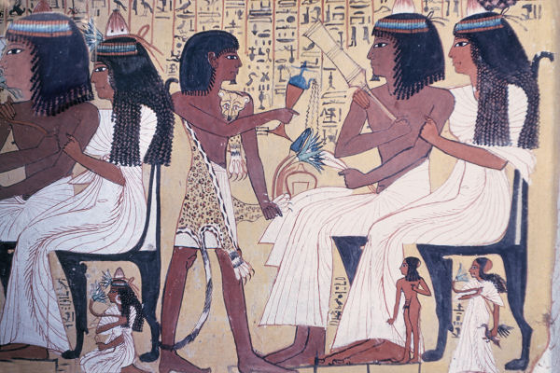
Exodus 9:20-21

Slide 21

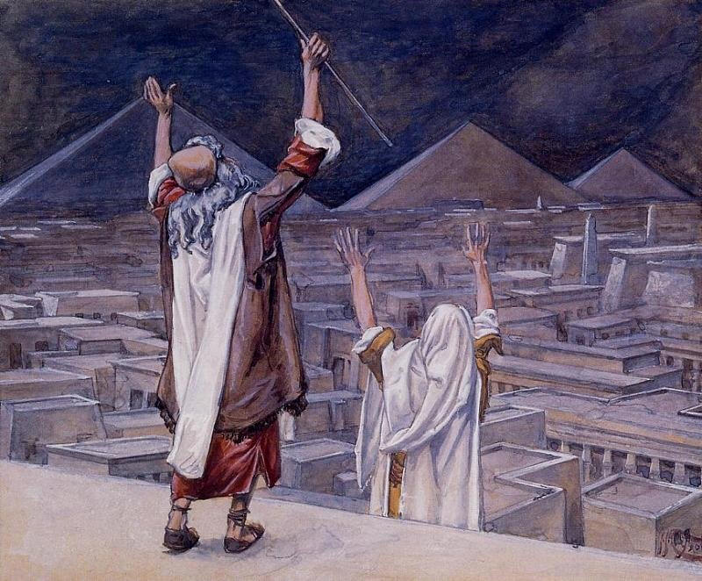
Exodus 9:22
Then the LORD
said to Moses,

Slide 22
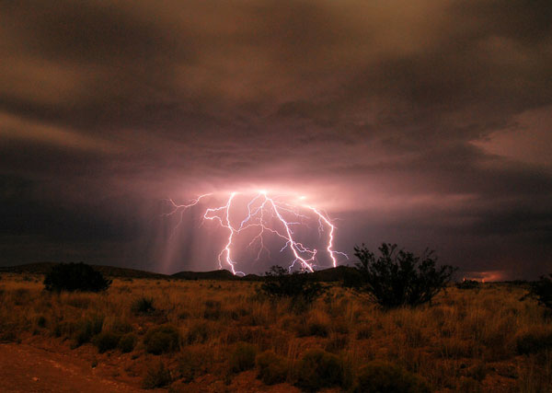
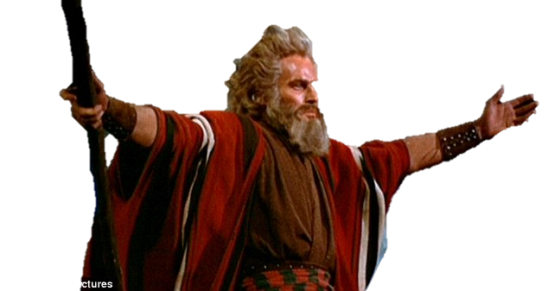
Exodus 9:23-24
Notes:
Moses: http://i.dailymail.co.uk/i/pix/2010/09/22/article-1313946-0B4A70CC000005DC-965_634x337.jpg

Slide 23
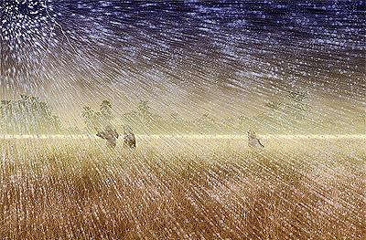
Exodus 9:25

Slide 24
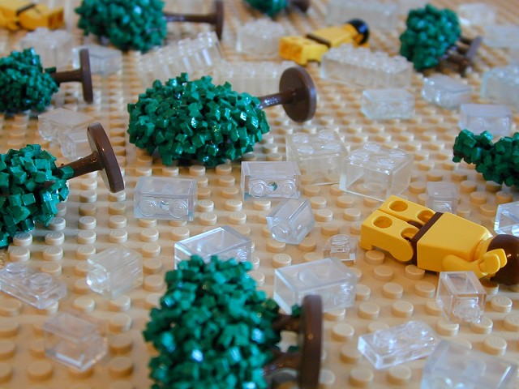
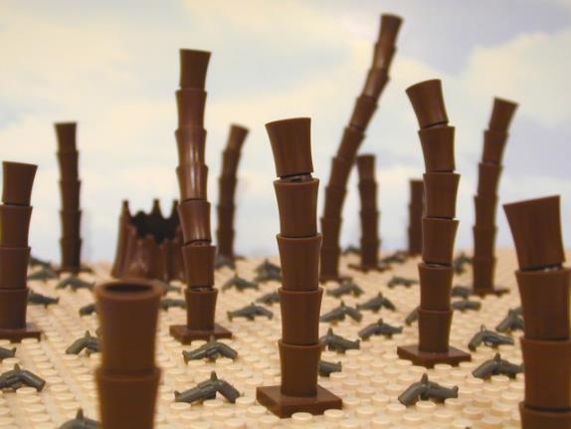
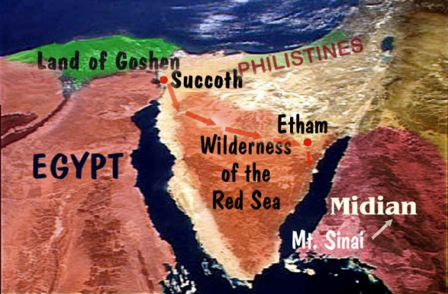
Exodus 9:26

Slide 25
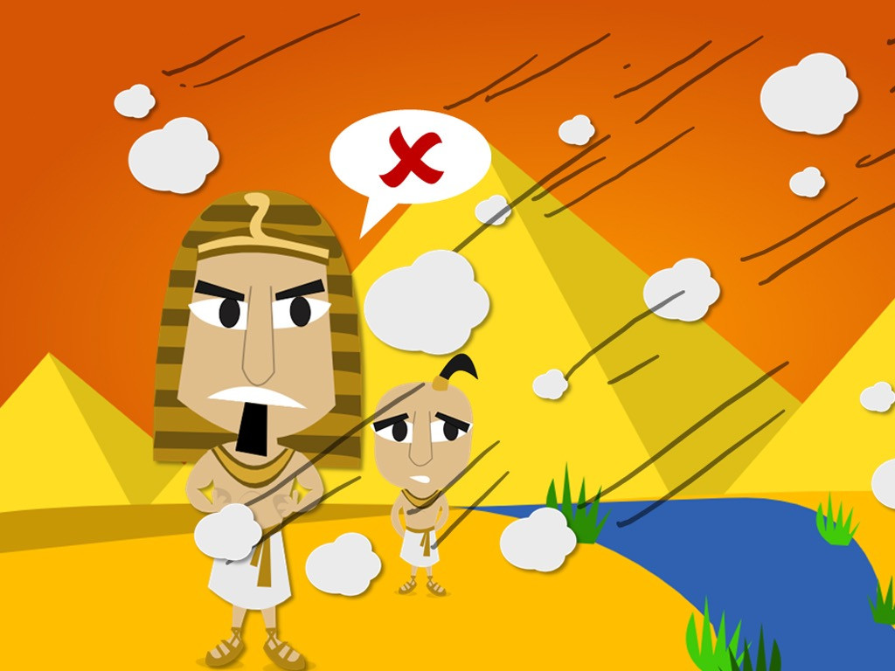
Then Pharaoh summoned Moses and Aaron.
Exodus 9:27-28

Slide 26
Moses replied,
Exodus 9:29-30

Slide 27
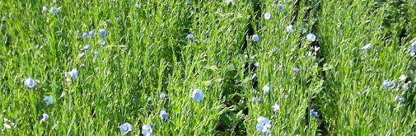
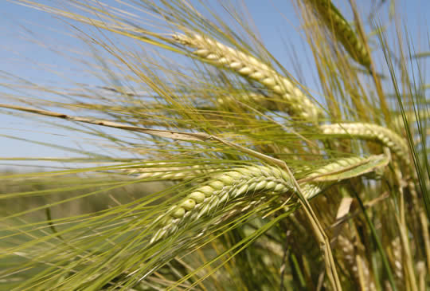

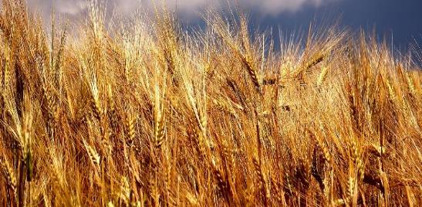
Exodus 9:31-32

Slide 28
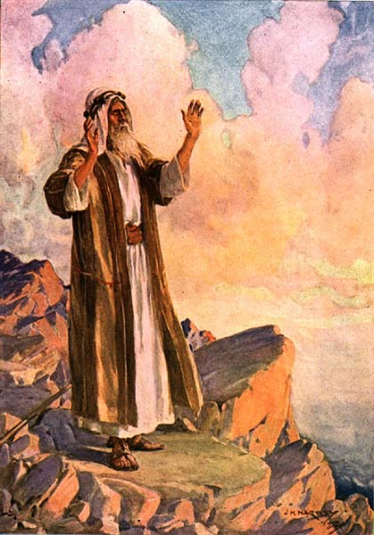
Exodus
9:33

Slide 29
Exodus
9:34-35

