Slide 1

Exodus Lesson #7
Exodus 7:25 – 8:32
Frogs, Gnats
and Flies...
Oh My!

Slide 2
Memory Verse
Know that the Lord has set apart his faithful servant for himself; the Lord hears when I call to him.
Psalm 4:3
#7

Slide 3
The Plague of Frogs
Exodus 7:25-8:15

Slide 4
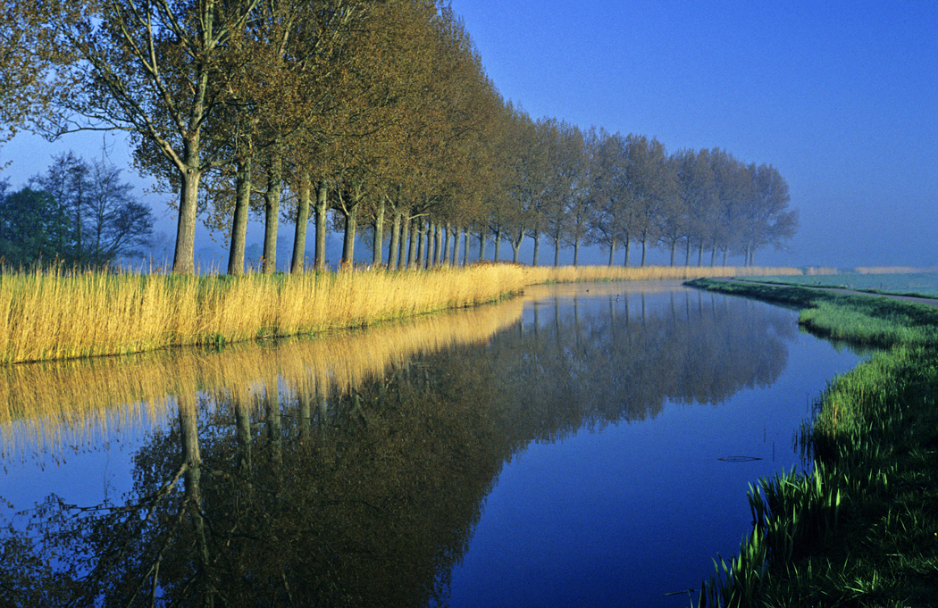
Read Exodus 7:29

Slide 5


Read
Exodus 8:1-2

Slide 6
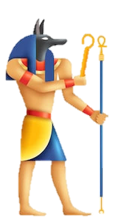

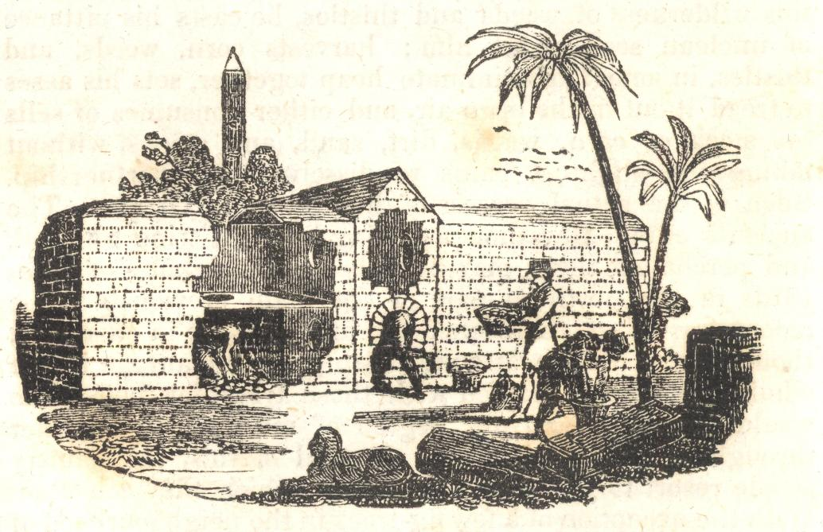
Read Exodus 8:3-4

Slide 7


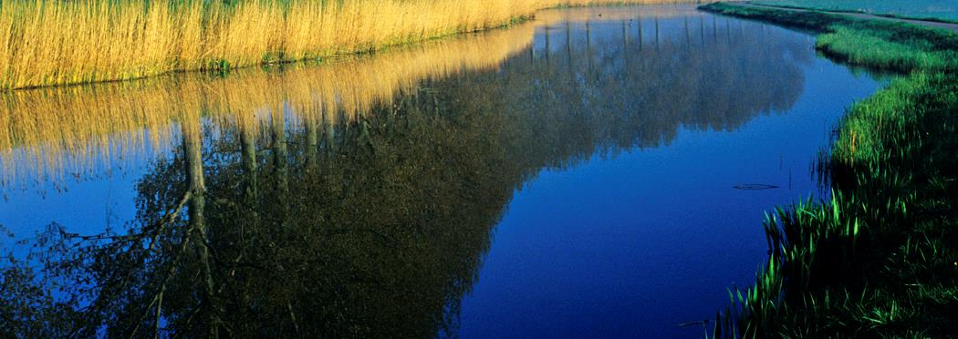
Read
Exodus 8:5
Read Exodus 8:6

Slide 8
Read Exodus 8:7

Slide 9
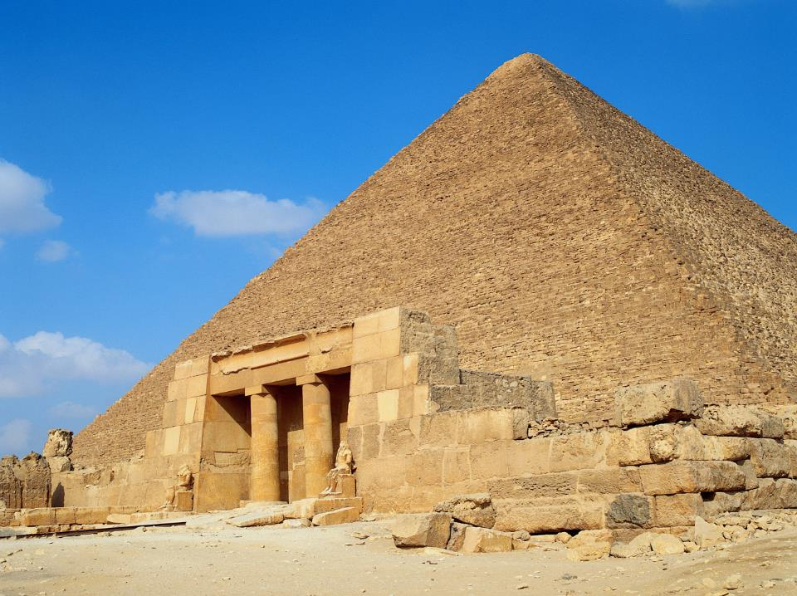


Read
Exodus 8:8

Slide 10
Read
Exodus 8:9

Slide 11
Tomorrow
Read
Exodus 8:10-11
Pharaoh said.

Slide 12


Read Exodus 8:12

Slide 13


Read Exodus 8:13-15

Slide 14
The Plague of Gnats
Exodus 8:16-19

Slide 15


Read Exodus 8:16-17

Slide 16
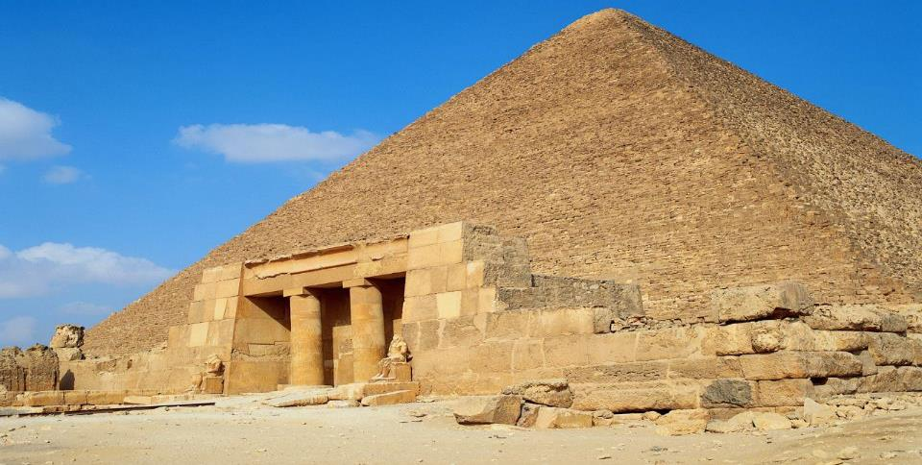
Read Exodus 8:18

Slide 17

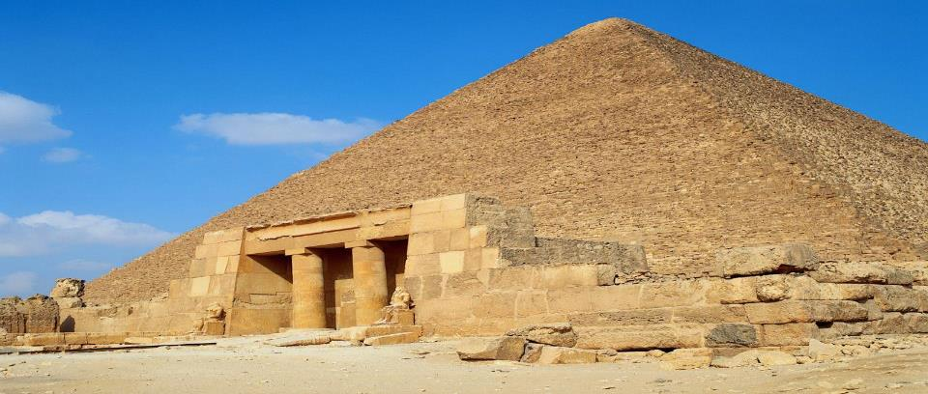
Read Exodus 8:19
This is the finger of God. *

Slide 18
The Plague of Flies
Exodus 8:20-32

Slide 19
Read Exodus 20-21

Slide 20
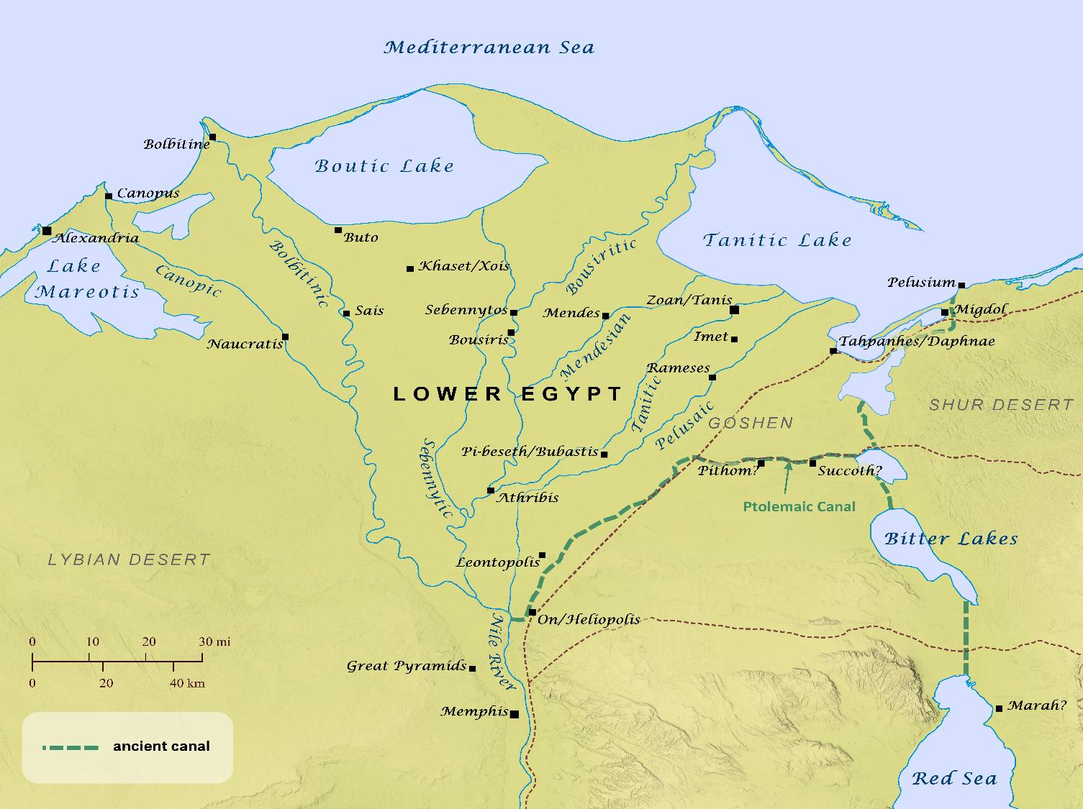
Read
Exodus 8:22-23
Goshen
Remember in Genesis, when Joseph’s family moved to Egypt, they settled in Goshen. They were still living there 400 years later.
Notes:
Maphttps://biblemapper.com/blog/images/hi-res/LowerEgypt_high.jpg

Slide 21
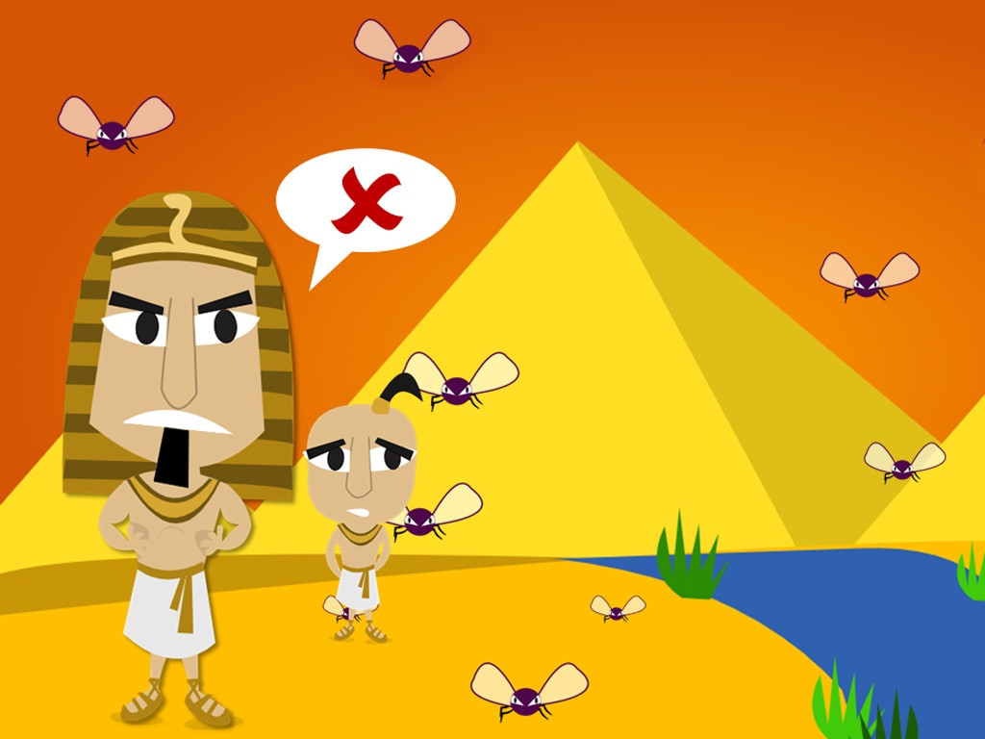
Read Exodus 8:24
SHOO, fly! Don’t bother me!
This is, like, the fourth plague

Slide 22
Read Exodus 8:25

Slide 23

Read
Exodus 8:26-27

Slide 24
Read Exodus 8:28
Fine!

Slide 25
Read
Exodus 8:29

Slide 26
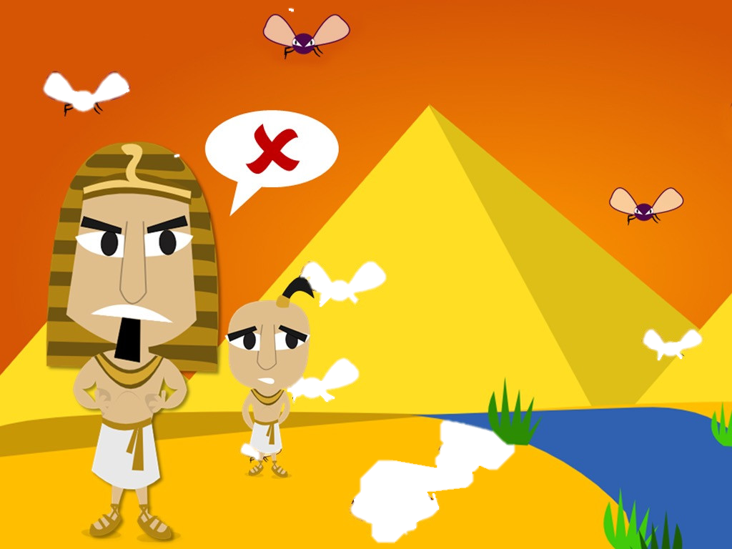
Read
Exodus 8:30-31
Phew!
Bye, bye, Flies!

Slide 27
Read
Exodus 8:30-31
Read Exodus 8:32

