Slide 1
Exodus Dig Site 5

Slide 2
Moses and Aaron went to Pharaoh and gave him a message from God. What was it?
Stomp your feet for:
Clap your hands for:
Hum or whistle for:
“My people are hungry. Let them go to the hills to hunt for food.”
“Let my people go, so that they may hold a festival to me in the wilderness.”
“Stop forcing my people to work for you!”

Slide 3
Moses and Aaron went to Pharaoh and gave him a message from God. What was it?
Clap your hands for:
“Let my people go, so that they may hold a festival to me in the wilderness.”

Slide 4


Did Pharaoh let the people go?

Slide 5
Did Pharaoh let the people go?
No! Pharaoh said, “I do not know the Lord and I will not let Israel go.”

Slide 6
Moses and Aaron again told Pharaoh that their God had met with them and asked Pharaoh to let them take a 3 day journey into the wilderness to do what?
Stand up for:
Sit down for:
Offer sacrifices to God
Rest and recover from their work

Slide 7
Moses and Aaron again told Pharaoh that their God had met with them and asked Pharaoh to let them take a 3 day journey into the wilderness to do what?
Stand up for:
Offer sacrifices to God

Slide 8
Did Pharaoh let the people go?

Slide 9
Did Pharaoh let the people go?
No! Pharaoh said, “Moses and Aaron, why are you taking the people away from their labor? Get back to your work!”

Slide 10
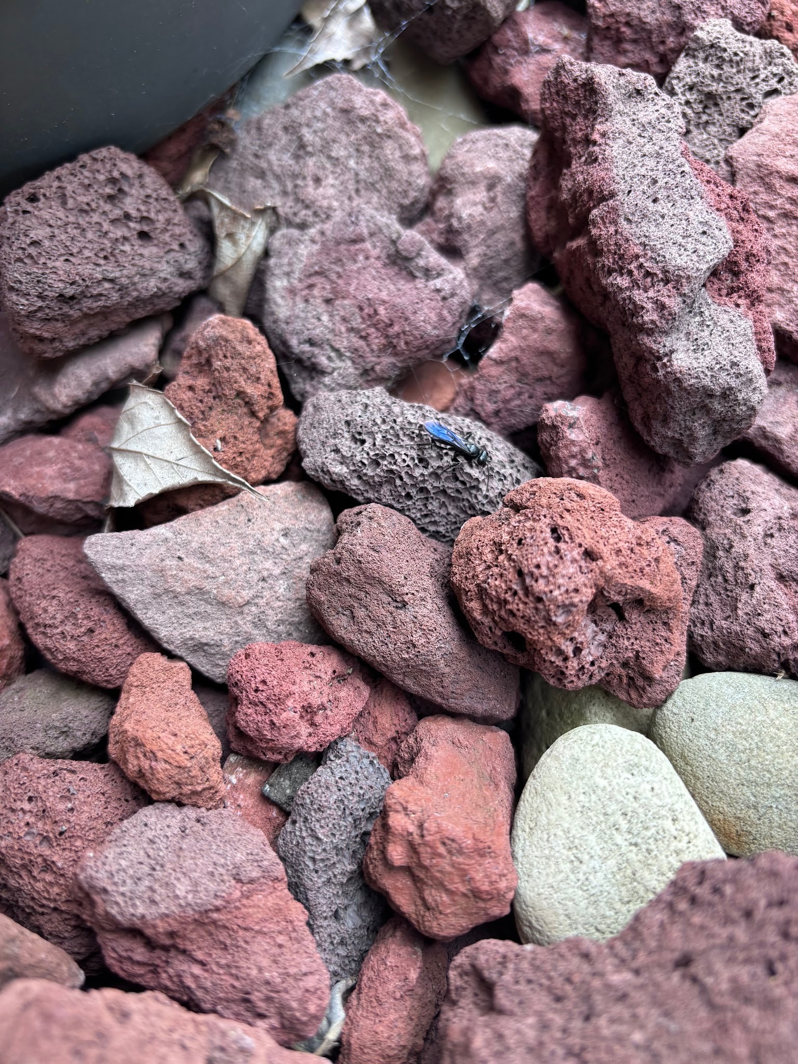
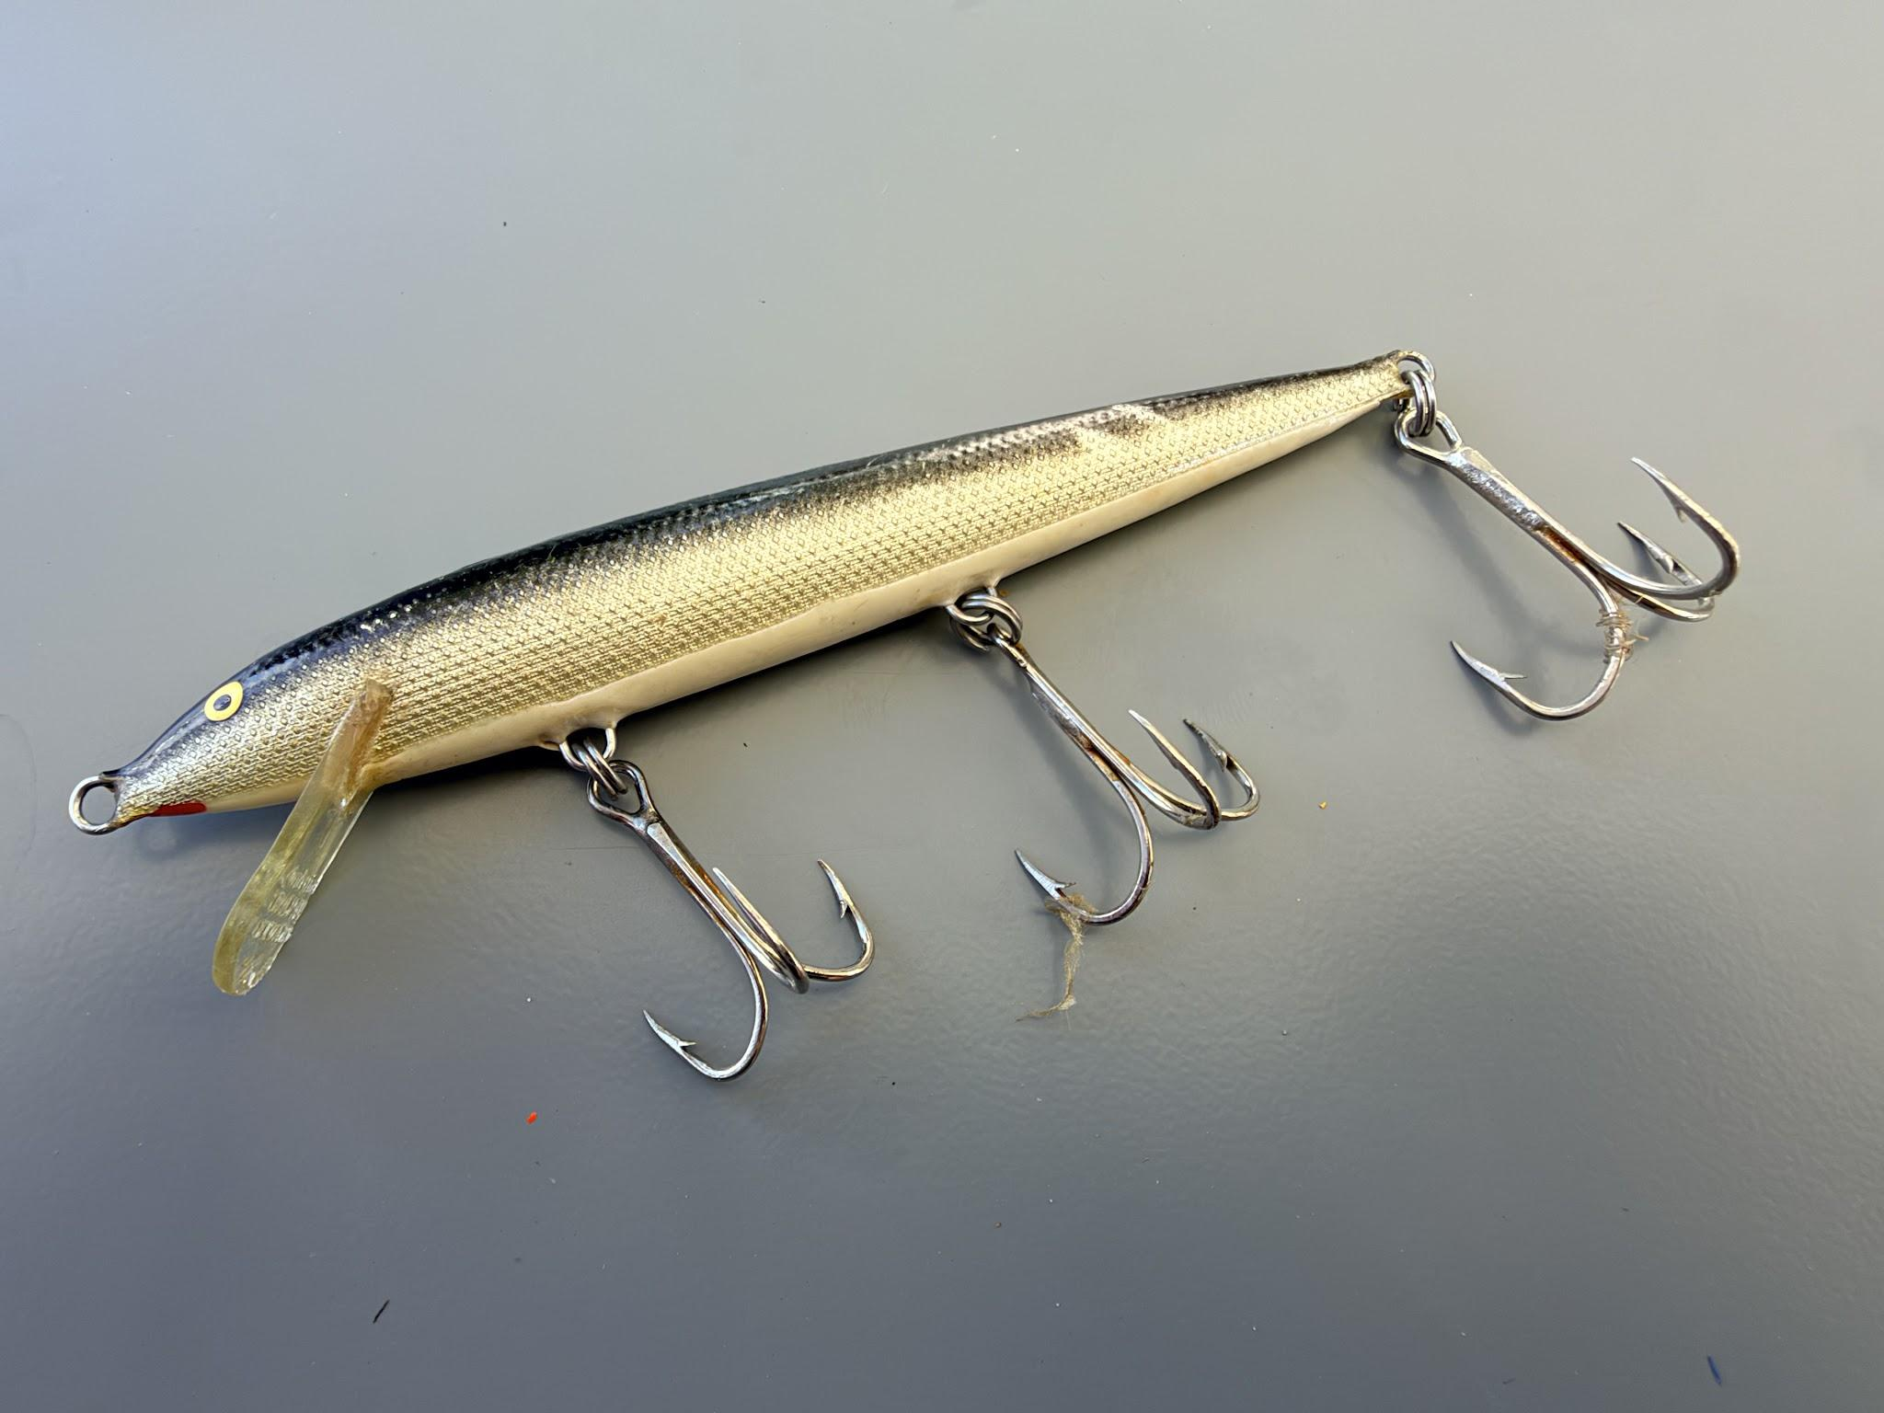
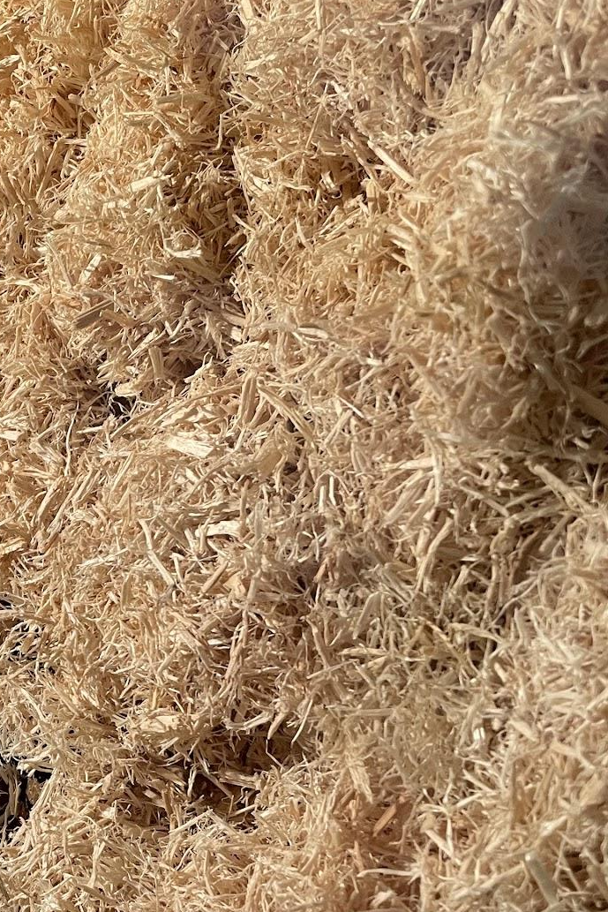
Pharaoh was not happy after Moses and Aaron talked to him, so he told the slave drivers not to give the people what?
Paper for:
Rock for:
Scissors for:

Slide 11
Pharaoh was not happy after Moses and Aaron talked to him, so he told the slave drivers not to give the people what?
Paper for:
They were not to give the people straw for making bricks. They had to gather their own.

Slide 12
How many bricks would the people be expected to make?
Jump up for:
Squat down for:
Stand straight for:
More than before
Less than before
The same amount as before

Slide 13
How many bricks would the people be expected to make?
Stand straight for:
The same amount as before

Slide 14
The people scattered all over and gathered stubble to use in place of straw to make bricks. Were they able to make the same number as before?

Slide 15
The people scattered all over and gathered stubble to use in place of straw to make bricks. Were they able to make the same number as before?
The slave drivers kept pressuring the people to complete the same work, but they weren’t able to do it.

Slide 16
The Israelite overseers were beaten and asked why the people had not met the quota of bricks for the last 2 days. What did they reply?
Jumping jacks for:
Toe touches for:
Spin around for:
Stop hitting us when there’s nothing else we can do.
The bricks will not form without full pieces of straw.
Your servants are being beaten, but the fault is with your own people.

Slide 17
The Israelite overseers were beaten and asked why the people had not met the quota of bricks for the last 2 days. What did they reply?
Spin around for:
Your servants are being beaten, but the fault is with your own people.

Slide 18
Did Pharaoh have compassion on them?

Slide 19
Did Pharaoh have compassion on them?
No! He called them lazy and said they’d better get to work and produce their full quota of bricks.

Slide 20
Who was waiting to meet with the overseers after they left Pharaoh?
Stand on 1 foot for:
High five a friend for:
The slave drivers
Moses and Aaron

Slide 21
Who was waiting to meet with the overseers after they left Pharaoh?
High five a friend for:
The overseers were upset that Moses and Aaron had gone to Pharaoh and said that they had made the Israelites obnoxious to Pharaoh and his officials.
Moses and Aaron

Slide 22
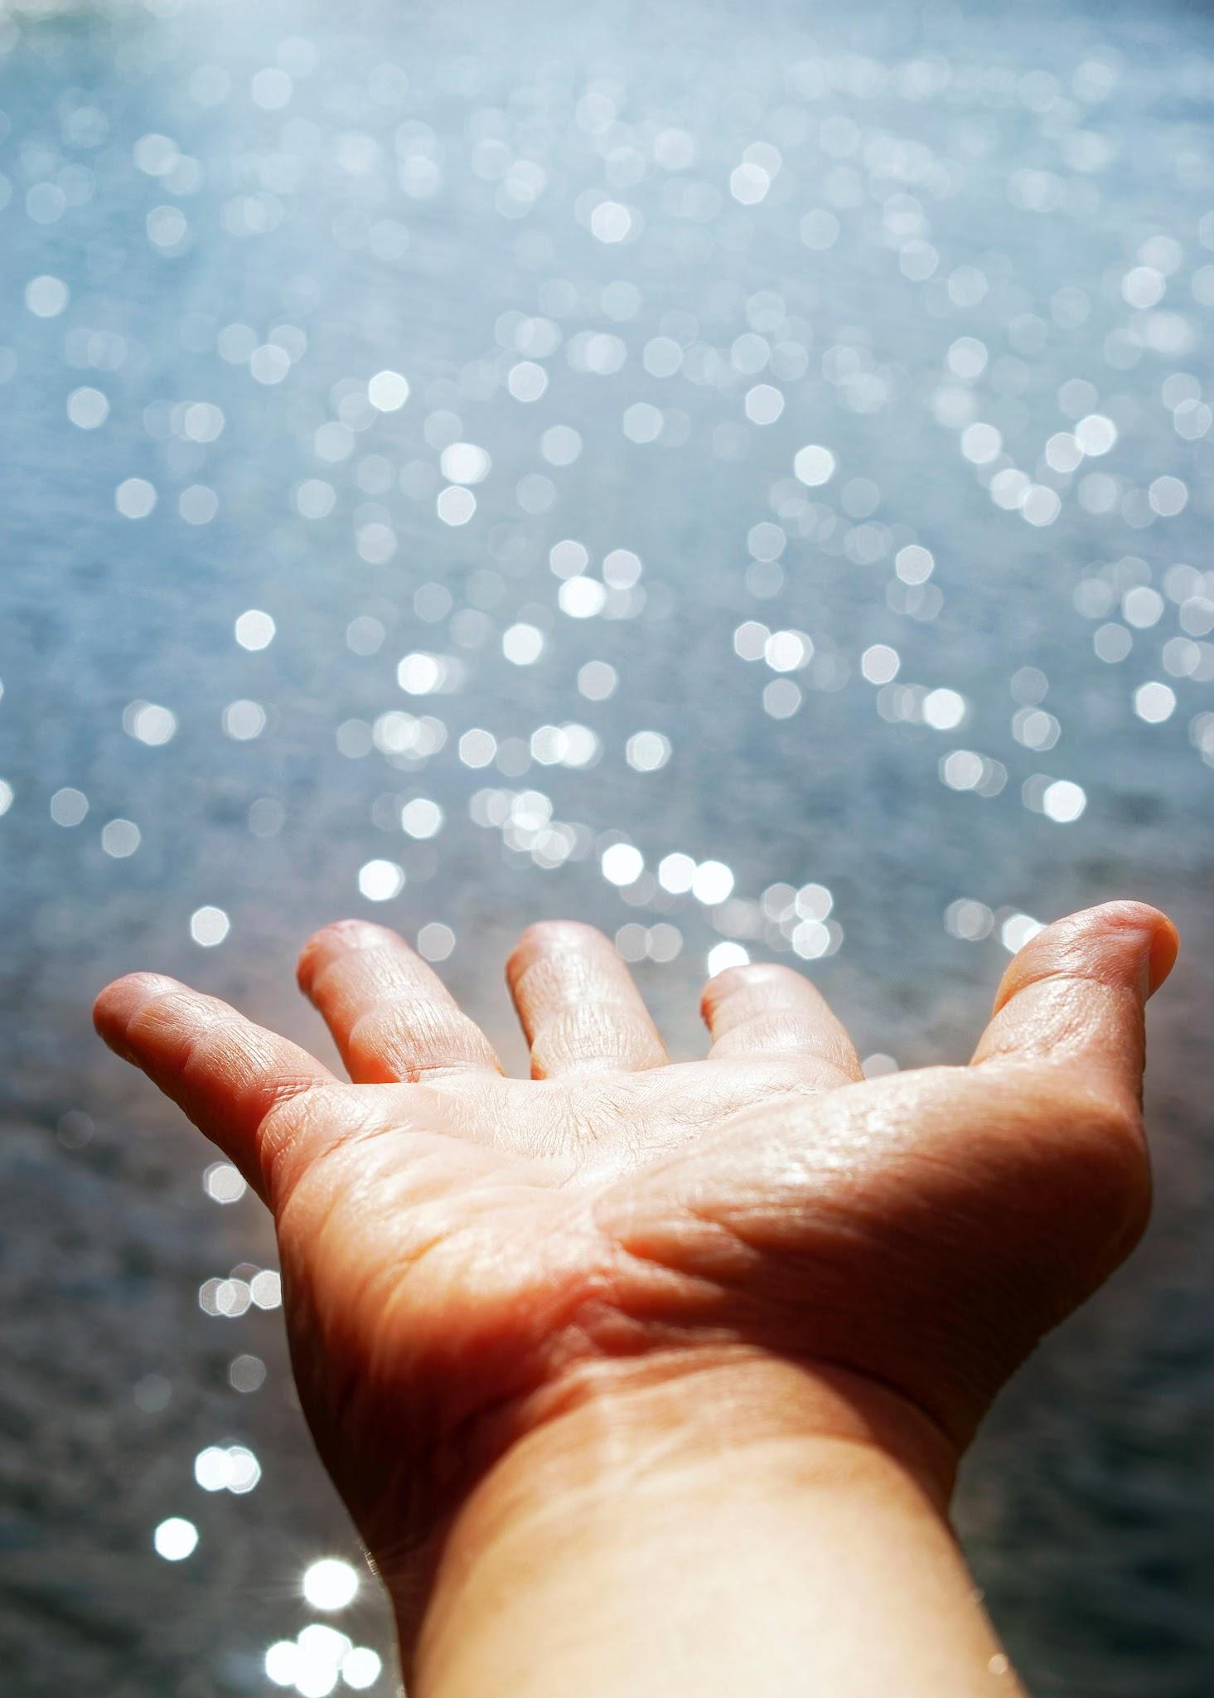
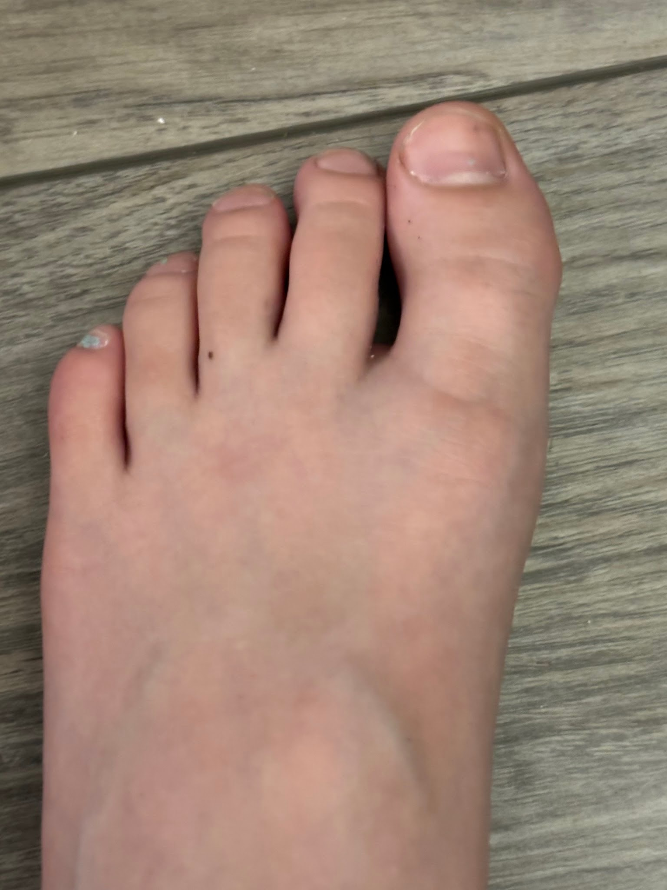
Moses cried out to God asking him why he had brought trouble on the people. God said, “Now you will see what I will do to Pharaoh. Because of my mighty ______ he will let them go; because of my mighty ______ he will drive them out of his country.”
Shout out the word that fills both blanks!

Slide 23
Moses cried out to God asking him why he had brought trouble on the people. God said, “Now you will see what I will do to Pharaoh. Because of my mighty ______ he will let them go; because of my mighty ______ he will drive them out of his country.”
HAND
HAND

Slide 24
Next, God reminded Moses of the things He had done for the Israelites. He said,
“I am the Lord. I appeared to Abraham, to _____
Shout out the words as we come to the blanks!

Slide 25
Next, God reminded Moses of the things He had done for the Israelites. He said,
“I am the Lord. I appeared to Abraham, to _____, and to _____
Shout out the words as we come to the blanks!
ISAAC

Slide 26
Next, God reminded Moses of the things He had done for the Israelites. He said,
“I am the Lord. I appeared to Abraham, to _____, and to _____ as God Almighty, but by my name the Lord, I did not make myself fully _____
Shout out the words as we come to the blanks!
ISAAC
JACOB

Slide 27
Next, God reminded Moses of the things He had done for the Israelites. He said,
“I am the Lord. I appeared to Abraham, to _____, and to _____ as God Almighty, but by my name the Lord, I did not make myself fully _____ to them. I also established my ________ with them
Shout out the words as we come to the blanks!
ISAAC
JACOB
KNOWN

Slide 28
Next, God reminded Moses of the things He had done for the Israelites. He said,
“I am the Lord. I appeared to Abraham, to _____, and to _____ as God Almighty, but by my name the Lord, I did not make myself fully _____ to them. I also established my ________ with them to give them the land of ______
Shout out the words as we come to the blanks!
ISAAC
JACOB
KNOWN
COVENANT

Slide 29
Next, God reminded Moses of the things He had done for the Israelites. He said,
“I am the Lord. I appeared to Abraham, to _____, and to _____ as God Almighty, but by my name the Lord, I did not make myself fully _____ to them. I also established my ________ with them to give them the land of ______ where they reside as foreigners.
Shout out the words as we come to the blanks!
ISAAC
JACOB
KNOWN
COVENANT
CANNAN

Slide 30
“Moreover, I have heard the _______ of the Israelites

Slide 31
“Moreover, I have heard the _______ of the Israelites whom the Egyptians are enslaving, and I have ___________ my covenant.
GROANING

Slide 32
“Moreover, I have heard the _______ of the Israelites whom the Egyptians are enslaving, and I have _________ my covenant.”
God said that he would free the Israelites from being what to the Egyptians? Shout it out!
GROANING
REMEMBERED
Enemies?
Friends?
Slaves?
Teachers?

Slide 33
God said that he would free the Israelites from being what to the Egyptians? Shout it out!
Slaves - God said he would redeem them with an outstretched hand and mighty acts of judgement.

Slide 34
God was going to take the Israelites as his own people and be their God. Then what was he going to do for the Israelites?
One hand up for:
Two hands up for:
Bring them to the land he swore to Abraham, Isaac and Jacob
Make them official Egyptians with the same rights as other Egyptians

Slide 35
God was going to take the Israelites as his own people and be their God. Then what was he going to do for the Israelites?
One hand up for:
Bring them to the land he swore to Abraham, Isaac and Jacob

Slide 36
When Moses told the Israelites all this, did they believe him?

Slide 37
When Moses told the Israelites all this, did they believe him?
They did not listen to him because of their discouragement and harsh labor.

