Slide 1
Exodus Dig Site 4

Slide 2
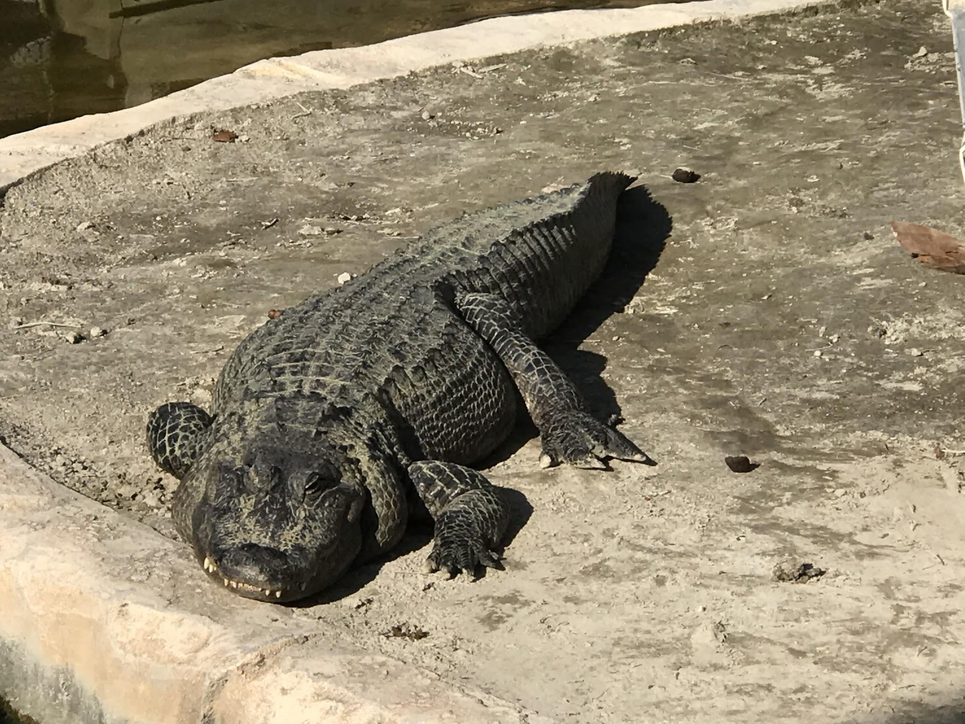
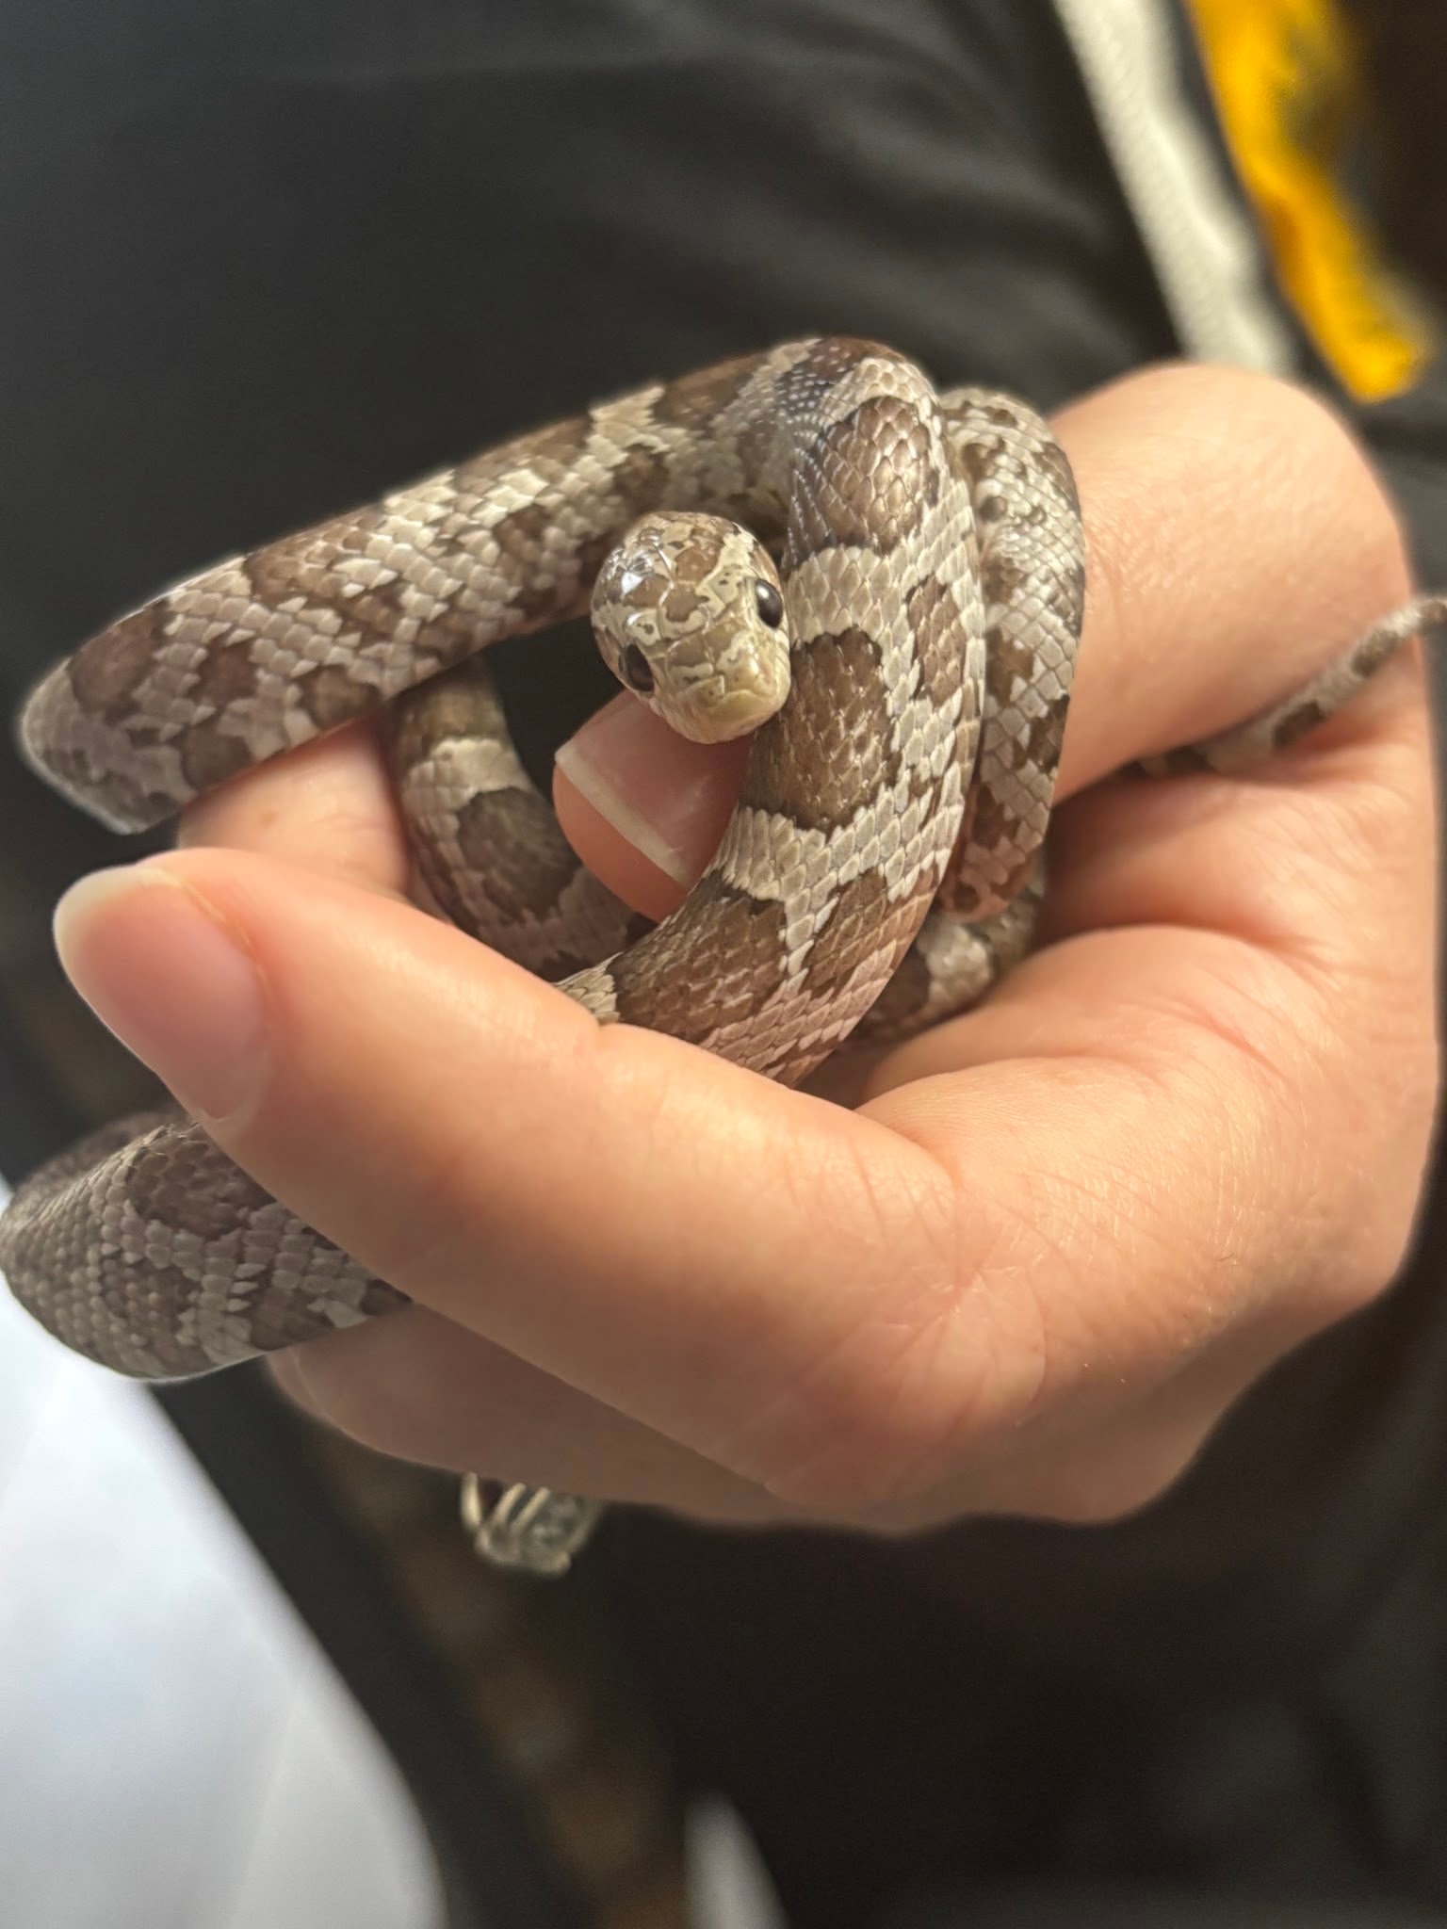
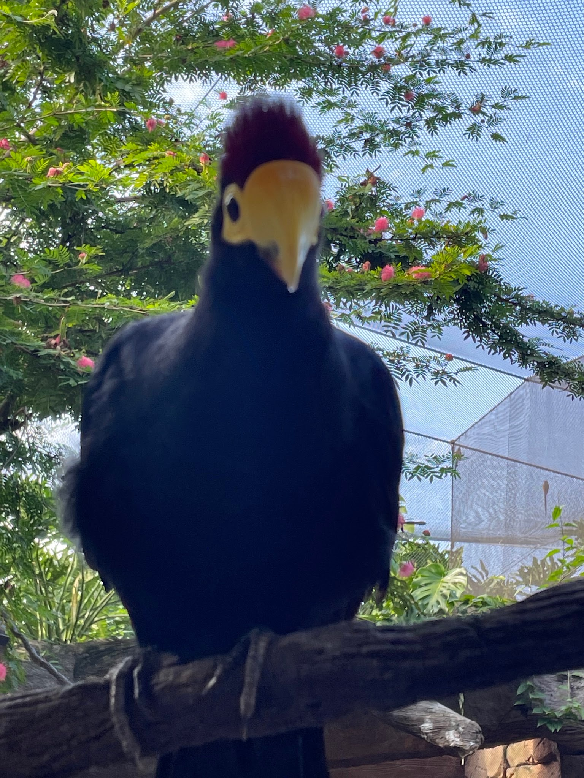
Moses asked God what he should do if the people don’t listen to him and God told him to throw his staff down. What would it become?
Stomp your feet for:
Clap your hands for:
Jump up and down for:

Slide 3
Moses asked God what he should do if the people don’t listen to him and God told him to throw his staff down. What would it become?
Clap your hands for:
Moses’ staff turned into a snake!

Slide 4


Did Moses grab the snake?

Slide 5
Did Moses grab the snake?

Slide 6
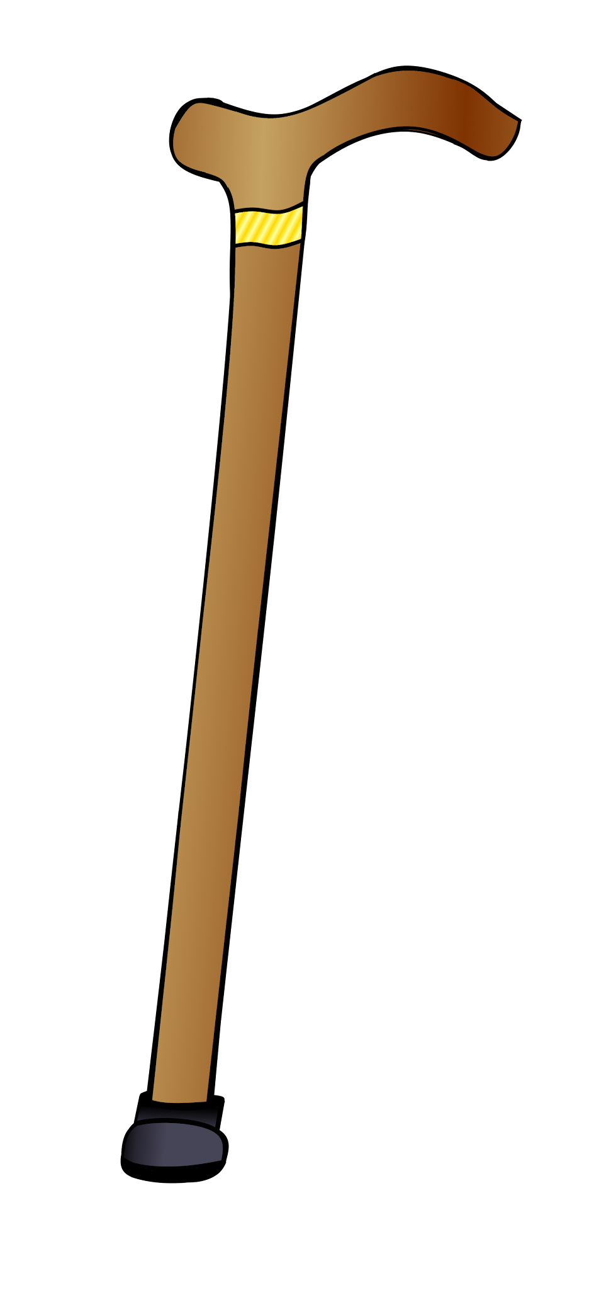
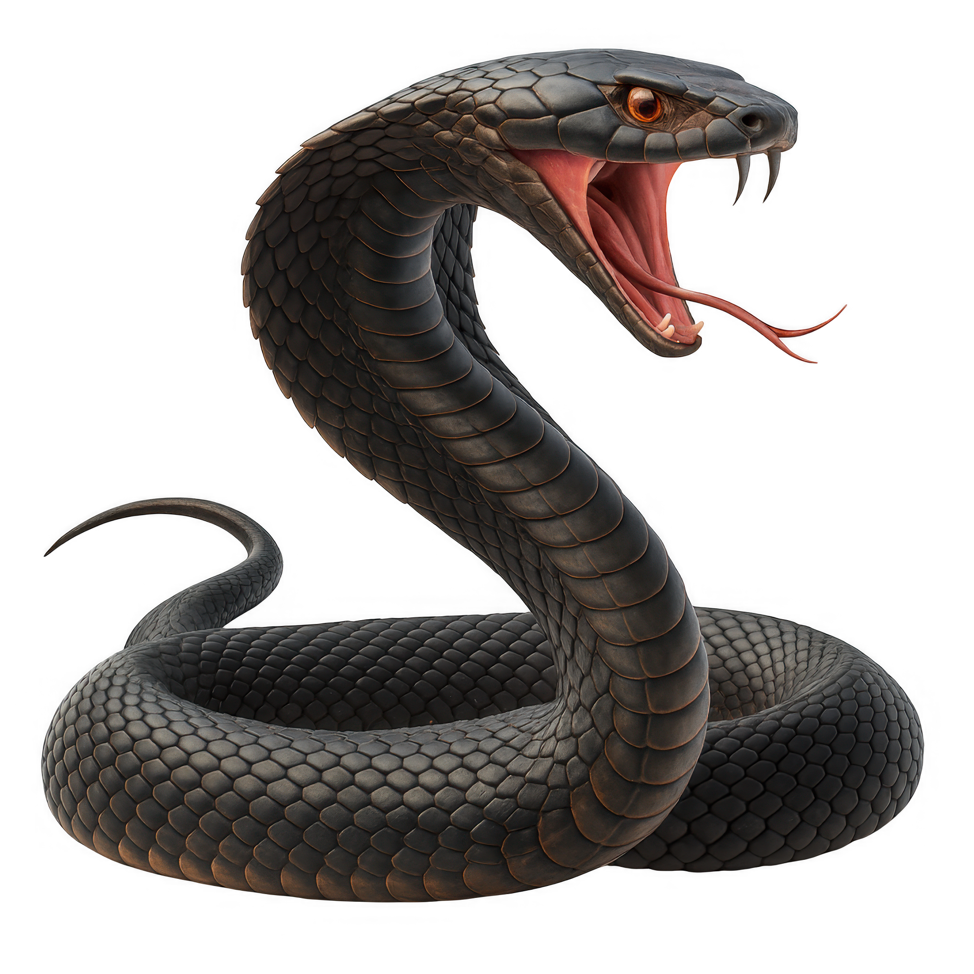
What happened when Moses grabbed the snake?
Touch your toes for:
Jumping Jacks for:

Slide 7
What happened when Moses grabbed the snake?
Touch your toes for:
The snake turned back into a staff!

Slide 8
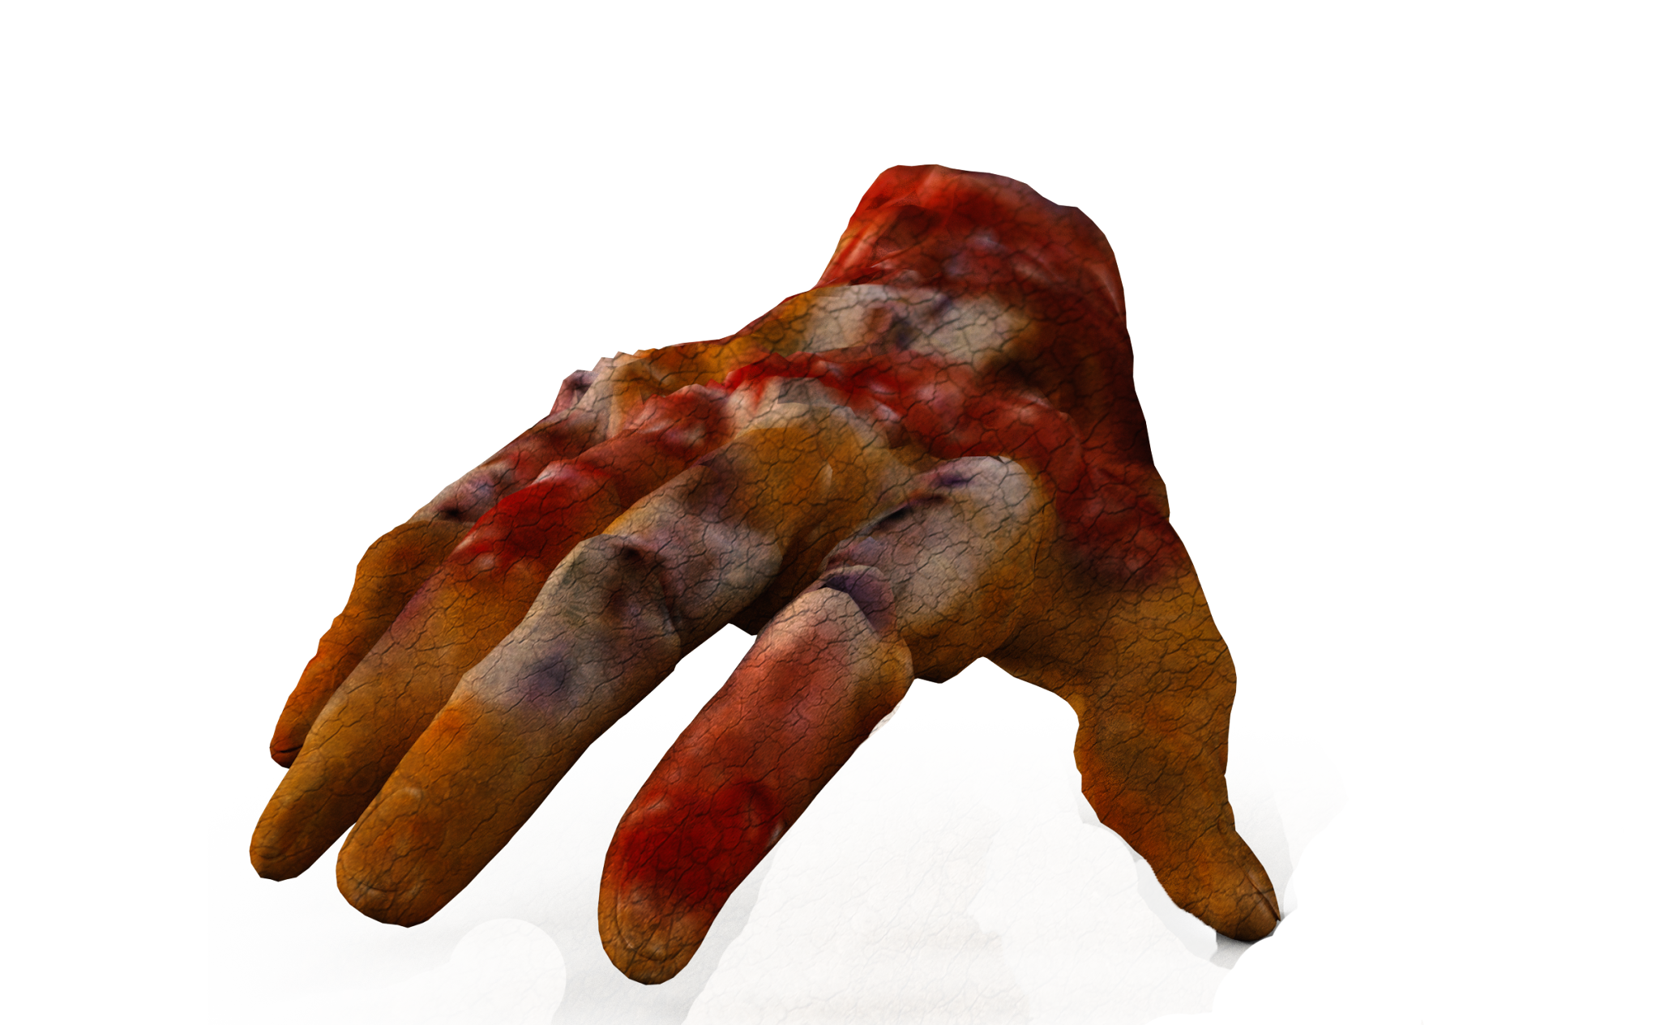
Next God told Moses to put his hand in his cloak. When he did this, what happened to his hand?
One hand for:
No hands for:
It had leprosy
His hand disappeared!

Slide 9
Next God told Moses to put his hand in his cloak. When he did this, what happened to his hand?
One hand for:
It had leprosy

Slide 10
When Moses put his leprous hand back into his cloak was it healed back to normal?

Slide 11
When Moses put his leprous hand back into his cloak was it healed back to normal?

Slide 12
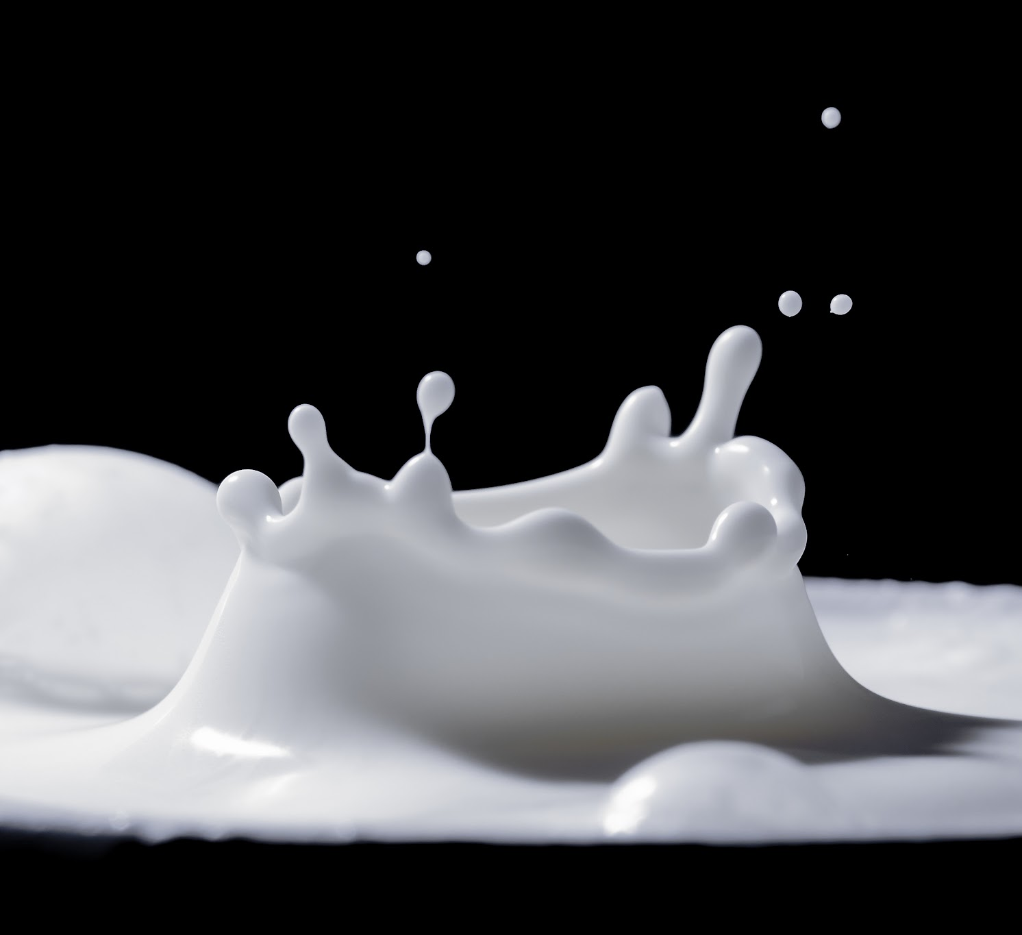
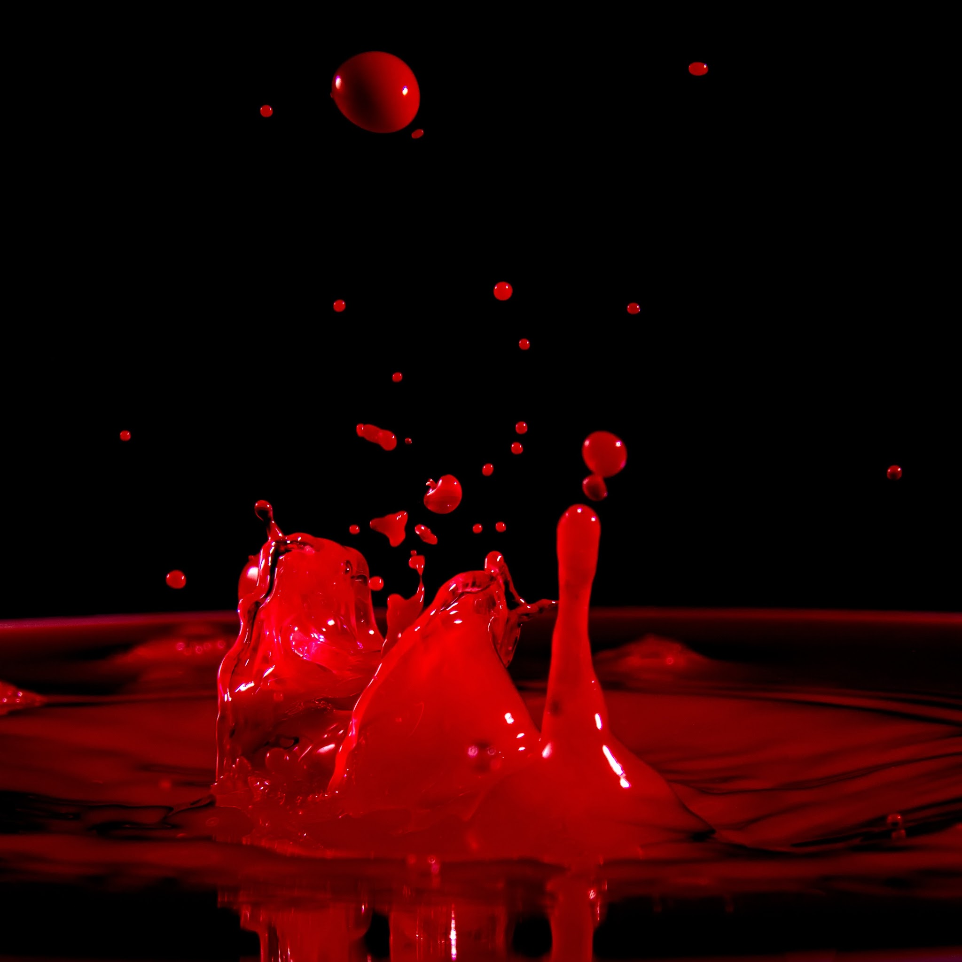
If these signs didn’t make the people believe, God told Moses to get water from the Nile and pour it on the ground. What would happen to it?
Sit on your knees for:
Stand on one foot for:

Slide 13
If these signs didn’t make the people believe, God told Moses to get water from the Nile and pour it on the ground. What would happen to it?
Stand on one foot for:
It turned to blood

Slide 14
Moses said that he was slow of speech and tongue, but God told Moses he would help him and teach him what to say. What was Moses’ response?
One hand for:
Two hands for:
No hands for:
“Please let me bring my wife and sons.”
“Pardon your servant, Lord, please send someone else.”
“I don’t believe you will help me.”

Slide 15
Moses said that he was slow of speech and tongue, but God told Moses he would help him and teach him what to say. What was Moses’ response?
Two hands for:
“Pardon your servant, Lord, please send someone else.”

Slide 16
God was going to give Moses a helper who could speak better than him. Who was it?
(Shout it out!)
Aaron
Seth
Reul
Judah
Caleb

Slide 17
God was going to give Moses a helper who could speak better than him. Who was it?
(Shout it out!)
Aaron
His brother Aaron was coming to meet Moses. God promised Moses that he would help them and that Aaron would speak to the people for Moses.

Slide 18
Who and what did Moses take with him to go back to Egypt?
(Shout it out as you see it)

Slide 19
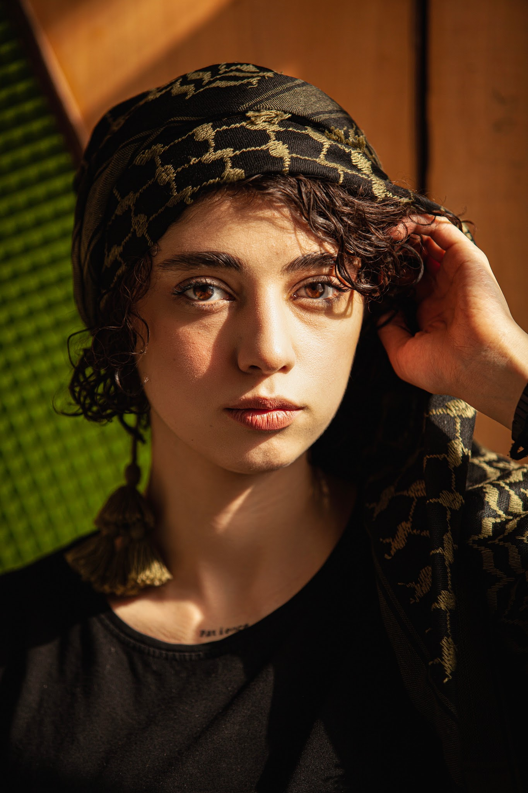
Who and what did Moses take with him to go back to Egypt?
(Shout it out as you see it)
His wife

Slide 20
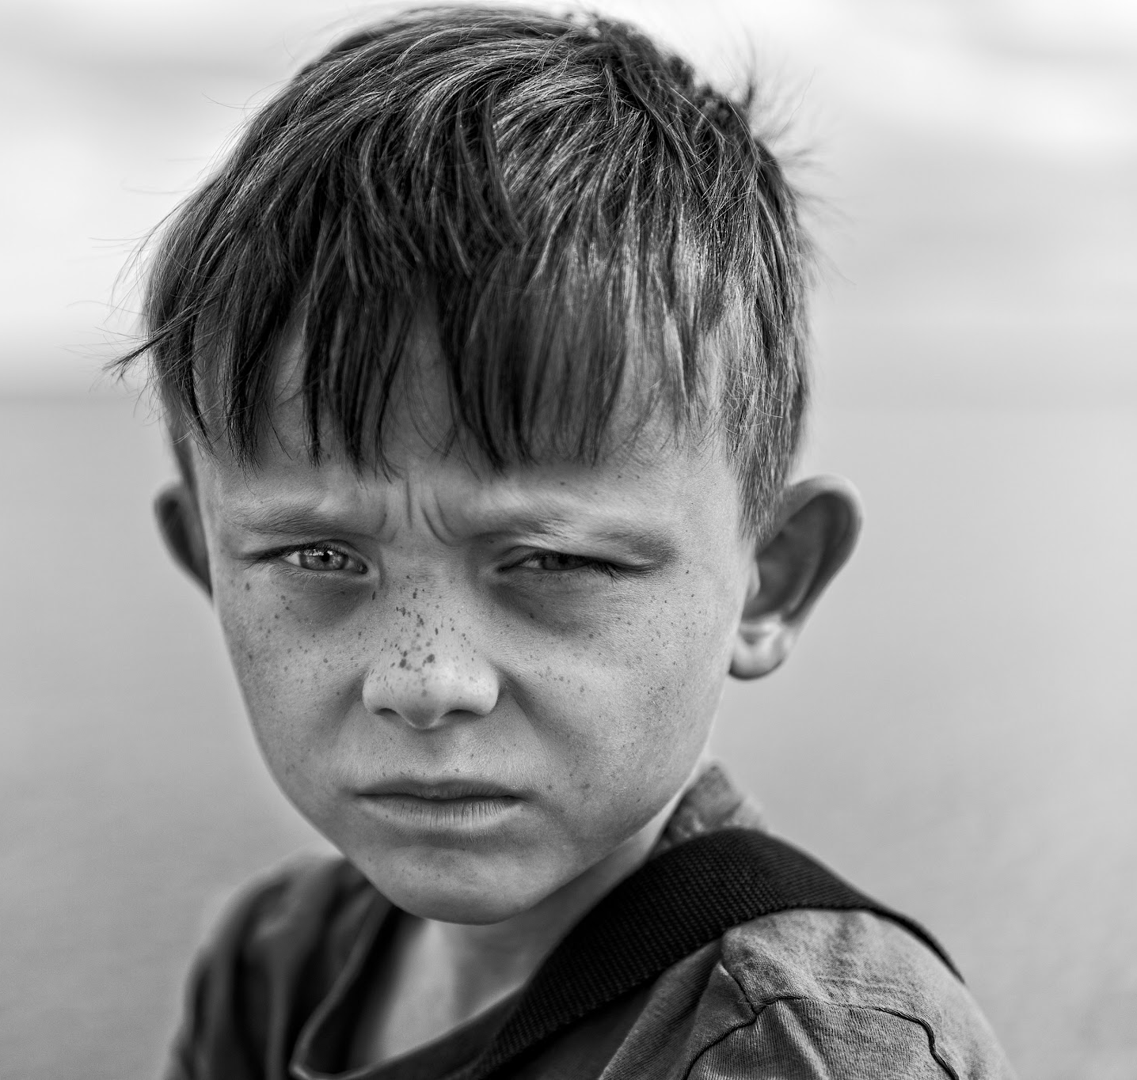
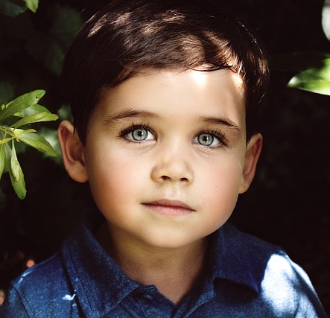
Who and what did Moses take with him to go back to Egypt?
(Shout it out as you see it)
His wife
His 2 sons

Slide 21
Who and what did Moses take with him to go back to Egypt?
(Shout it out as you see it)
His staff
His wife
His 2 sons

Slide 22
How did Aaron know to go meet Moses?
Stomp your feet for:
Clap your hands for:
The Lord told Aaron to go meet Moses in the wilderness.
Zipporah sent for Aaron.

Slide 23
How did Aaron know to go meet Moses?
Stomp your feet for:
The Lord told Aaron to go meet Moses in the wilderness.

Slide 24
When Moses and Aaron gathered all of the elders of the Israelites, who told them all that the Lord had said?
Stand up for:
Sit down for:
Moses
Aaron

Slide 25
When Moses and Aaron gathered all of the elders of the Israelites, who told them all that the Lord had said?
Sit down for:
Aaron

Slide 26
Did Moses perform the signs that the Lord had told him to show the people?

Slide 27
Did Moses perform the signs that the Lord had told him to show the people?

Slide 28
Did the people believe what Moses and Aaron were telling them?

Slide 29
Did the people believe what Moses and Aaron were telling them?

Slide 30

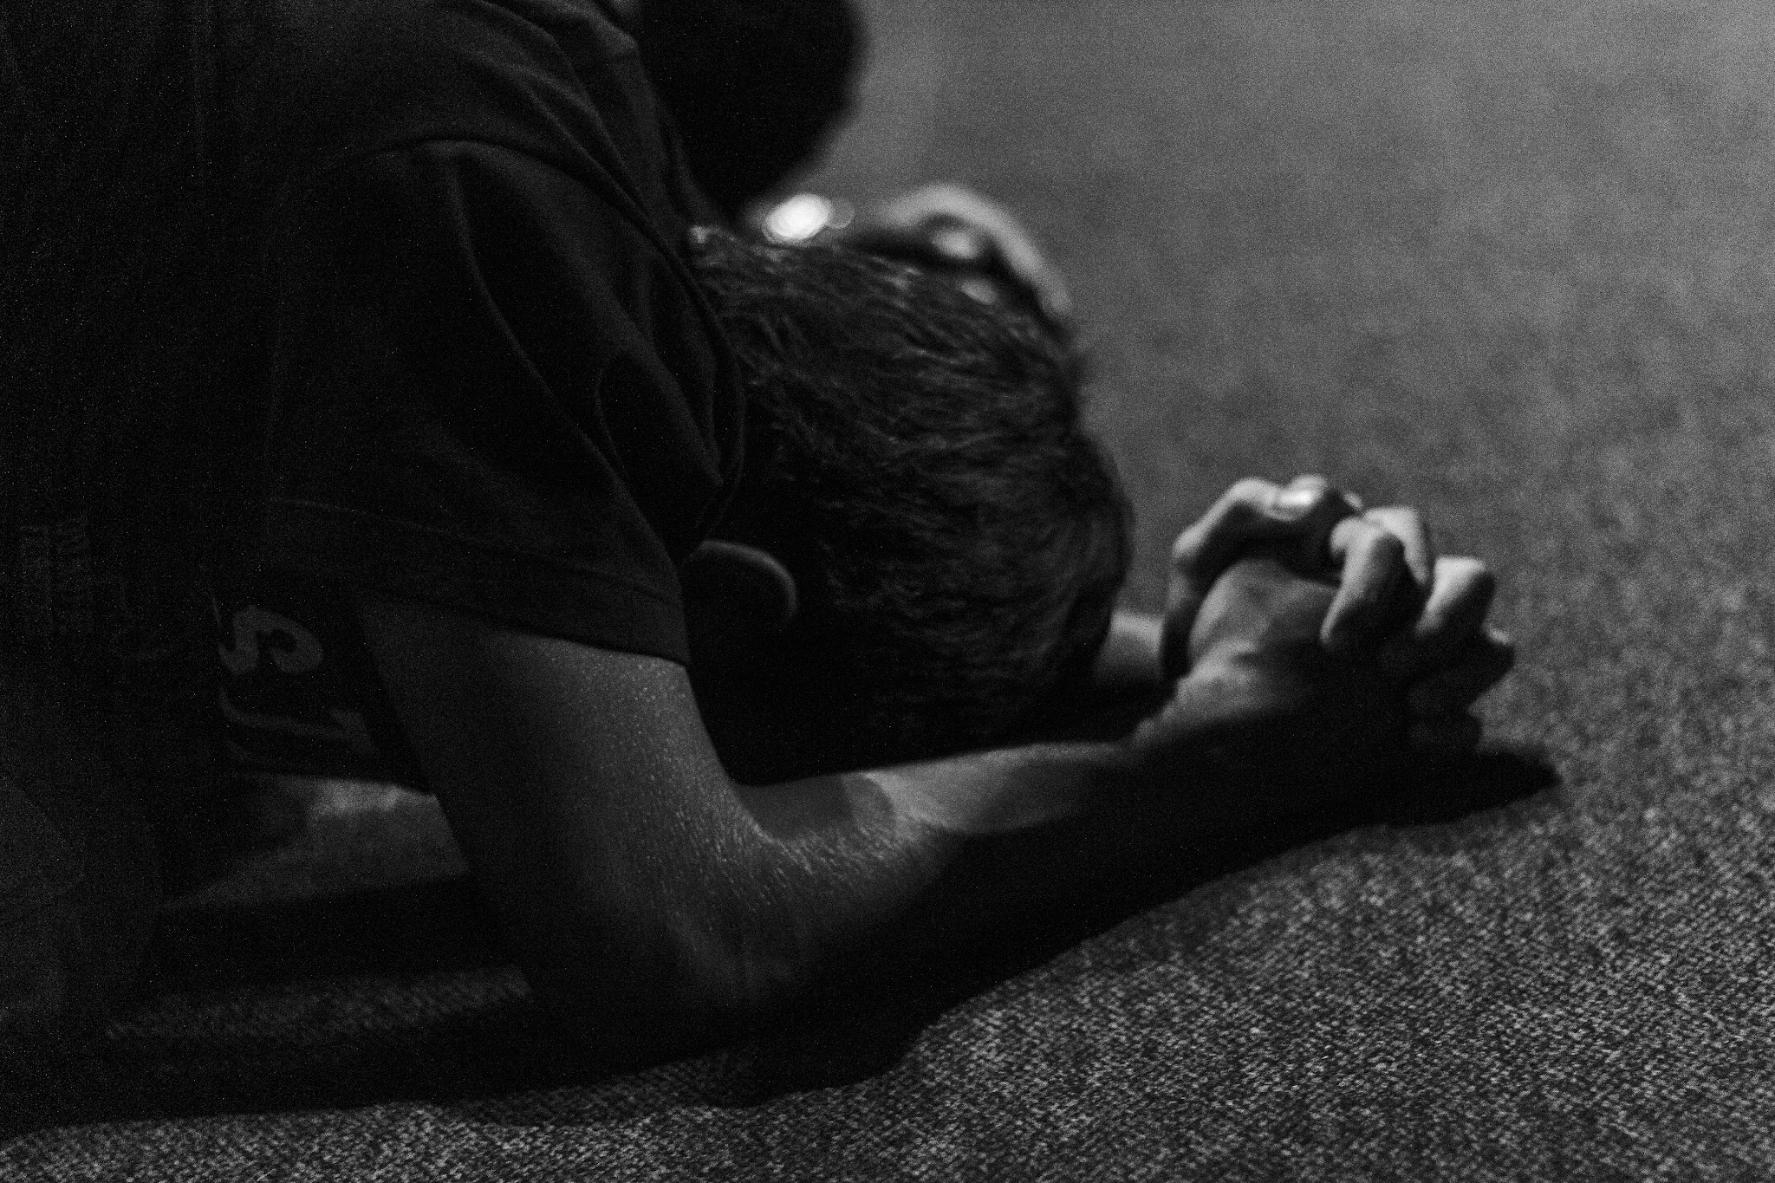

What did the people do when they heard that the Lord was concerned about them and had seen their misery?
Do the correct action!

Slide 31
What did the people do when they heard that the Lord was concerned about them and had seen their misery?
Do the correct action!
They bowed down and worshipped.

