Slide 1
Exodus Dig Site 3

Slide 2
While Moses was living in Midian, the king of Egypt died. The Israelites were still in slavery and crying out for help. God heard their groaning and remembered his covenant with Abraham, Isaac, and Jacob. God was concerned for his people. So

Slide 3
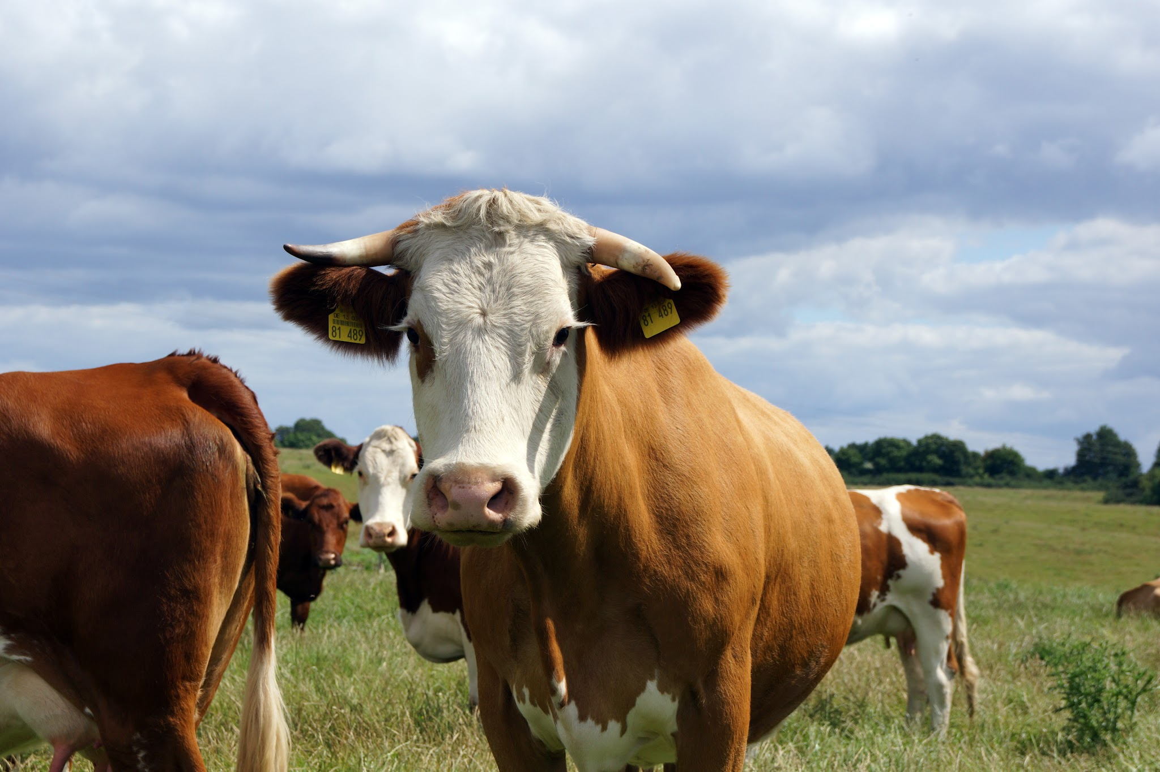
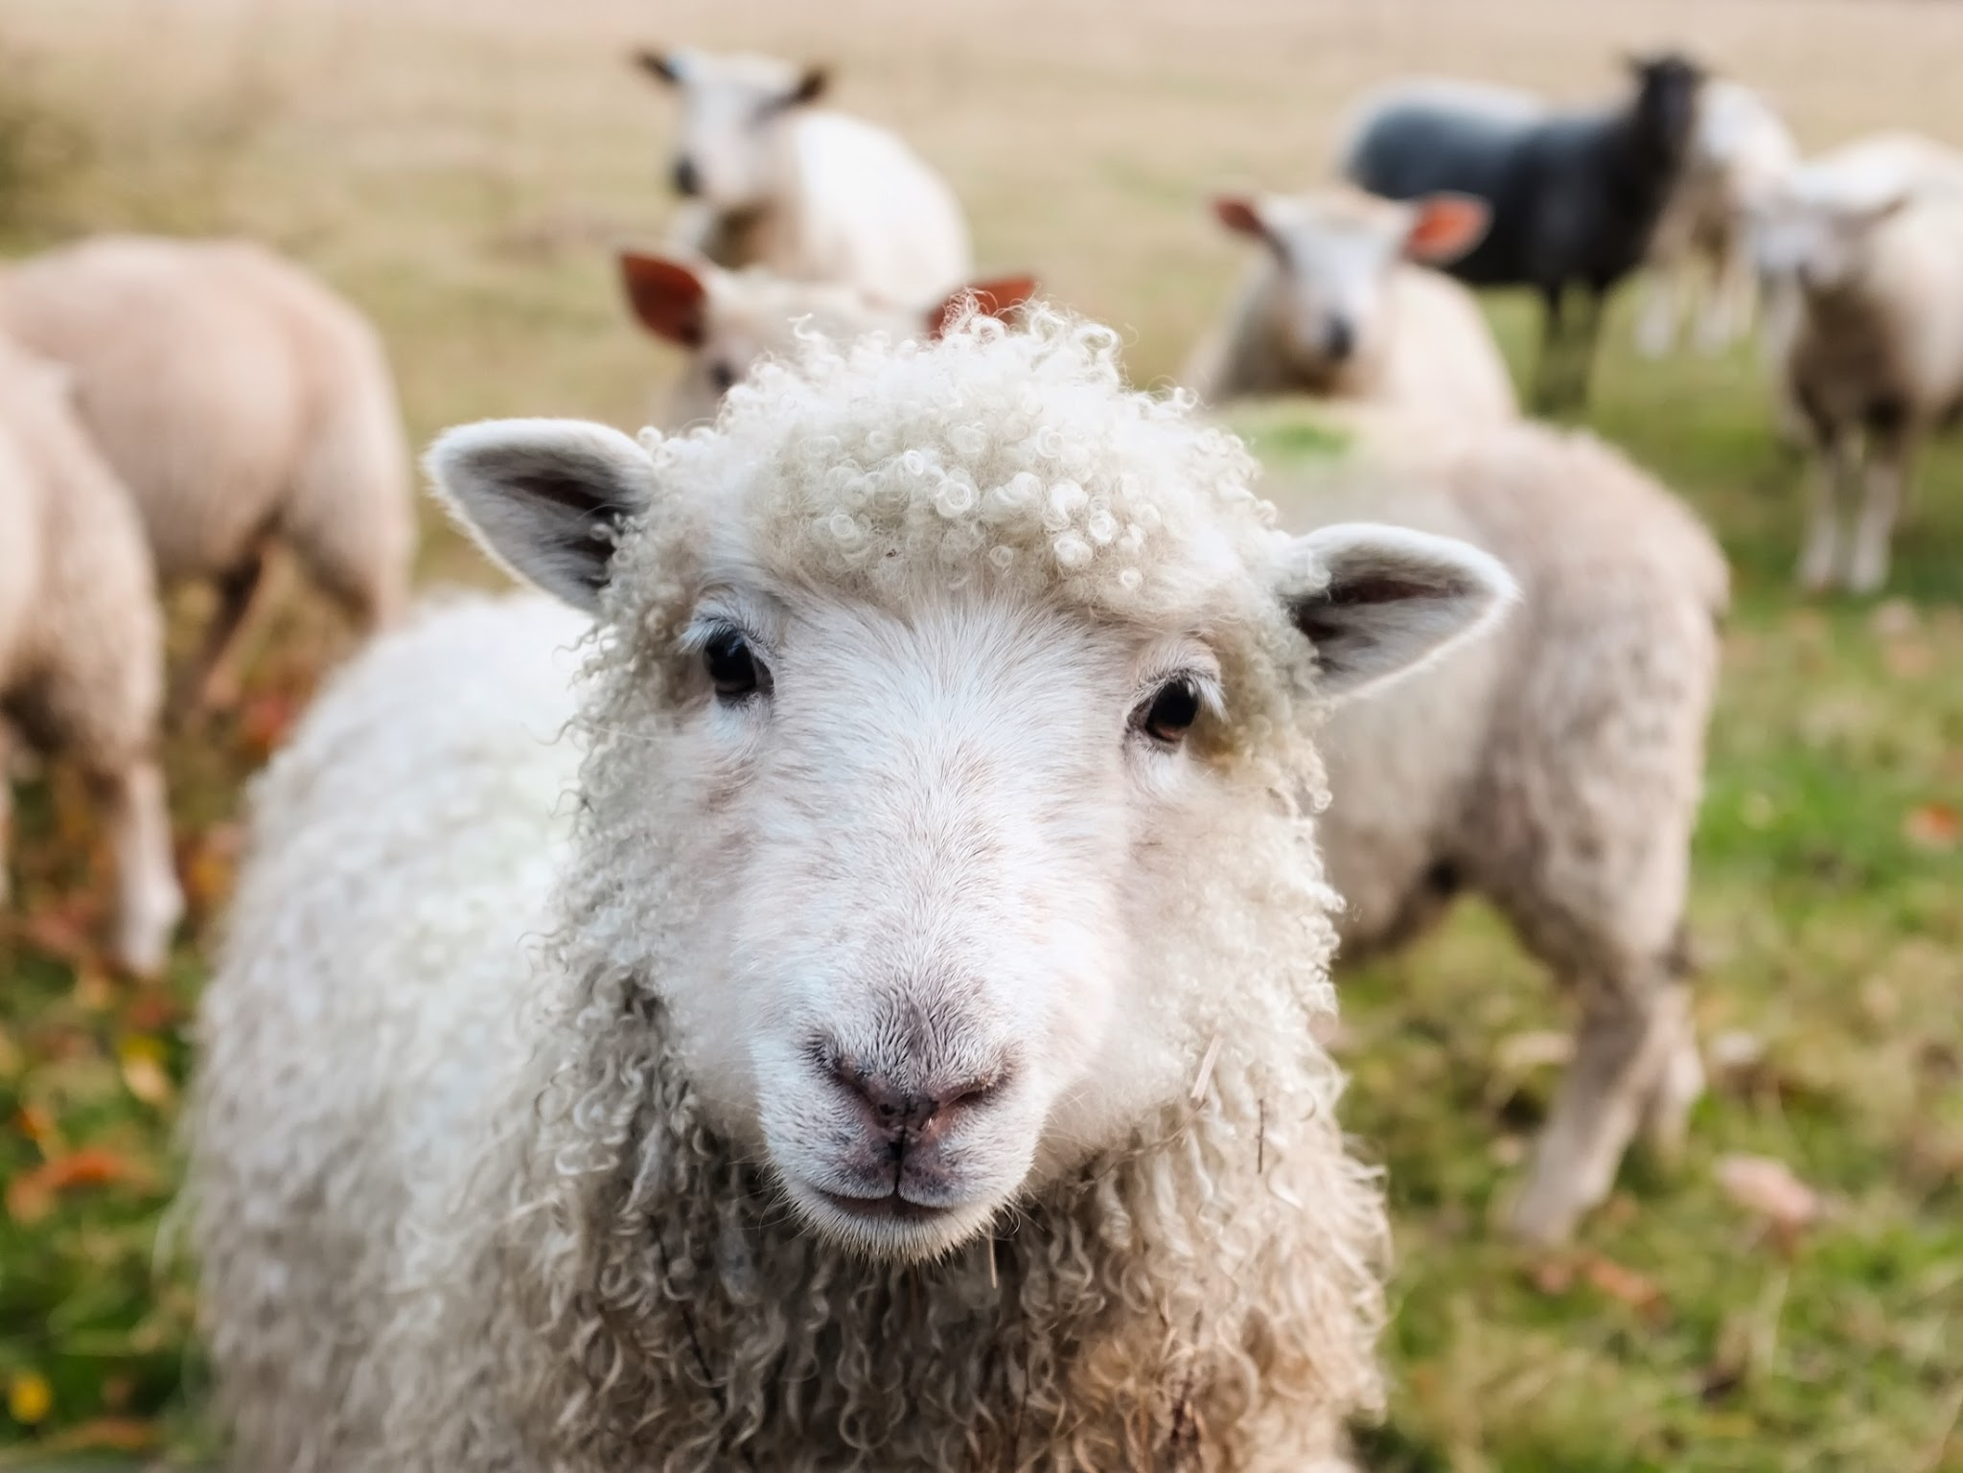
What animal was Moses taking care of for his father-in-law?
Say “moo” for:
Say “baa” for:

Slide 4
What animal was Moses taking care of for his father-in-law?
Say “baa” for:
Moses was tending the flock of his father-in-law, Jethro. “Flock” typically means a group of sheep

Slide 5
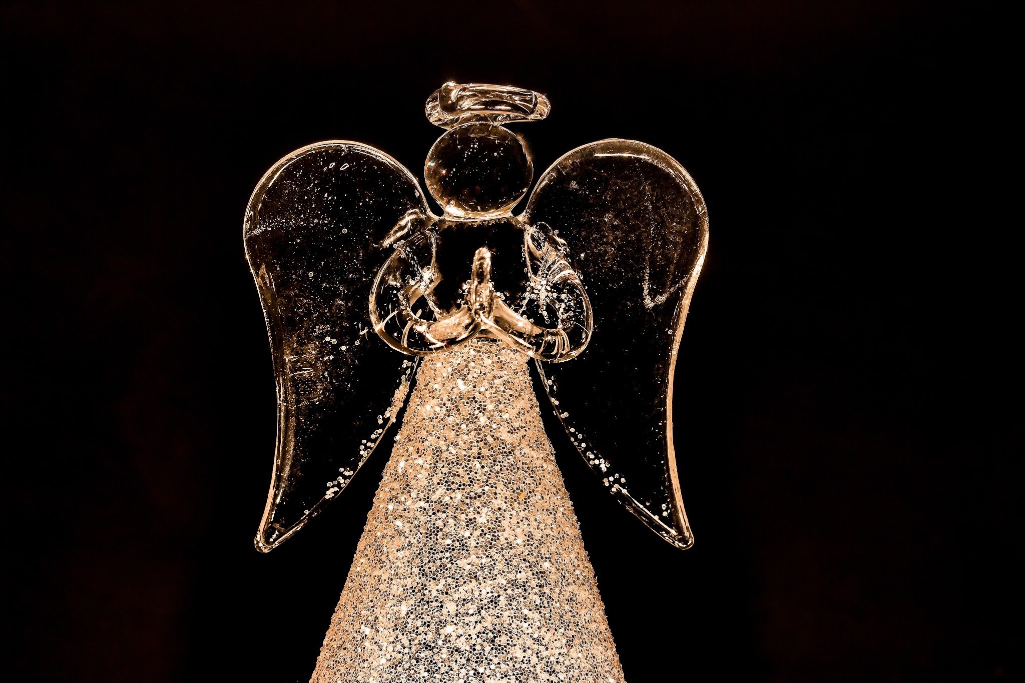
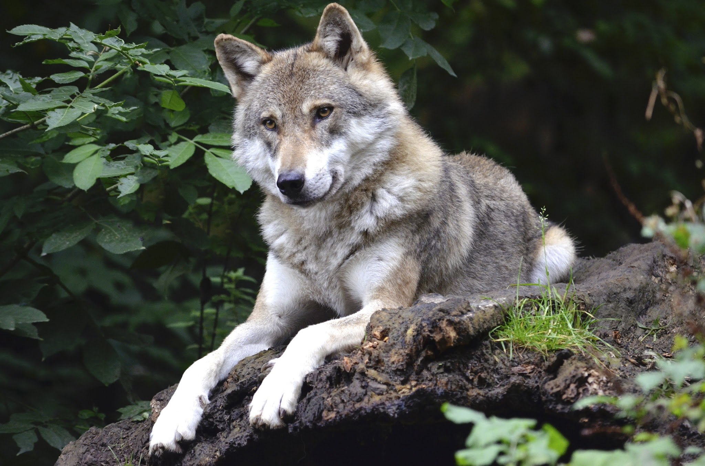
Moses led the flock to the far side of the wilderness. He came to Horeb, called the mountain of God. What appeared to him there?
Sing “la la la” for:
Howl for:

Slide 6
Moses led the flock to the far side of the wilderness. He came to Horeb, called the mountain of God. What appeared to him there?
Sing “la la la” for:
An angel appeared to Moses

Slide 7
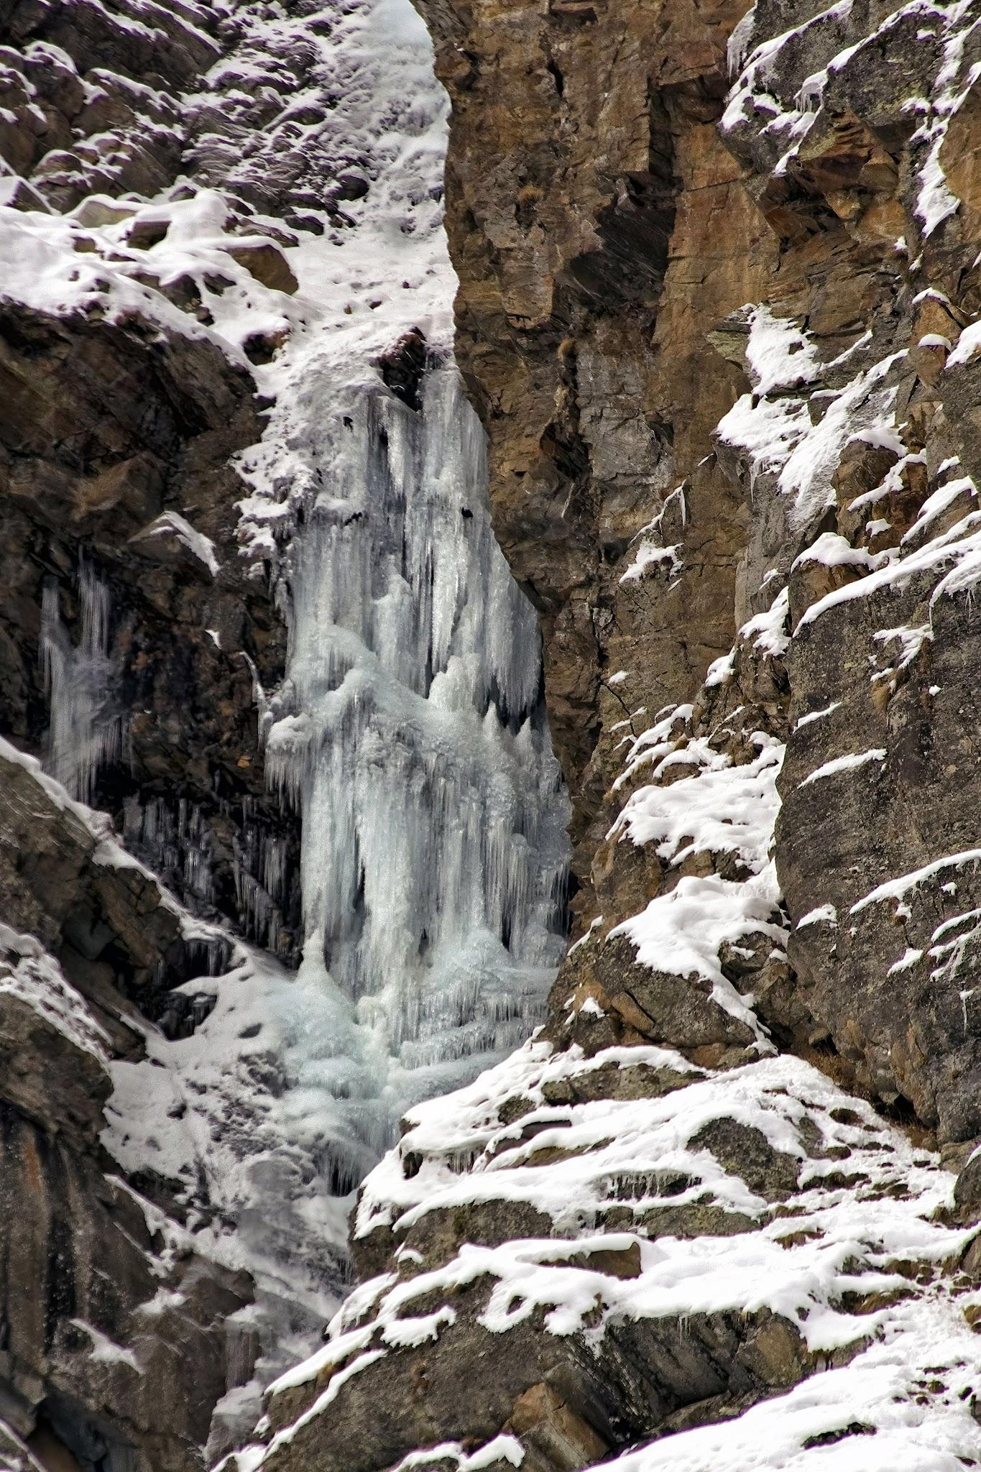
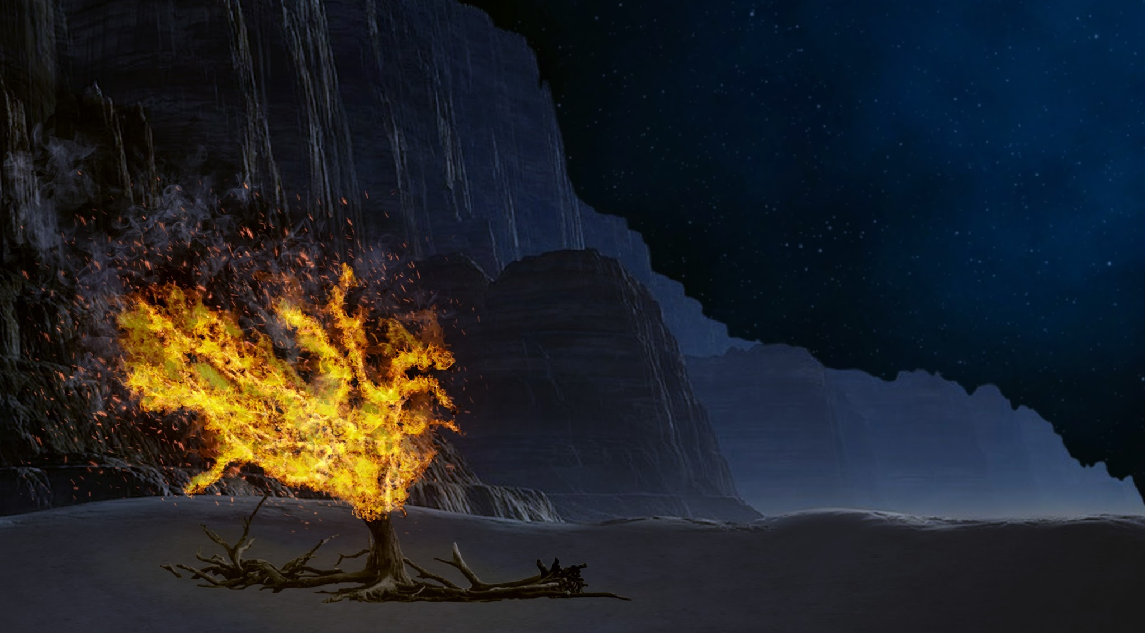
The angel appeared within what?
Jumping jacks for a burning bush
Toe touches for a frozen waterfall

Slide 8
The angel appeared within what?
Jumping jacks for a burning bush
Moses saw that although the bush was on fire it did not burn up.

Slide 9
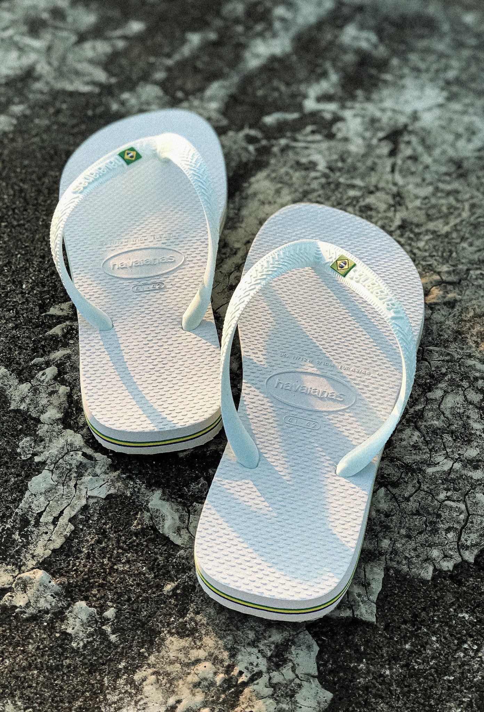

God spoke to Moses from within the bush. What did God tell Moses to take off?
Touch your toes for:
Pat your head for:

Slide 10
God spoke to Moses from within the bush. What did God tell Moses to take off?
Touch your toes for:
God said, “Do not come any closer. Take off your sandals, for the place where you are standing is holy ground.”

Slide 11
The Lord said, “I have indeed seen the misery of my people in _____.”
(Shout it out)

Slide 12
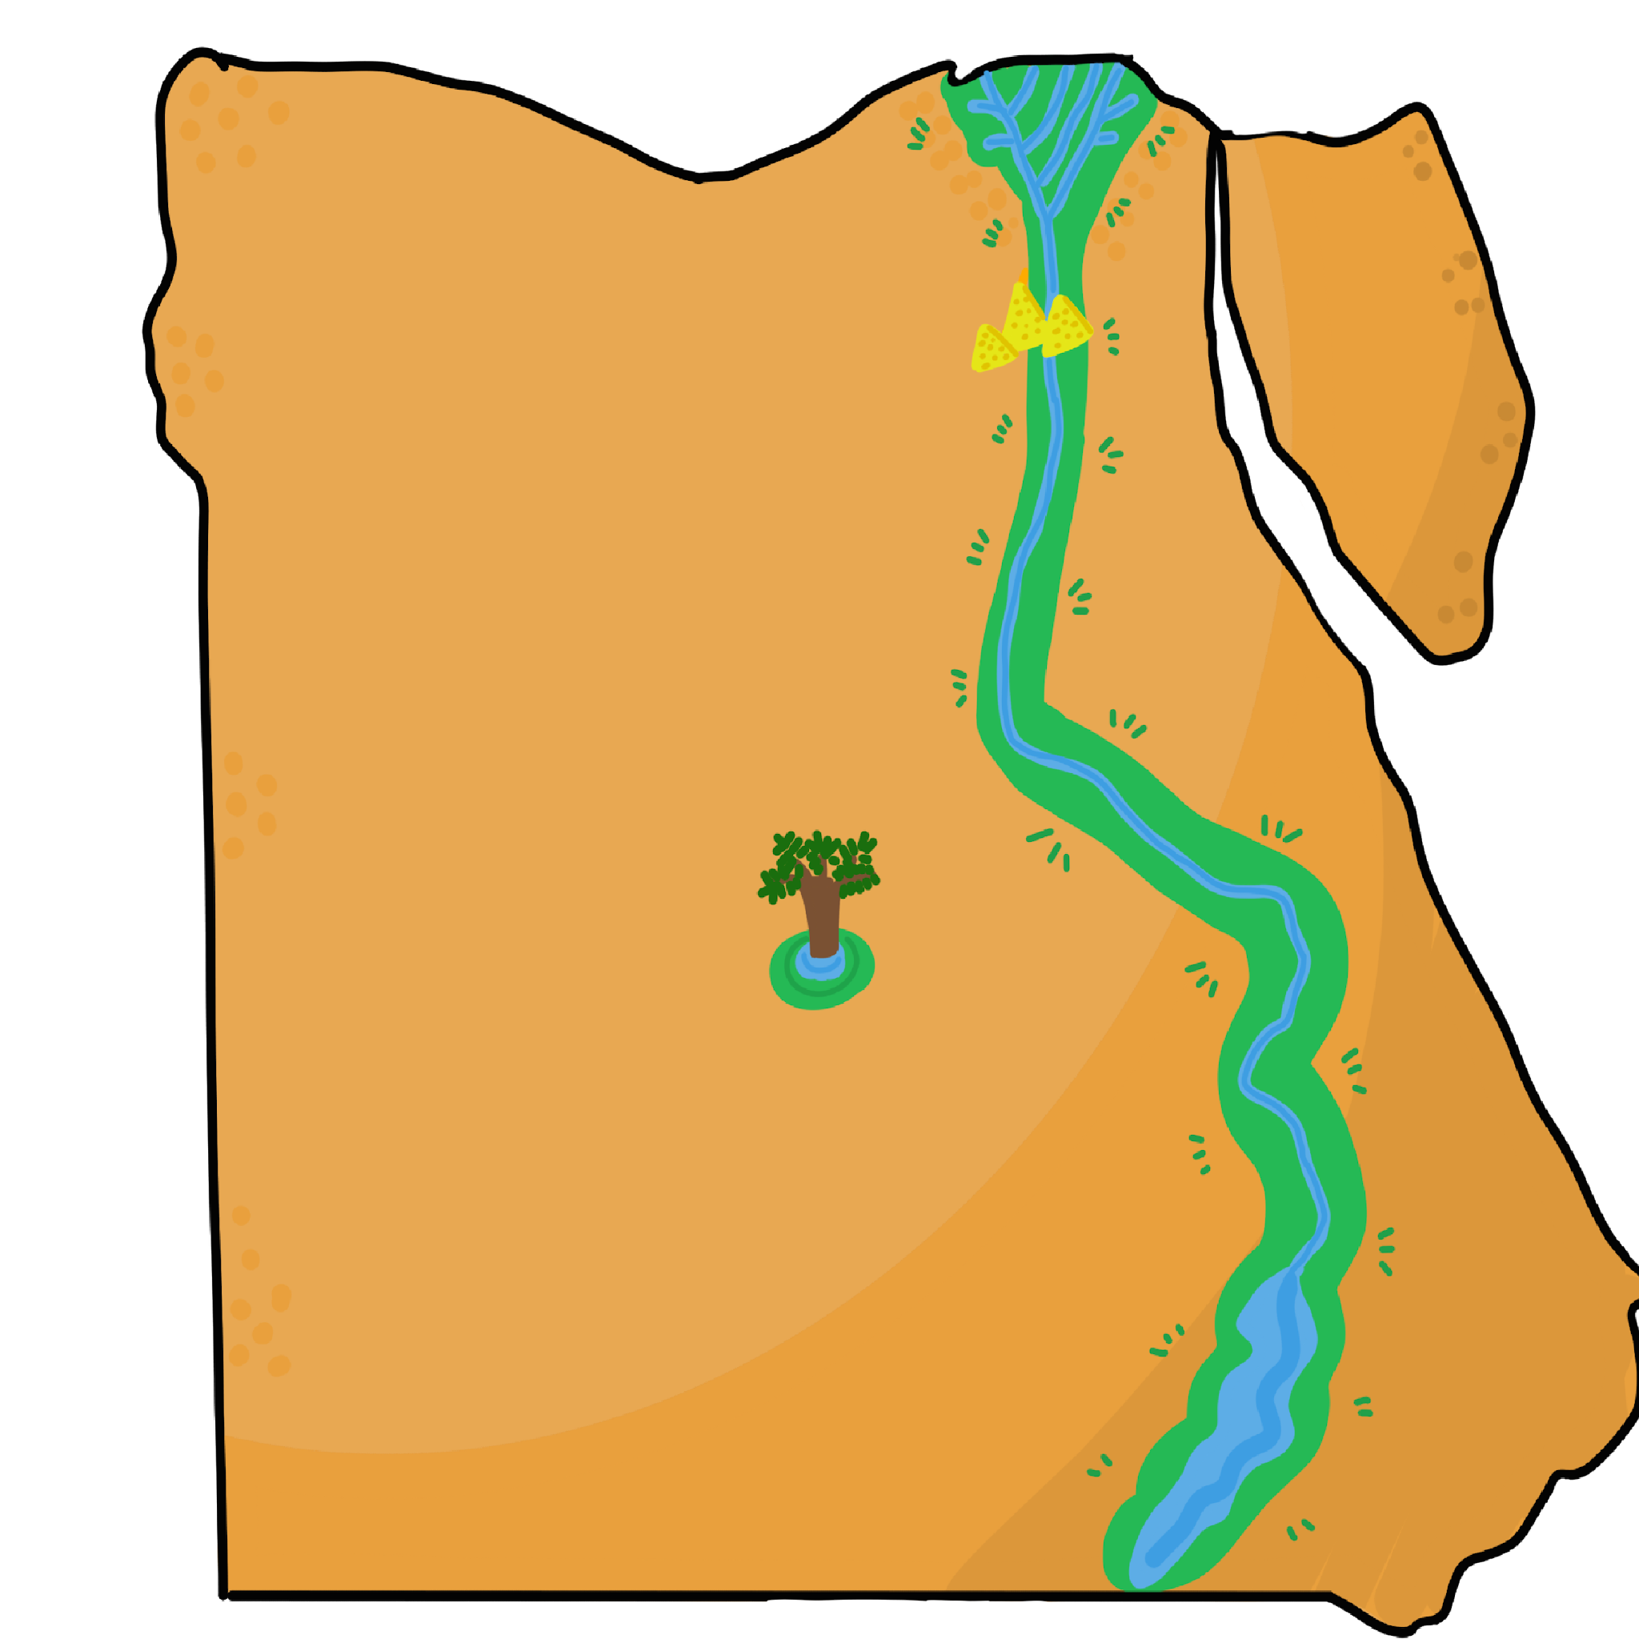
The Lord said, “I have indeed seen the misery of my people in _____.”
EGYPT
(Shout it out)

Slide 13
“I have heard them _____ ___ because of their slave drivers.”
(Shout it out)

Slide 14

“I have heard them ______ ___ because of their slave drivers
and I am concerned about their suffering.”
CRYING OUT
(Shout it out)
(Exodus 3:7 - memory verse from dig site 1)

Slide 15

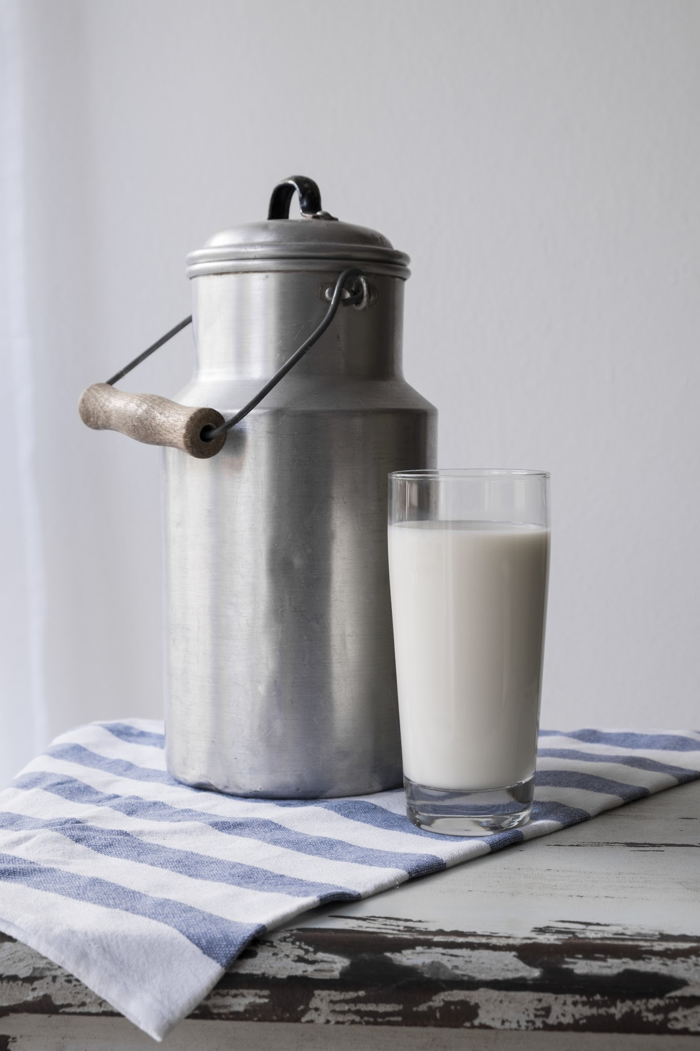
The Lord also said he had come to rescue them and bring them out of Egypt to a spacious land flowing with
and
(Shout it out)

Slide 16
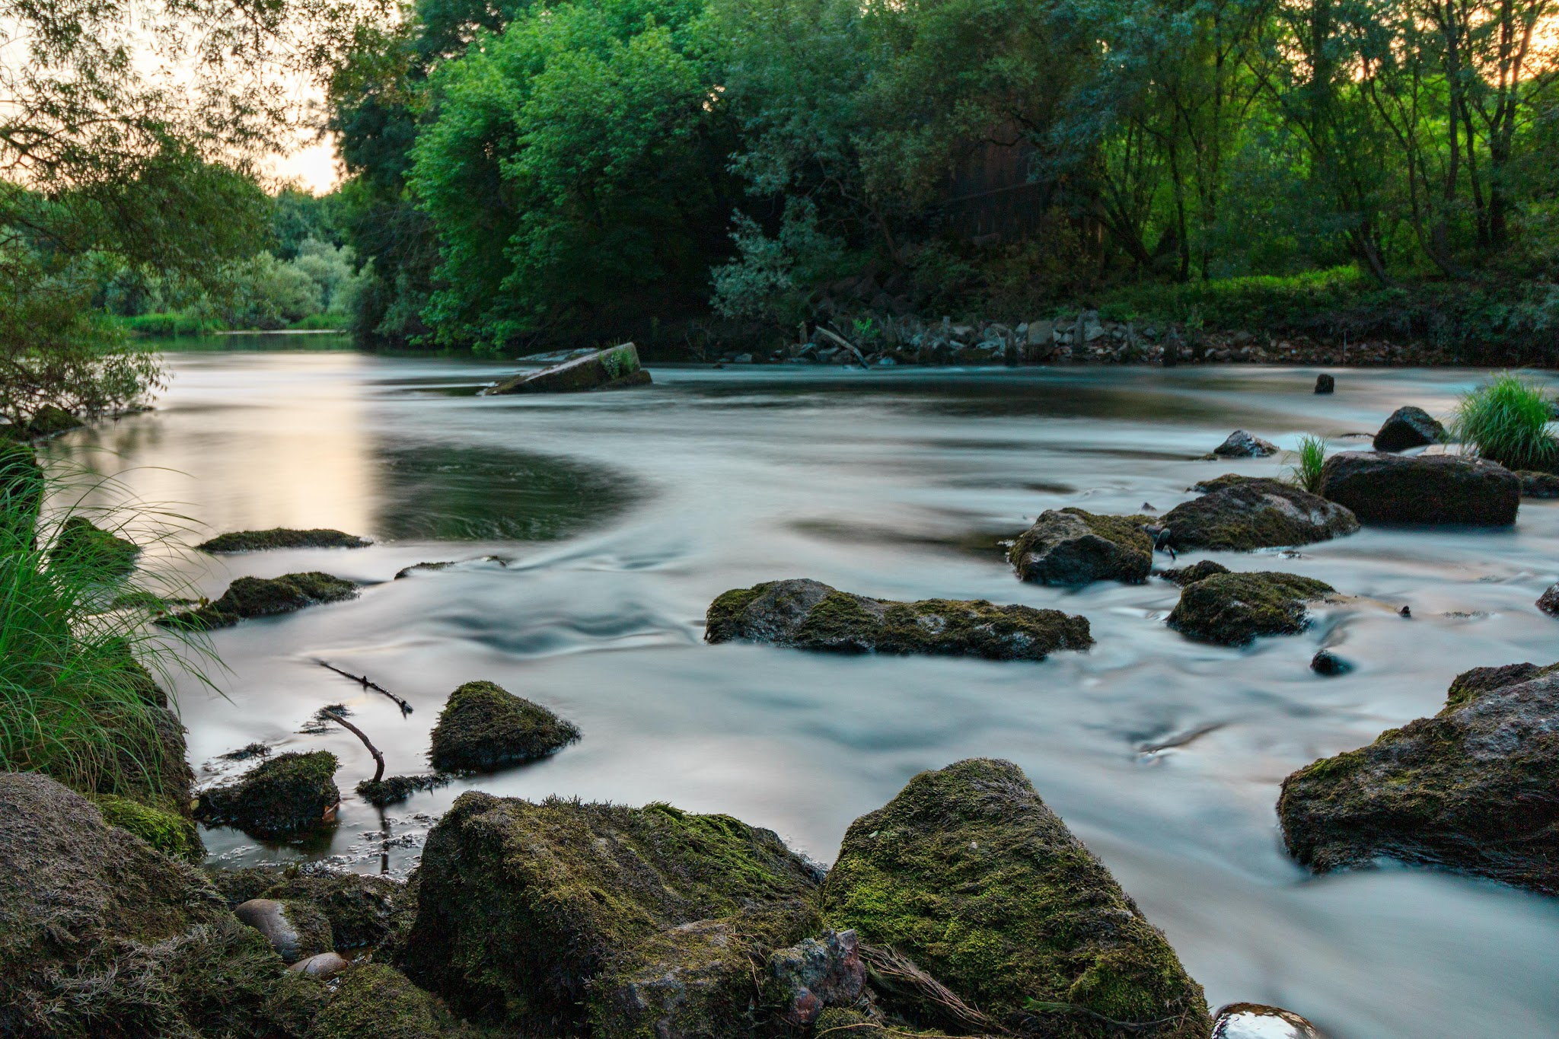
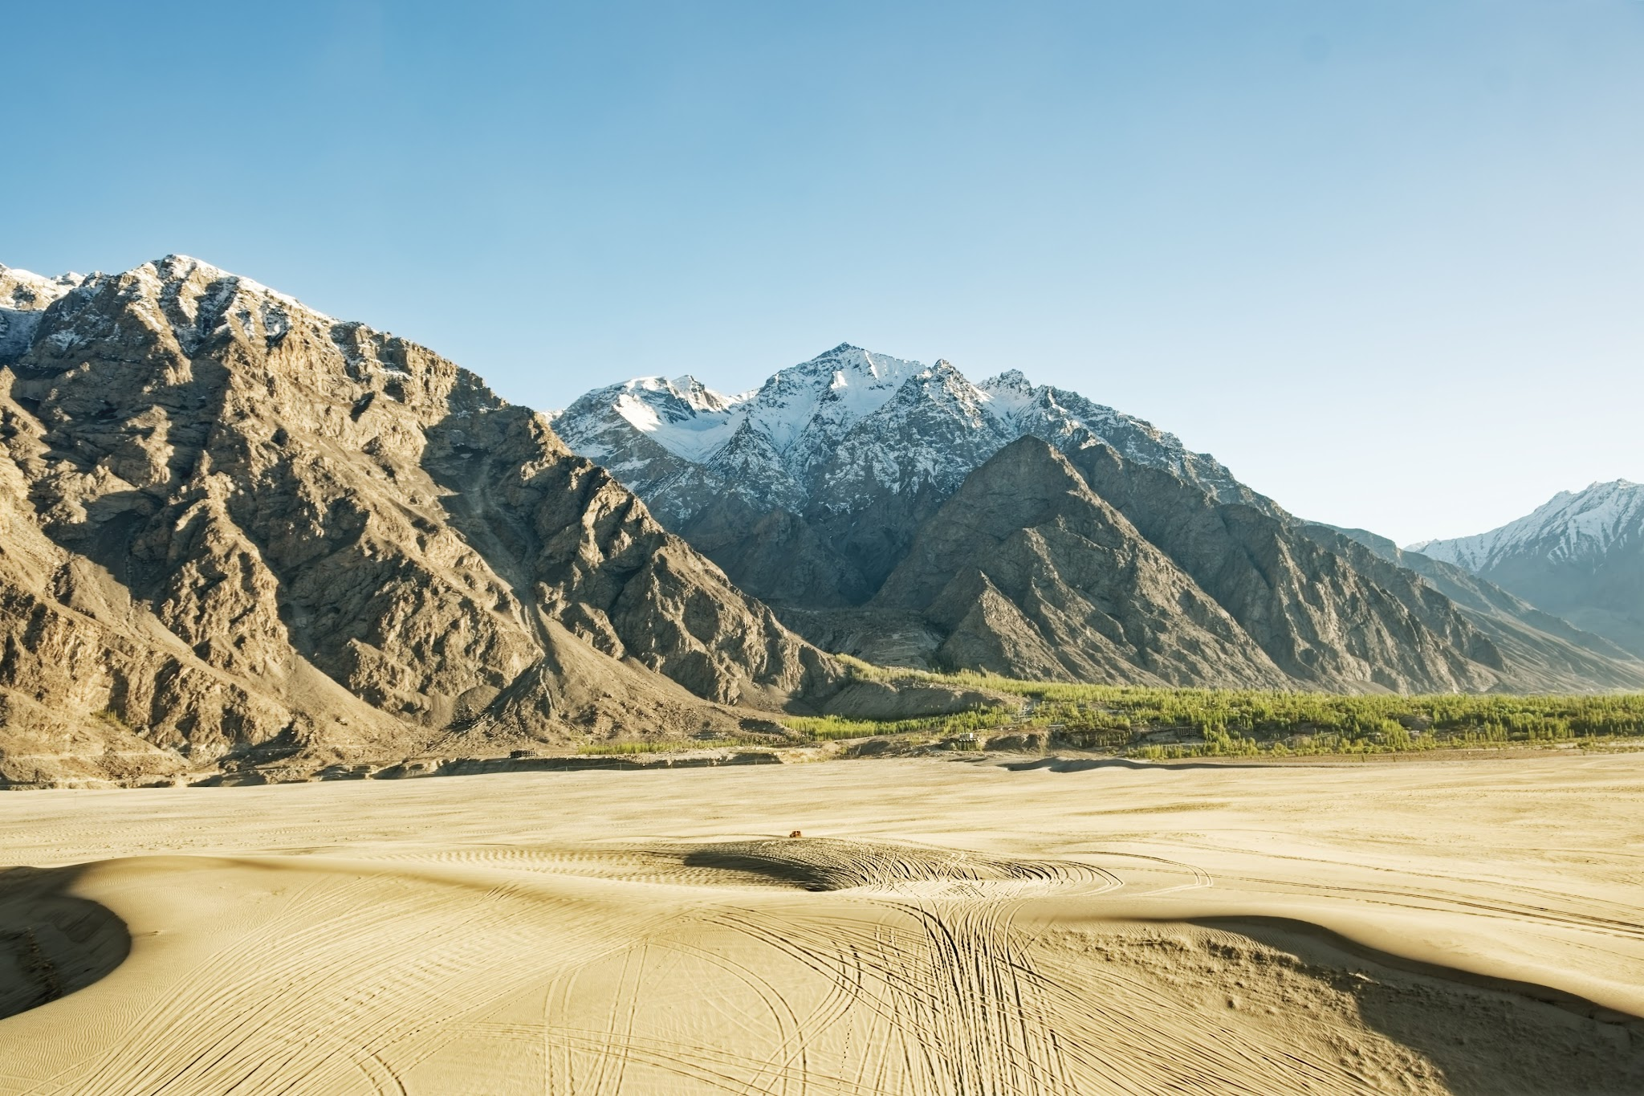
Moses said to God, “Who am I that I should go to Pharaoh and bring the Israelites out of Egypt?” God told Moses, “I will be with you.” He also said there would be a sign that it really was God who sent him. What was that sign?
One hand up for:
Two hands up for:
The people would drink from the river
The people would worship on the same mountain

Slide 17
Moses said to God, “Who am I that I should go to Pharaoh and bring the Israelites out of Egypt?” God told Moses, “I will be with you.” He also said there would be a sign that it really was God who sent him. What was that sign?
Two hands up for:
The people would worship on the same mountain

Slide 18
God said to Moses I am who __ ___.”
(Shout it out)

Slide 19
God said to Moses I am who __ ___. This is what you are to say to the Israelites: ‘__ ___ has sent me to you.’”
I AM
(Shout it out)

Slide 20
God said to Moses I am who __ ___. This is what you are to say to the Israelites: ‘__ ___ has sent me to you.’”
I AM
I AM
(Shout it out)
(Exodus 3:14 - memory verse from this dig site)

Slide 21


The Lord told Moses to get the elders of the Israelites together and tell them the Lord had seen all that was happening to them in Egypt and he had come to bring them out of their misery. Would the elders believe Moses?

Slide 22
The Lord told Moses to get the elders of the Israelites together and tell them the Lord had seen all that was happening to them in Egypt and he had come to bring them out of their misery. Would the elders believe Moses?

Slide 23
Moses and the elders were supposed to go to the king of Egypt and say, “The Lord, the God of the Hebrews has met with us, let us take…”
Hold up 1 finger for a 1 day journey
Hold up 2 fingers for a 2 day journey
Hold up 3 fingers for a 3 day journey

Slide 24
Moses and the elders were supposed to go to the king of Egypt and say, “The Lord, the God of the Hebrews has met with us, let us take a 3 day journey into the wilderness to offer sacrifices to the Lord.”

Slide 25
The Lord told Moses the king of Egypt would let them go or would not let them go (right away)?

Slide 26
The Lord told Moses the king of Egypt would let them go or would not let them go (right away)?
The king of Egypt would not let them go unless a mighty hand compelled them.

Slide 27
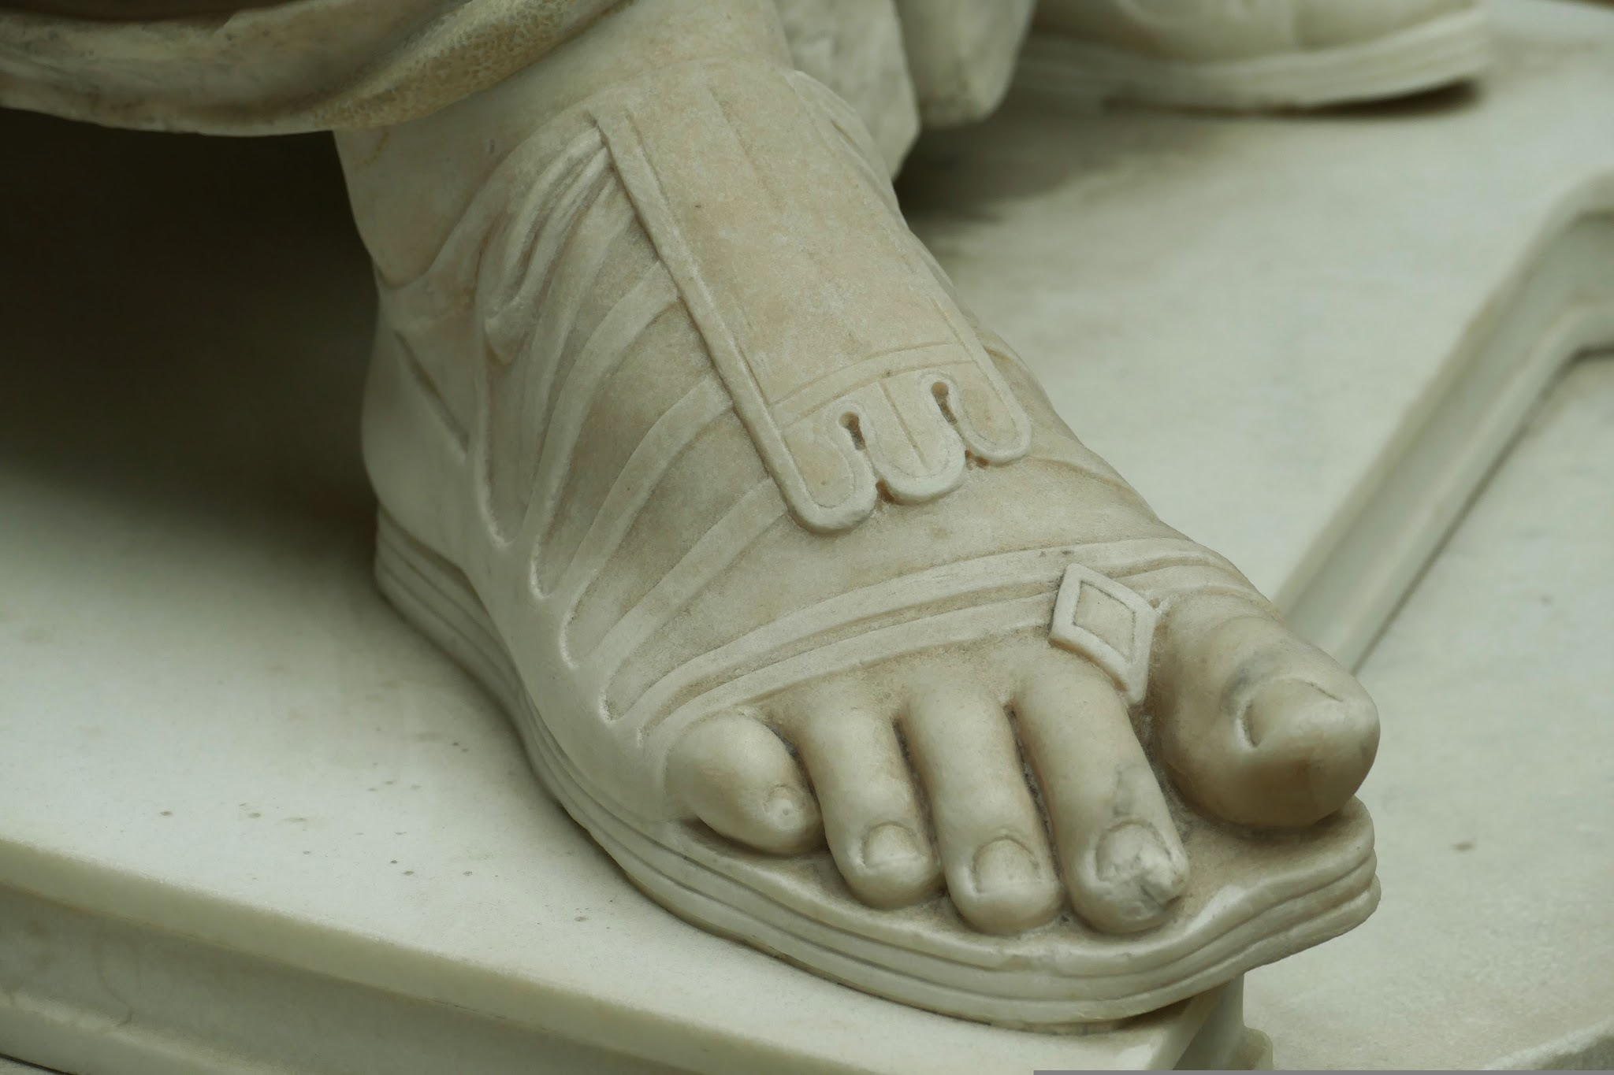
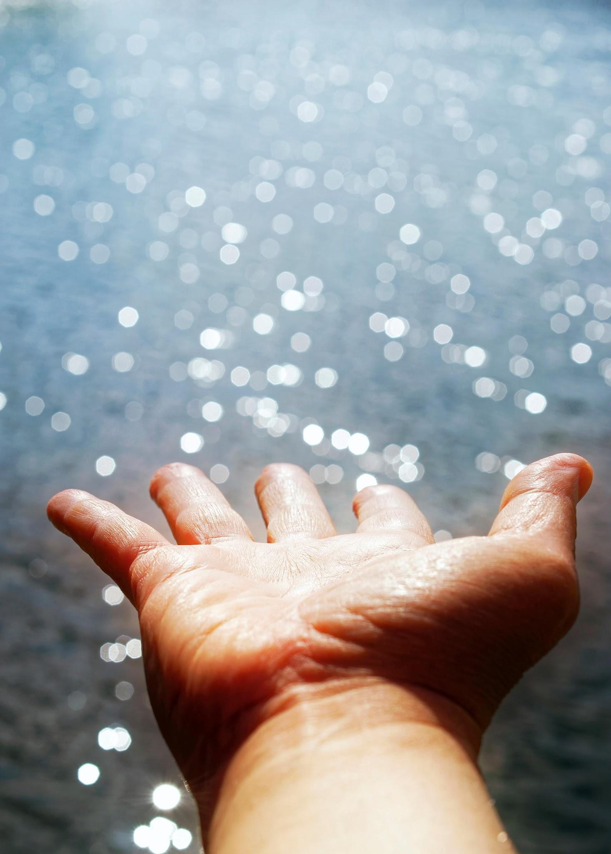
So what was the Lord going to do to the Egyptians?
Stomp your feet for:
Stretch your hands for:

Slide 28
So what was the Lord going to do to the Egyptians?
Stretch your hands for:
The Lord would stretch out his hand and strike the Egyptians with all the wonders that he would perform among them.

Slide 29
After the Lord stretched out his hand against the Egyptians, would Pharaoh let the Israelites go?

Slide 30
After the Lord stretched out his hand against the Egyptians, would Pharaoh let the Israelites go?

Slide 31
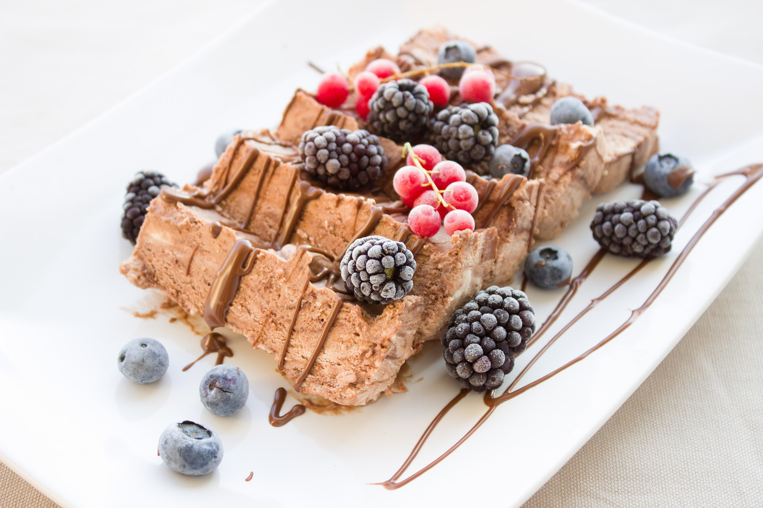
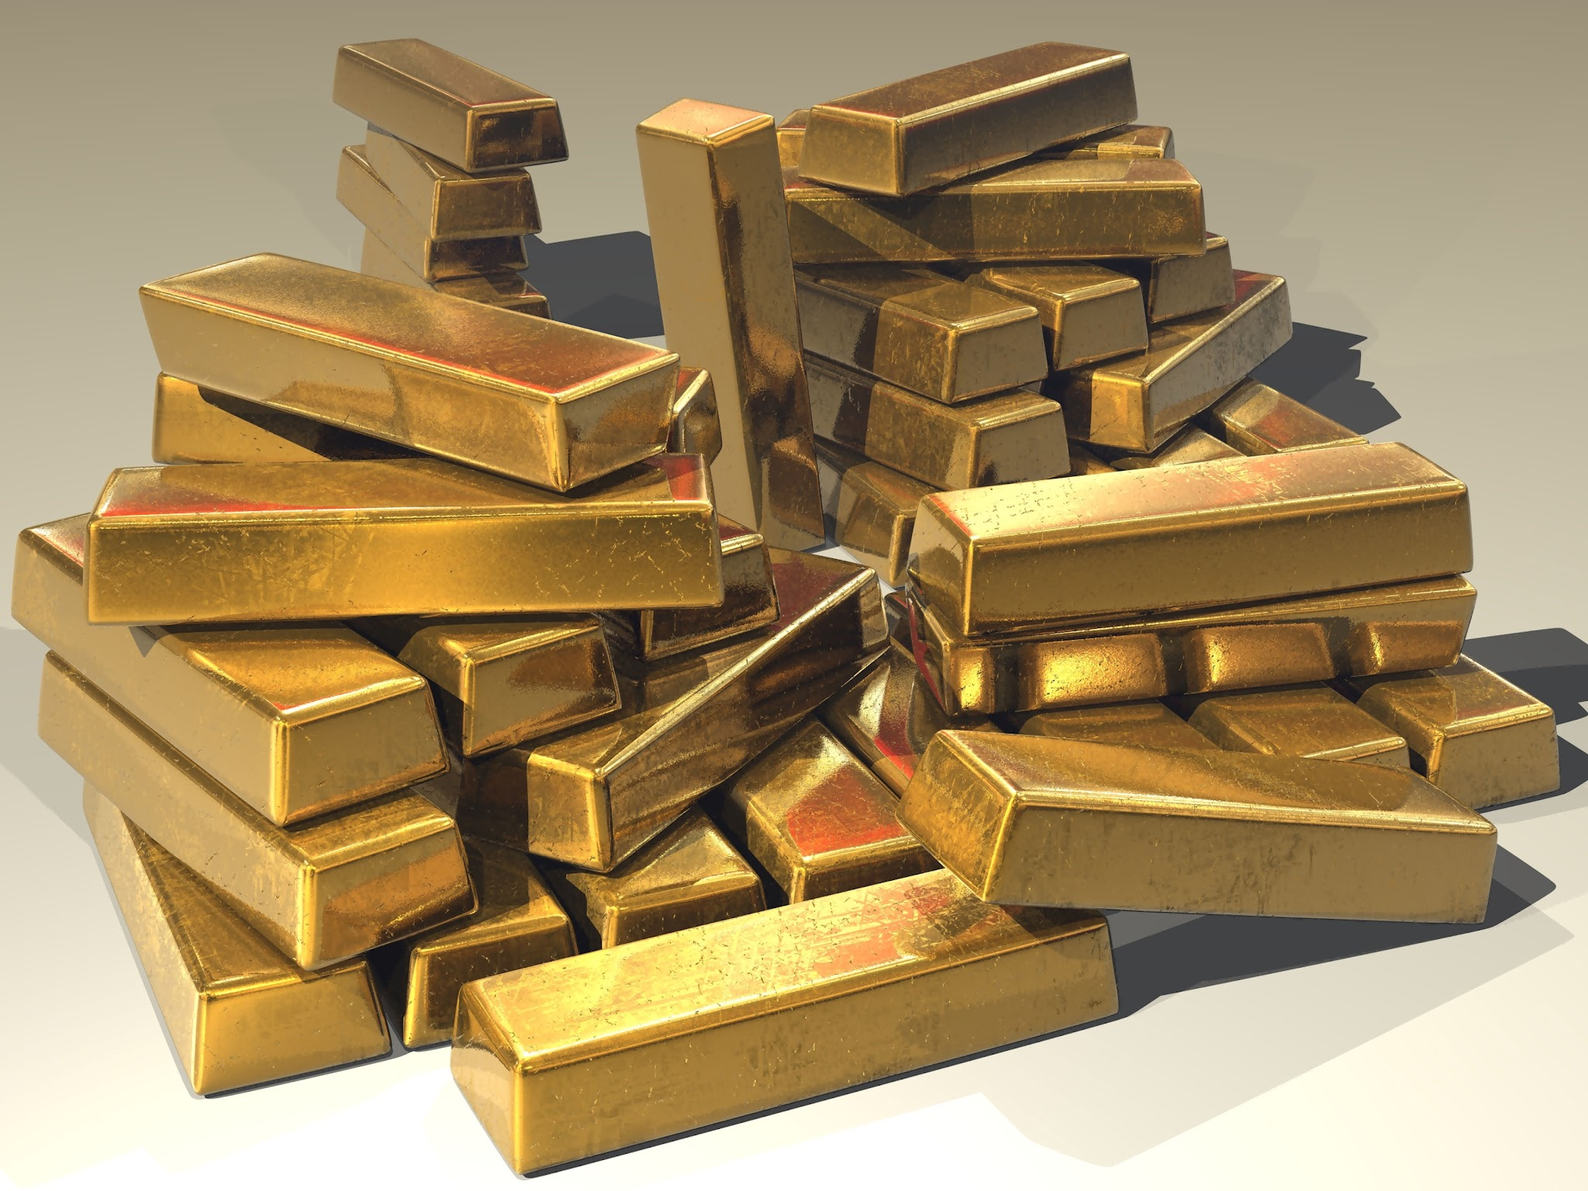
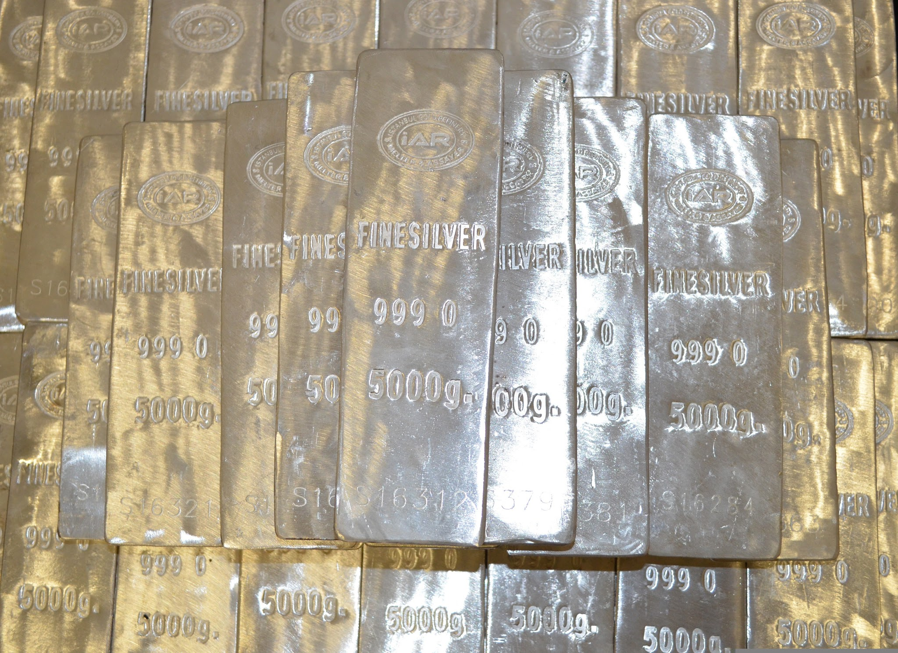
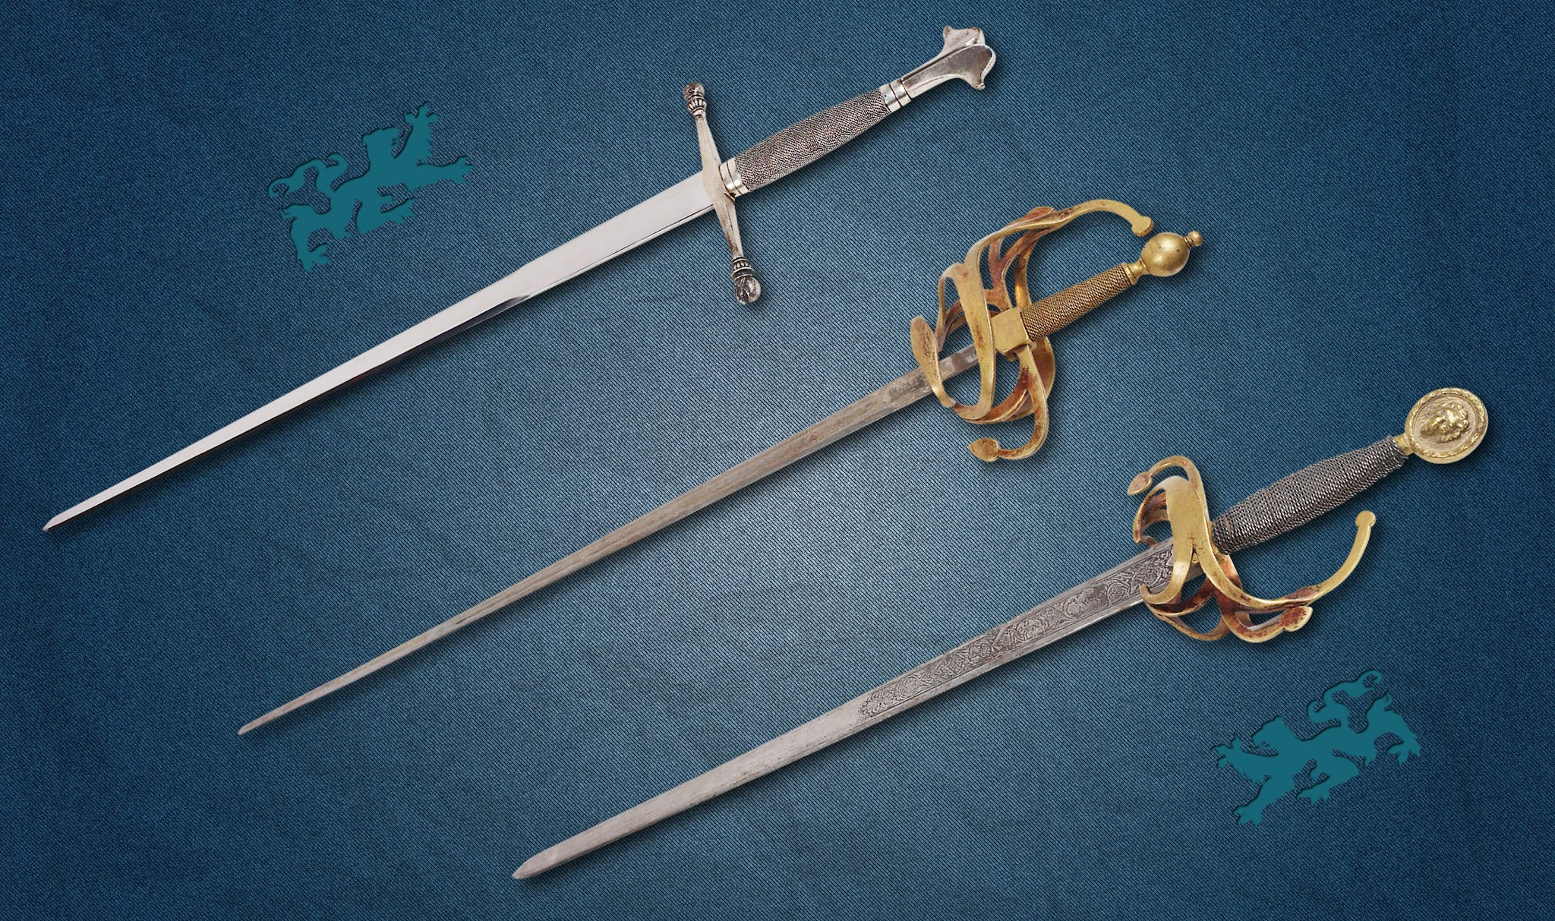
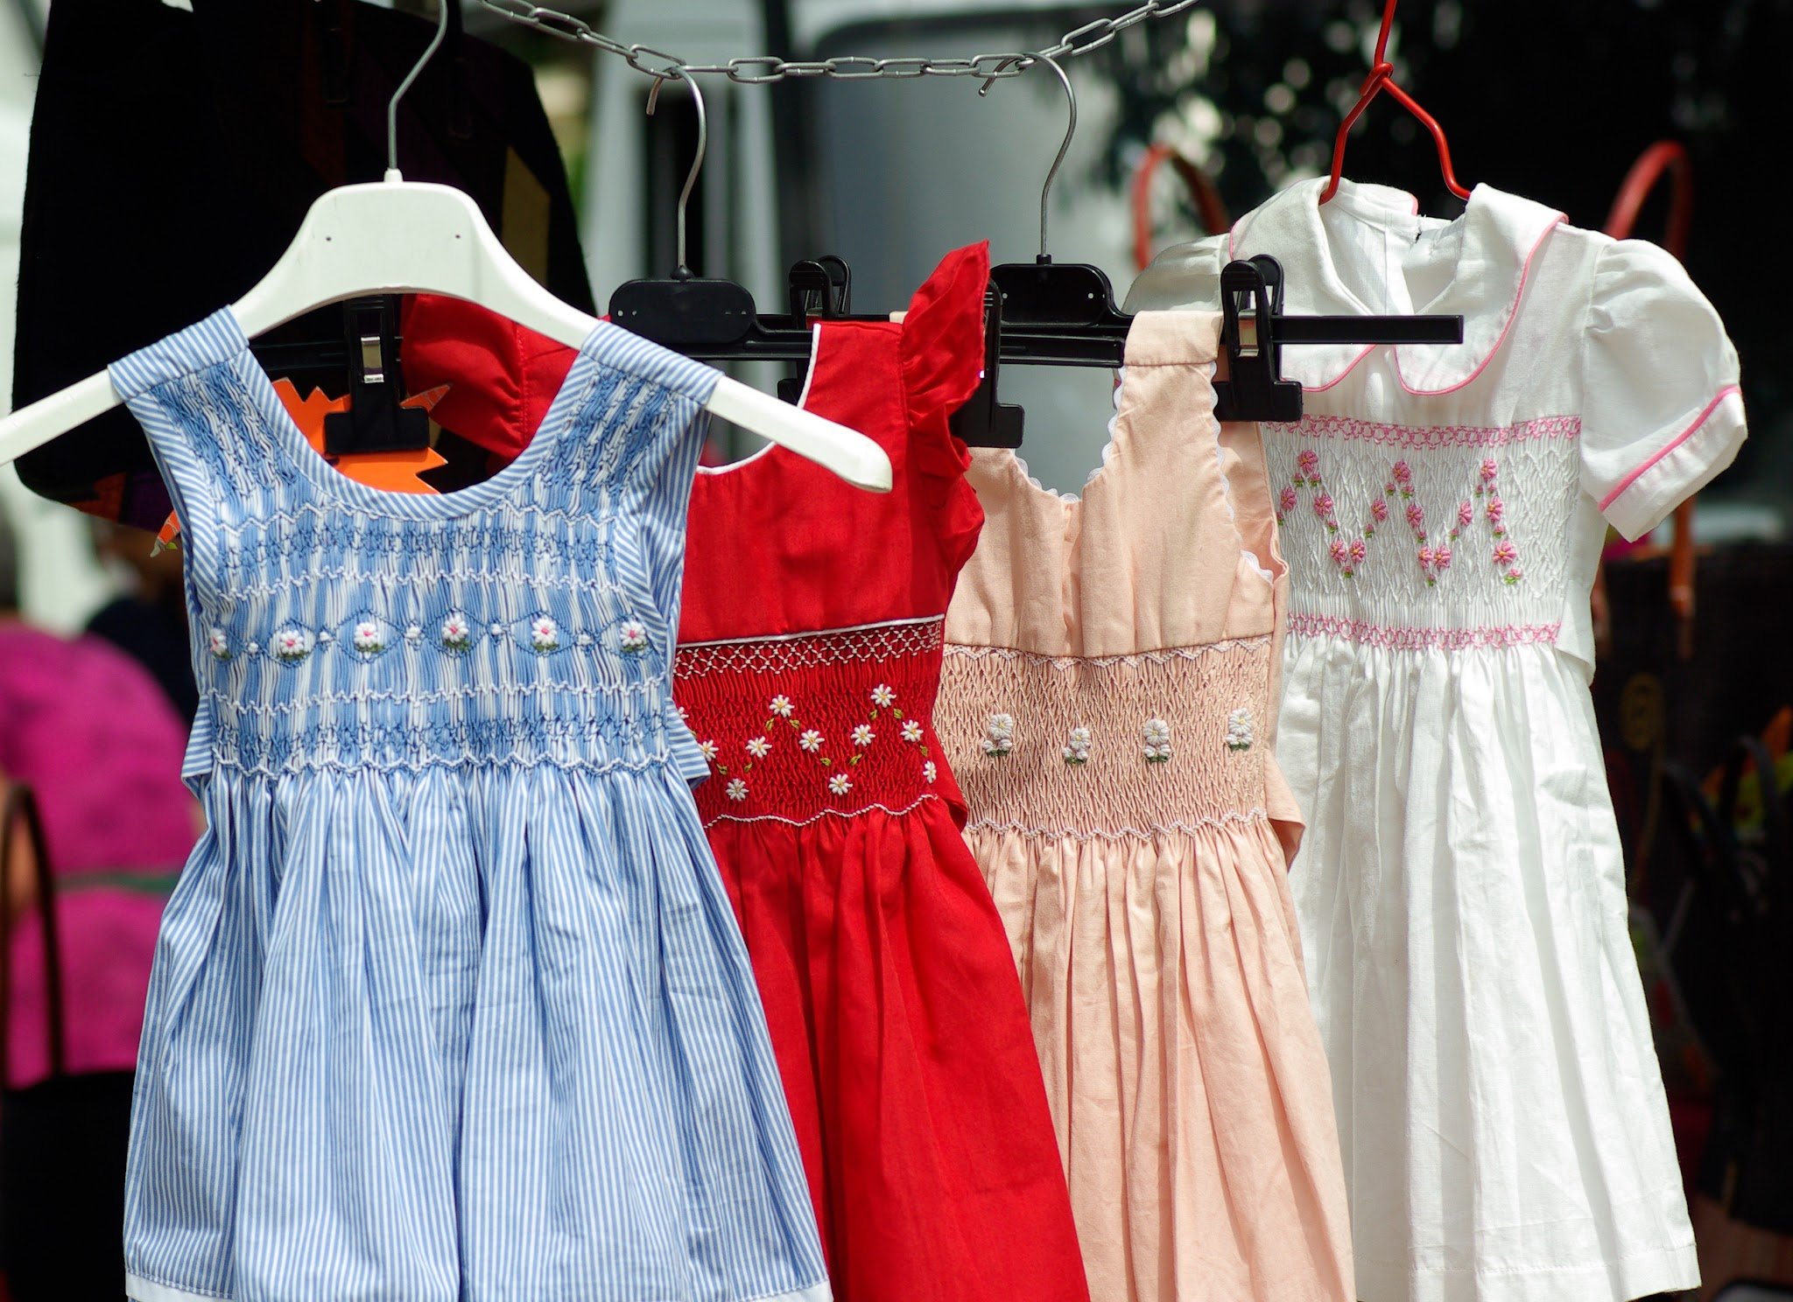
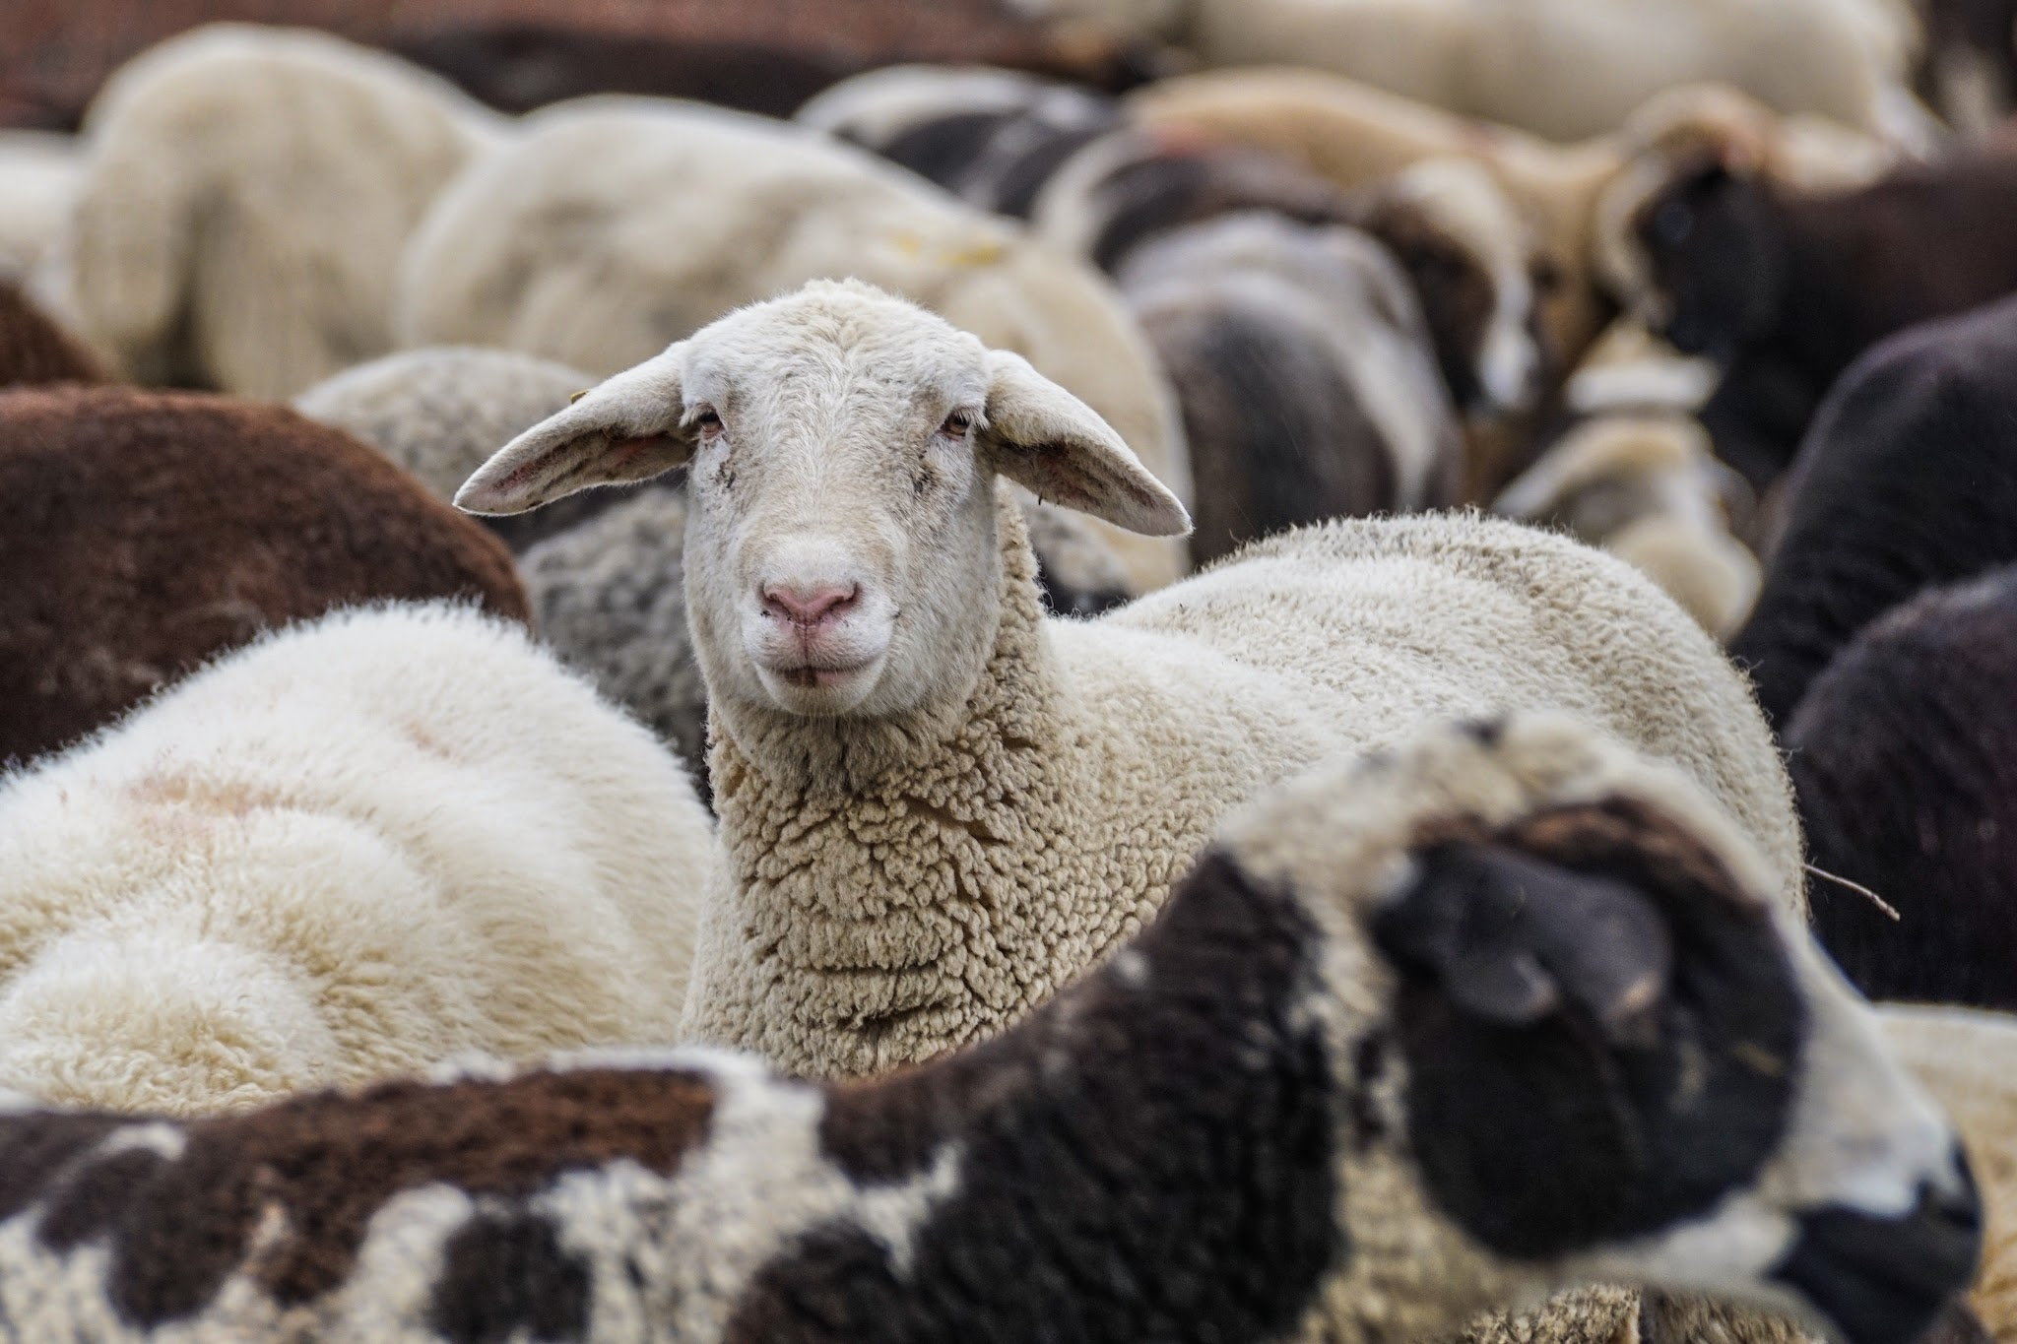
The Lord would cause the Egyptians to be friendly toward the Israelites when they left. What items below were the Israelite women to ask for?

Slide 32
The Lord would cause the Egyptians to be friendly toward the Israelites when they left. What items below were the Israelite women to ask for?
Gold, silver, and clothing

