Slide 1
Exodus Dig Site 2

Slide 2

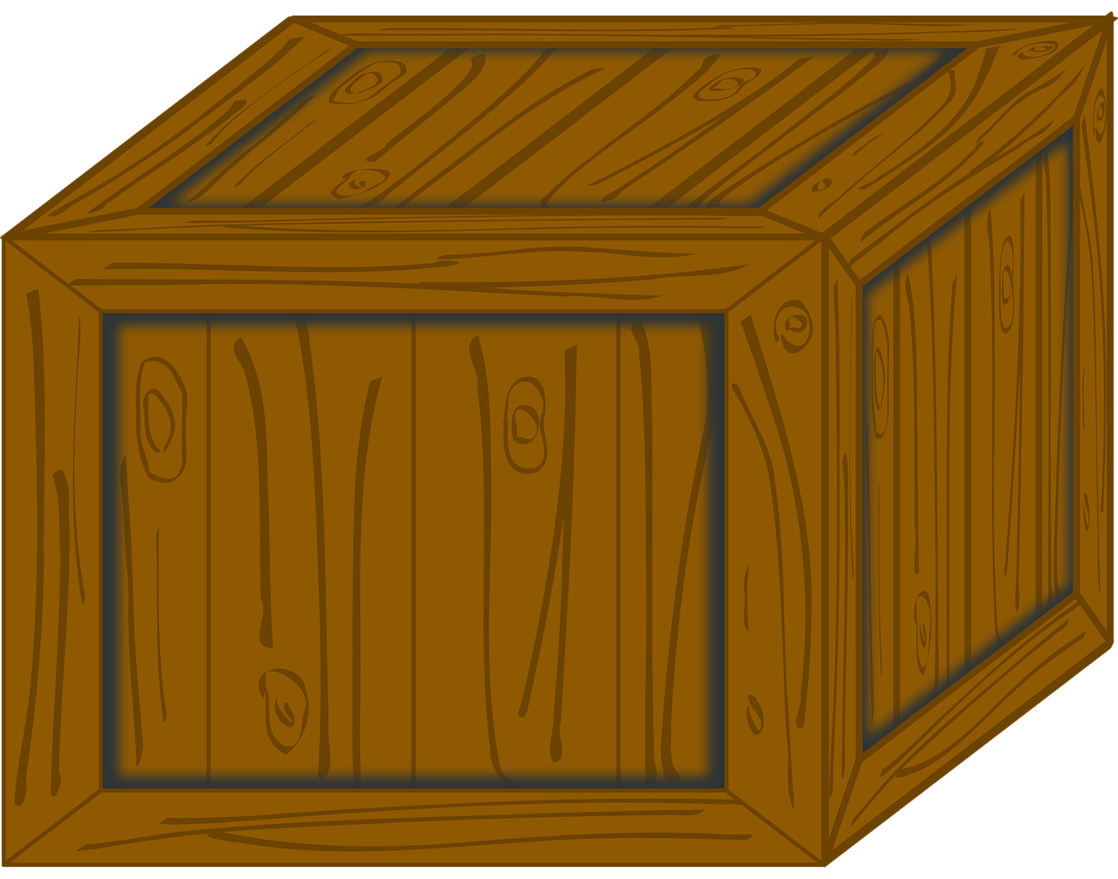

Pharaoh had ordered that all of the Hebrew boys be thrown into the Nile. A Levite woman hid her baby boy for 3 months, but when she couldn’t hide him anymore, what did she put him in?
Clap your hands for:
Stomp your feet for:
Pat your legs for:

Slide 3
Pharaoh had ordered that all of the Hebrew boys be thrown into the Nile. A Levite woman hid her baby boy for 3 months, but when she couldn’t hide him anymore, what did she put him in?
Pat your legs for:
She put him in a basket and put it among the reeds of the Nile

Slide 4
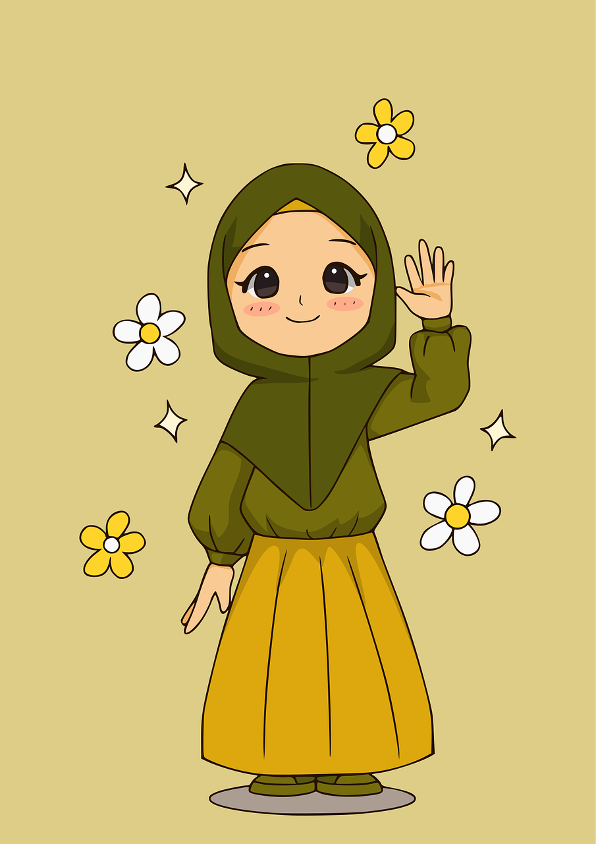
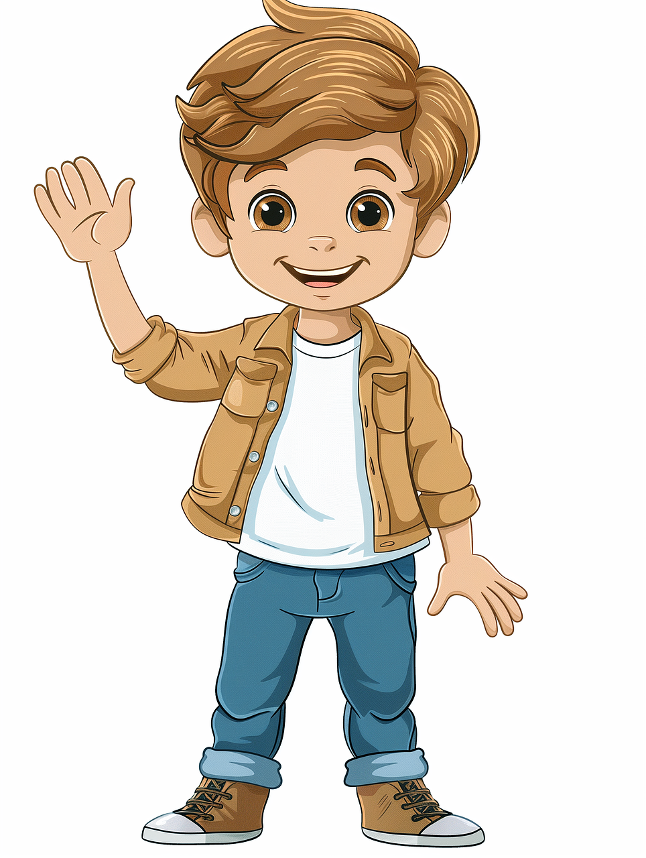
Who stood at a distance to see what would happen to the baby?
One hand up for:
Two hands up for:
the baby’s sister
the baby’s brother

Slide 5
Who stood at a distance to see what would happen to the baby?
One hand up for:
the baby’s sister

Slide 6
Who came down to bathe and saw the basket?
Jumping jacks for:
Toe touches for:
Pharaoh’s son
Pharaoh’s daughter

Slide 7
Who came down to bathe and saw the basket?
She opened the basket and saw the baby was crying and felt sad for him. She realized he must be one of the Hebrew babies her father had ordered thrown in the river.
Toe touches for:
Pharaoh’s daughter

Slide 8
The baby’s sister offered to find a Hebrew woman to nurse the baby. Pharaoh’s daughter agreed. Who did the sister bring?
Rock for:
Paper for:
Scissors for:
The baby’s own mother
Her older sister
She could not find anyone to nurse the baby

Slide 9
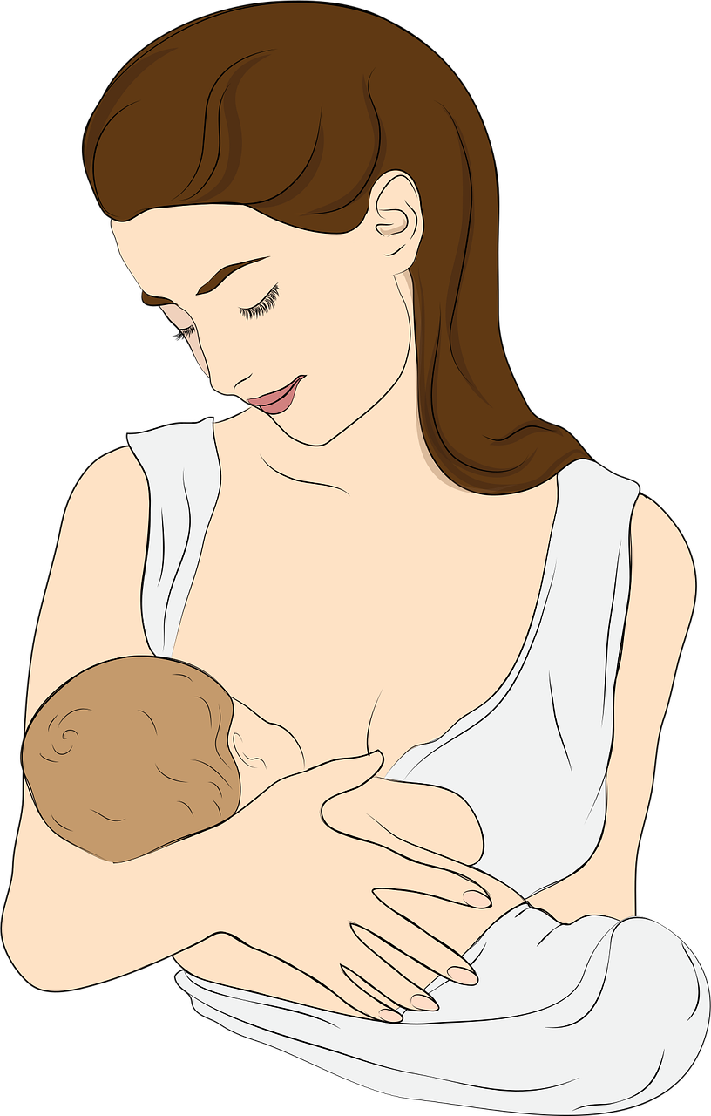
The baby’s sister offered to find a Hebrew woman to nurse the baby. Pharaoh’s daughter agreed. Who did the sister bring?
The baby’s own mom got to take care of him while he was nursing and Pharaoh’s daughter even paid her to do it!
Rock for:
The baby’s own mother

Slide 10
What did Pharaoh’s daughter name the baby?
Shout it out!
Daniel?
David?
Moses?
Daniel?
Joseph?

Slide 11
What did Pharaoh’s daughter name the baby?
Shout it out!
She named him Moses and said, “I drew him out of the water.” The name Moses sounds like “draw out” in Hebrew
Moses

Slide 12
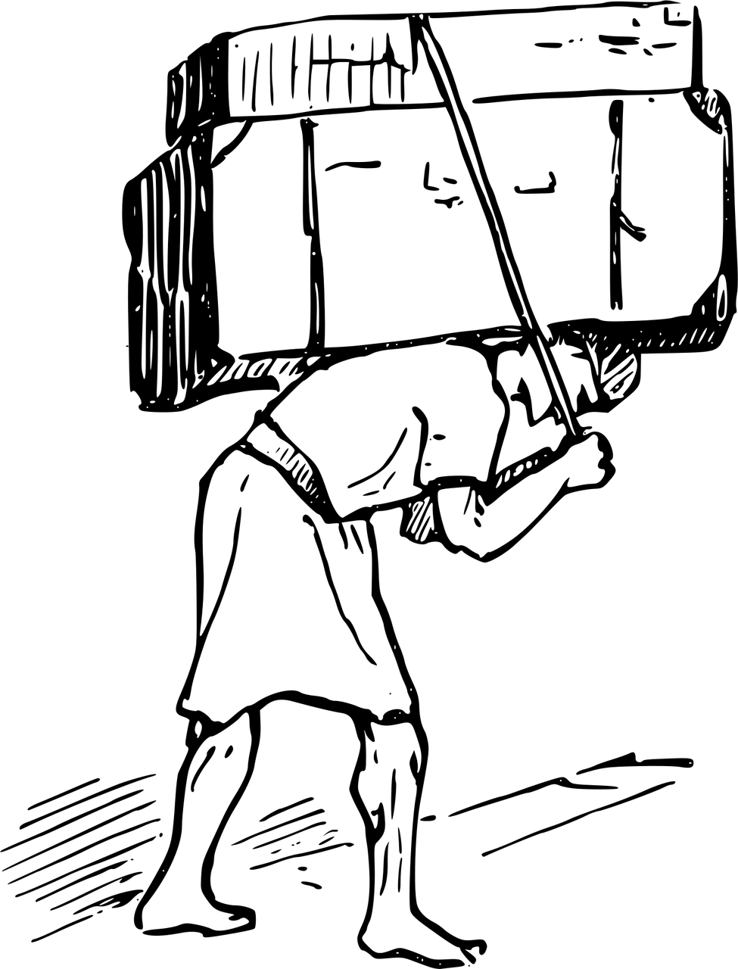

When Moses had grown up, what did he see his people doing?
Stand up for:
Sit down for:

Slide 13
When Moses had grown up, what did he see his people doing?
Stand up for:
He saw his people, the Hebrews, hard at work in slavery to the Egyptians

Slide 14
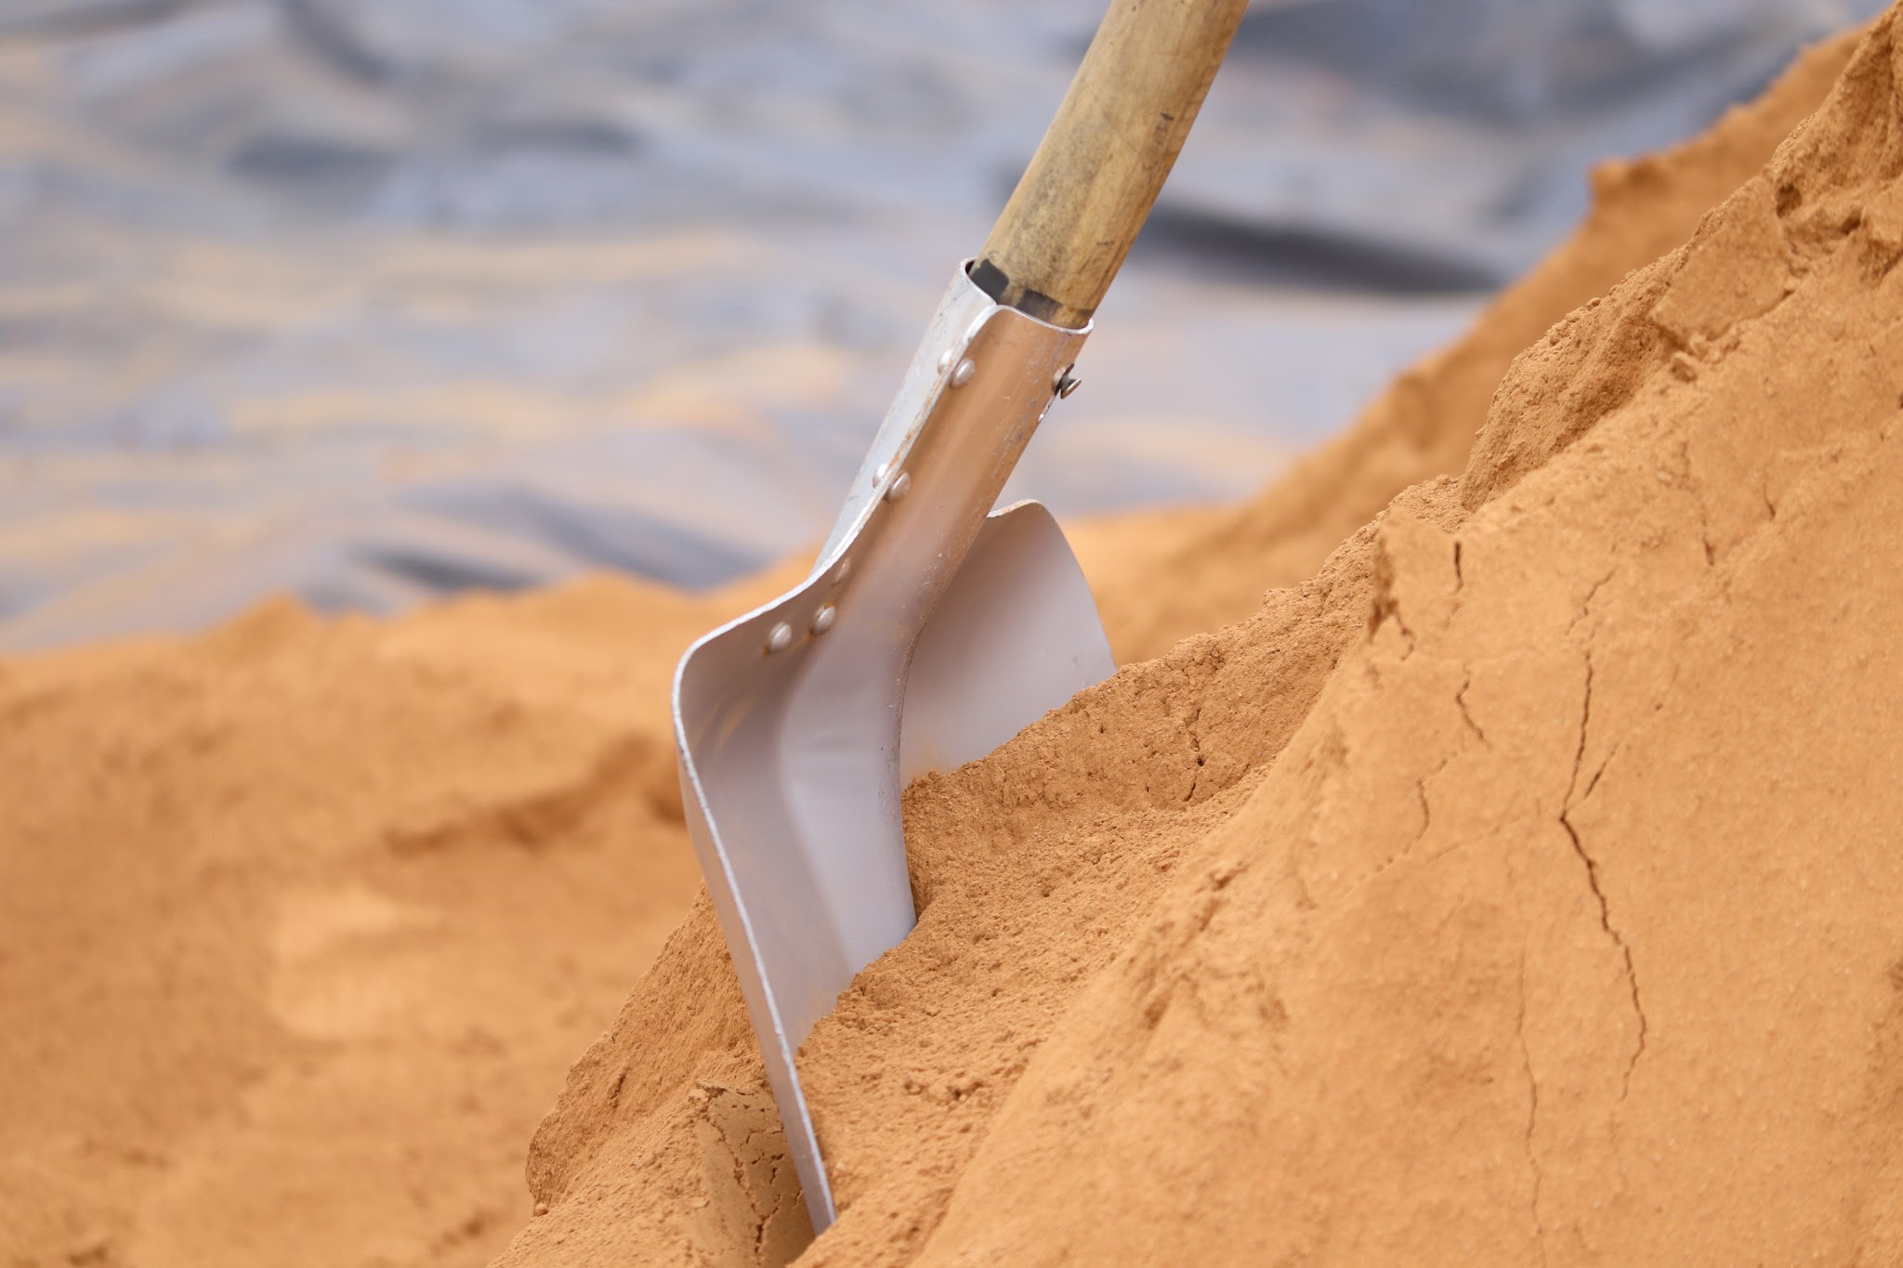
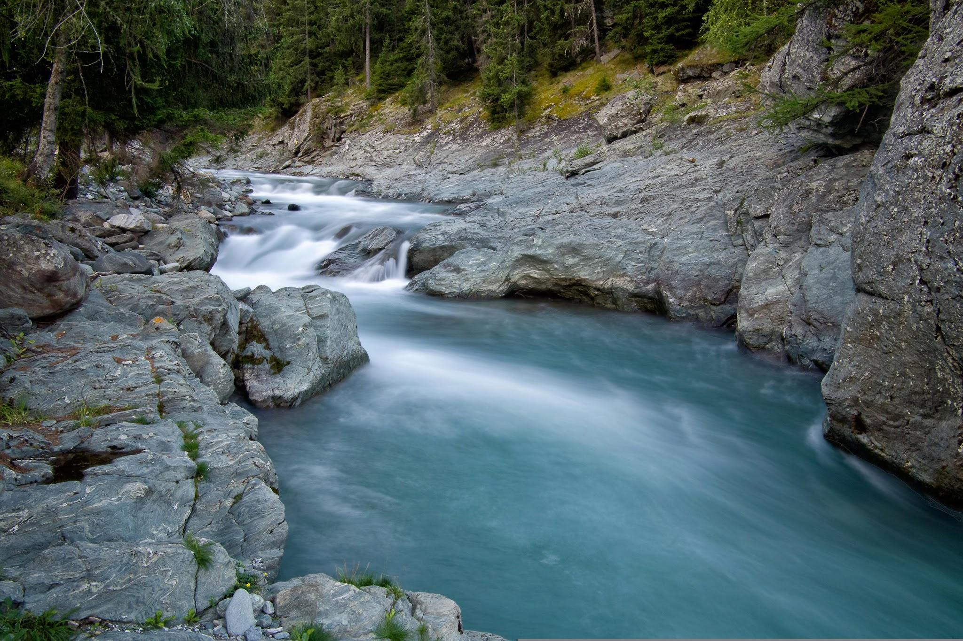
When Moses saw an Egyptian beating a Hebrew, he killed the Egyptian. Which picture shows how he tried to hide what he had done?
Spin around for:
Hop up and down for:

Slide 15
When Moses saw an Egyptian beating a Hebrew, he killed the Egyptian. Which picture shows how he tried to hide what he had done?
Spin around for:
He buried him in the sand.

Slide 16

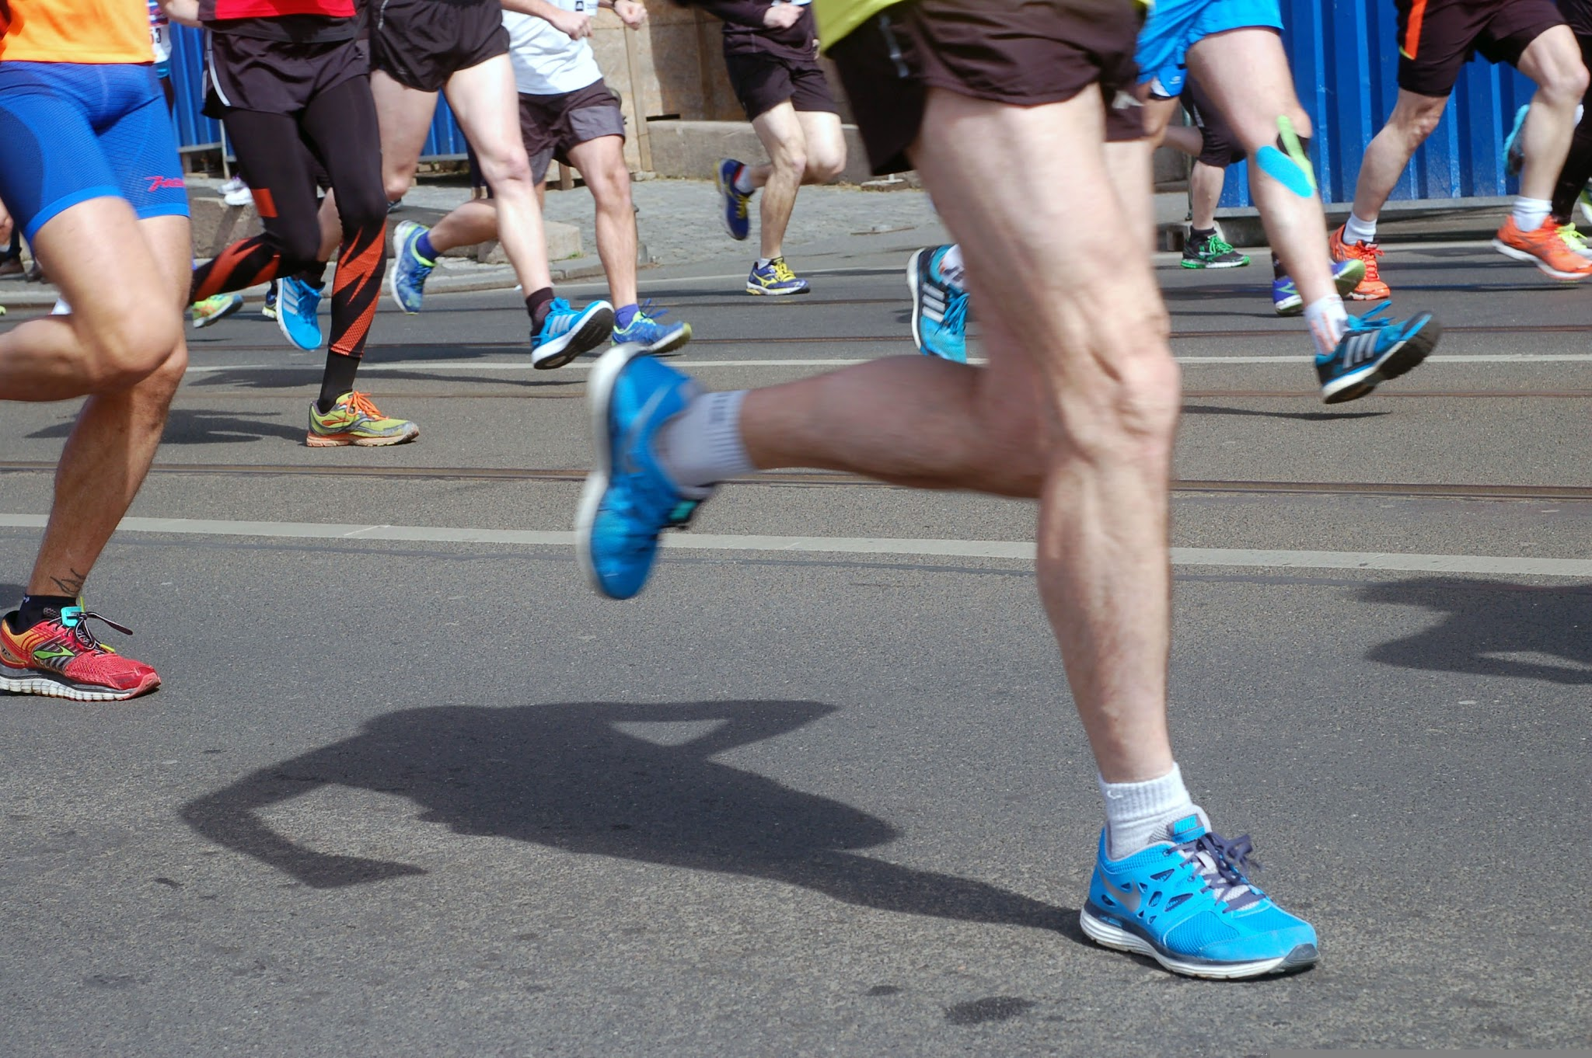
The next day, Moses saw that 2 Hebrews were fighting and scolded them. One of the men asked Moses if he was going to kill them like he did the Egyptian. Moses was afraid everyone knew what he’d done, and Pharaoh even tried to kill him. What did Moses do next?
Make crying noises for:
Run in place for:
He ran away
He went home and cried

Slide 17
The next day, Moses saw that 2 Hebrews were fighting and scolded them. One of the men asked Moses if he was going to kill them like he did the Egyptian. Moses was afraid everyone knew what he’d done, and Pharaoh even tried to kill him. What did Moses do next?
He fled to Midian, and there he sat down by a well.
Run in place for:
He ran away

Slide 18
Count out loud the daughters of the priest who came to the well to water their father’s flock.

Slide 19

Count out loud the daughters of the priest who came to the well to water their father’s flock.
1

Slide 20
Count out loud the daughters of the priest who came to the well to water their father’s flock.
1
2

Slide 21
Count out loud the daughters of the priest who came to the well to water their father’s flock.
1
2
3

Slide 22
Count out loud the daughters of the priest who came to the well to water their father’s flock.
1
2
3
4

Slide 23
Count out loud the daughters of the priest who came to the well to water their father’s flock.
1
2
3
4
5

Slide 24
Count out loud the daughters of the priest who came to the well to water their father’s flock.
1
2
3
4
5
6

Slide 25
Count out loud the daughters of the priest who came to the well to water their father’s flock.
1
2
3
4
5
6
7

Slide 26
Who came along to chase the girls away?
Shout it out!
1
2
3
4
5
6
7

Slide 27
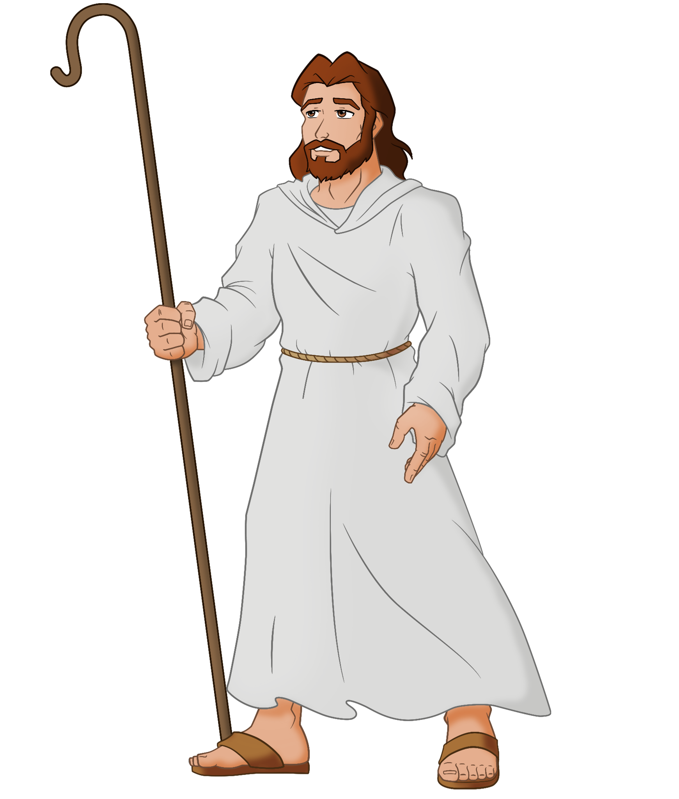
Who came along to chase the girls away?
Shepherds came and drove the girls away

Slide 28


Did Moses rescue the girls?

Slide 29
Did Moses rescue the girls?
Moses rescued the girls and gave water to their flock.

Slide 30
The girls told their father Reuel about what Moses had done and he invited Moses to eat with them. After that, Reuel gave Moses his daughter Zipporah in marriage. They had a son. What did they name him?
Shout it out!
Gershom?
Rueben?
Zebulun?
Dan?

Slide 31
The girls told their father Reuel about what Moses had done and he invited Moses to eat with them. After that, Reuel gave Moses his daughter Zipporah in marriage. They had a son. What did they name him?
Shout it out!
Gershom
Moses said, “I have become a foreigner in a foreign land.” The name Gershom sounds like “foreigner there” in Hebrew

