Slide 1
Exodus Dig Site 1

Slide 2
Jacob’s family arrived in Egypt with how many descendants of Jacob?
Jumping Jacks for: Toe touches for: Sit on the floor for:
70 100 300

Slide 3
Jacob’s family arrived in Egypt with how many descendants of Jacob?
Jumping Jacks for:
70

Slide 4

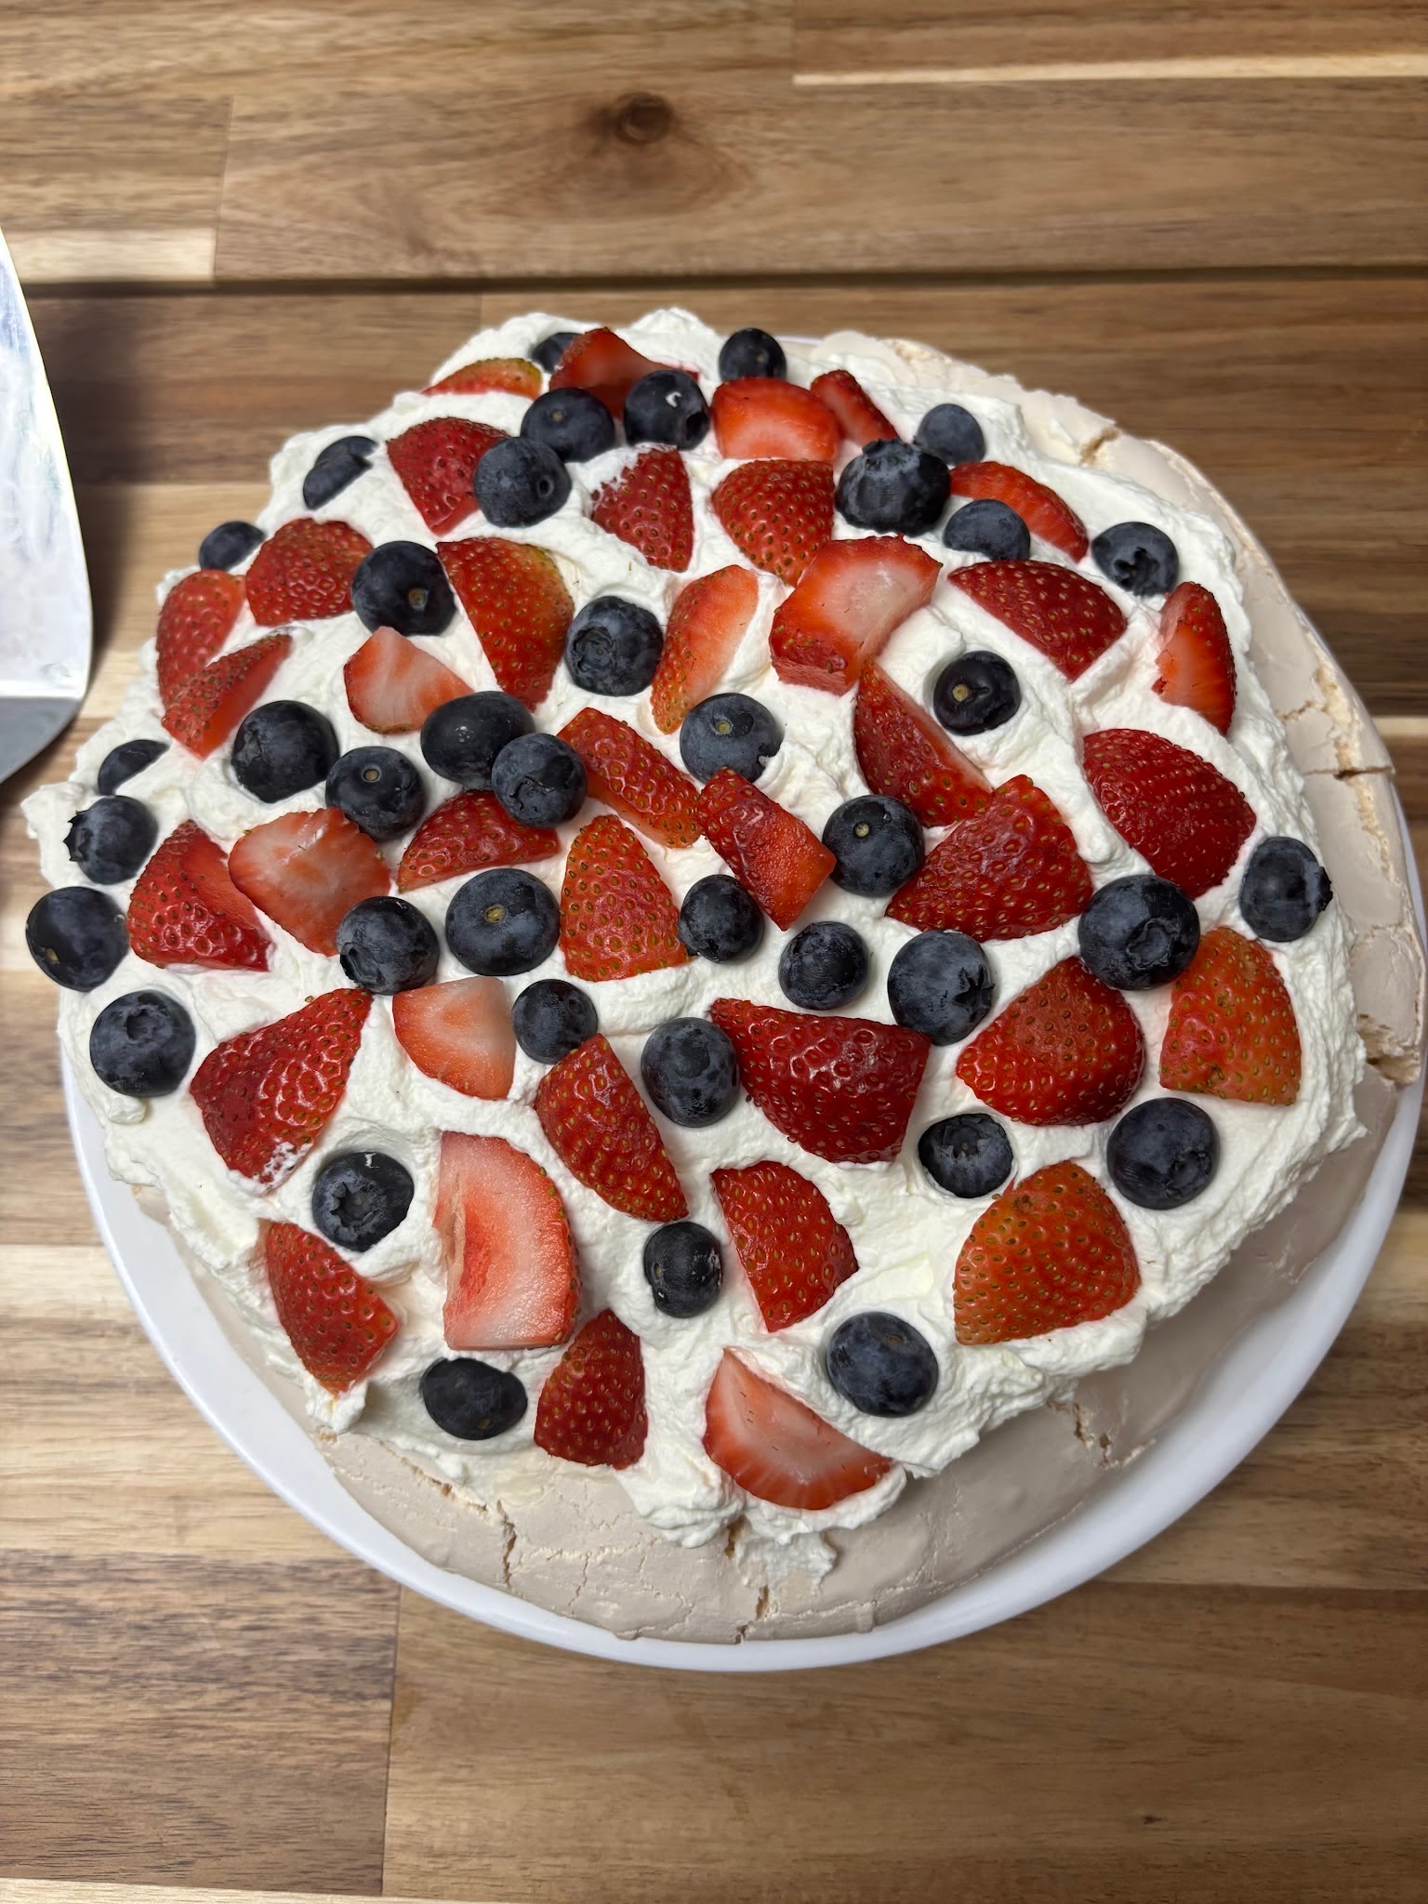
Which picture represents what happened with the Israelites after Joseph’s generation all died?
Clap your hands for: Stomp your feet for:

Slide 5
Which picture represents what happened with the Israelites after Joseph’s generation all died?
Clap your hands for:
They were fruitful and multiplied

Slide 6
The new king did not like that there were so many Israelites. What did he do to them?
One hand up for: Two hands up for: No hands up for:
Put them in jail Made them slaves Threw a banquet for them

Slide 7
The new king did not like that there were so many Israelites. What did he do to them?
One hand up for: Two hands up for: No hands up for:
Put them in jail Made them slaves Threw a ban

Slide 8


When the Israelites were oppressed, did they divide and fade away?

Slide 9
When the Israelites were oppressed, did they divide and fade away?
No! They multiplied and spread

Slide 10
The king’s (Pharaoh’s) plan to keep the Israelites from growing in numbers was not working, so he created an evil plan. Who did he tell the Hebrew midwives to kill?
Baby Boys
Baby Girls

Slide 11
The king’s (Pharaoh’s) plan to keep the Israelites from growing in numbers was not working, so he created an evil plan. Who did he tell the Hebrew midwives to kill?
Baby Boys

Slide 12
Did the midwives, Shiphrah and Puah, do what Pharaoh told them to do and kill the baby boys?

Slide 13
Did the midwives, Shiphrah and Puah, do what Pharaoh told them to do and kill the baby boys?
No, the midwives let the baby boys live because they feared God

Slide 14
Did the number of Israelites go up or down after this?
(Point up or down)

Slide 15
Did the number of Israelites go up or down after this?
The people became even more numerous and God gave those midwives their own families

Slide 16
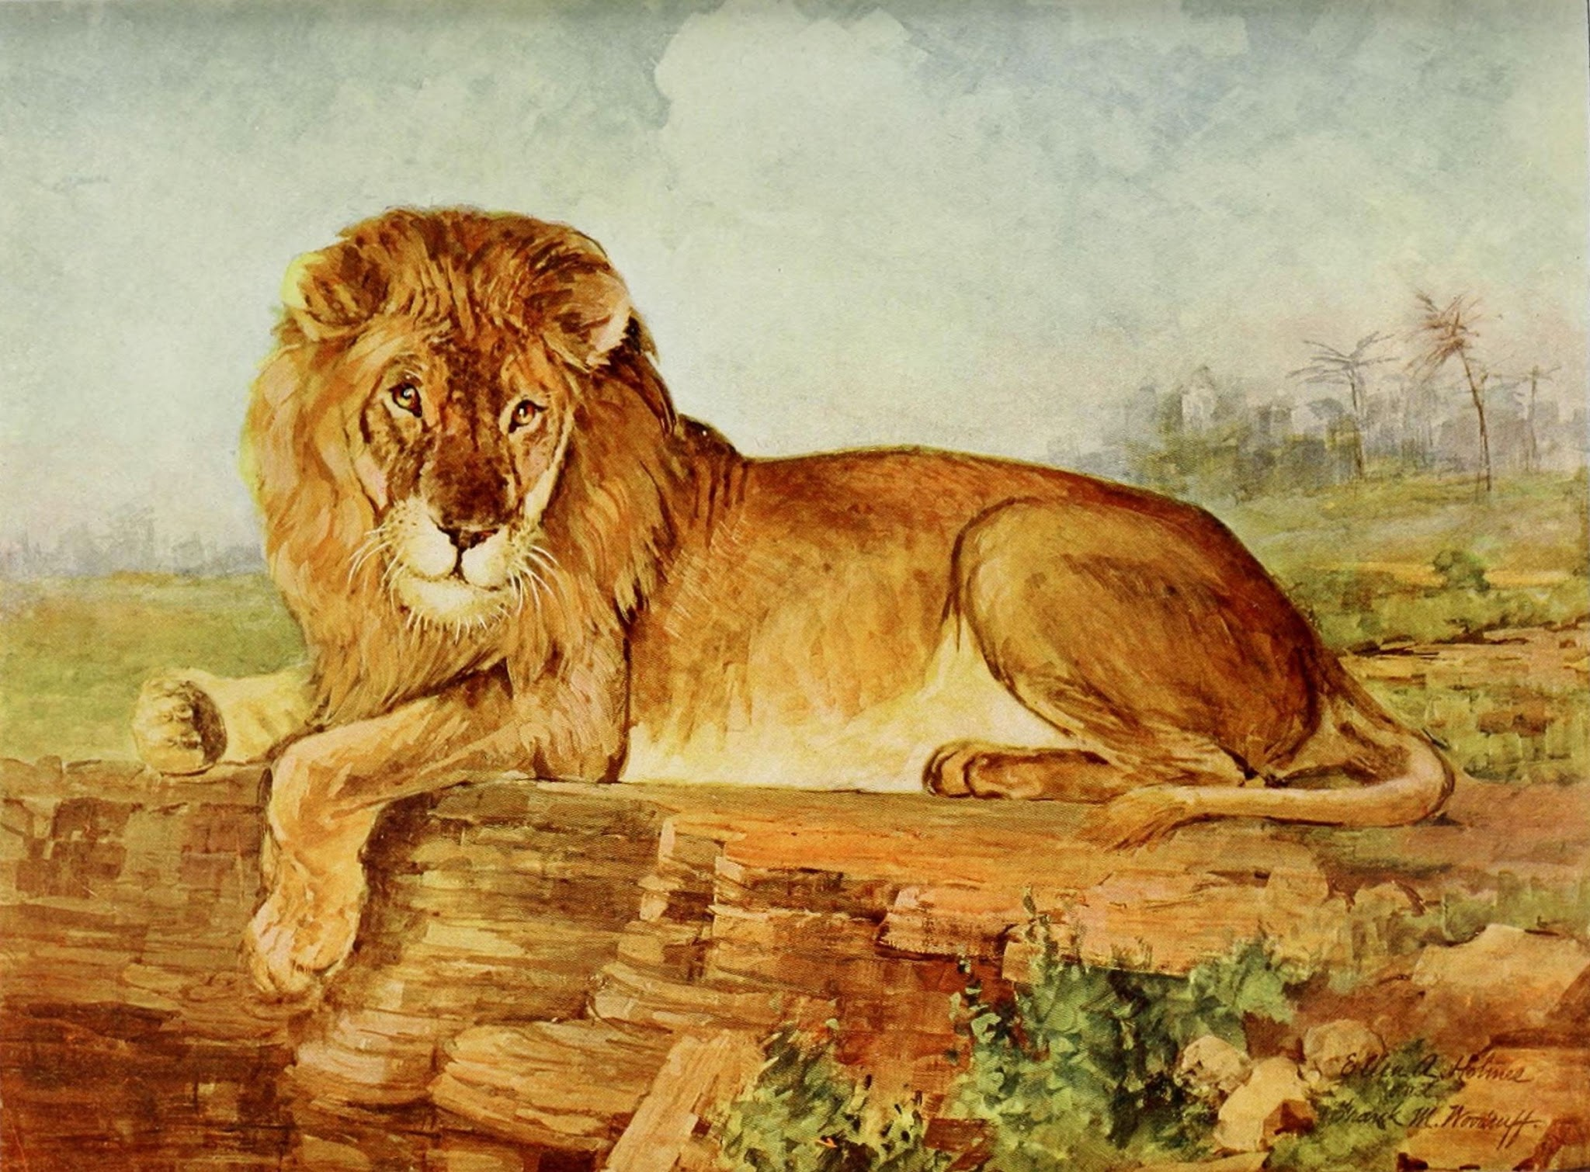
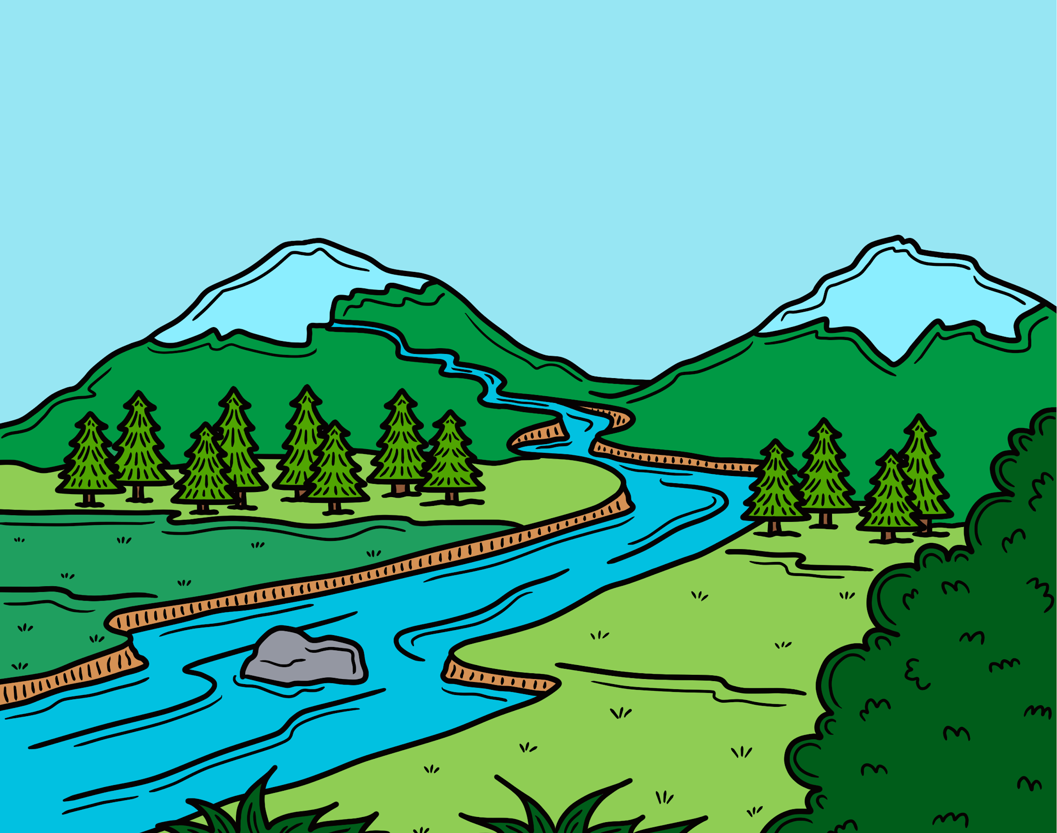
Pharaoh was angry that his first 2 attempts at getting rid of the Israelites did not work, so now he made a terrible rule. He said every Hebrew baby boy should be thrown where?
Shout it out
The lion’s den
The Nile River

Slide 17
Pharaoh was angry that his first 2 attempts at getting rid of the Israelites did not work, so now he made a terrible rule. He said every Hebrew baby boy should be thrown where?
Shout it out
The Nile River

