Slide 1
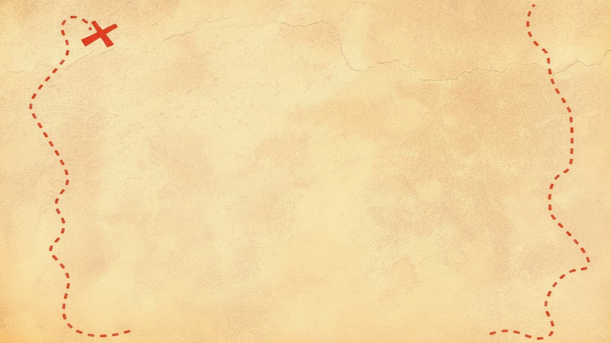


Dig Site 2 Memory Verse
Hide God's Word in Your Heart!
This activity will help you memorize your Bible verse for the week. Each slide removes more words from the verse. Click your mouse or spacebar to fill in the blanks one at a time but try to say it out loud with the missing words yourself before clicking. Don't forget to practice the reference at the top.

Slide 2

Psalm 7:10
"My shield is God most high,
who saves the upright in heart."
Notes:
Scripture quotations taken from The Holy Bible, New International Version®, NIV®. Copyright © 1973, 1978, 1984, 2011 by Biblica, Inc.
Image created with ChatGPT

Slide 3
Psalm 7:10
"My shield is God most high,
who saves the upright in heart."
What Does It Mean?
Shields are used for protection and defense. Do you remember Genesis 15:1b from last year? God told Abraham he was his shield. This psalm was written by Kind David, but David also trusted God to protect him. Ephesians 6:16 tells us to take up our shield of faith. If we trust in God and love Him with our whole heart, we can depend on Him to protect and defend us, especially if people are against us because we love God.

Slide 4
Psalm 7:___
"My _____ is God most _____,
who _____ the upright in ______."
10
shield
high
saves
heart
Notes:
Scripture quotations taken from The Holy Bible, New International Version®, NIV®. Copyright © 1973, 1978, 1984, 2011 by Biblica, Inc.

Slide 5
Psalm __:___
"My _____ is ____ most _____,
____ _____ the _______ in ______."
7
10
shield
God
high
who
saves
upright
heart
Notes:
Scripture quotations taken from The Holy Bible, New International Version®, NIV®. Copyright © 1973, 1978, 1984, 2011 by Biblica, Inc.

Slide 6
_______ __:___
"___ _____ __ ____ _____ _____,
____ _____ ___ _______ ___ ______."
Psalm
7
10
My
shield
is
God
most
high
who
saves
the
upright
in
heart
Notes:
Scripture quotations taken from The Holy Bible, New International Version®, NIV®. Copyright © 1973, 1978, 1984, 2011 by Biblica, Inc.

