Slide 1
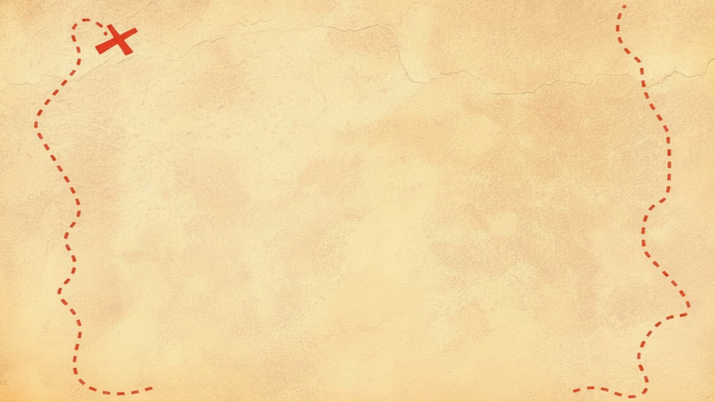


Dig Site 1 Memory Verse
Hide God's Word in Your Heart!
This activity will help you memorize your Bible verse for the week. Each slide removes more words from the verse. Click your mouse or spacebar to fill in the blanks one at a time but try to say it out loud with the missing words yourself before clicking. Don't forget to practice the reference at the top.

Slide 2


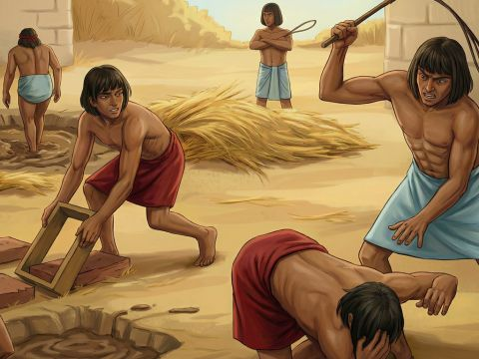
Exodus 3:7
The LORD said,
"I have indeed seen the misery of my people in Egypt.
I have heard them crying out because of their slave drivers,
and I am concerned about their suffering.
Notes:
Scripture quotations taken from The Holy Bible, New International Version®, NIV®. Copyright © 1973, 1978, 1984, 2011 by Biblica, Inc.
Image: https://www.freebibleimages.org/illustrations/spi-moses-pharaoh/

Slide 3
Exodus 3:7
What does it mean?
God sees what we are going through!
We can tell God anything and He hears us!
God cares about us and will help us!
The LORD said,
"I have indeed seen the misery of my people in Egypt.
I have heard them crying out because of their slave drivers,
and I am concerned about their suffering.
Notes:
Scripture quotations taken from The Holy Bible, New International Version®, NIV®. Copyright © 1973, 1978, 1984, 2011 by Biblica, Inc.
Image: https://www.freebibleimages.org/illustrations/spi-moses-pharaoh/

Slide 4
Exodus 3:7
LORD
The _____ said,
"I have indeed seen the misery of my people in ______.
I have heard them crying out because of their _____ drivers,
and I am concerned about their ________.
Egypt
slave
suffering
Notes:
Scripture quotations taken from The Holy Bible, New International Version®, NIV®. Copyright © 1973, 1978, 1984, 2011 by Biblica, Inc.

Slide 5
Exodus 3:7
LORD
The _____ said,
"I have indeed seen the _____ of my people in ______.
I have _____ them crying ___ because of their _____ drivers,
and I am ________ about their ________.
misery
Egypt
heard
out
slave
concerned
suffering
Notes:
Scripture quotations taken from The Holy Bible, New International Version®, NIV®. Copyright © 1973, 1978, 1984, 2011 by Biblica, Inc.

Slide 6
Exodus _:7
3
The
LORD
seen
___ _____ said,
"I have indeed _____ the _____ of my ______ in ______.
I have _____ them _____ ___ because of their _____ drivers,
and _ am ________ ____ their ________.
misery
people
Egypt
heard
crying
out
slave
I
concerned
about
suffering
Notes:
Scripture quotations taken from The Holy Bible, New International Version®, NIV®. Copyright © 1973, 1978, 1984, 2011 by Biblica, Inc.

Slide 7
Exodus _:_
3
7
The
LORD
said
I
indeed
seen
___ _____ ____,
"_ have _____ _____ the _____ of ___ ______ in ______.
I have _____ them _____ ___ because __their _____ ______,
and _ am ________ ____ ____ ________.
misery
my
people
Egypt
heard
crying
out
of
slave
drivers
I
concerned
about
their
suffering
Notes:
Scripture quotations taken from The Holy Bible, New International Version®, NIV®. Copyright © 1973, 1978, 1984, 2011 by Biblica, Inc.

Slide 8
______ _:_
Exodus
3
7
The
LORD
said
I
have
indeed
seen
___ _____ ____,
"_ ____ _____ _____ ___ _____ __ ___ ______ __ ______.
_ ____ _____ ____ _____ ___ _______ __ ____ ____ ______,
___ _ __ ________ ____ ____ ________.
the
misery
of
my
people
in
Egypt
I
have
heard
them
crying
out
because
of
their
slave
drivers
and
am
concerned
I
about
their
suffering
Notes:
Scripture quotations taken from The Holy Bible, New International Version®, NIV®. Copyright © 1973, 1978, 1984, 2011 by Biblica, Inc.

