Slide 1

DigSite #5
Exodus
5:1-23-6:1-9
A Meeting with Pharaoh

Slide 2
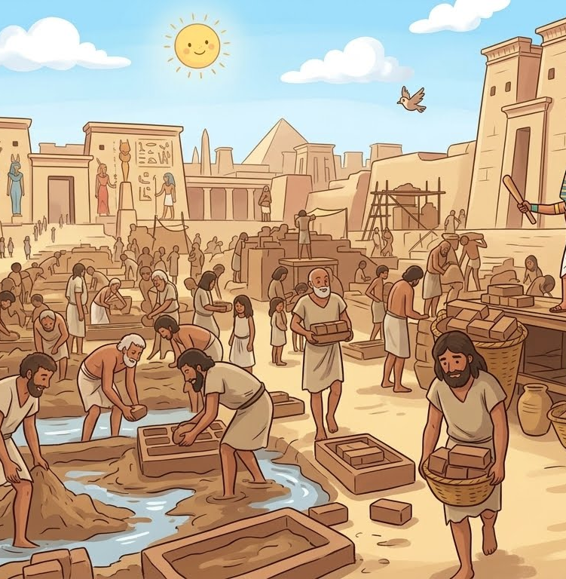
Exodus 6:5
Memory Verse
Moreover, I have heard the groaning of the Israelites, whom the Egyptians are enslaving,
and I have remembered my covenant.
Notes:
Image AI generated

Slide 3
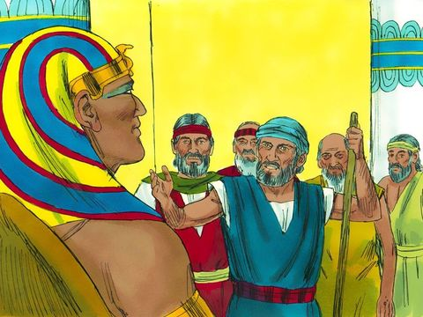
Read Exodus 5:1-2
Notes:
https://www.freebibleimages.org/illustrations/moses-pharaoh/

Slide 4
Read Exodus 5:3
Although Moses and Aaron asked to take a 3-day journey instead of leaving for good, this was likely a figure of speech and just a polite way of negotiating with Pharaoh. The three days may have also been a way to describe how far they were going to travel, not how long they would be gone. Either way, they were not lying. Pharaoh would have clearly understood their intentions to leave Egypt permanently.

Slide 5
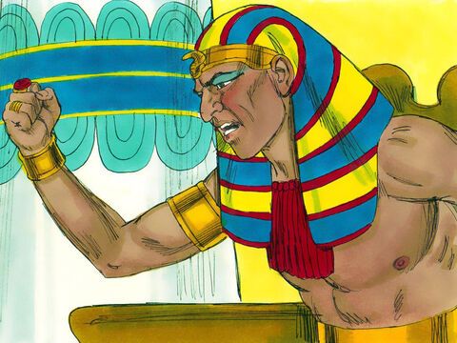
Read Exodus 5:4-5

Slide 6
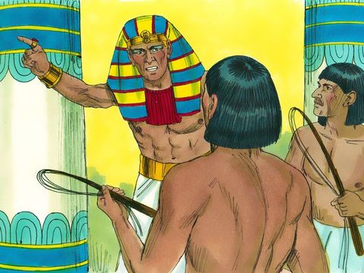
Read Exodus 5:6-9

Slide 7
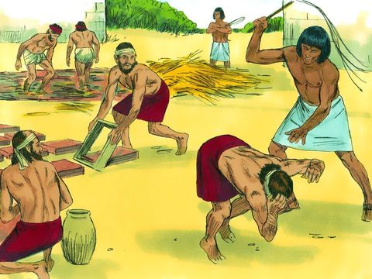
Read Exodus 5:10-14

Slide 8
Read Exodus 5:15-16

Slide 9
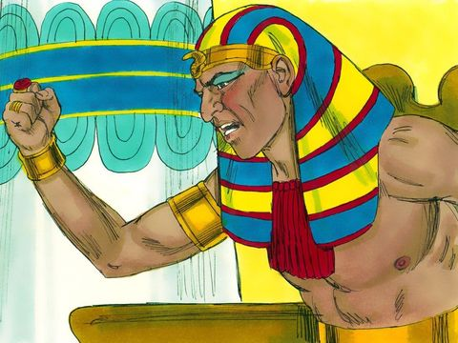
Read
Exodus 5:17-18

Slide 10
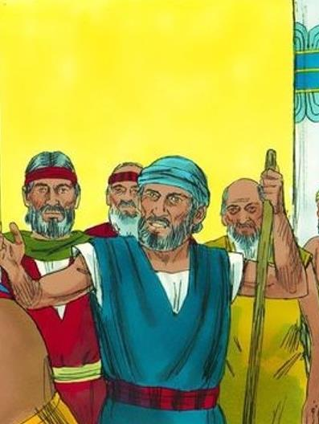
Read
Exodus 5:19-21

Slide 11
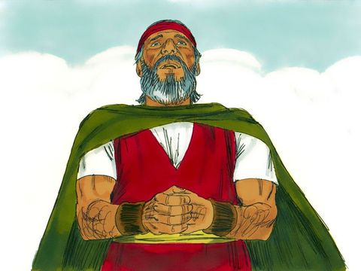
Read Exodus 5:22-23
*It's ok to take our doubts and questions to God!

Slide 12
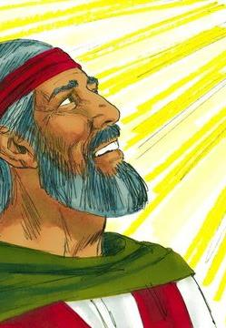
Read Exodus 6:1

Slide 13
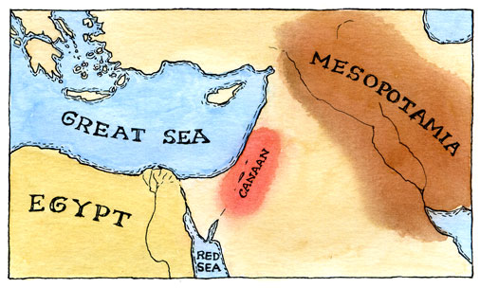
Read Exodus 6:2-4
Did You Know?
When you see LORD (all capitals) in the Bible, it stands for Yahweh. Have you heard that name for God?

Slide 14
Exodus 6:5
Memory Verse
Moreover, I have heard the groaning of the Israelites, whom the Egyptians are enslaving,
and I have remembered my covenant.
Notes:
Image AI generated

Slide 15
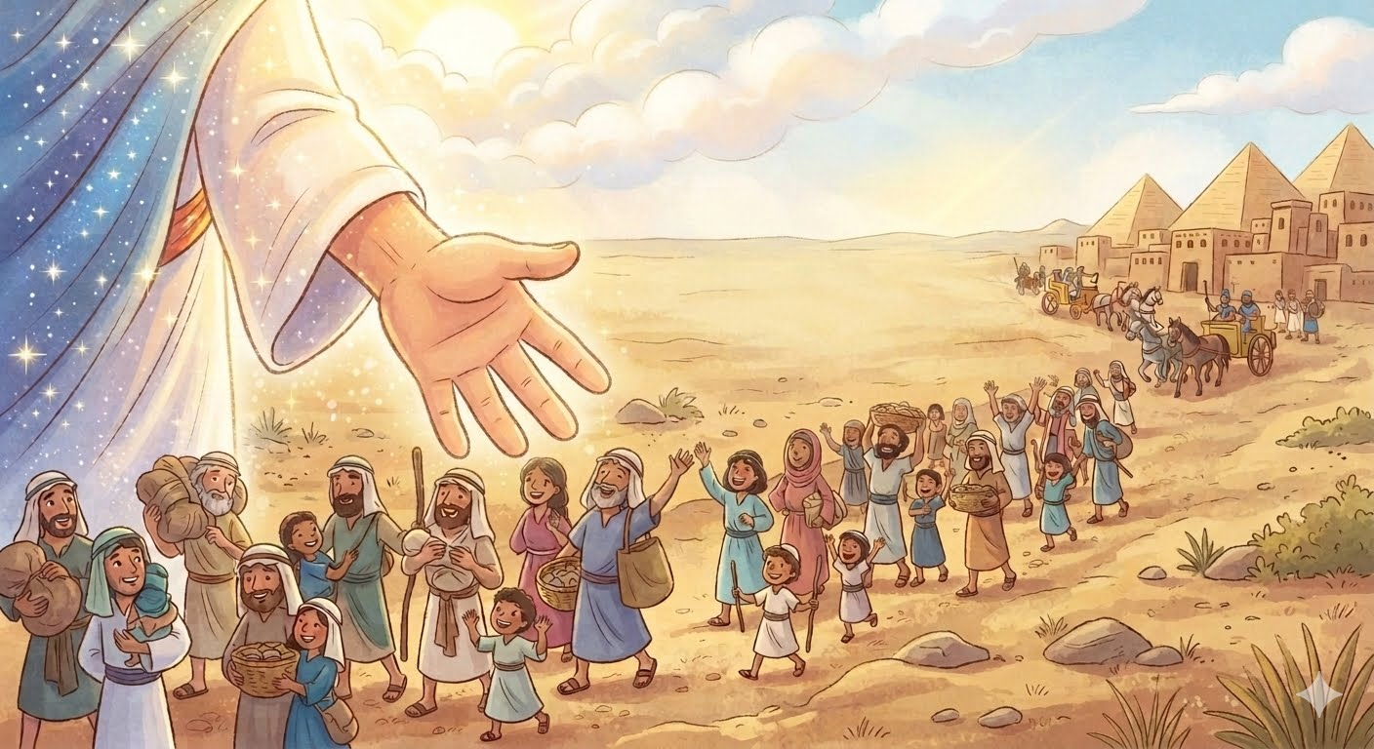
Read
Exodus 6:6-7
Notes:
Image Ai generated

Slide 16
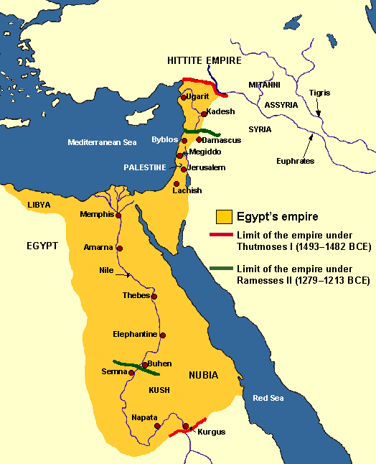
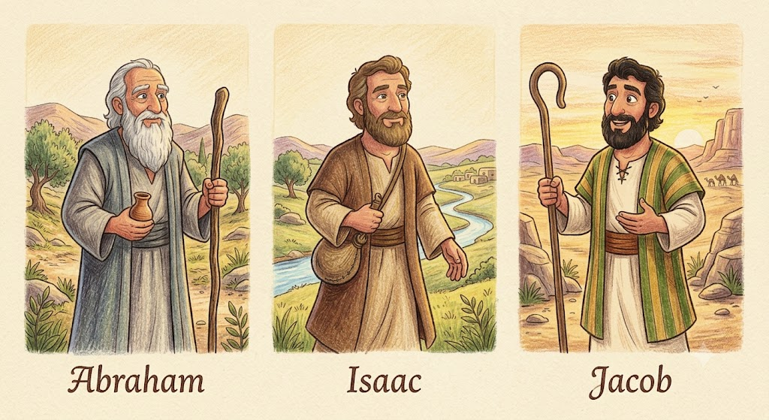
Read
Exodus 6:8
Notes:
Abraham, Isaac, and Jacob – AI generated

Slide 17
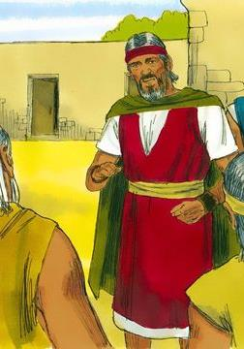

Read
Exodus 6:9

