Slide 1

Lesson #4
Exodus 4:1-21, 27-31

Slide 2


Psalm 9:10
Those who know your name trust in you, for you, Lord,
Have never forsaken those who seek you.

Slide 3
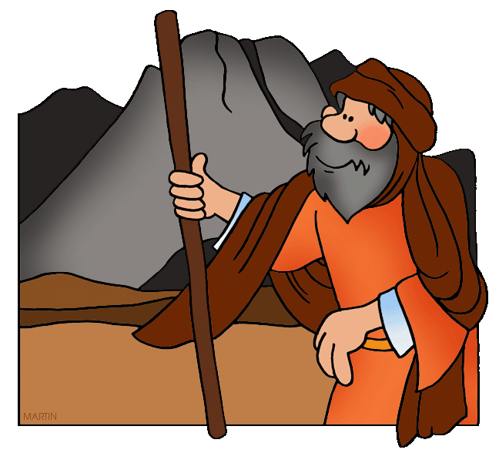
Read:
Exodus 4:1-2

Slide 4
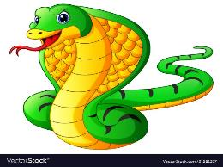
Read:
Exodus 4:3

Slide 5
Read:
Exodus 4:4

Slide 6

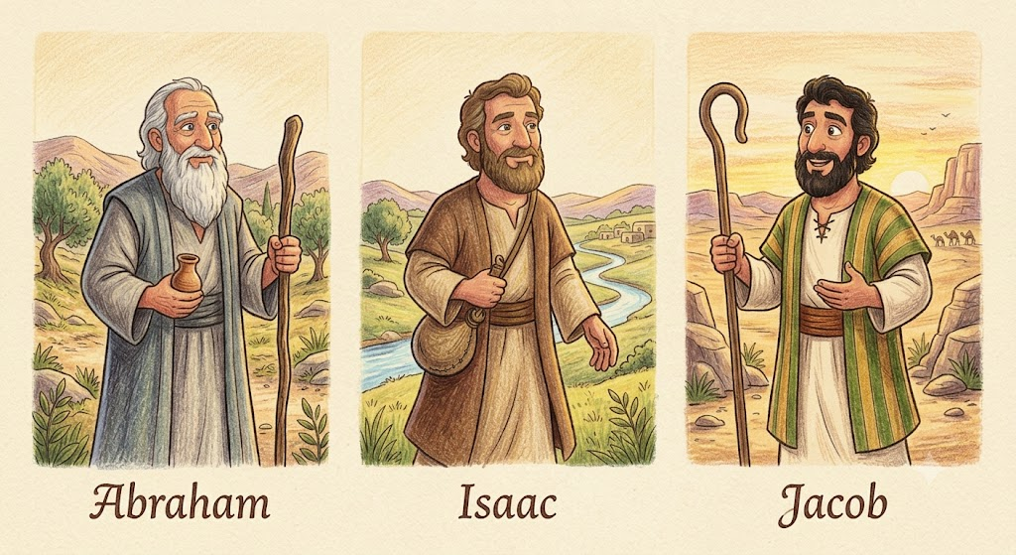
Read:
Exodus 4:5

Slide 7
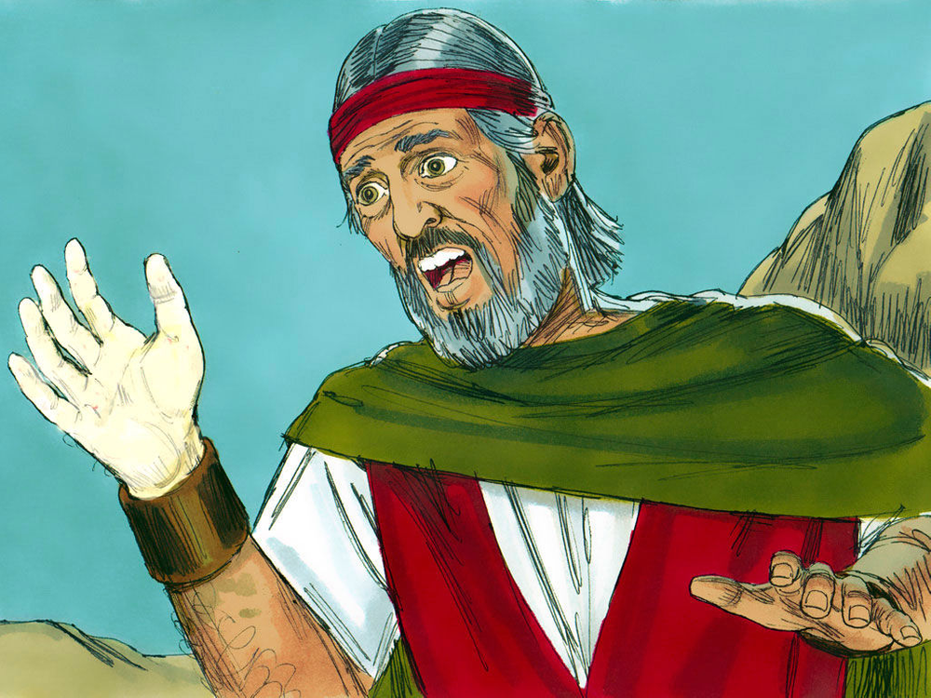
Read: Exodus 4:6
Notes:
https://www.freebibleimages.org/illustrations/moses-burning-bush/

Slide 8
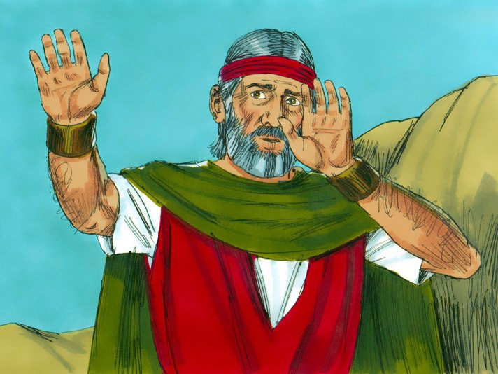
Read: Exodus 4:7
Notes:
https://www.freebibleimages.org/illustrations/moses-burning-bush/

Slide 9
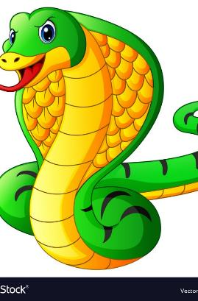
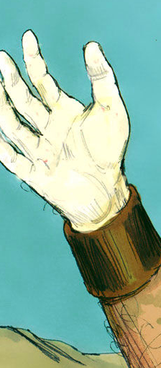
Read: Exodus 4:8

Slide 10
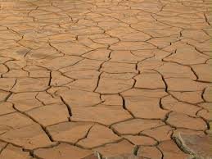
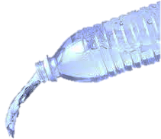
Read: Exodus 4:9

Slide 11

Read: Exodus 4:10-11

Slide 12

Now go; I will help you speak and will teach you what to say.”
*Exodus 4:12 – You learned (or will learn) this memory verse in our Acts study!

Slide 13
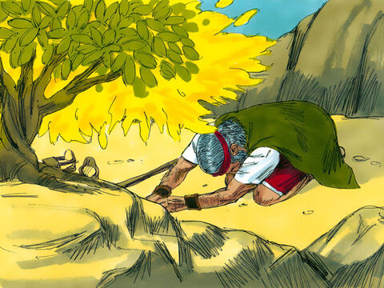
Read: Exodus 4:13-14

Slide 14
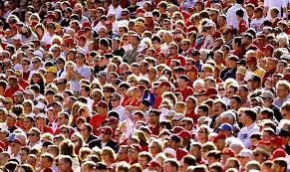
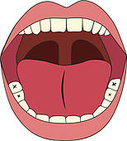
Read: Exodus 4:15-16
WORDS

Slide 15

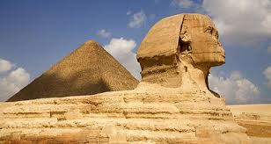
Read: Exodus 4:17

Slide 16
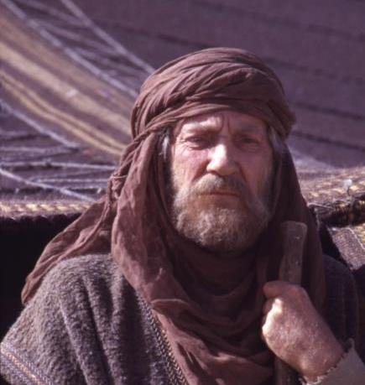
Read:
Exodus 4:18

Slide 17
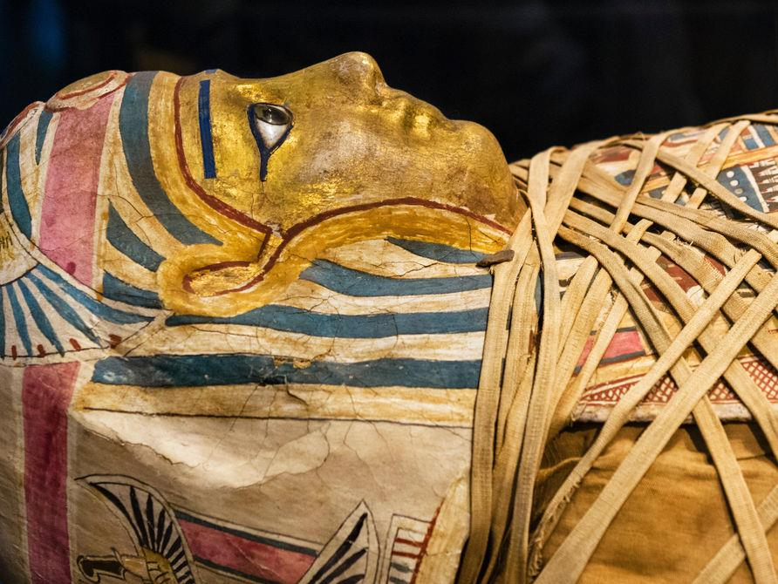
Read: Exodus 4:19

Slide 18
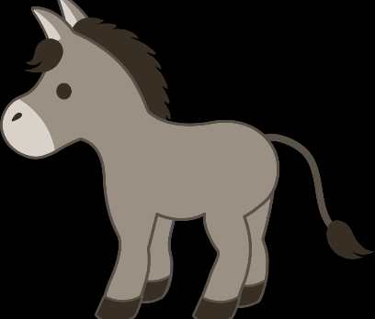
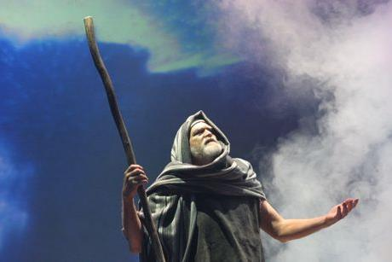
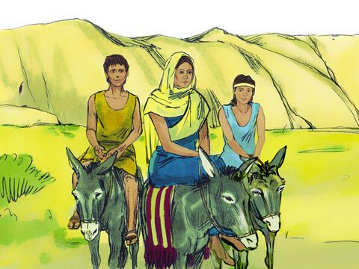
Read:
Exodus 4:20
Notes:
https://www.freebibleimages.org/illustrations/moses-burning-bush/

Slide 19
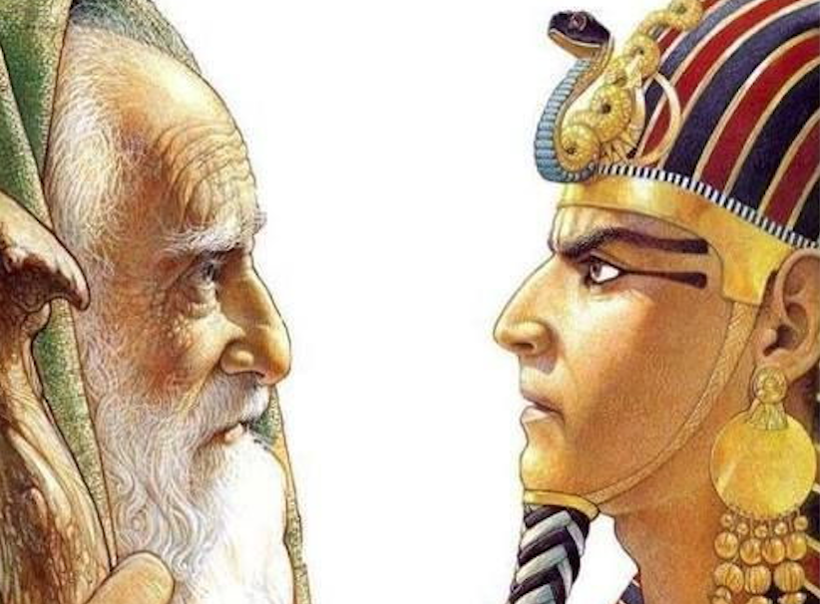

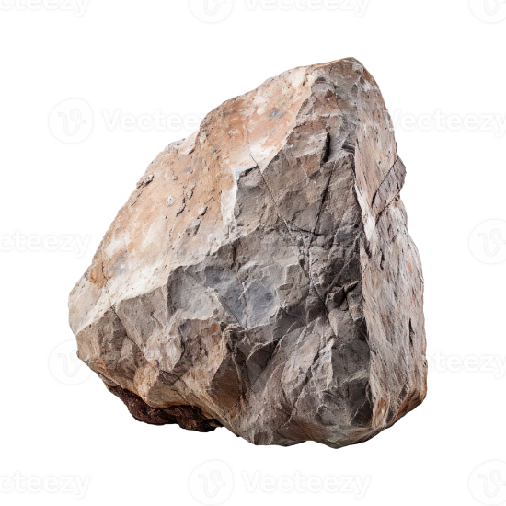
Read:
Exodus 4:21

Slide 20
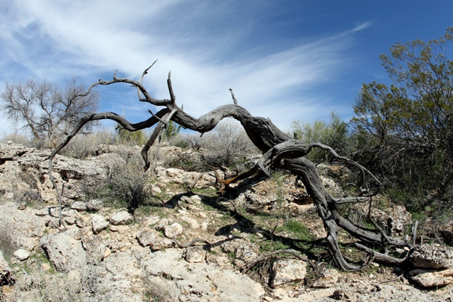
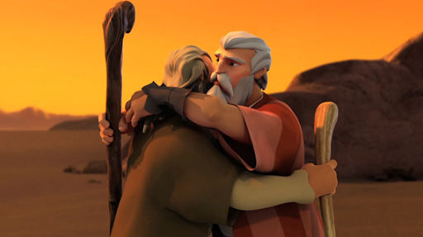
Read:
Exodus 4:27-28

Slide 21
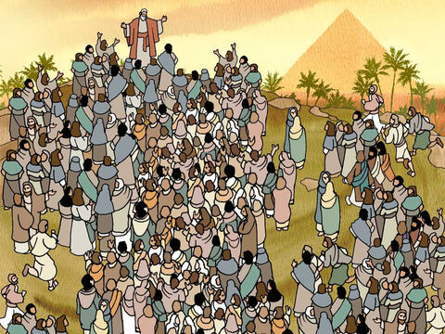
Read: Exodus 4:29
Notes:
https://www.freebibleimages.org/illustrations/yo-moses2/

Slide 22
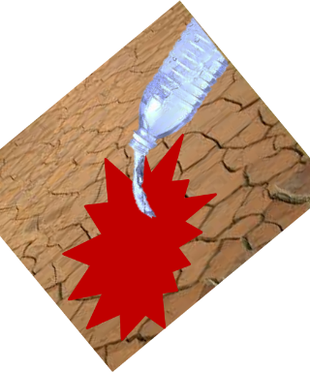
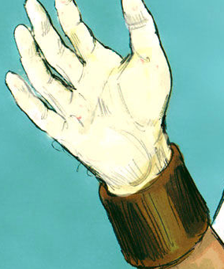
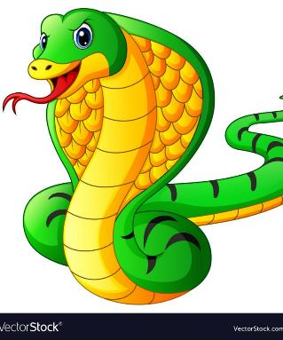
Read:
Exodus 4:30-31a

Slide 23
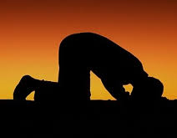
Read:
Exodus 4:31b
*God had not forgotten His people in their misery, and He does not forget us when we are going through difficult times. He sees us, is concerned about us, and helps us!

