Slide 1
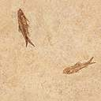

DigSite #3
Exodus 2:23-3:22
Moses and the Burning Bush

Slide 2


Exodus 3:14
God said to Moses,
“I AM WHO I AM.
This is what you are to say to the Israelites:
‘I AM has sent me to you.’ ”
Notes:
Scripture quotations taken from The Holy Bible, New International Version®, NIV®. Copyright © 1973, 1978, 1984, 2011 by Biblica, Inc.

Slide 3


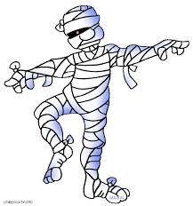
Read Exodus 2:23

Slide 4
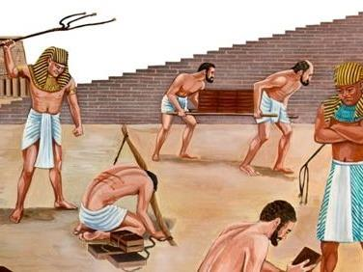
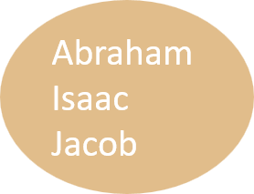
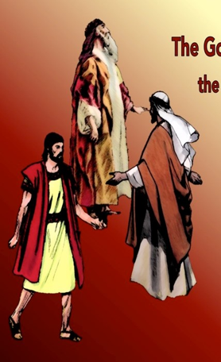
Read
Exodus 2:24-25

Slide 5
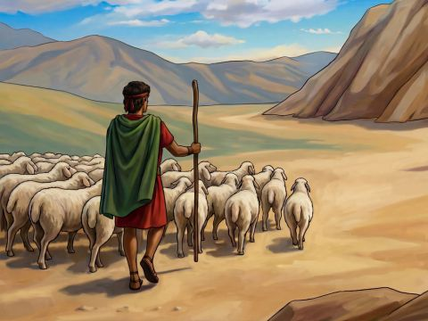
Read Exodus 3:1
Did You Know?
Horeb and Sinai are referring to the same place!
Notes:
https://www.freebibleimages.org/illustrations/spi-moses-burning-bush/

Slide 6
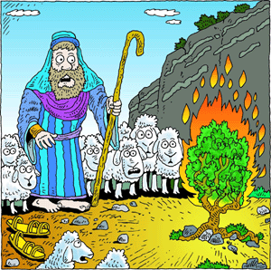
Read
Exodus 3:2-3

Slide 7
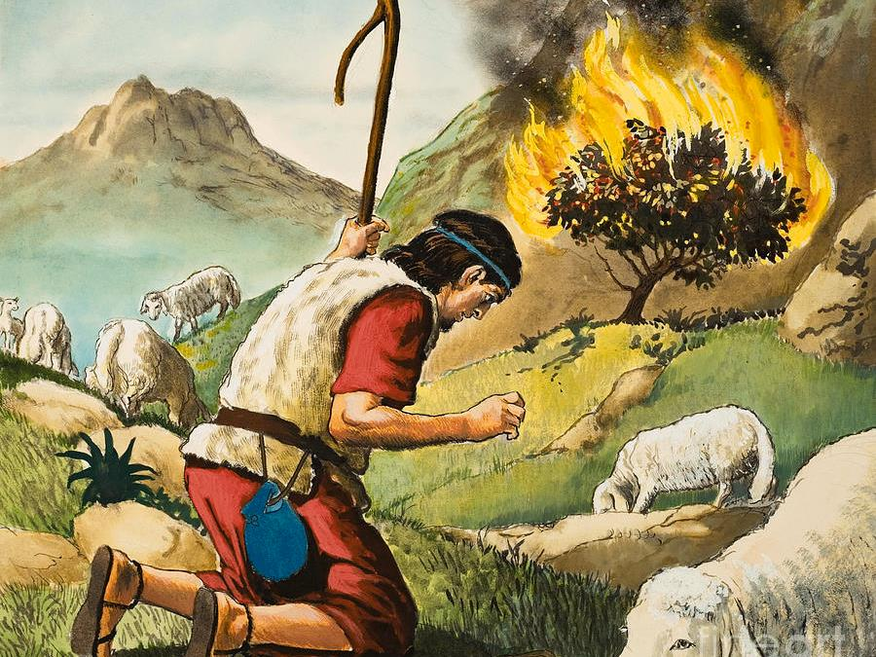
Read Exodus 3:4

Slide 8
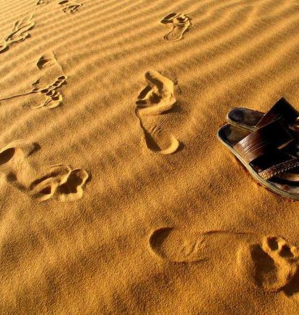
Read
Exodus 3:5-6

Slide 9
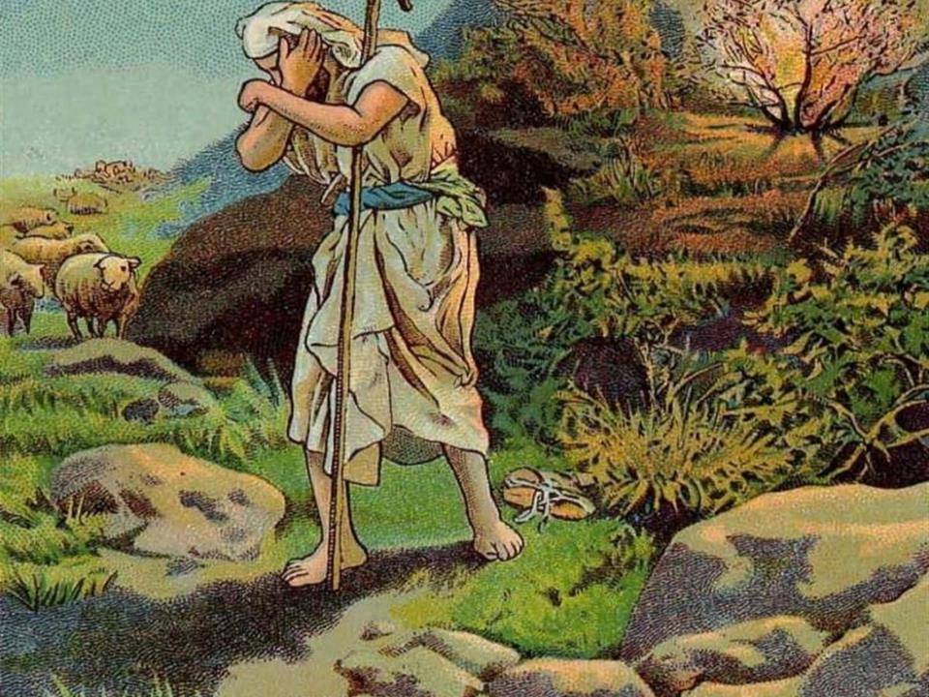

Slide 10
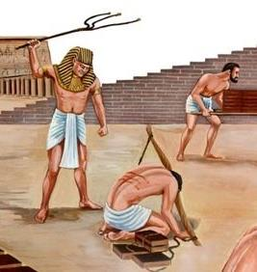
The Lord said, “I have indeed seen the misery of my people in Egypt. I have heard them crying out because of their slave drivers, and
I am concerned about their suffering.
*Memory Verse! Exodus 3:7

Slide 11
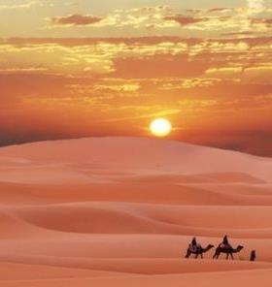


Read Exodus 3:8
Milk
Honey
God was going to provide for the Israelites and bless them.

Slide 12
Read Exodus 3:9

Slide 13
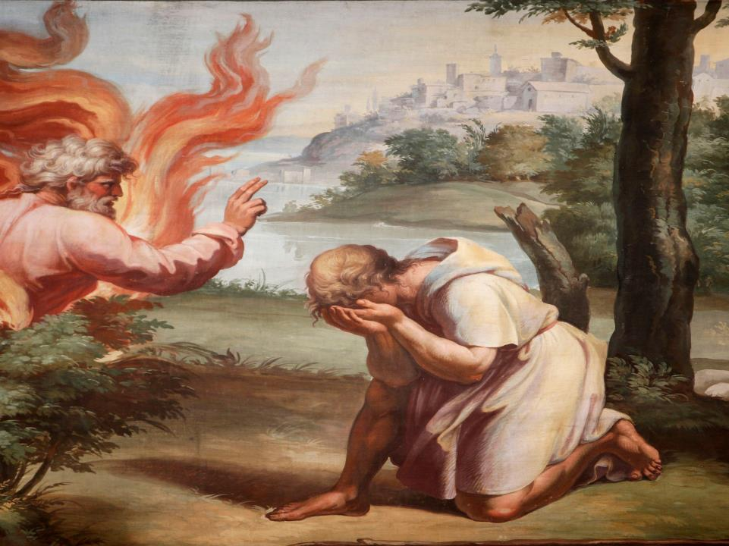
Read Exodus 3:10

Slide 14
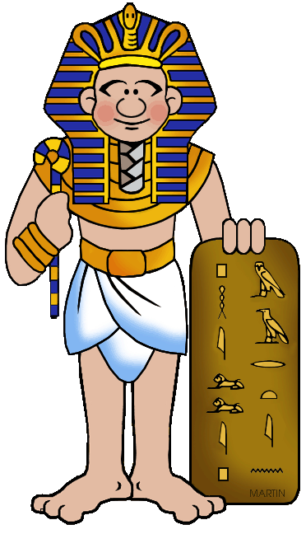
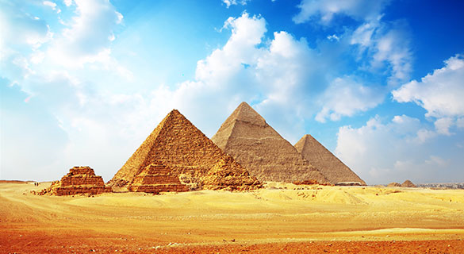
Read Exodus 3:11

Slide 15
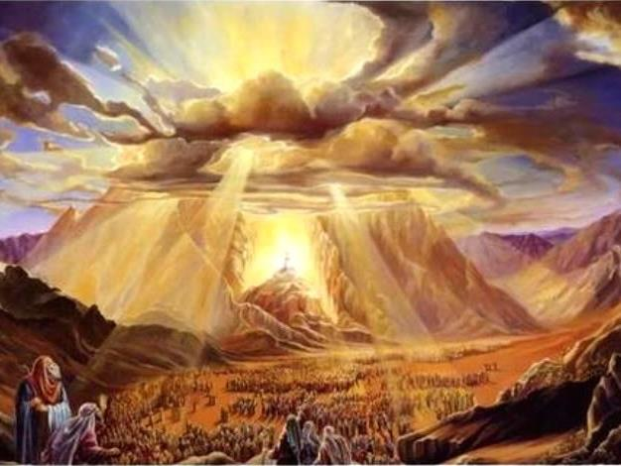
Read Exodus 3:12

Slide 16
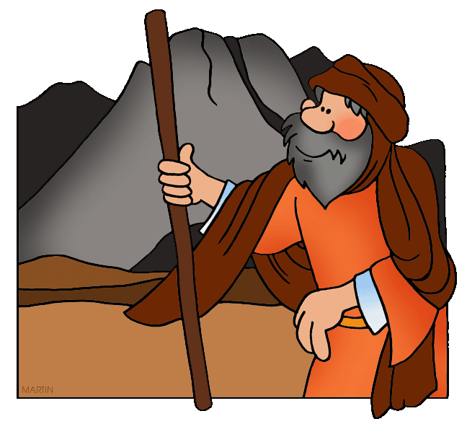
Read
Exodus 3:13

Slide 17
God said to Moses, “I am who I am. This is what you are to say to the Israelites: ‘I am has sent me to you.’”
*Memory Verse! Exodus 3:14
I am = Yahweh
Notes:
Scripture quotations taken from The Holy Bible, New International Version®, NIV®. Copyright © 1973, 1978, 1984, 2011 by Biblica, Inc.

Slide 18
Read
Exodus 3:15-16

Slide 19
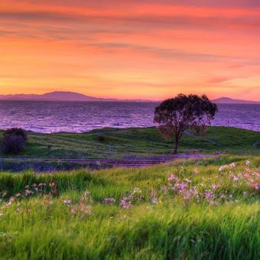
Read Exodus 3:17
Milk
Honey

Slide 20
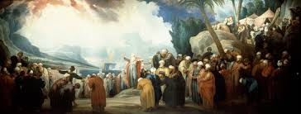

Read Exodus 3:18

Slide 21

Read
Exodus
3:19

Slide 22

Read
Exodus 3:20

Slide 23
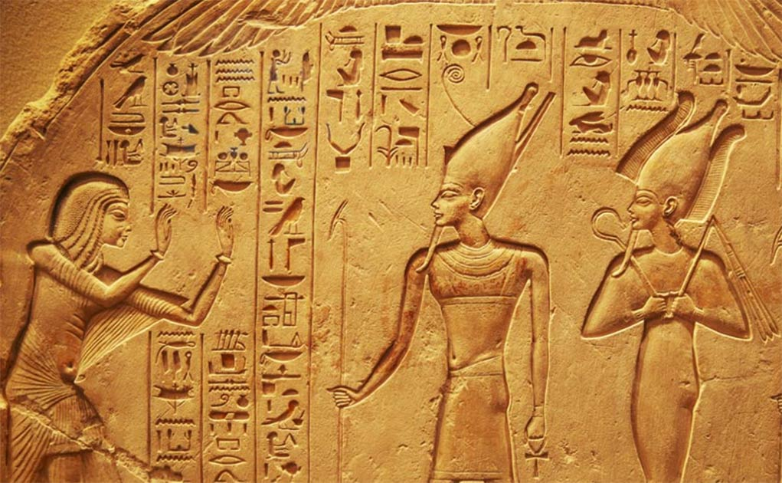


Read Exodus 3:21

Slide 24
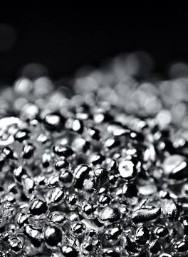
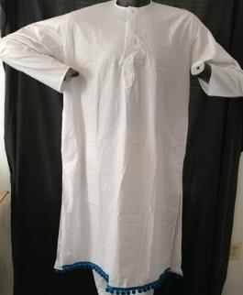
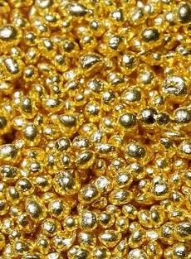
Read
Exodus 3:22
Plunder usually means items are taken during war or by violent means, but the Egyptians gave these items willingly in peace because it was God's plan.

Slide 25
Did You Know?
This was to fulfill the promise God made to Abraham when He made a covenant with him in Genesis 15. Do you remember the smoking firepot and the blazing torch?
"Then the Lord said to him, 'Know for certain that for four hundred years your descendants will be strangers in a country not their own and that they will be enslaved and mistreated there. But I will punish the nation they serve as slaves, and afterward they will come out with great possessions.'" Genesis 15:13-14
Notes:
Scripture quotations taken from The Holy Bible, New International Version®, NIV®. Copyright © 1973, 1978, 1984, 2011 by Biblica, Inc.

