Slide 1

DigSite #2
Exodus 2:1-22
The Birth of Moses

Slide 2


Psalm 7:10
My shield is
God Most High,
who saves the upright in heart
Notes:
Scripture quotations taken from The Holy Bible, New International Version®, NIV®. Copyright © 1973, 1978, 1984, 2011 by Biblica, Inc.

Slide 3
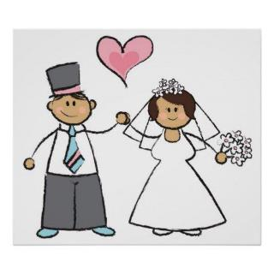
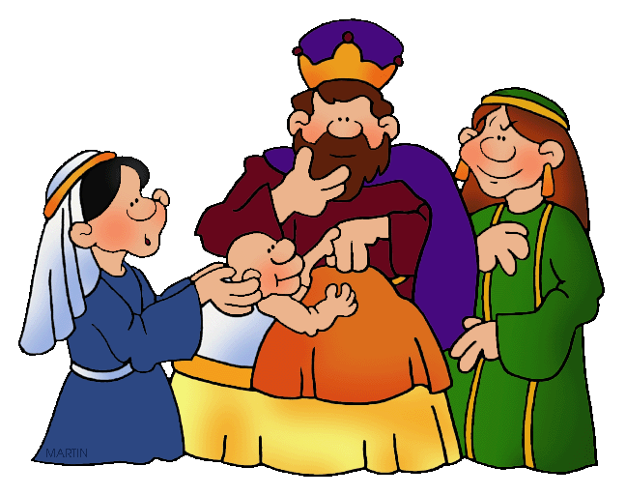
Read Exodus 2:1-2

Slide 4
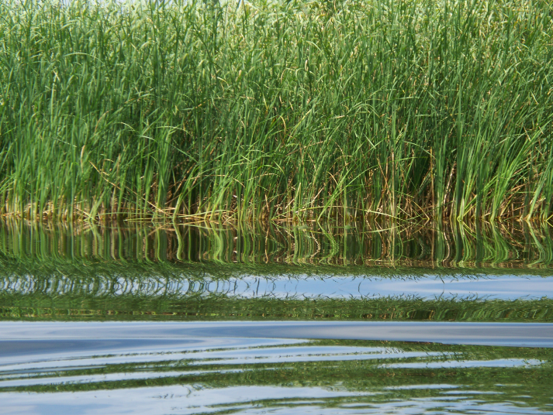
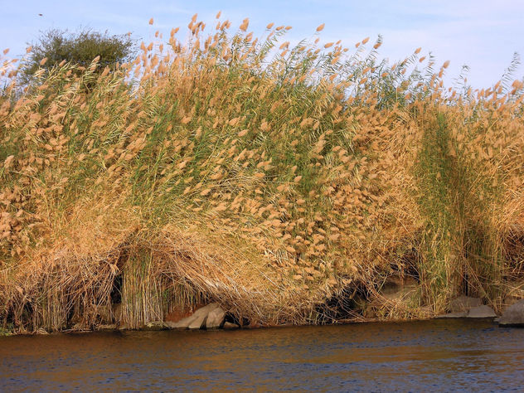
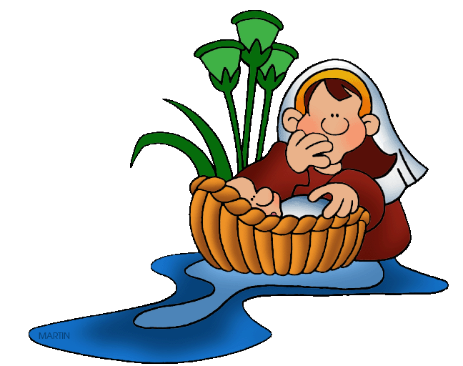
Read Exodus 2:3
Did You Know?
The Hebrew word in the Bible for Moses' basket is the same one used for Noah's ark! Both times, people had to trust God to direct the course of a boat to provide protection, and He did!

Slide 5
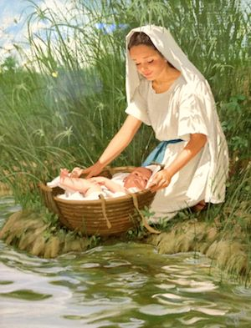
Read Exodus 2:4
The sister of Moses mentioned here was most likely Miriam. In Exodus 15, Miriam is called a prophet, and she leads the people in singing!

Slide 6
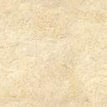
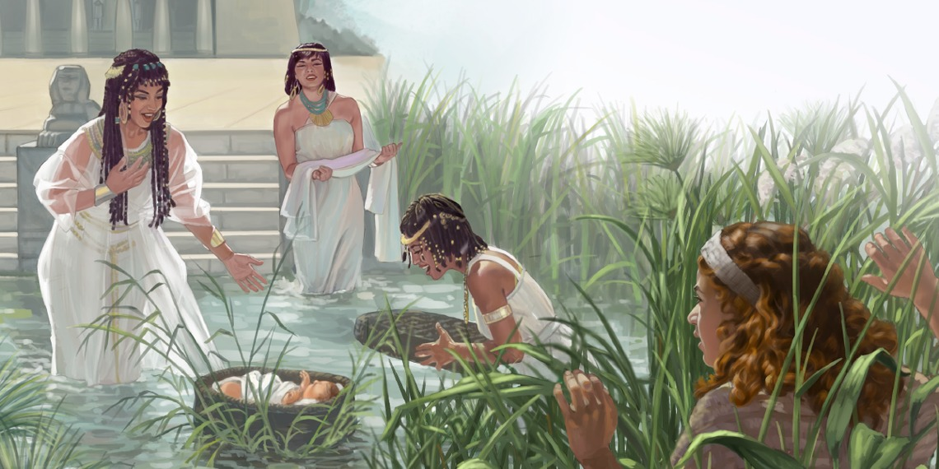
Read Exodus 2:5

Slide 7
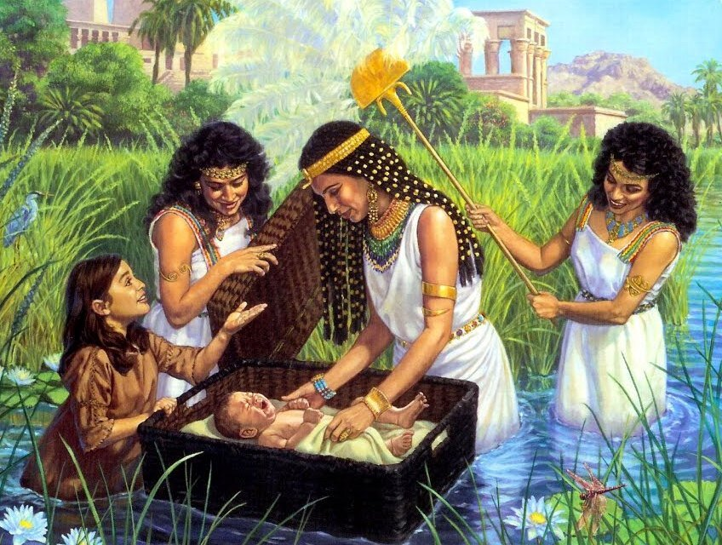
Read Exodus 2:6-8

Slide 8

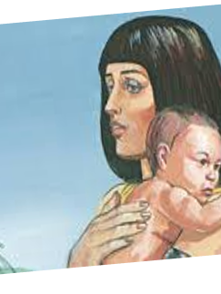
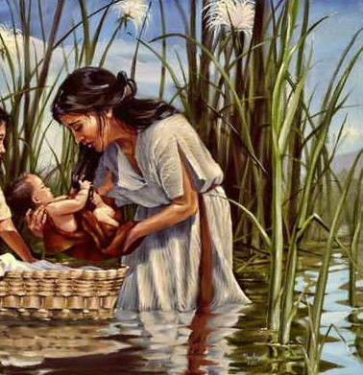
Read Exodus 2:9

Slide 9
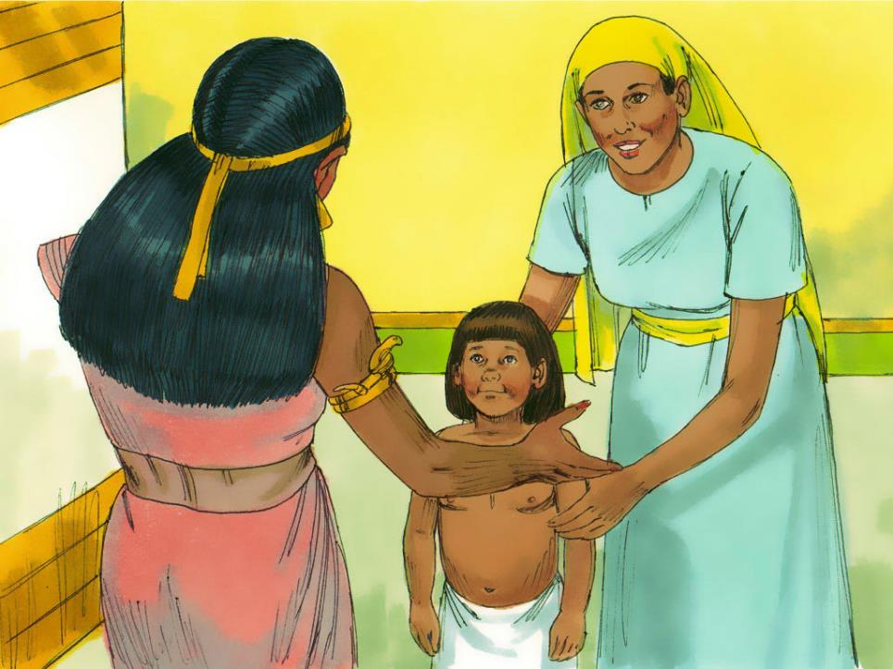
Read Exodus 2:10
Notes:
https://www.freebibleimages.org/illustrations/baby-moses/

Slide 10
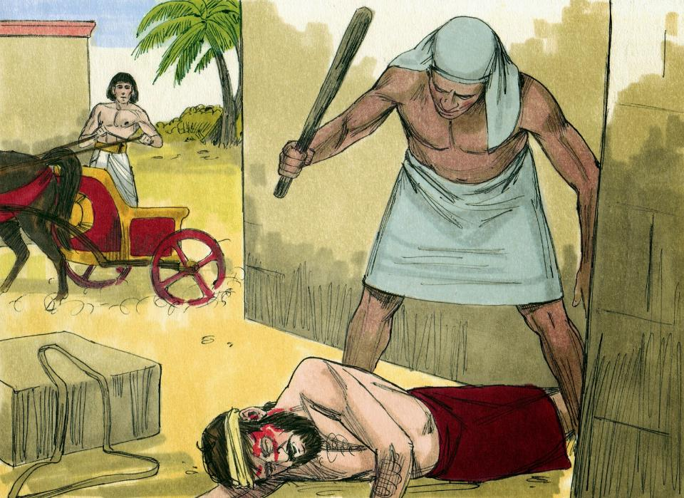
Read Exodus 2:11-14
Notes:
https://www.freebibleimages.org/illustrations/moses-prince/

Slide 11
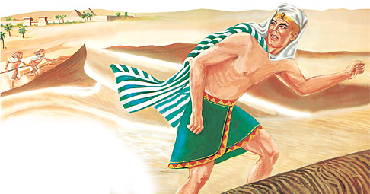
Read Exodus 2:15

Slide 12
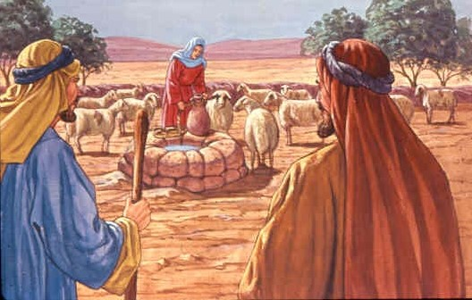
Read Exodus 2:16

Slide 13
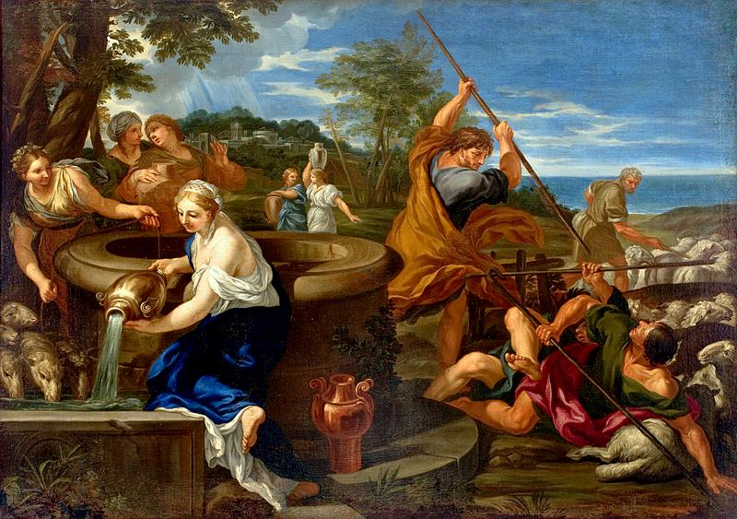
Read Exodus 2:17

Slide 14
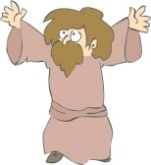
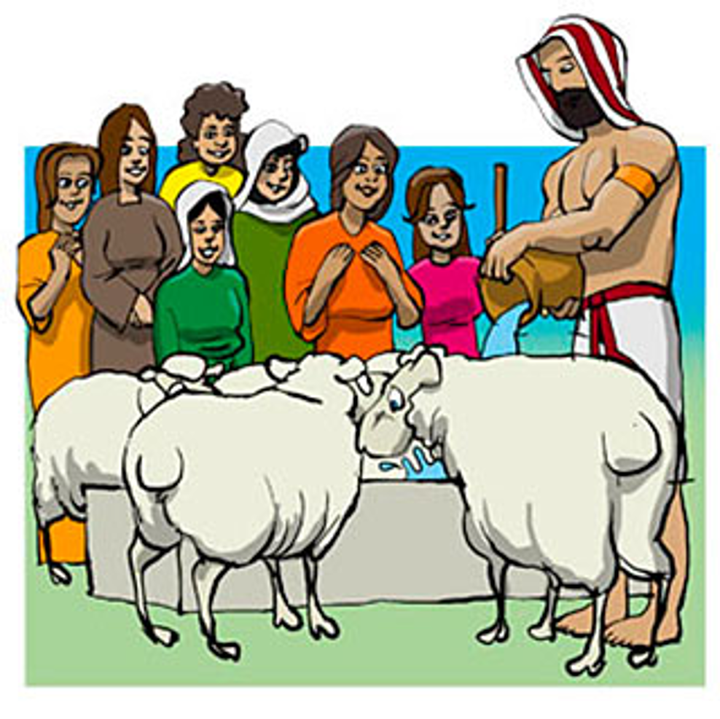
Read Exodus 2:18-20

Slide 15
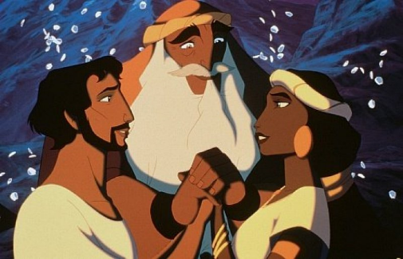
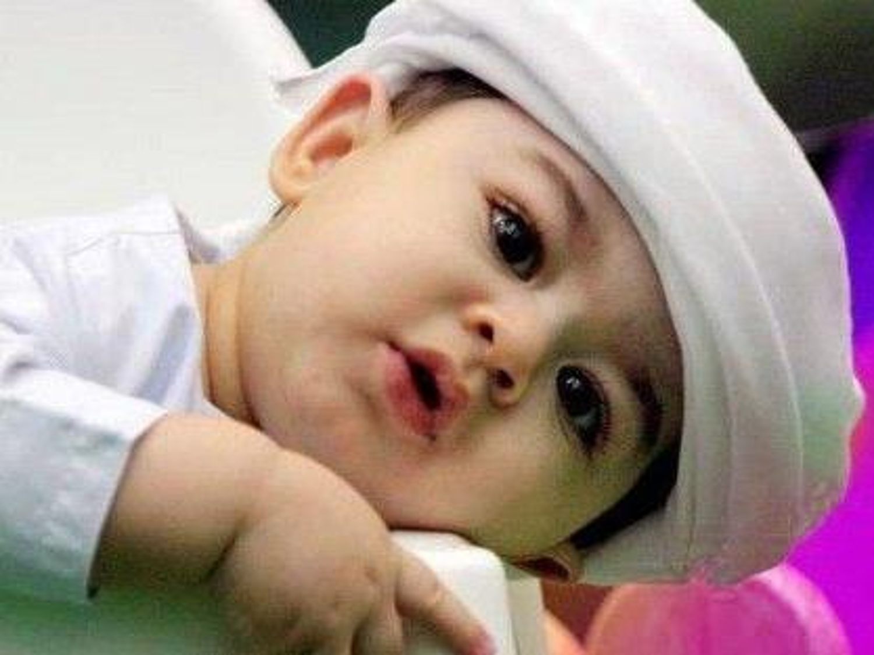
Read Exodus 2:21-22

