Slide 1
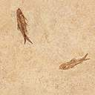

Lesson #1
Exodus 1:1-22

Slide 2


Exodus 3:7
The LORD said,
"I have indeed seen the misery of my people in Egypt.
I have heard them crying out because of their slave drivers,
and I am concerned about their suffering.
Notes:
Scripture quotations taken from The Holy Bible, New International Version®, NIV®. Copyright © 1973, 1978, 1984, 2011 by Biblica, Inc.

Slide 3

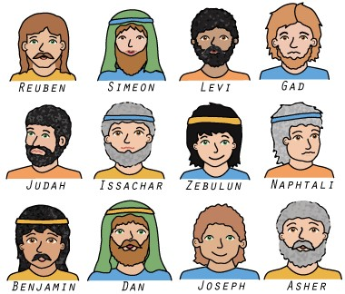
Read Exodus 1:1-4
Reuben
Simeon
Levi
Judah
Dan
Naphtali
Gad
Asher
x
Issachar
Zebulun
Benjamin

Slide 4


Read Exodus 1:5
= 70

Slide 5
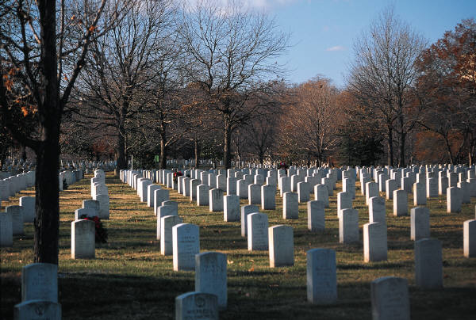
Read Exodus 1:6

Slide 6
Read Exodus 1:7

Slide 7
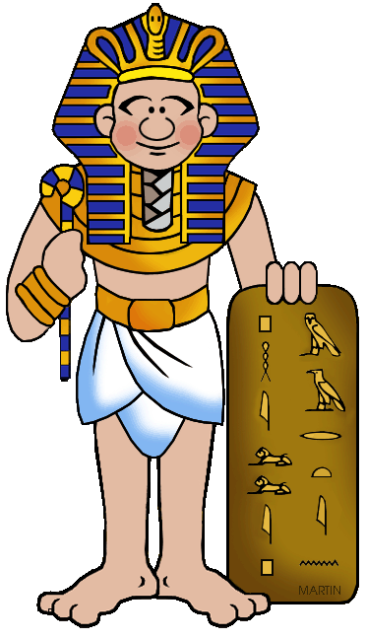
Read Exodus 1:8
Joseph WHO?
?

Slide 8
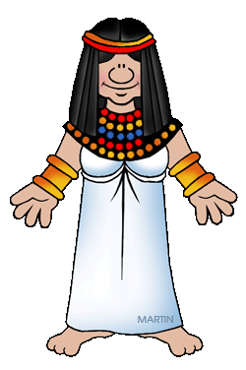
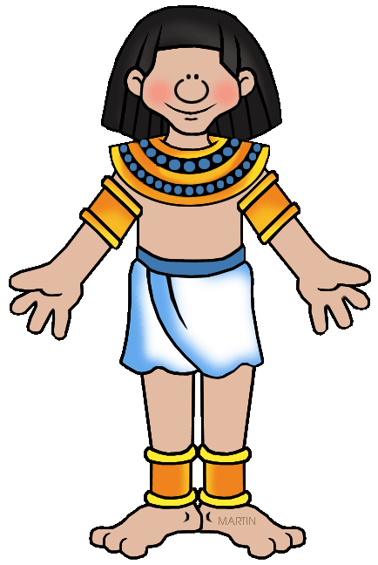
Read Exodus 1:9-10
There are too many Israelites!

Slide 9

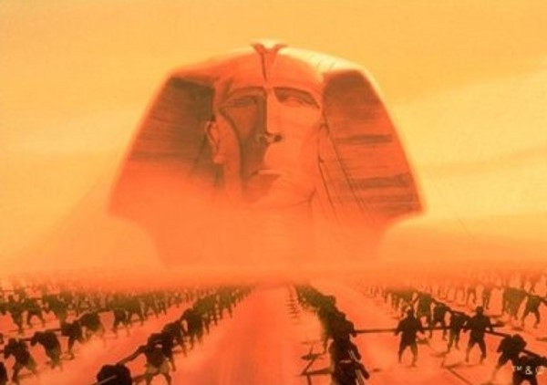
Read Exodus 1:11

Slide 10
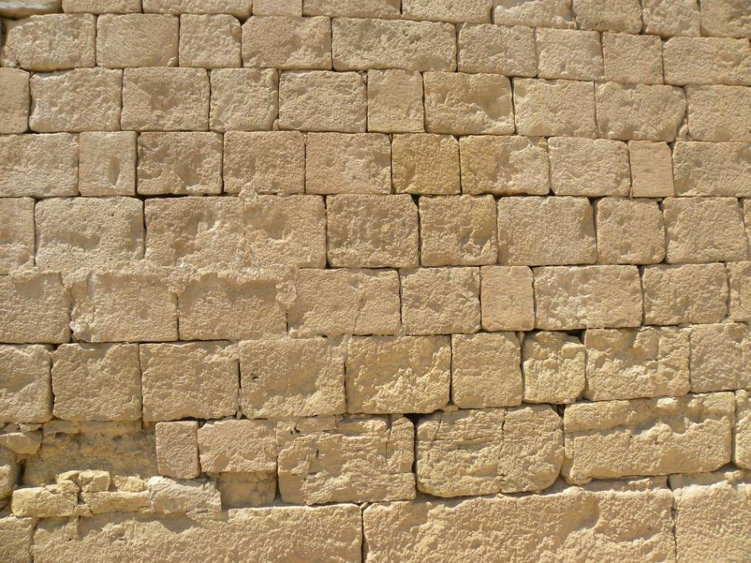
Pithom & Rameses store cities for Pharaoh

Slide 11
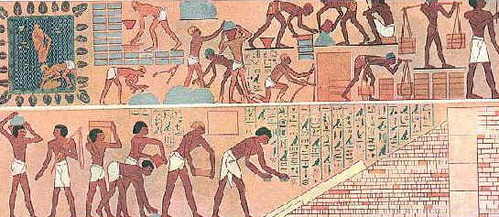
Read Exodus 1:12-14

Slide 12
Read Exodus 1:15-16
Shiphrah and Puah

Slide 13
Read Exodus 1:17

Slide 14
Read Exodus 1:18-19
"Why have you done this?
Why have you let the boys live?"

Slide 15
*To fear God doesn't mean to be afraid of God. It means to respect and honor Him. The midwives chose to obey God first!
Read Exodus 1:20-21

Slide 16
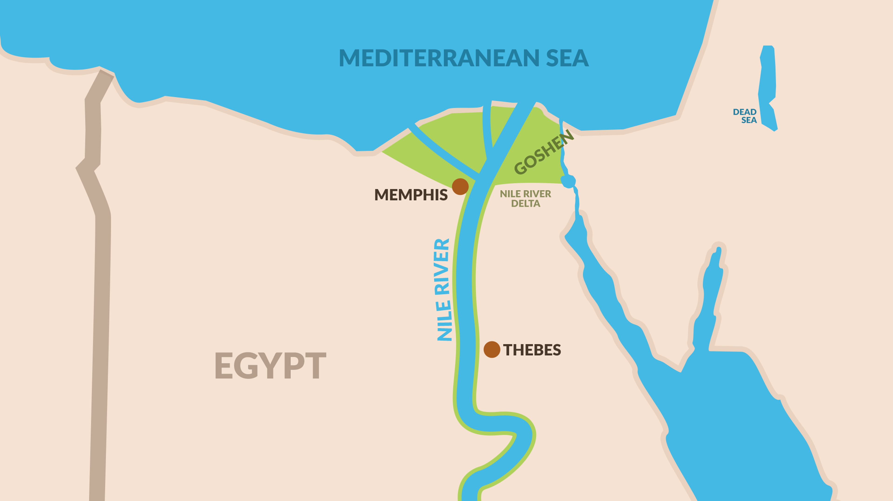
Read Exodus 1:22
Throw the baby boys into the Nile!

