Slide 1
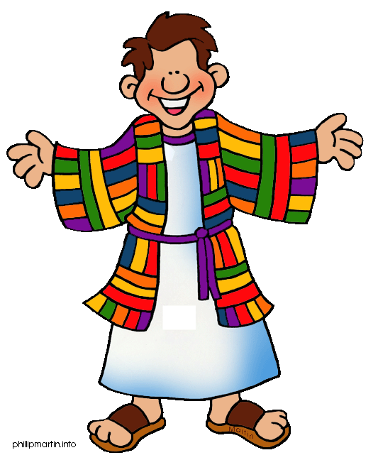
Dig Site 19
Genesis 45:1-46:7
"I am Joseph!:

Slide 2
The Truth
God can work through
people who obey Him!

Slide 3
MEMORY VERSE
Dig Site 19
Genesis 45:7
But God sent me ahead of you
to preserve for you
a remnant on earth
and to save your lives by
a great deliverance.
Genesis 45:7

Slide 4
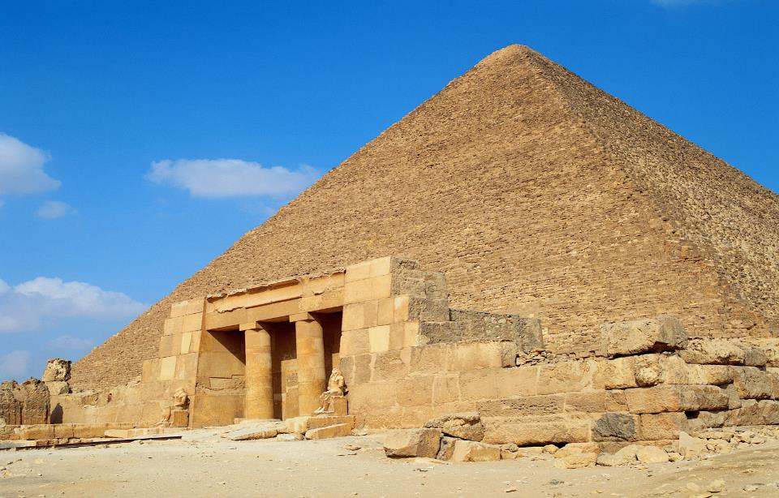
Then Joseph could no longer control himself before all his attendants, and he cried out
.
Have everyone leave my presence!

Slide 5


So there was no one with Joseph when he made himself known to his brothers.

Slide 6
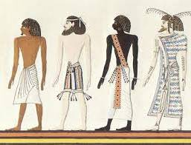

And he wept so loudly that the Egyptians heard him, and Pharaoh’s household heard about it.

Slide 7

Joseph said to his brothers,
I am Joseph!
Is my father still living?

Slide 8




But his brothers were not able to answer him, because they were terrified at his presence.

Slide 9
Then Joseph said to his brothers,
Come close to me.

Slide 10
When they had done so, he said,
I am your brother Joseph, the one you sold into Egypt!

Slide 11
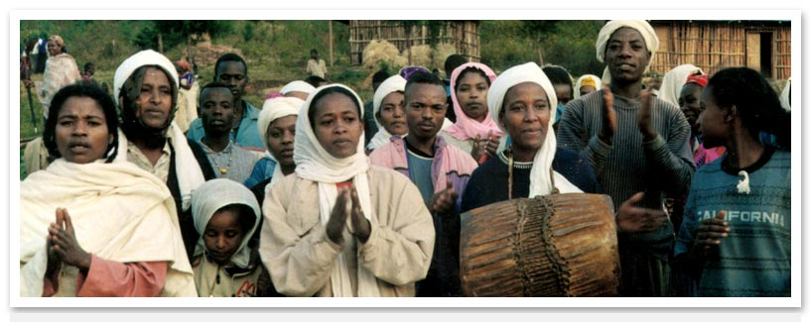
And now, do not be distressed and do not be angry with yourselves for selling me here, because it was to save lives that God sent me ahead of you.

Slide 12
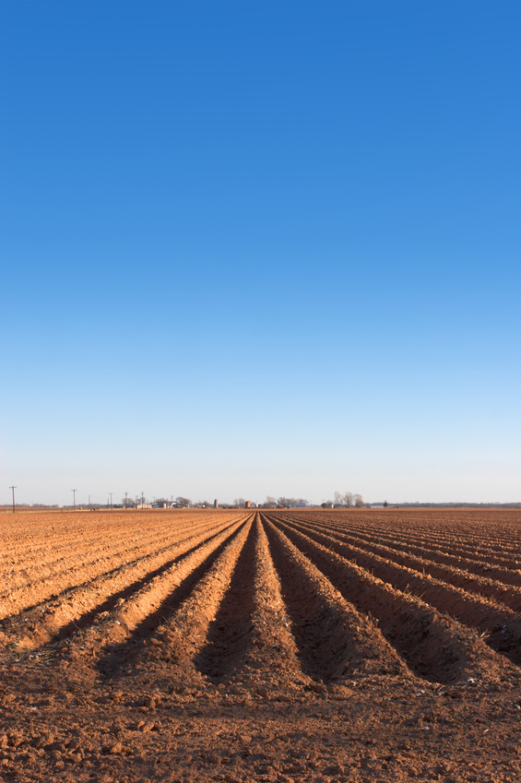
For 2 years now there has been famine in the land, and for the next 5 years there will be no plowing and reaping.

Slide 13
But God sent me ahead of you to preserve for you a remnant on earth and to save your lives by a great deliverance.

Slide 14
Gene
So then, it was not you who sent me here, but God. He made me father to Pharaoh, lord of his entire household and ruler of all Egypt.

Slide 15
Now hurry back to my father and say to him, ‘This is what your son Joseph says:
God has made me lord of all Egypt.
Come down to me; don’t delay.

Slide 16
You shall live in the region of Goshen and be near me—you,
your children and grandchildren, your flocks
and herds,
and all you have.

Slide 17
I will provide for you there, because 5 years of famine are still to come. Otherwise you and your household and all who belong to you will become destitute.

Slide 18
You can see for yourselves, and so can my brother Benjamin, that it is really I who am speaking to you

Slide 19
Tell my father about all the honor accorded me in Egypt and about everything you have seen. And bring my father down here quickly.

Slide 20
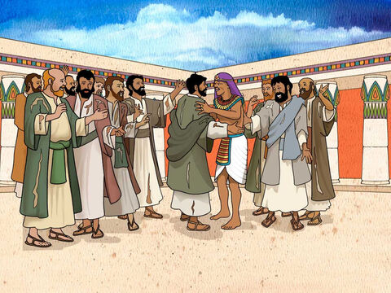
Then he threw his arms around his brother Benjamin and wept, and Benjamin embraced him, weeping.

Slide 21






And he kissed all his brothers and wept over them.
Afterward his brothers talked with him.

Slide 22
When the news reached Pharaoh’s palace that Joseph’s brothers had come, Pharaoh and all his officials were pleased.

Slide 23
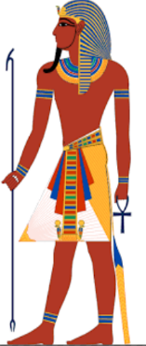
Pharaoh said to Joseph
Tell your brothers, ‘Do this: Load your animals and return to the land of Canaan,

Slide 24
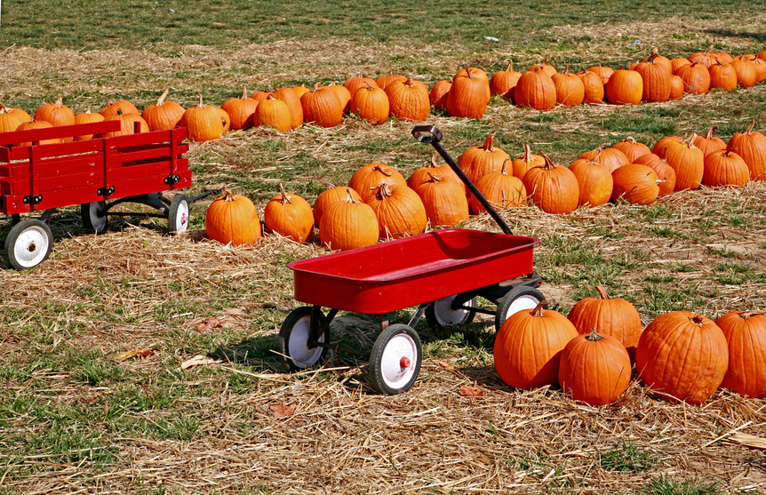
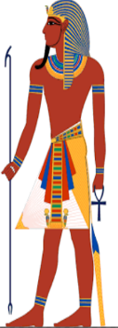
Gene
And bring your father and your families back to me.
I will give you the best of the land of Egypt and you can enjoy the fat of the land.

Slide 25
You are also directed to tell them, ‘Do this: Take some carts from Egypt for your children and your wives, and get your father and come.

Slide 26
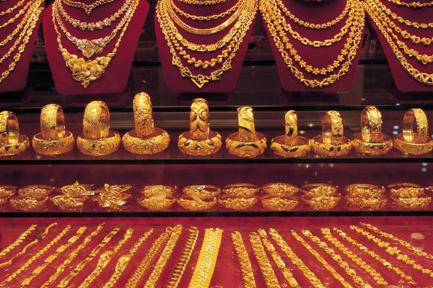
Gene
Never mind about your belongings,
because the best of all Egypt will be yours.

Slide 27
So the sons of Israel did this.
Joseph gave them carts, as Pharaoh had commanded, and he also gave them provisions for their journey

Slide 28
To each of them he gave new clothing, but to Benjamin he gave 300 shekels of silver and 5 sets of clothes

Slide 29
And this is what he sent to his father: 10 donkeys loaded with the best things of Egypt, and 10 female donkeys loaded with grain and bread and other provisions for his journey.

Slide 30
Then he sent his brothers away, and as they were leaving he said to them,
Don’t quarrel on the way!

Slide 31
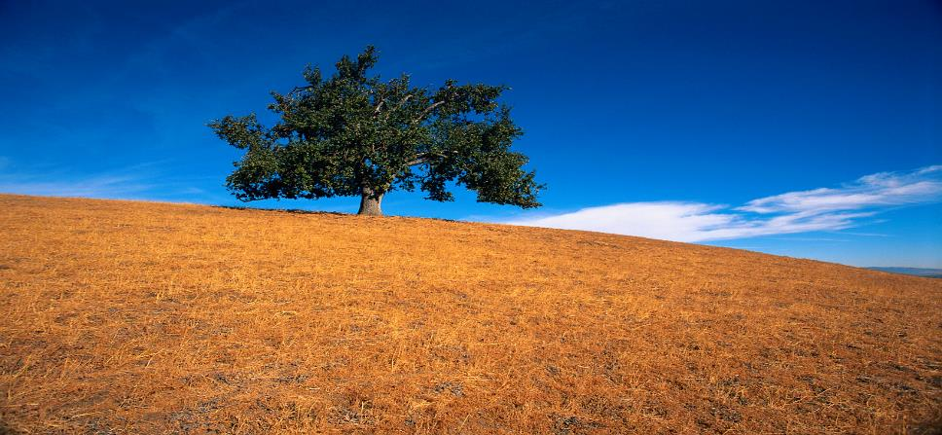
So they went up out of Egypt and came to their father Jacob in the land of Canaan.

Slide 32

Jacob was stunned; he did not believe them.
They told him
Joseph is still alive!
In fact, he is ruler of all Egypt.

Slide 33

But when they told him everything Joseph had said to them, and when he saw the carts Joseph had sent to carry him back, the spirit of their father Jacob revived.

Slide 34

And
Israel said,
I’m convinced!
My son Joseph is still alive.
I will go and see him before I die.

Slide 35
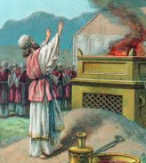
So Israel set out with all that was his, and when he reached Beersheba, he offered sacrifices to the God of his father Isaac.

Slide 36
And God spoke to Israel in a vision at night and said, he replied.
Jacob! Jacob!
Here I am,

Slide 37
he said
I am God,
the God of your father
Do not be afraid to go down
to Egypt, for I will make you
into a great nation there.

Slide 38
I will go down to Egypt with you, and I will surely bring you back again. And Joseph’s own hand will close your eyes.

Slide 39
Then Jacob left Beersheba, and Israel’s sons took their father Jacob and their children and their wives in the carts that Pharaoh had sent to transport him.

Slide 40
So Jacob and all his offspring went to Egypt, taking with them their livestock and the possessions they had acquired in Canaan.

Slide 41
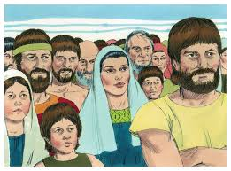
Jacob brought with him to Egypt his sons and grandsons and his daughters and granddaughters— all his offspring.

