Slide 1
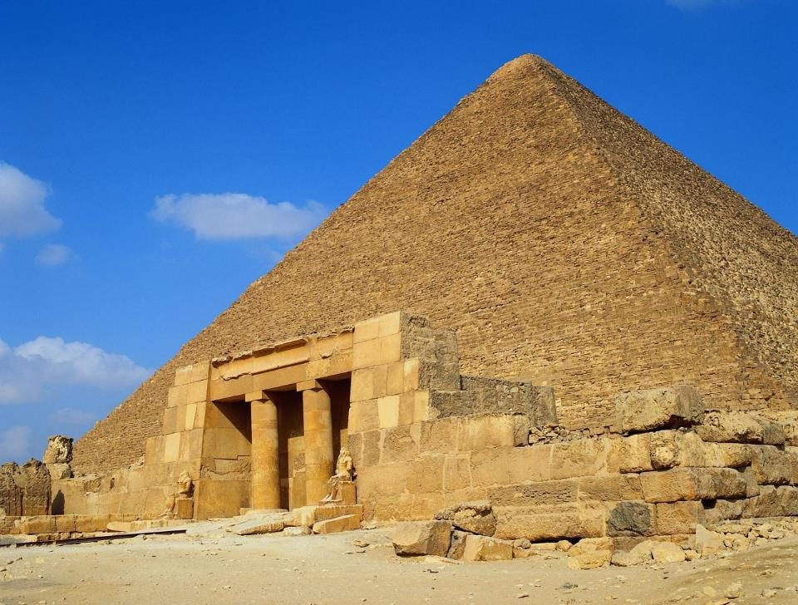
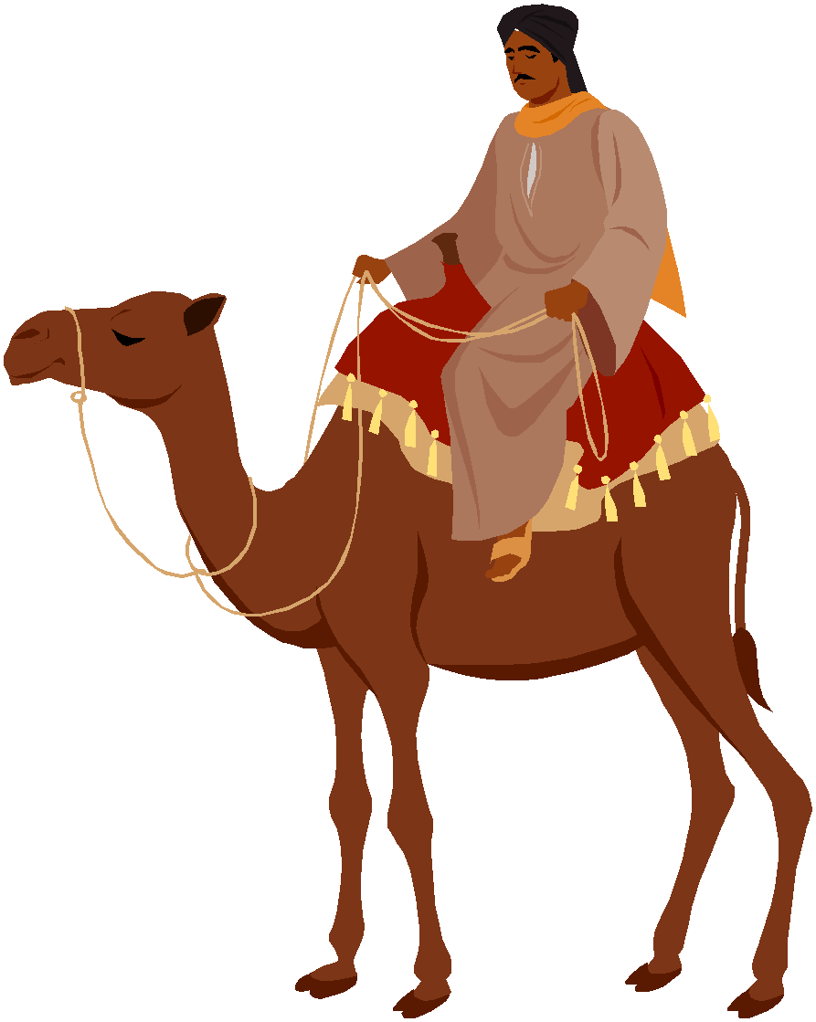
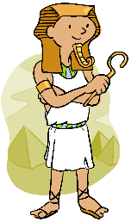
Dig Site 18
Genesis 43:1-15, 23b-32;
44:1-18, 33-34
FACE TO FACE

Slide 2
The Truth
God is forgiving, and He wants us to forgive others!

Slide 3
forgiving each other,
Ephesians 4:32
Be kind and compassionate to one another,
Memory Verse
just as in Christ God forgave you.
DS#18

Slide 4
Now the famine was still severe in the land.

Slide 5
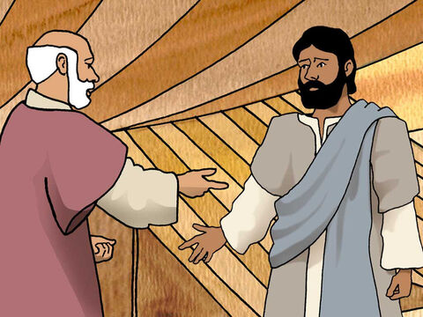
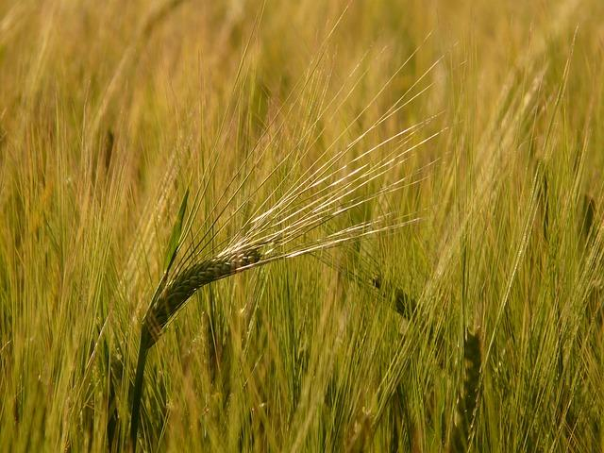
So when they had eaten all the grain they had brought from Egypt, their father said to them,
Go back and buy us a little more food.

Slide 6
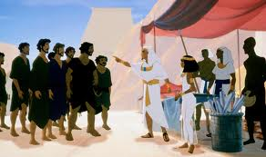
But Judah said to him,
"The man warned us solemnly, 'You will not see my face again unless your brother is with you.'

Slide 7
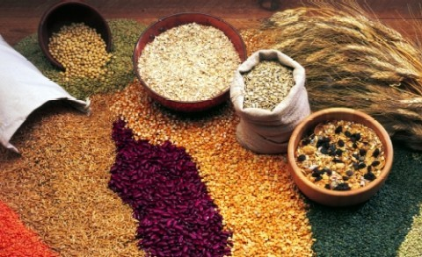
If you will send our brother along with us, we will go down and buy food for you.

Slide 8
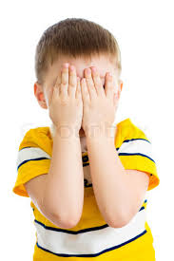
But if you will not send him, we will not go down, because the man said to us,
'You will not see my face again unless your brother is with you.'"

Slide 9

Israel asked,
Why did you bring this trouble on me by telling the man you had another brother?

Slide 10
They replied,
The man questioned us closely about ourselves and our family. ‘Is your father still living?’ he asked us. ‘Do you have another brother?’
We simply answered his questions. How were we to know he would say, ‘Bring your brother down here’?

Slide 11
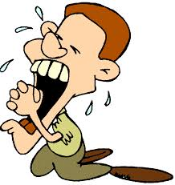
Then Judah said to Israel his father,
Send the boy along with me and we will go at once, so that we and you and our children may live and not die.

Slide 12
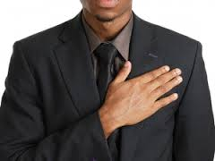
I myself will guarantee his safety; you can hold me personally responsible for him.
If I do not bring him back to you and set him here before you, I will bear the blame before you all my life.

Slide 13
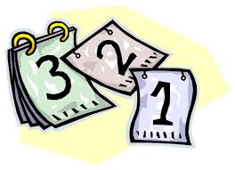
As it is, if we had not delayed, we could have gone and returned twice.

Slide 14
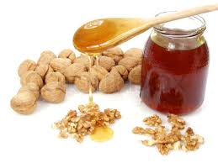
Then their father Israel said to them,
If it must be, then do this: Put some of the best products of the land in your bags and take them down to the man as a gift
—a little balm and a little honey, some spices and myrrh, some pistachio nuts and almonds.

Slide 15
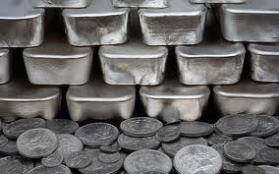
Take double the amount of silver with you, for you must return the silver that was put back into the mouths of your sacks. Perhaps it was a mistake.

Slide 16
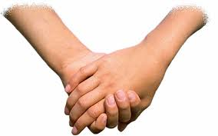
Take your brother also and go back to the man at once.

Slide 17
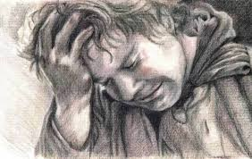
And may God Almighty (El-Shaddai) grant you mercy before the man so that he will let your other brother and Benjamin come back with you.
As for me, if I am bereaved, I am bereaved.

Slide 18
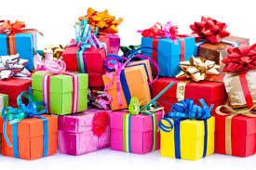
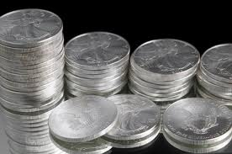
So the men took the gifts and double the amount of silver, and Benjamin also. They hurried down to Egypt and presented themselves to Joseph.

Slide 19
AT JOSEPH’S HOUSE

Slide 20
Then he brought Simeon out to them.

Slide 21
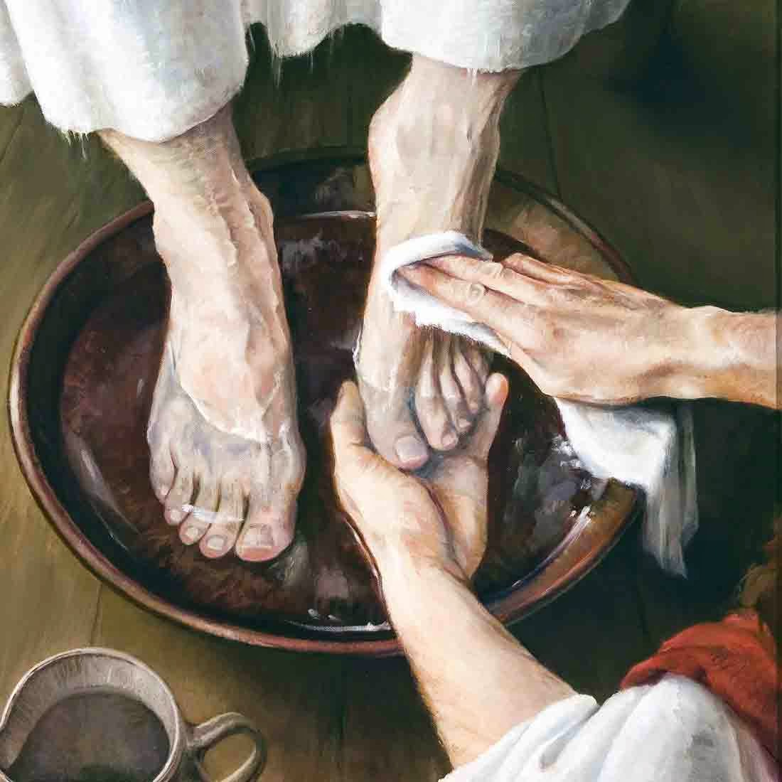
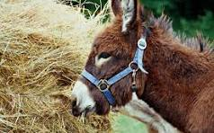
The steward took the men into Joseph's house, gave them water to wash their feet and provided fodder for their donkeys.
*Fodder: food, such as hay, for farm animals
This Photo by Unknown Author is licensed under CC BY-NC-ND

Slide 22
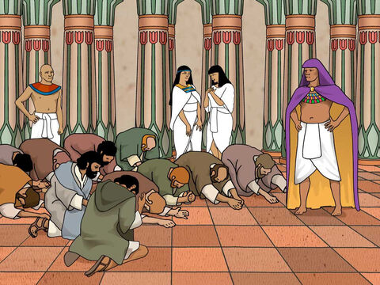
They prepared their gifts for Joseph's arrival at noon, because they had heard that they were to eat there.
When Joseph came home, they presented to him the gifts they had brought into the house, and they bowed down before him to the ground.

Slide 23
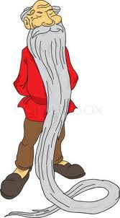

He asked them how they were, and then he said,
How is your aged father you told me about? Is he still living?

Slide 24
They replied, "Your servant our father is still alive and well."
And the bowed down, prostrating themselves before him.

Slide 25
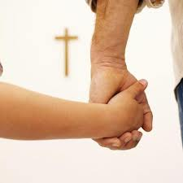
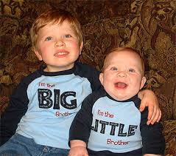
As he looked about and saw his brother Benjamin, his own mother’s son, he asked,
Is this your youngest brother, the one you told me about?
And he said,
God be gracious to you, my son.

Slide 26
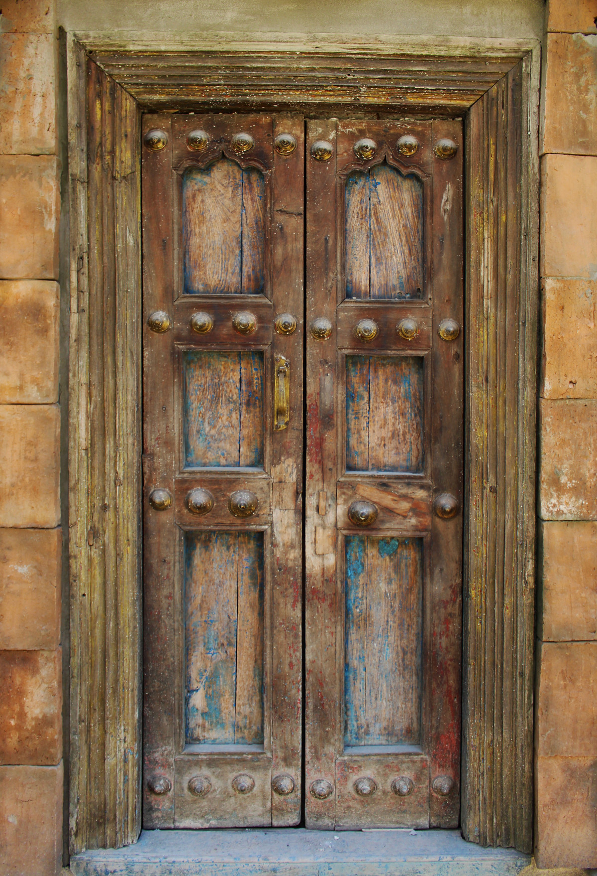
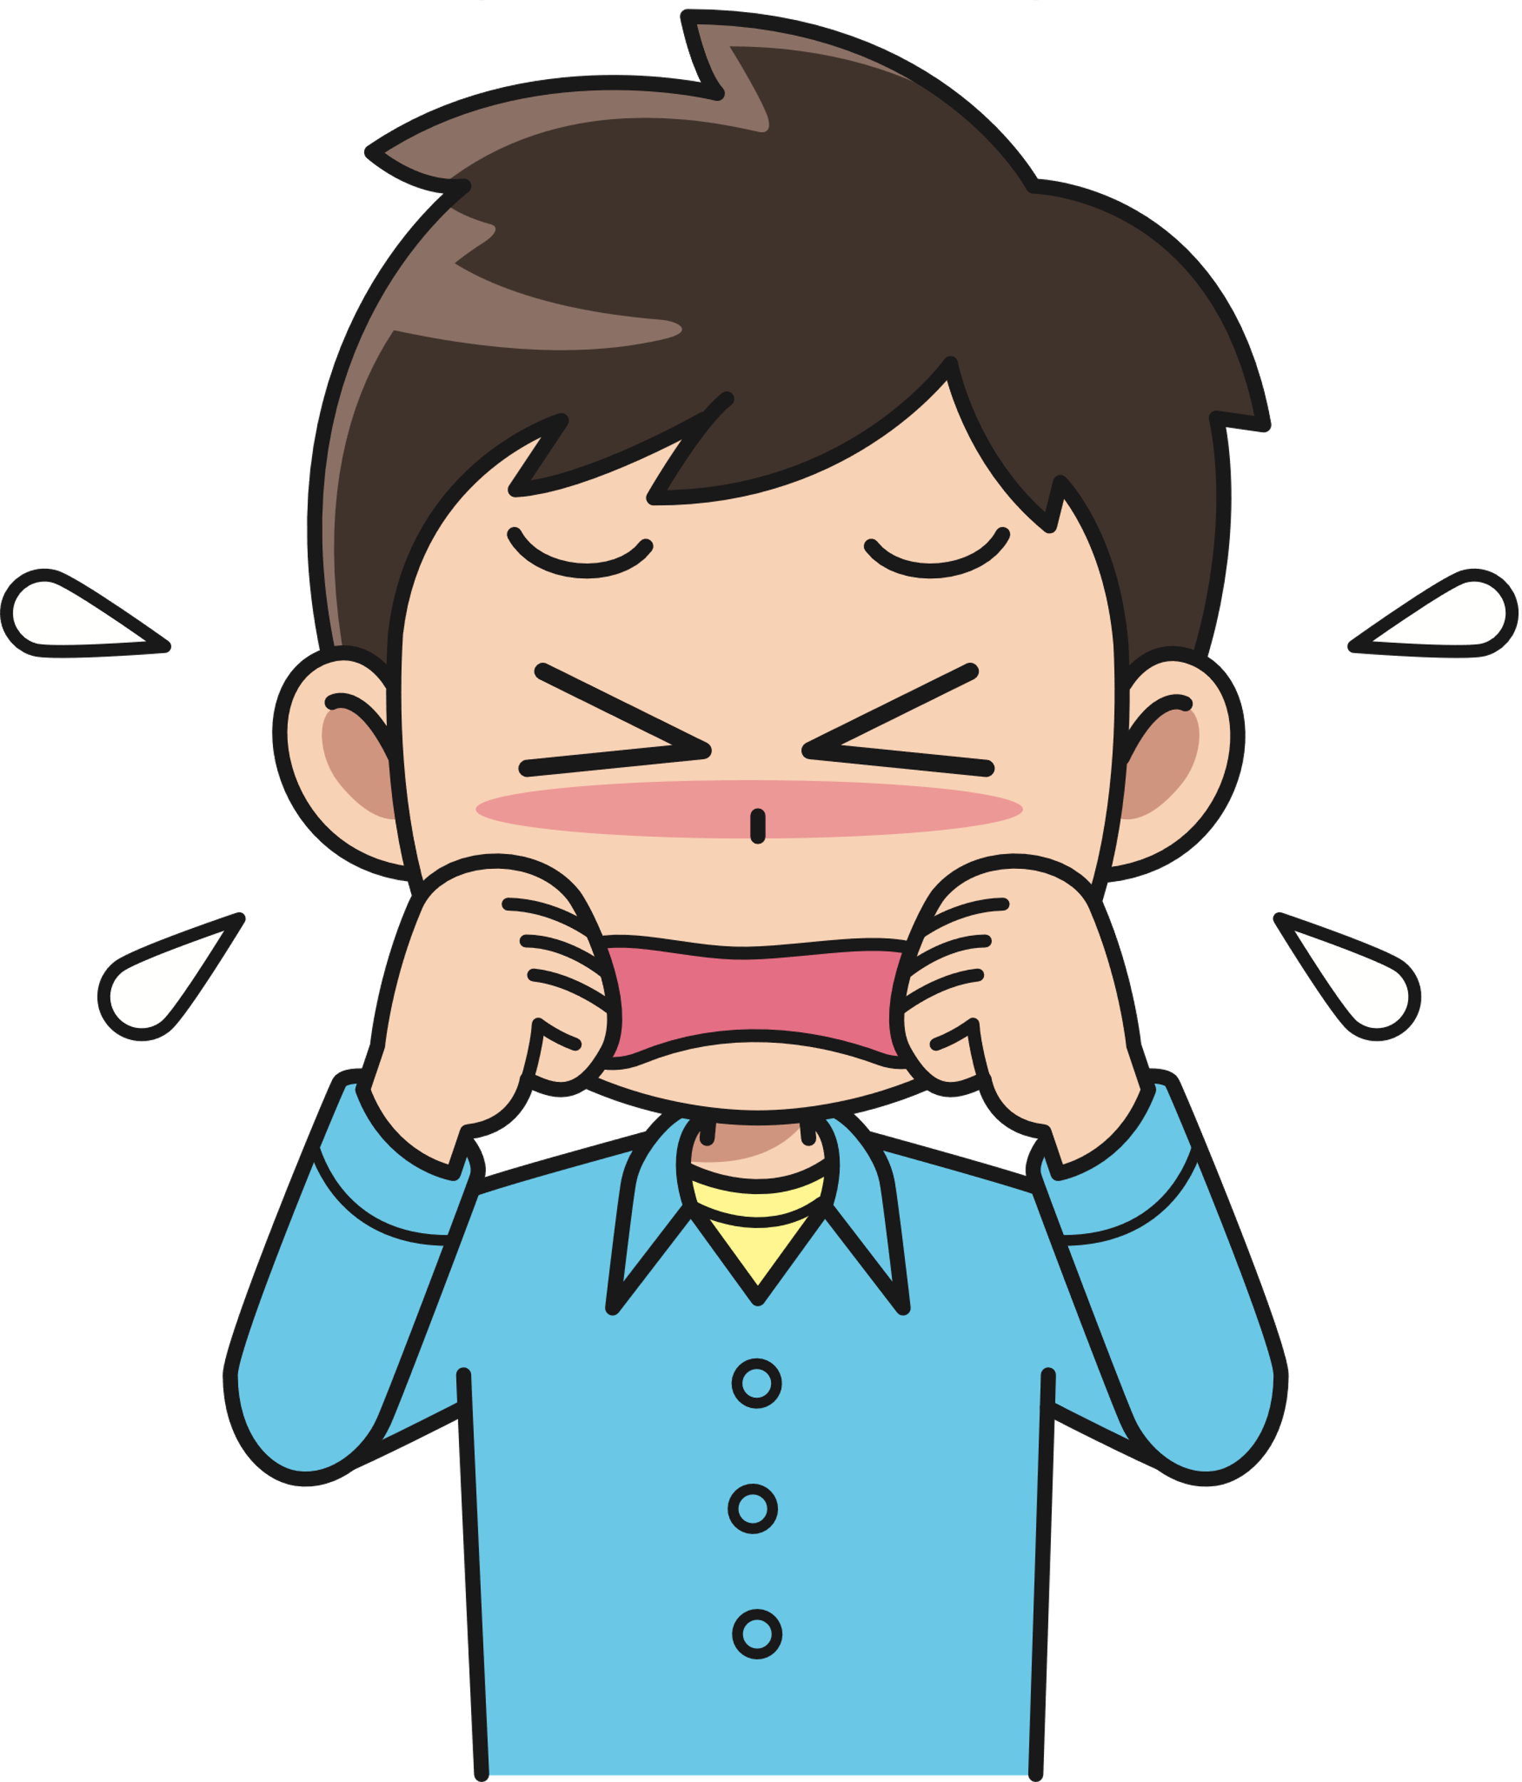
Deeply moved at the sight of his brother, Joseph hurried out and looked for a place to weep. He went into his private room and wept there.

Slide 27
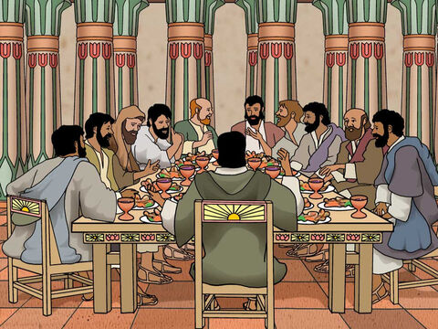
After he had washed his face, he came out and, controlling himself, said,
Serve the food.

Slide 28
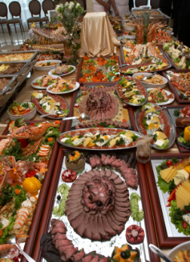
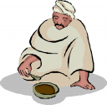
They served him by himself, the brothers by themselves, and the Egyptians who ate with him by themselves, because Egyptians could not eat with Hebrews, for that is detestable to Egyptians.

Slide 29
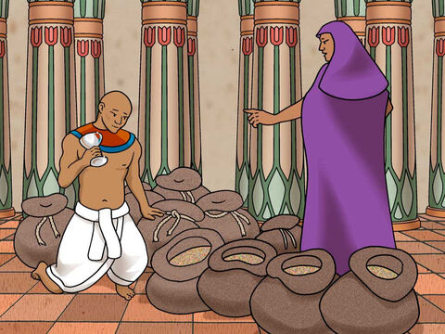
Now Joseph gave these instructions to the steward of his house:
“Fill the men’s sacks with as much food as they can carry, and put each man’s silver in the mouth of his sack.
Then put my cup,
the silver one,
in the mouth of the youngest one’s sack, along with the silver for his grain.”
And he did as Joseph said.

Slide 30
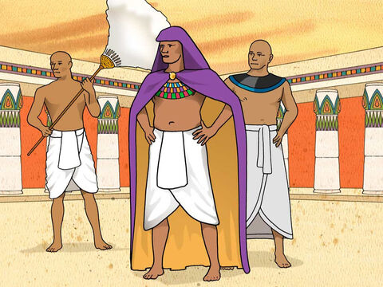
As morning dawned, the men were sent on their way with their donkeys. They had not gone far from the city when Joseph said to his steward,
Go after those men at once, and when you catch up with them, say to them,
‘Why have you repaid good with evil? Isn’t this the cup my master drinks from and also uses for divination? This is a wicked thing you have done.

Slide 31
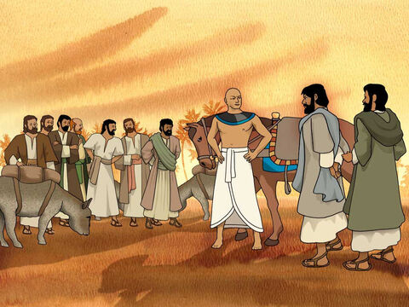
When he caught up with them, he repeated these words to them. But they said to him,
Why does my lord say such things?
Far be it from your servants to do anything like that! We even brought back to you from the land of Canaan the silver we found inside the mouths of our sacks.

Slide 32
So why would we steal silver or gold from your master’s house?
If any of your servants is found to have it, he will die; and the rest of us will become my lord’s slaves.
"let it be as you say.
Whoever is found to have it will become my slave; the rest of you will be free from blame.”
"Very well, then," he said

Slide 33
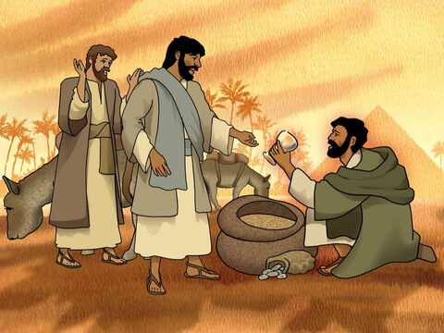
Each of them quickly lowered his sack to the ground and opened it. Then the steward proceeded to search, beginning with the oldest and ending with the youngest.
And the cup was found in Benjamin’s sack.

Slide 34
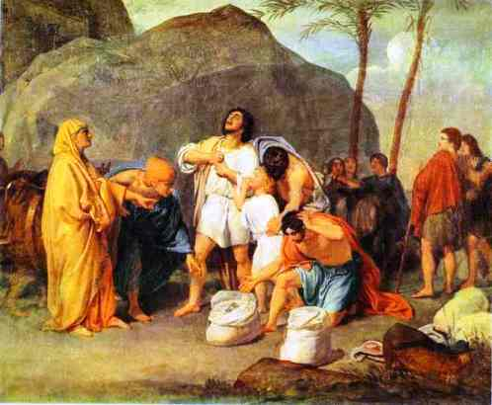
Each of them quickly lowered his sack to the ground and opened it. Then the steward proceeded to search, beginning with the oldest and ending with the youngest. And the cup was found in Benjamin’s sack.*
At this, they tore their clothes. Then they all loaded their donkeys and returned to the city.

Slide 35
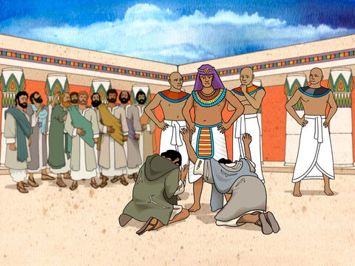
Joseph was still in the house when Judah and his brothers came in, and they threw themselves to the ground before him.

Slide 36
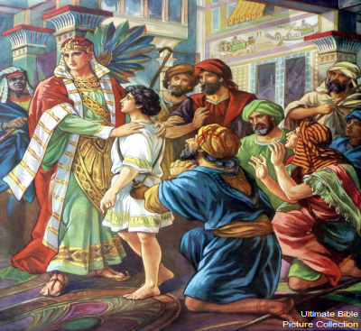
Joseph said to them,
What is this you have done?
Don’t you know that a man like me can find things out by divination?

Slide 37
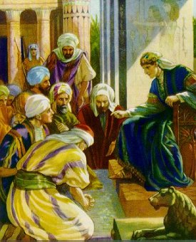
Judah replied.
What can we say to my lord?
What can we say? How can we prove our innocence? God has uncovered your servants’ guilt. We are now my lord’s slaves—we ourselves and the one who was found to have the cup.

Slide 38
What can we say? How can we prove our innocence? God has uncovered your servants’ guilt. We are now my lord’s slaves—we ourselves and the one who was found to have the cup.

Slide 39
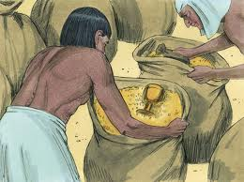
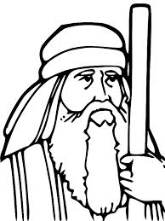
But Joseph said,
"Far be it from me to do such a thing! Only the man who was found to have the cup will become my slave. The rest of you, go back to your father in peace."

Slide 40
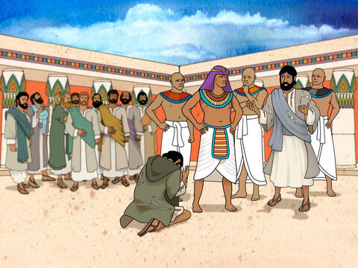
Then Judah went up to him and said: “Pardon your servant, my lord, let me speak a word to my lord."
"Do not be angry with your servant, though you are equal to Pharaoh himself."

Slide 41
“Now then, please let your servant remain here as my lord’s slave in place of the boy, and let the boy return with his brothers."

Slide 42
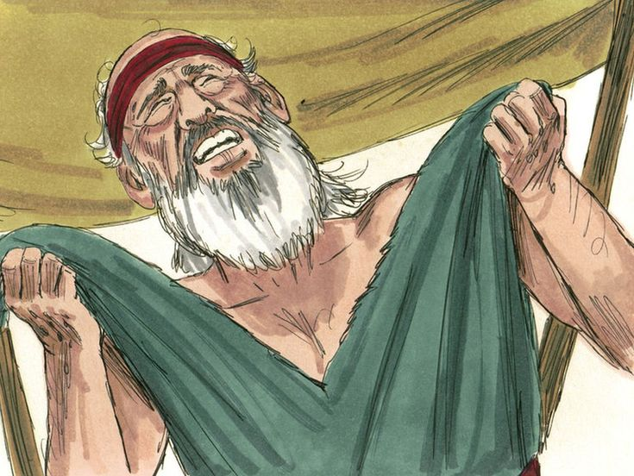
"How can I go back to my father if the boy is not with me?
No!
Do not let me see the misery that would come on my father.”

