Slide 1
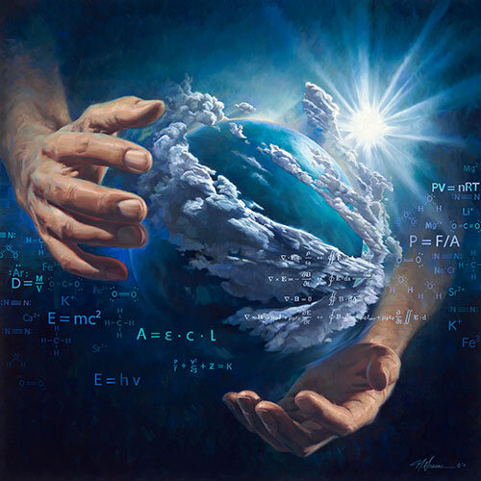
Dig Site 1
Genesis
1:1-31,
2:2-3, 7
In the Beginning…

Slide 2
The Truth
God is the creator of the world!

Slide 3
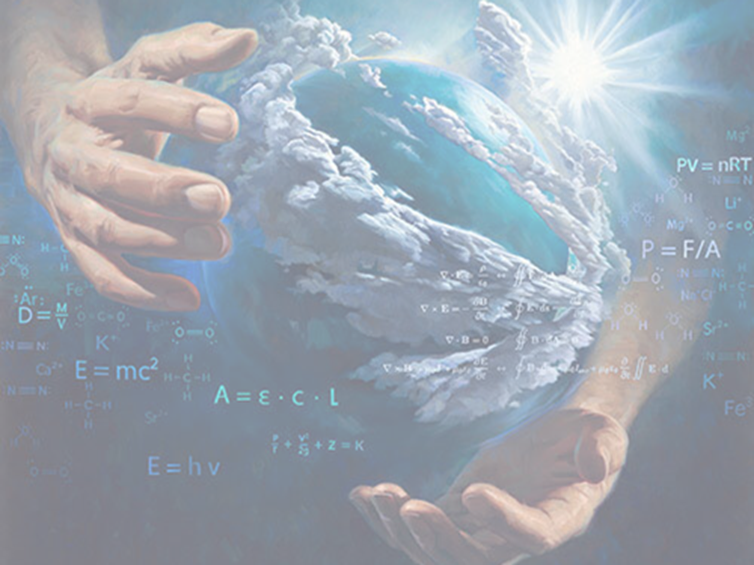
Genesis 1:1
In the beginning God created the heavens and the earth.
Memory Verse #1

Slide 4
Now the earth was formless and empty, darkness was over the surface of the deep, and the Spirit of God was hovering over the waters.

Slide 5
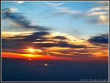
And God said, "Let there be light," and there was light.
God saw that the light was good, and He separated the light from the darkness.

Slide 6
God called the light "day," and the darkness he called "night."
And there was evening, and there was morning-the 1st day.

Slide 7
1
4
2
5
6
3

Slide 8
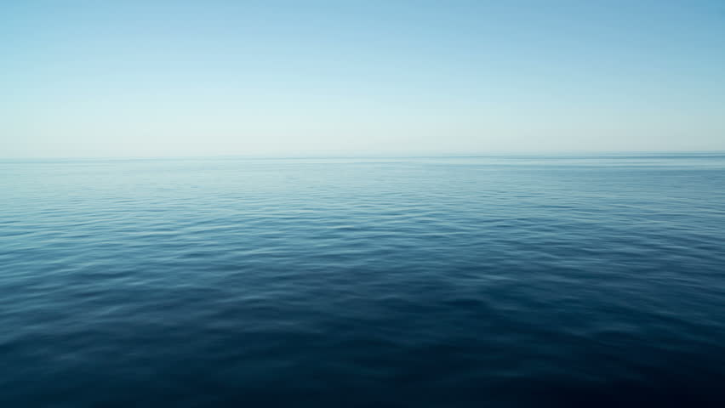
And God said,
"Let there be a vault
between the waters to separate water from water."

Slide 9
So God made the vault
and separated the water under the vault from the water above it.
And it was so.
God called the vault “sky.”
And there was evening, and there was morning—the 2nd day.

Slide 10


1
4
2
5
6
3

Slide 11
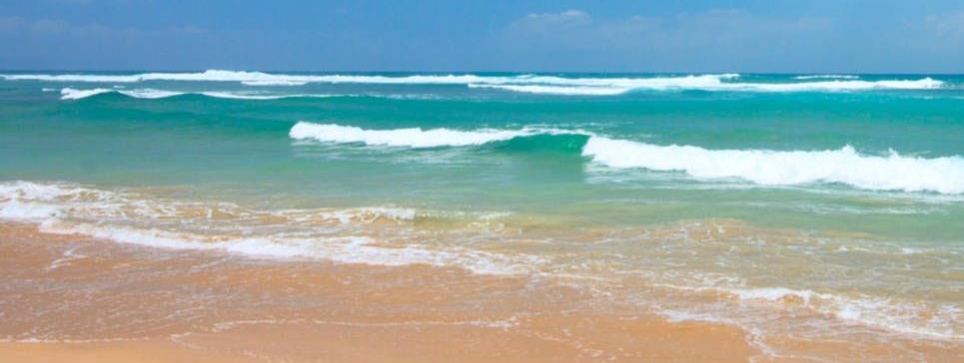
And God said, "Let the water under the sky be gathered to one place, and let dry ground appear." And it was so.
God called the dry ground "land," and the gathered waters he called "seas."
And God saw that it was good.

Slide 12
Then God said,
“Let the land produce vegetation:
seed-bearing plants and trees on the land that bear fruit
with seed in it,
according to their various kinds.”
And it was so.

Slide 13
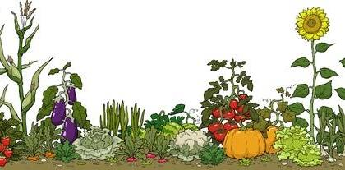
The land produced vegetation:
plants bearing seed according to their kinds and trees bearing fruit with seed in it according to their kinds.
And God saw that it was good.
And there was evening, and there was morning—the 3rd day.

Slide 14






1
4
2
5
3
6

Slide 15
And God said,
"Let there be lights in the vault of the sky to separate the day from the night, and let them serve as signs to mark sacred times and days and years,

Slide 16
and let them be lights in the vault of the sky to give light on the earth." And it was so.
God made two great lights—the greater light to govern the day and the lesser light to govern the night. He also made the stars.

Slide 17
God set them in the expanse of the sky to give light on the earth,
to govern the day and the night, and to separate light from darkness.
And God saw that it was good.
And there was evening, and there was morning—the 4th day.

Slide 18
1
4
2
5
3
6

Slide 19
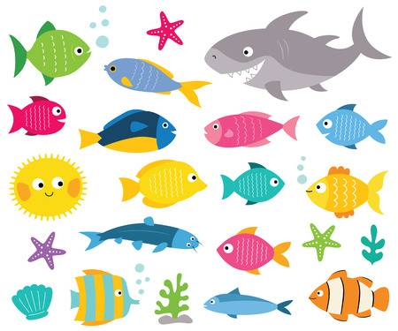


"Let the
water teem with living creatures,
and let birds fly above the earth
across the vault of the sky."

Slide 20
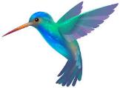

So God created the great creatures of the sea and every living thing with which the water teems and that moves about in it, according to their kinds, and every winged bird according to its kind.
And God saw that it was good.

Slide 21


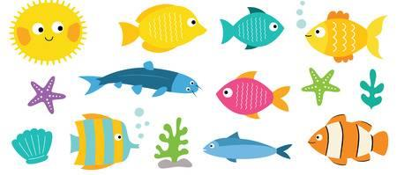
God blessed them and said,
"Be fruitful and increase in number and fill the water in the seas, and let the birds increase on the earth."
And there was evening, and there was morning—the 5th day.

Slide 22






1
4
2
5
3
6

Slide 23
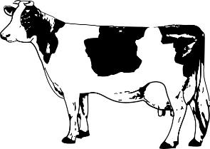

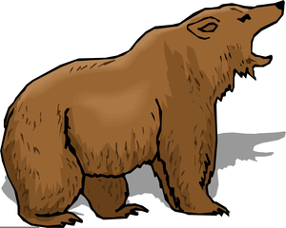
And God said,
"Let the land produce
living creatures
according to their kinds:
the livestock,
the creatures that
move along the ground,
and the wild animals,
each according
to its kind."
And it was so.

Slide 24
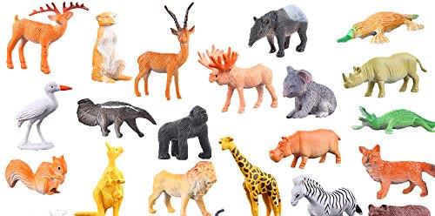
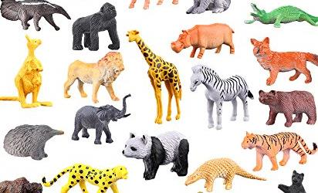
God made the wild animals according to their kinds, the livestock according to their kinds, and all the creatures that move along the ground according to their kinds.
And God saw that it was good.

Slide 25
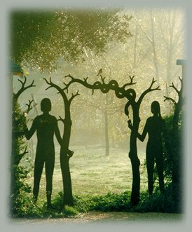
Then God said,
“Let us make mankind in our image,
in our likeness,
so that they may rule over the fish of the sea and the birds of the sky, over the livestock and all the wild animals, and over all the creatures that move along the ground.”

Slide 26
Memory Verse #2
Genesis 1:27
So God created mankind
in his own image,
in the image of God
he created them;
male and female he created them.

Slide 27

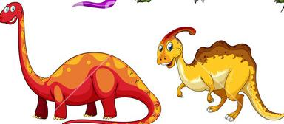

God blessed them and said to them,
"Be fruitful and increase in number; fill the earth and subdue it.
Rule over the fish in the sea and the birds in the sky and over every living creature that moves on the ground."

Slide 28
Then God said, "I give you every seed-bearing plant on the face of the whole earth and every tree that has fruit with seed in it.
They will be yours for food.

Slide 29
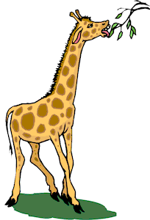
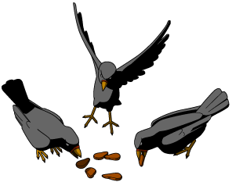

And to all the beasts of the earth and all the birds in the sky and all the creatures that move along the ground—everything that has the breath of life in it—I give every green plant for food."
And it was so.

Slide 30

God saw all that he had made, and it was
very good.
And there was evening, and there was morning—the 6th day.

Slide 31
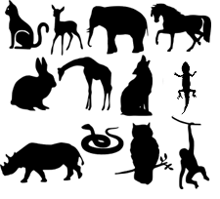

1
4
2
5
3
6

Slide 32
By the 7th day God had finished the work he had been doing;
so on the 7th day he rested from all his work.

Slide 33
Then God blessed the
7th day and made it holy, because on it he rested from all the work of creating that he had done.

Slide 34
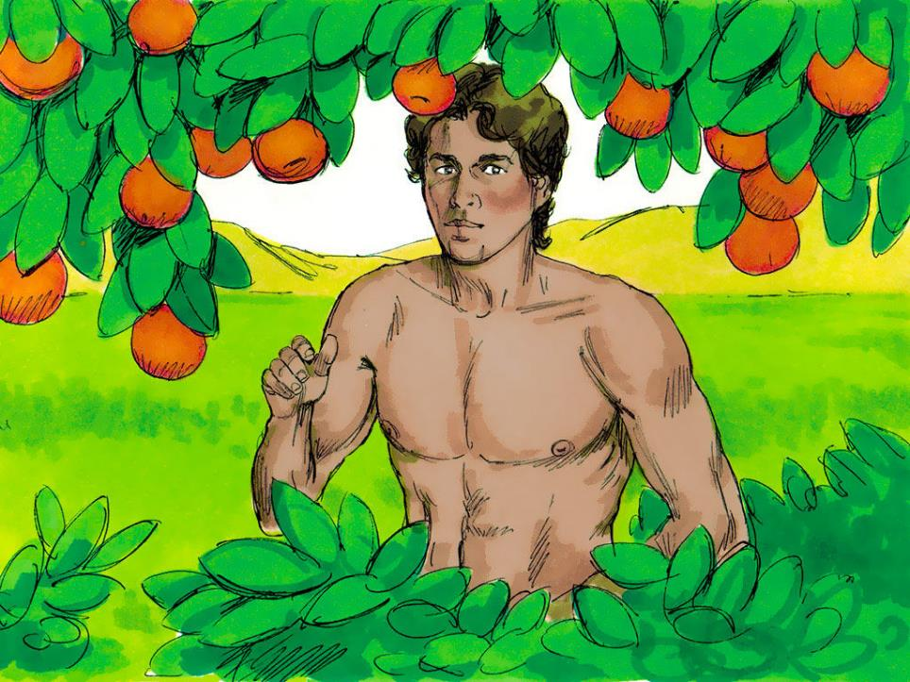
Then the LORD God formed a man from the dust of the ground and breathed into his nostrils the breath of life, and the man became a living being.

