Slide 1

Dig Site 17
Are You Spies?
Genesis 42:1-38

Slide 2
The Truth
God is honored by the obedience of those who love Him!

Slide 3
I am with you and will watch over you wherever you go, and I will bring you back to this land. I will not leave you until I have done what I have promised you.
Genesis 28:15
Memory Verse

Slide 4
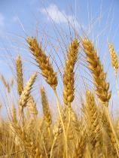
When Jacob learned that there was grain in Egypt, he said to his sons,
“Why do you just keep looking at each other?”

Slide 5
He continued,
“I have heard there is grain in Egypt. Go down there and buy some for us so we may live and not die.”
R.I.P

Slide 6
Then ten of Joseph’s brothers went down to buy grain from Egypt.

Slide 7
But Jacob did not send Benjamin, Joseph’s brother, with the others, because he was afraid harm might come to him.
R.I.P
No!

Slide 8
So Israel’s sons were among those who went to buy grain, for there was famine in the land of Canaan also.
I’m hungry!

Slide 9
Now Joseph was the governor of the land, the person who sold grain to all its people.

Slide 10
So when Joseph’s brothers arrived, they bowed down to him with their faces to the ground.
Food!

Slide 11
As soon as Joseph saw his brothers he recognized them, but he pretended to be a stranger and spoke harshly to them.
“Where do you come from?”
“From the land of Canaan, to buy food,”
Food!
they replied.

Slide 12
Although Joseph recognized his brothers, they did not recognize him.

Slide 13
Then he remembered his dreams about them and said to them,
“You are spies! You have come to see where our land is unprotected.”

Slide 14
“No, my lord,” they answered. “Your servants have come to buy food.”

Slide 15
“We are all the sons of one man. Your servants are honest men, not spies.”

Slide 16
“No!” he said to them. “You have come to see where our land is unprotected.”

Slide 17
“No!” he said to them. “You have come to see where our land is unprotected.”
But they replied, “Your servants were twelve brothers, the sons of one man, who lives in the land of Canaan. The youngest is now with our father, and one is no more.”

Slide 18
Joseph said to them, “It is just as I told you: You are spies! And this is how you will be tested: As surely as Pharaoh lives, you will not leave this place unless your youngest brother comes here. Send one of your number to get your brother, the rest of you will be kept in prison,

Slide 19
“so that your words may be tested to see if you are telling the truth. If you are not, then as surely as Pharaoh lives, you are spies!” And he put them all in custody for three days.

Slide 20
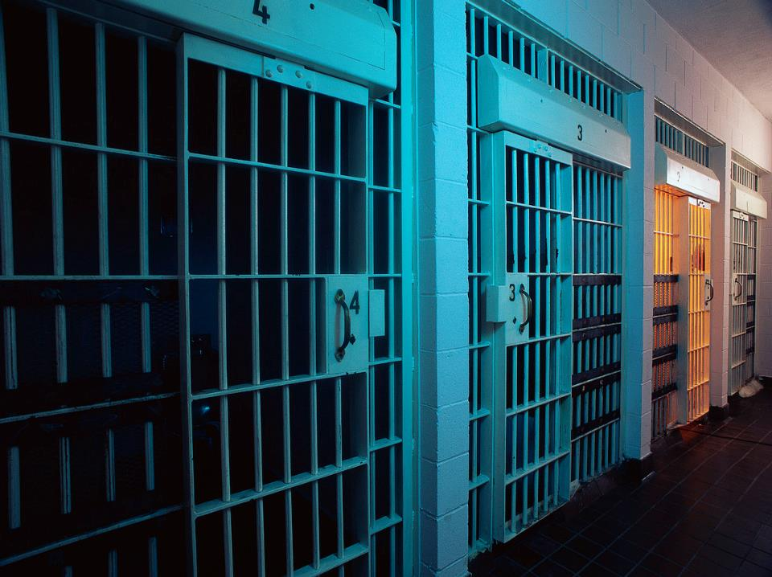
On the third day, Joseph said to them, “Do this and you will live, for I fear God: If you are honest men, let one of your brothers stay here in prison, while the rest of you go

Slide 21
“and take grain for your starving households. But you must bring your youngest brother to me, so that your words may be verified and that you may not die.” This they proceeded to do.

Slide 22
They said to one another, “Surely we are being punished because of our brother. We saw how distressed he was when he pleaded with us for his life, but we would not listen; that’s why this distress has come on us.”

Slide 23
Rueben replied, “Didn’t I tell you not to sin against the boy? But you wouldn’t listen! Now we must give an accounting for his blood.” They did not realize that Joseph could understand them, since he was using an interpreter.

Slide 24
Then he turned away from them and began to weep, but then came back and spoke to them again.

Slide 25
He had Simeon taken and bound before their eyes.

Slide 26
Joseph gave orders to fill their bags with grain, to put each man’s silver back in his sack, and give them provisions for their journey.

Slide 27
After this was done for them, they loaded their grain on their donkeys and left.

Slide 28
At the place were they stopped for the night one of them opened his sack to get feed for his donkey, and he saw his silver in the mouth of his sack.
“My silver has been returned,” he said to his brothers. “Here it is in my sack.”

Slide 29
Their hearts sank and they turned to each other trembling and said,
“What is this God has done to us?”

Slide 30
When they came to their father Jacob in the land of Canaan, they told him all that had happened to them. They said,

Slide 31
“The man who is lord over the land spoke harshly to us and treated us as though we were spying on the land. But we said to him, ‘We are honest men: we are not spies. We were twelve brothers, sons of one father. One is no more, and the youngest is now with our father in Canaan.’”

Slide 32
“The man who is lord over the land spoke harshly to us and treated us as though we were spying on the land. But we said to him, ‘We are honest men: we are not spies. We were twelve brothers, sons of one father. One is no more, and the youngest is now with our father in Canaan.’”
“Then the man who is lord over the land said to us, ‘This is how I will know whether you are honest men: Leave one of your brothers here with me, and take food for your starving households and go. But bring your youngest brother to me so I will know you are not spies but honest men. Then I will give your brother back to you, and you can trade in the land.’”
When they came to their father Jacob in the land of Canaan, they told him all that had happened to them.
They said,*

Slide 33
As they were emptying their sacks, there in each man’s sack was his pouch of silver! When they and their father saw the money pouches they were frightened. Their father Jacob said to them,

Slide 34
“You have deprived me of my children. Joseph is no more and Simeon is no more, and now you want to take Benjamin. Everything is against me!”

Slide 35
Then Reuben said to his father,

Slide 36
“You may put both my sons to death if I do not bring him back to you. Entrust him to my care, and I will bring him back.”

Slide 37
But Jacob said, “My son will not go down there with you; his brother is dead and he is the only one left. If harm comes to him on the journey you are taking, you will bring my gray head down to the grave in sorrow.”

