Slide 1
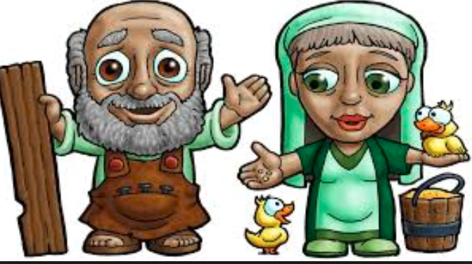
Dig Site 4
Genesis 6:5 – 7:16
One Man Stood Up

Slide 2
The Truth
God is with you, even if you feel alone in doing what is right!

Slide 3
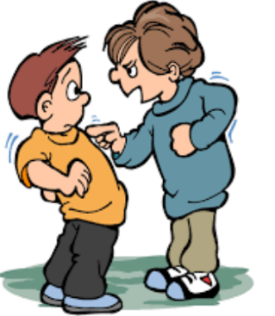
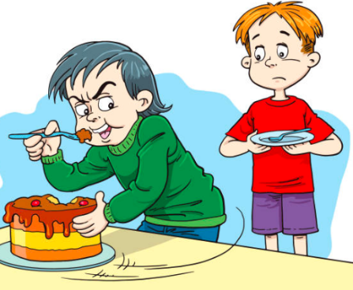
The LORD saw how great the wickedness of the human race had become
on the earth, and that every inclination of the thoughts of the human heart were only evil all the time.

Slide 4

The LORD regretted that he had made human beings on the earth, and his heart was deeply troubled.

Slide 5
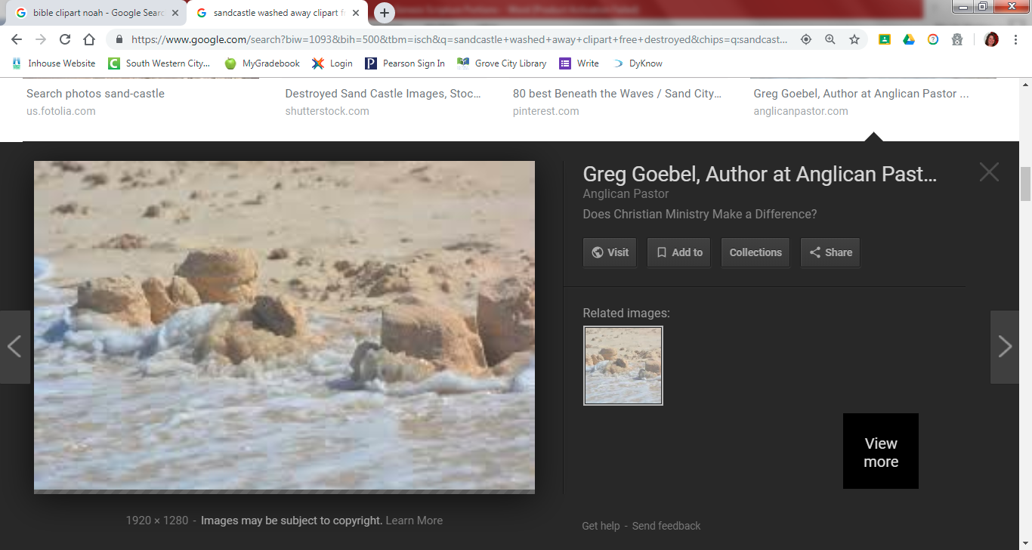
So the LORD said, "I will wipe from the face of the earth the human race, whom I have created—and with them the animals, the birds, and the creatures that move along the ground— for I regret that I have made them."

Slide 6
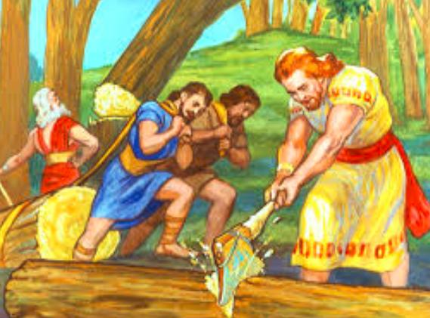
But Noah found favor in the eyes of the LORD. This is the account of Noah and his family.

Slide 7
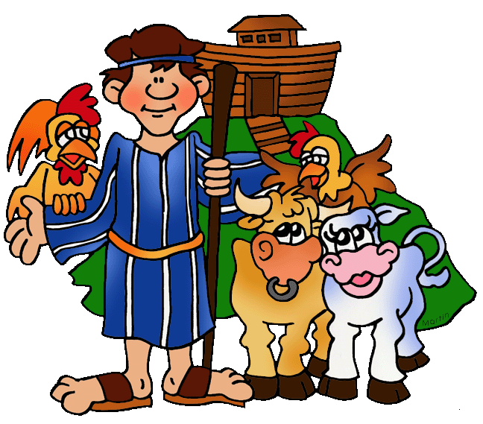
Memory Verse #4
Noah was a righteous man, blameless among the people of his time, and he walked faithfully with God.
Genesis 6:9b

Slide 8

Noah had three sons:
Shem, Ham and Japheth.

Slide 9
Now the earth was corrupt in God's sight and was full of violence. God saw how corrupt the earth had become, for all the people on earth had corrupted their ways.
So God said to Noah, "I am going to put an end to all people, for the earth is filled with violence because of them. I am surely going to destroy both them and the earth.

Slide 10

So make yourself an ark of cypress wood; make rooms in it and coat it with pitch inside and out.
This is how you are to build it: The ark is to be 300 cubits long, 50 cubits wide and 30 cubits high.
------50----
-----------30
----300-----

Slide 11
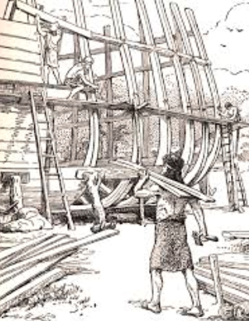
Make a roof for it leaving below the roof an opening 1 cubit high all around.
Put a door in the side of the ark and make lower, middle and upper decks.

Slide 12
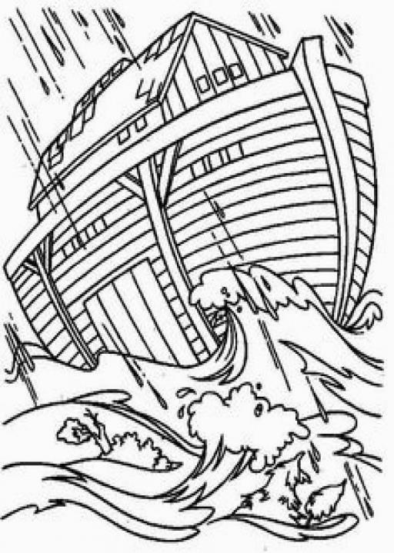
I am going to bring floodwaters on the earth to destroy all life under the heavens, every creature that has the breath of life in it. Everything on earth will perish.

Slide 13
But I will establish my covenant with you, and you will enter the ark— you and your sons and your wife and your sons' wives with you.

Slide 14
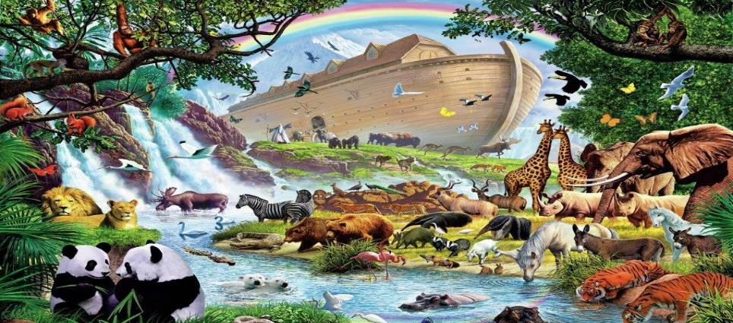
You are to bring into the ark 2 of all living creatures, male and female, to keep them alive with you. 2 of every kind of bird, of every kind of animal and of every kind of creature that moves along the ground will come to you to be kept alive.

Slide 15
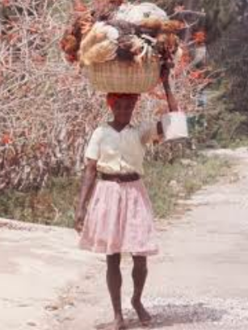
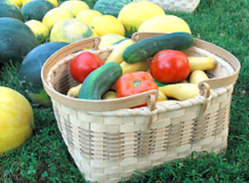
You are to take every kind of food that is to be eaten and store it away as food for you and for them.
Noah did everything just as God commanded him.

Slide 16
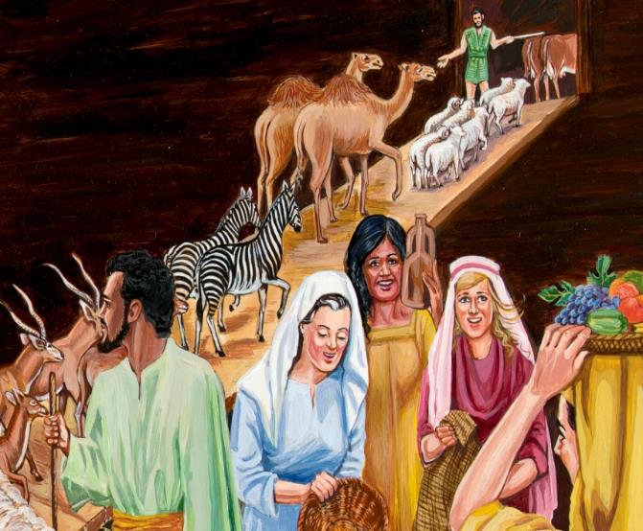
The LORD then said to Noah,
"Go into the ark, you and your whole family,
because I have found you righteous in this generation.

Slide 17
Take with you 7 pairs of every kind of clean animal, a male and its mate,
and 1 pair of every kind of unclean animal, a male and its mate,
and also 7 pairs of every kind of bird, male and female,
to keep their various kinds alive throughout the earth.

Slide 18

7 days from now
I will send rain on the earth
for 40 days and 40 nights,
and I will wipe from the face of the earth every living creature
I have made.

Slide 19
And Noah did ALL
that the LORD commanded him.

Slide 20
Noah was 600 years old when the floodwaters came on the earth.

Slide 21

And Noah and his sons and his wife and his sons' wives entered the ark to escape the waters of the flood.

Slide 22
Pairs of clean and unclean animals, of birds and of all creatures that move along the ground, male and female, came to Noah and entered the ark, as God had commanded Noah. And after the 7 days the floodwaters came on the earth.

Slide 23


In the 600th year of Noah's life,
on the 17th day of the 2nd month—
on that day all the springs of
the great deep burst forth,
and the floodgates of the heavens
were opened. And rain fell on the earth
40 days and 40 nights.

Slide 24

On that very day Noah and his sons, Shem, Ham and Japheth, together with his wife and the wives of his three sons, entered the ark.

Slide 25
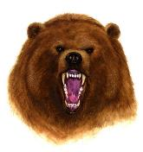
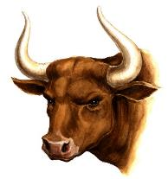
They had with them every wild animal according to its kind, all livestock according to their kinds, every creature that moves along the ground according to its kind and every bird according to its kind, everything with wings.

Slide 26
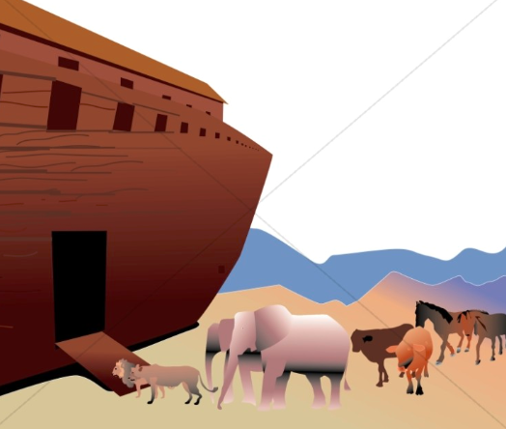
Pairs of all creatures that
have the breath of life in them came to Noah and entered the ark.
The animals going in were male and female of every living thing,
as God had commanded Noah.

Slide 27
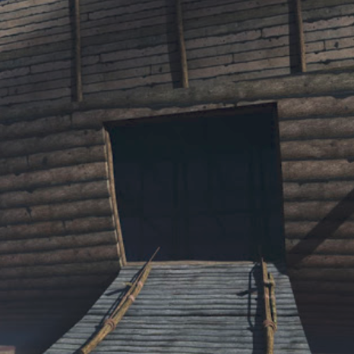
Then the LORD
shut him in.

