Slide 1
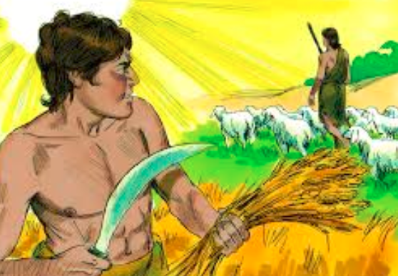
Dig Site #3
Genesis
4:1-16, 25-26
Cain's Conflict

Slide 2

The Truth
God is a holy
andmerciful
God!

Slide 3
Adam made love to his wife Eve, and she became pregnant and gave birth to Cain.
She said, "With the help of the LORD I have brought forth a man."
Later she gave birth to his brother Abel.
Cain
Abel

Slide 4
Now Abel kept flocks,
and Cain worked the soil.
Abel
Cain

Slide 5
In the course of time Cain brought some of the fruits of the soil as an offering to the LORD.
And Abel also brought an offering- fat portions from some of the firstborn of his flock.

Slide 6
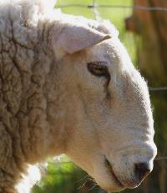
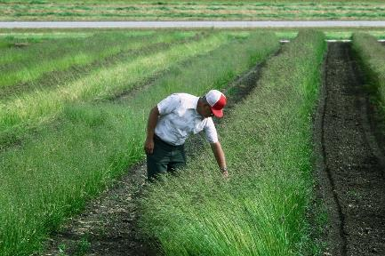
The LORD looked with favor on Abel and his offering,
but on Cain and his offering he did not look with favor.
So Cain was very angry, and his face was downcast.
Abel
Cain

Slide 7
Then the LORD said to Cain,
"Why are you angry? Why is your face downcast?
If you do what is right,
will you not be accepted?
?

Slide 8

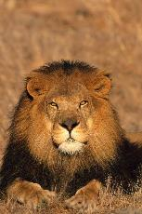
Memory Verse #3
Genesis 4:7b
But if you do not do what is right,
sin is crouching at your door; it desires to
have you,
but you must rule over it.“

Slide 9
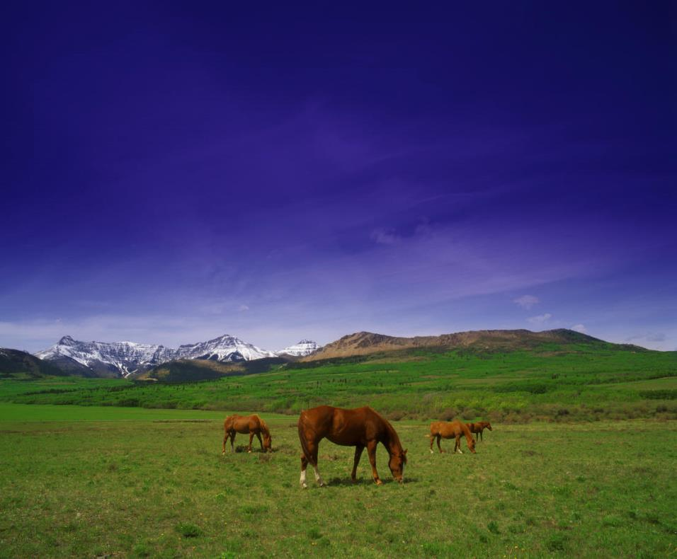
Now Cain said to his brother Abel, "Let's go out to the field."
While they were in the field, Cain attacked his brother Abel and killed him.

Slide 10
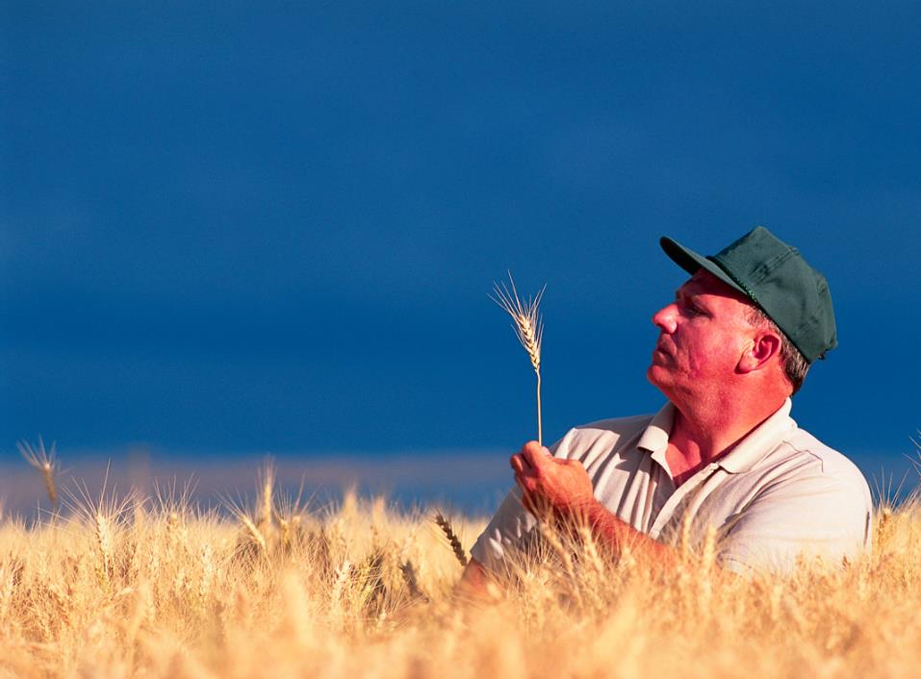
Then the LORD said to Cain,
"Where is your brother Abel?"
"I don't know," he replied.
"Am I my brother's keeper?"

Slide 11
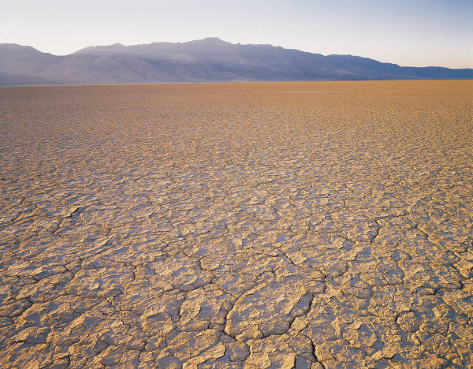
The LORD said, "What have you done? Listen! Your brother's blood cries out to me from the ground.
Now you are under a curse and driven from the ground, which opened its mouth to receive your brother's blood from your hand.

Slide 12
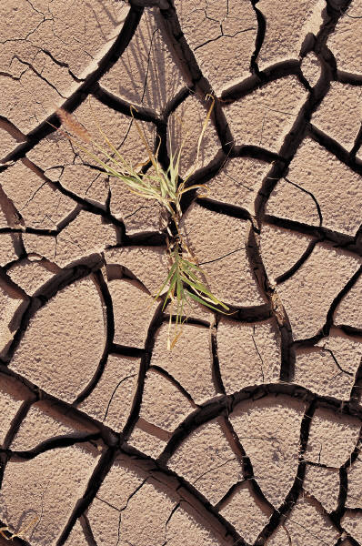
When you work the ground, it will no longer yield its crops for you.
You will be a restless wanderer on the earth.

Slide 13
Cain said to the LORD, "My punishment is more than I can bear.
Today you are driving me from the land, and I will be hidden
from your presence;
I will be a restless wanderer on the earth, and whoever finds me will kill me."

Slide 14
But the LORD said to him, "Not so; anyone who kills Cain will suffer vengeance seven times over."
Then the LORD put a mark on Cain so that no one who found him would kill him.
So Cain went out from the LORD's presence and lived in the land of Nod, east of Eden.

Slide 15
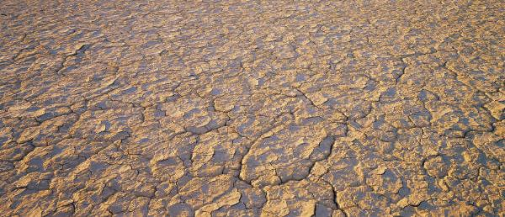
So Cain went out from the LORD's presence and lived in the land of Nod, east of Eden.

Slide 16
Adam made love to his wife again, and she gave birth to a son and named him Seth, saying, "God has granted me another child in place of Abel, since Cain killed him."

Slide 17

Seth also had a son, and he named him Enosh.
At that time people began to call on the name of the LORD.

