Slide 1
Dig Site 4
Acts 6:1-15 & 7:51-8:3

Slide 2
The Truth
God is with us even in times of persecution!

Slide 3
James 1:12
"Blessed is the one who perseveres under trial because, having stood the test, that person will receive the crown of life that the Lord has promised to those who love him."

Slide 4
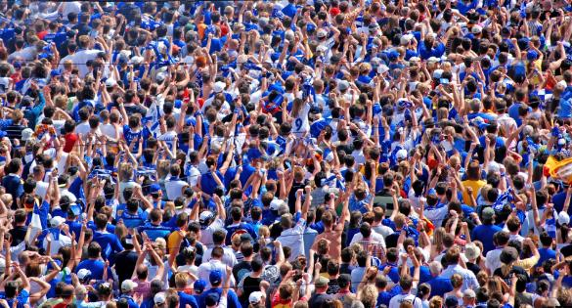
widow – woman whose husband died
In those days when the number of disciples was increasing, the Hellenistic Jews among them complained against the Hebraic Jews because their widows were being overlooked in the daily distribution of food.

Slide 5
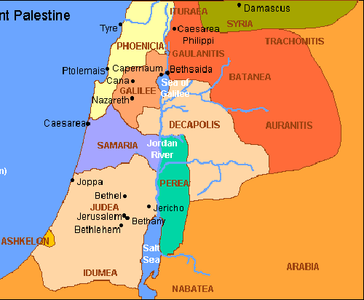
Grecian Jews - speak mainly Greek, used to live outside of Judea and Galilee but settled in Jerusalem
Hebraic Jews - speak mainly Aramaic and were born in Jerusalem or Judea

Slide 6
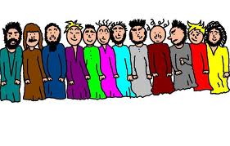
So the Twelve gathered all the disciples together and said,
It would not be right for us to neglect the ministry of the word of God in order to wait on tables.

Slide 7

7
Brothers and sisters, choose seven men from among you who are known to be full of the Spirit and wisdom. We will turn this responsibility over to them and will give our attention to prayer and the ministry of the word.
+
+

Slide 8
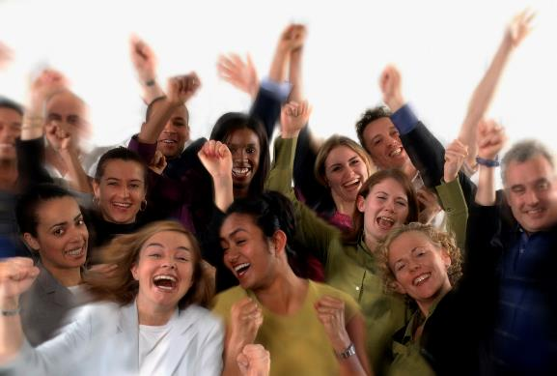
This proposal pleased
the whole group.
Great idea!

Slide 9
The Seven Chosen:
Stephen, a man full of faith and of the Holy Spirit
Philip
Procorus
Nicanor
Timon
Parmenas
Nicolas from Antioch, a convert to Judaism.

Slide 10
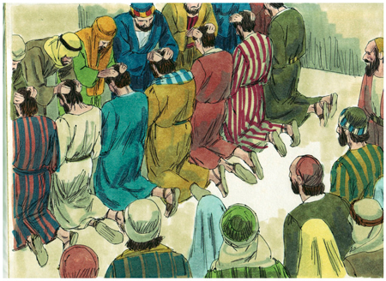
They presented these men to the apostles, who prayed and laid their hands on them.

Slide 11
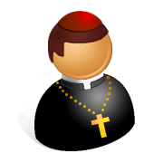
So the word of God spread. The number of disciples in Jerusalem increased rapidly, and a large number of priests became obedient to the faith.

Slide 12
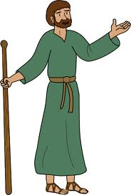
Now Stephen, a man full of God’s grace and power, performed great wonders and signs among the people.

Slide 13
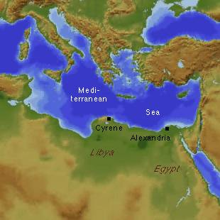
Opposition arose, however, from members of the Synagogue of the Freedmen (as it was called)—Jews of Cyrene and Alexandria as well as the provinces of Cilicia and Asia—who began to argue with Stephen.
Cilicia

Slide 14

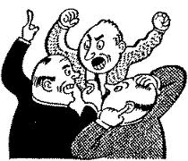
But they could not stand up against the wisdom the Spirit gave him as he spoke. Then they secretly persuaded some men to say,

Slide 15

“We have heard Stephen speak blasphemous words against Moses and against God.”
blasphemy – the act of insulting or showing contempt or lack of reverence for God.

Slide 16
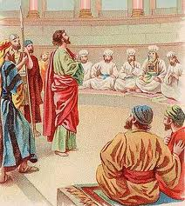
So they stirred up the people and the elders and the teachers of the law. They seized Stephen and brought him before the Sanhedrin.

Slide 17
This fellow never stops speaking against this holy place and against the law.
They produced false witnesses,
who testified,
For we have heard him say that this Jesus of Nazareth will destroy this place and change the customs Moses handed down to us.

Slide 18
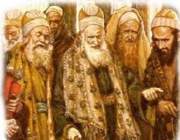

All who were sitting in the Sanhedrin looked intently at Stephen, and they saw that his face was like the face of an angel.

Slide 19
You stiff-necked people! Your hearts and ears are still uncircumcised. You are just like your ancestors: You always resist the Holy Spirit! Was there ever a prophet your ancestors did not persecute? They even killed those who predicted the coming of the Righteous One. And now you have betrayed and murdered him—you who have received the law that was given through angels but have not obeyed it.

Slide 20
When the members of the Sanhedrin heard this, they were furious and gnashed their teeth at him.

Slide 21
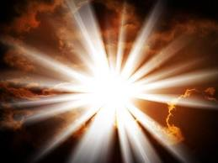
But Stephen, full of the Holy Spirit, looked up to heaven and saw the glory of God, and Jesus standing at the right hand of God.

Slide 22
“Look,” he said, “I see heaven open and the Son of Man standing at the right hand of God.”

Slide 23
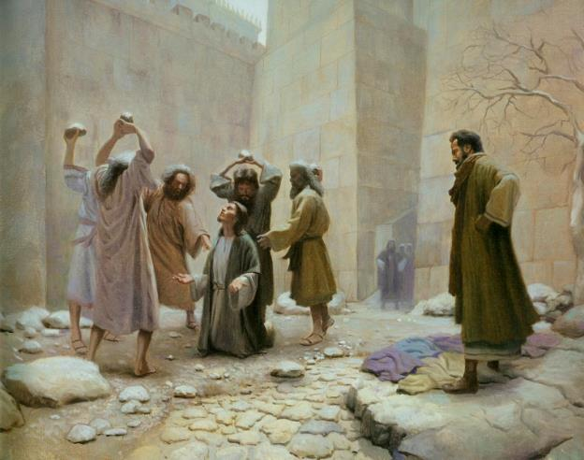
At this they covered their ears and, yelling at the top of their voices, they all rushed at him, dragged him out of the city and began to stone him.

Slide 24
Meanwhile, the witnesses laid their coats at the feet of a young man named Saul.

Slide 25
While they were stoning him, Stephen prayed, "Lord Jesus, receive my spirit." Then he fell on his knees and cried out, "Lord, do not hold this sin against them." When he had said this, he fell asleep. And Saul approved of their killing him.

Slide 26
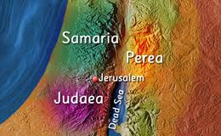
On that day a great persecution broke out against the church in Jerusalem, and all except the apostles were scattered throughout Judea and Samaria.

Slide 27
Godly men buried Stephen and mourned deeply for him.

Slide 28
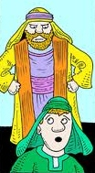


But Saul began to destroy the church. Going from house to house, he dragged off both men and women and put them in prison.

