Slide 1
Dig Site 7
ACTS
Acts 10:1-23
To Eat or Not to Eat

Slide 2
God can change our way of thinking!
The Truth

Slide 3
"Do not conform to the pattern of this world, but be transformed by the renewing of your mind. Then you will be able to test and approve what God's will is – his good, pleasing and perfect will."
Romans 12:2

Slide 4
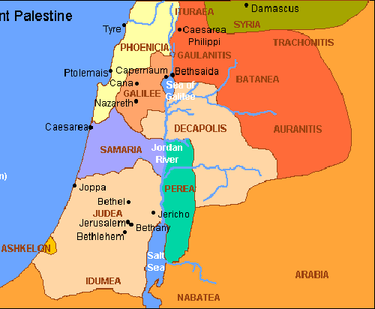
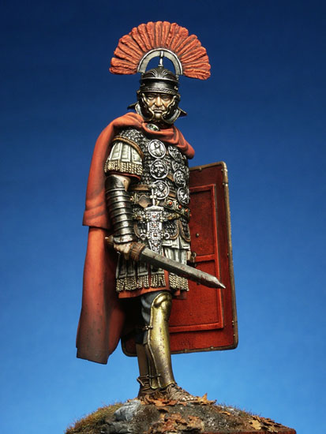
At Caesarea there was a man named Cornelius, a centurion in what was known as the Italian Regiment.
65 miles
A centurion was in charge of 100 soldiers. In Caesarea, the soldiers protected the city and harbor.

Slide 5
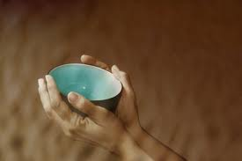
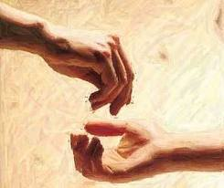
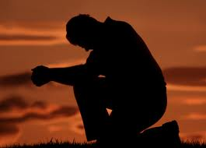
He and all his family were devout and God-fearing; he gave generously to those in need and prayed to God regularly.

Slide 6
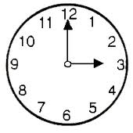
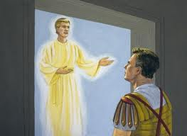
"What is it, Lord?"
"Cornelius!"
One day at about three in the afternoon he had a vision. He distinctly saw an angel of God, who came to him and said, “Cornelius!” Cornelius stared at him in fear. What is it , Lord?” he asked.

Slide 7
The angel answered, “Your prayers and gifts to the poor have come up as a memorial offering before God. Now send men to Joppa to bring back a man named Simon who is called Peter. He is staying with Simon the tanner, whose house is by the sea.”

Slide 8
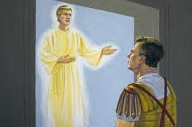
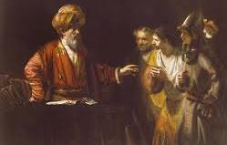
When the angel who spoke to him had gone, Cornelius called two of his servants and a devout soldier who was one of his attendants. He told them everything that had happened and sent them to Joppa.

Slide 9
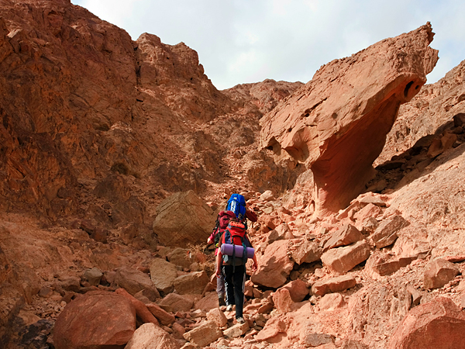
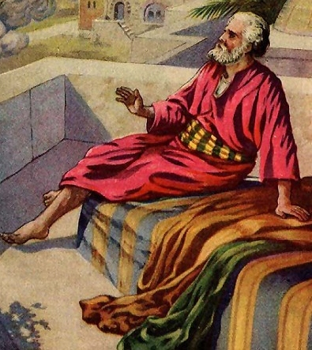

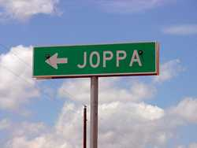
About noon the following day as they were on their journey and approaching the city, Peter went up on the roof to pray.

Slide 10
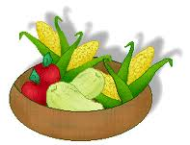
He became hungry and wanted something to eat, and while the meal was being prepared, he fell into a trance.
I’m hungry!

Slide 11
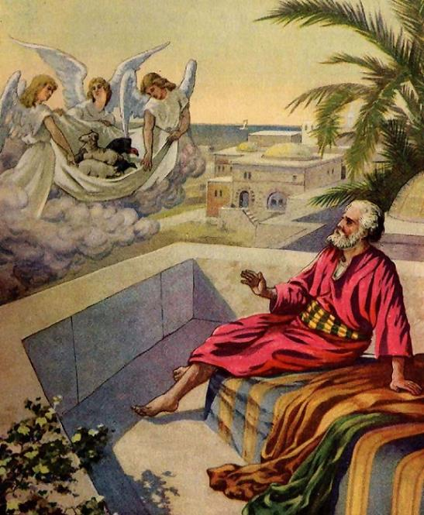
He saw heaven opened and something like a large sheet being let down to earth by its four corners. It contained all kinds of four-footed animals, as well as reptiles and birds.

Slide 12

Then a voice told him,
"Get up, Peter. Kill and eat."
"Surely not, Lord! I have never eaten anything impure or unclean."

Slide 13
"Do not call anything impure that God has made clean."
The voice spoke to him a second time,

Slide 14
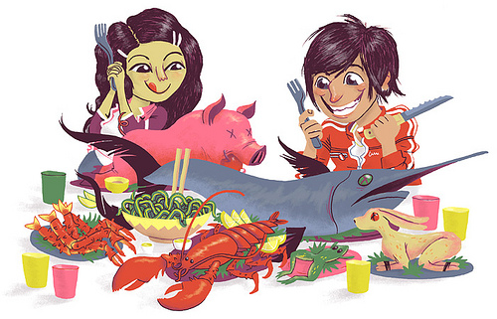
Some Forbidden Foods:
lizards
mice
snails
pigs
turtles
snakes
squid
squirrels
shellfish
The idea of unclean or impure animals is part of Jewish law that specifies which foods are allowed (kosher) or not allowed for Jews. These laws are based upon the books of Leviticus and Deuteronomy.

Slide 15
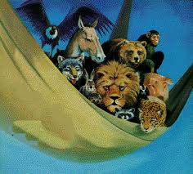
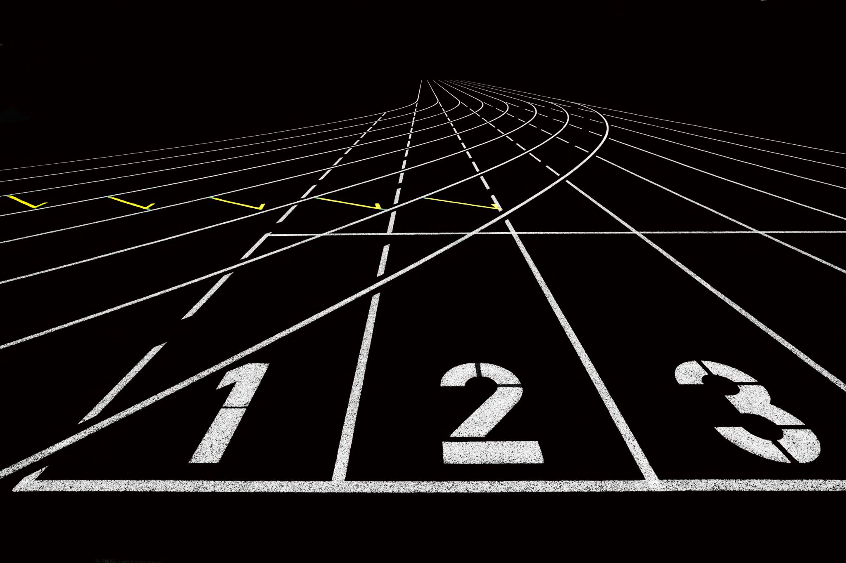
This happened three times, and immediately the sheet was taken back to heaven.

Slide 16
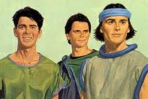
While Peter was wondering about the meaning of the vision, the men sent by Cornelius found out where Simon’s house was and stopped at the gate. They called out, asking if Simon who was known as Peter was staying there.
Is Simon Peter staying here?

Slide 17
"Simon, three men are looking for you. So get up and go downstairs. Do not hesitate to go with them, for I have sent them."
While Peter was still thinking about the vision, the Spirit said to him,

Slide 18
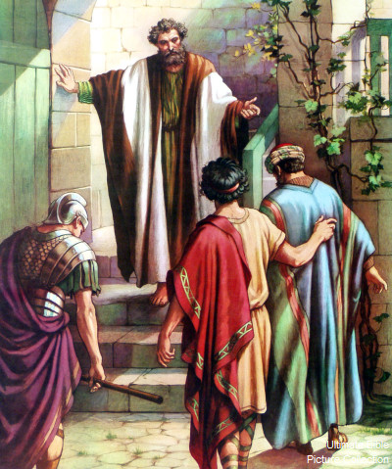
Peter went down and said to the men,
"I’m the one you’re looking for. Why have you come?"

Slide 19
The men replied,
We have come from Cornelius the centurion. He is a righteous and God-fearing man, who is respected by all the Jewish people. A holy angel told him to ask you to come to his house so that he could hear what you have to say.

Slide 20
Then Peter invited the men into the house to be his guests.

Slide 21
The next day Peter started out with them, and some of the believers from Joppa went along.
30 miles

