Slide 1
“He is Risen! He is Risen Indeed!”
Lesson #20
Matthew 27:57-28:20

Slide 2
Hide it in your
Matthew 28:19-20
DS#20

Slide 3
Therefore go and
make disciples of all nations,
baptizing them in the name of the Father and of the Son
and of the Holy Spirit,
and teaching them to obey everything
I have commanded you.
And surely I am with you always,
to the very end of the age.”
Matthew 28:19-20
DS #20

Slide 4
The Truth Jesus forgives and shows concern for people, and we must do the same.

Slide 5
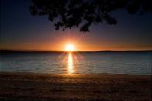
As evening approached, there came a rich man from Arimathea, named Joseph, who had himself become a disciple of Jesus.

Slide 6
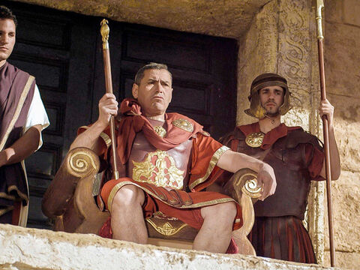
Going to Pilate, he asked for Jesus’ body, and Pilate ordered that it be given to him.
Could I please have Jesus’ body?

Slide 7
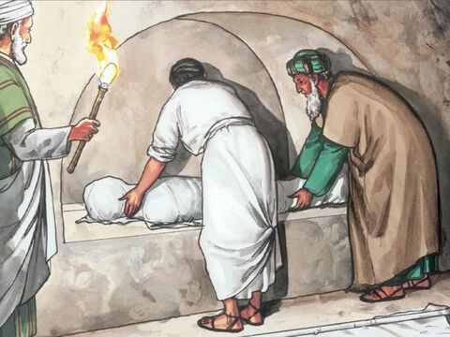
Joseph took the body, wrapped it in a clean linen cloth, and placed it in his own new tomb that he had cut out of the rock.
Notes:
7

Slide 8
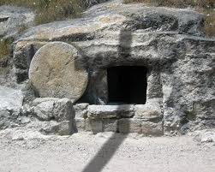
He rolled a big stone in front of the entrance to the tomb and went away.
Notes:
8

Slide 9
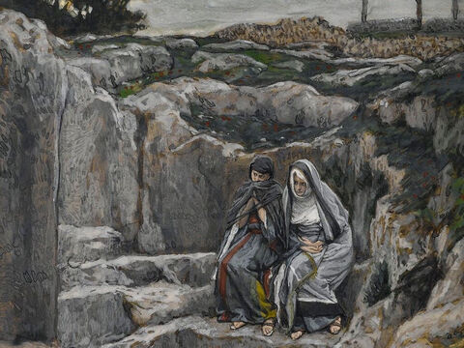
Mary Magdalene and the other Mary were sitting there opposite the tomb.
Notes:
9

Slide 10
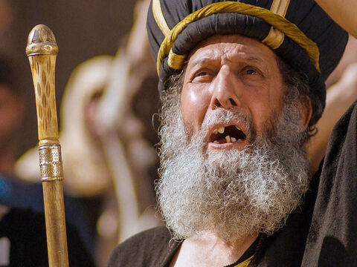
The next day, the one after Preparation Day, the chief priests and the Pharisees went to Pilate.
Sir
they said,
Notes:
10

Slide 11
we remember that while he was still alive that deceiver said, ‘After THREE days
I will rise again.’
Notes:
11

Slide 12
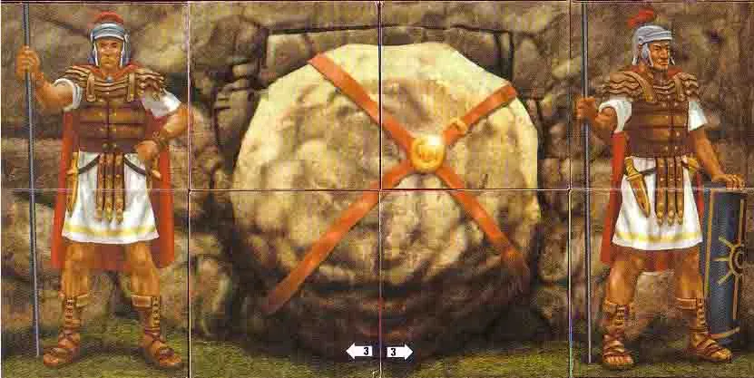
So give the order for the tomb to be made secure until the THIRD day.
1 day
2 days
3 days

Slide 13
Otherwise, his disciples may come and steal the body and tell the people that he has been raised from the dead.
Notes:
13

Slide 14
This last deception will be worse than the first.
Notes:
14

Slide 15
“Take a guard,” Pilate answered. “Go, make the tomb as secure as you know how.”

Slide 16
So they went and made the tomb secure by putting a seal on the stone and posting the guard.
Notes:
16

Slide 17
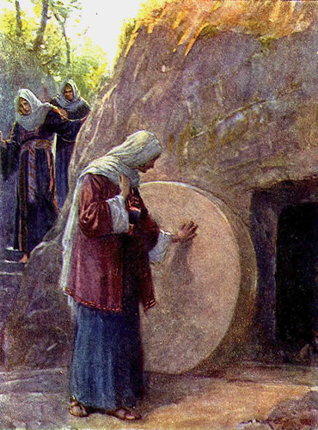
After the Sabbath, at dawn on the first day of the week, Mary Magdalene and the other Mary went to look at the tomb.

Slide 18
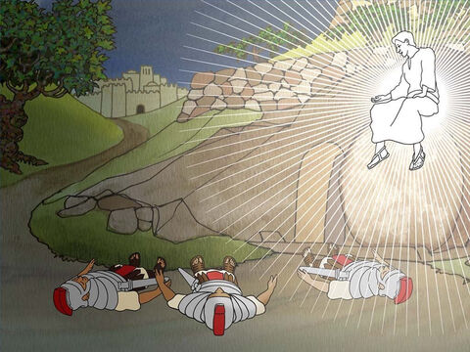
There was a violent earthquake, for an angel of the Lord came down from heaven and, going to the tomb, rolled back the stone and sat on it.

Slide 19
His appearance was like lightning, and his clothes were white as snow. The guards were so afraid of him that they shook and became like dead men.

Slide 20
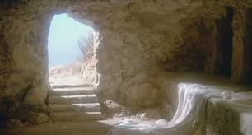
The angel said to the women, “Do not be afraid, for I know that you are looking for Jesus, who was crucified. He is not here; he has risen, just as he said. Come and see the place where he lay.

Slide 21
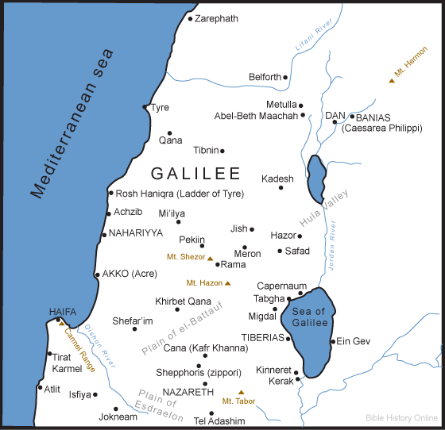
Then go quickly and tell his disciples: ‘He has risen from the dead and is going ahead of you into Galilee. There you will see him.’ Now I have told you.”

Slide 22
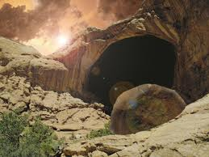
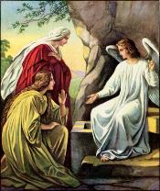
So the women hurried away from the tomb, afraid yet filled with joy, and ran to tell his disciples.
Notes:
22

Slide 23
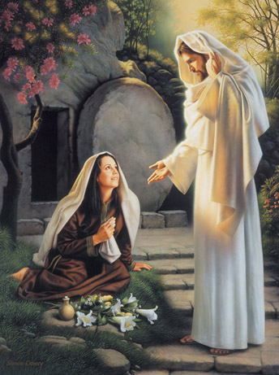
Suddenly Jesus met them.
Greetings,
he said.

Slide 24
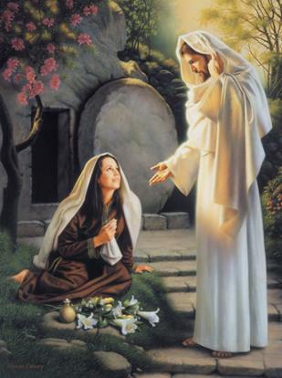
They came to him, clasped his feet and worshiped him. Then Jesus said to them,
Do not be afraid.
Go and tell my brothers to go to Galilee;
there they will see me.
Notes:
24

Slide 25
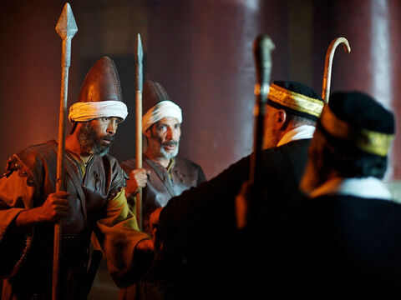
While the women were on their way, some of the guards went into the city and reported to the chief priests everything that had happened.
Notes:
25

Slide 26
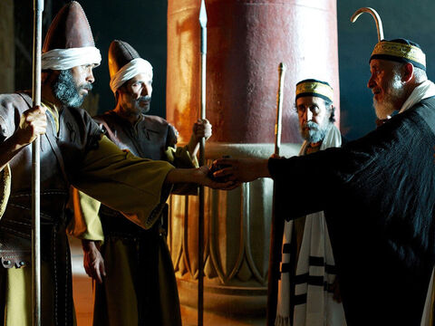
When the chief priests had met with the elders and devised a plan, they gave the soldiers a large sum of money, telling them,

Slide 27
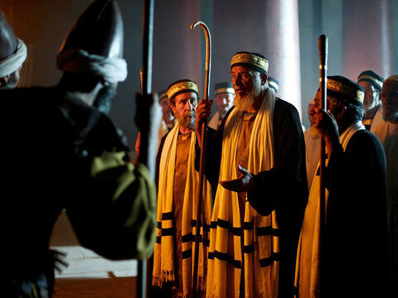
“You are to say, ‘His disciples came during the night and stole him away while we were asleep.’ If this report gets to the governor, we will satisfy him and keep you out of trouble.”

Slide 28
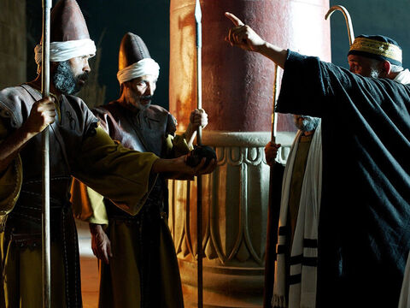
So the soldiers took the money and did as they were instructed. And this story has been widely circulated among the Jews to this very day.
Notes:
28

Slide 29
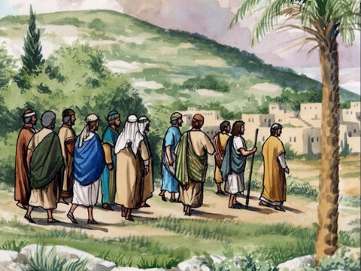
Then the eleven disciples went to Galilee, to the mountain where Jesus had told them to go.
Notes:
29

Slide 30
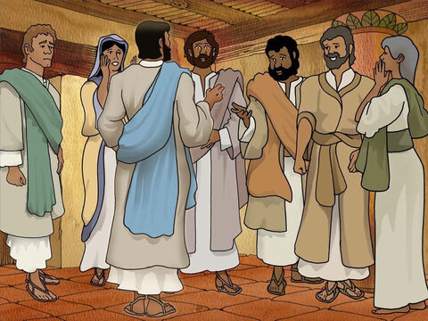
When they saw him, they worshiped him; but some doubted.
Notes:
30

Slide 31
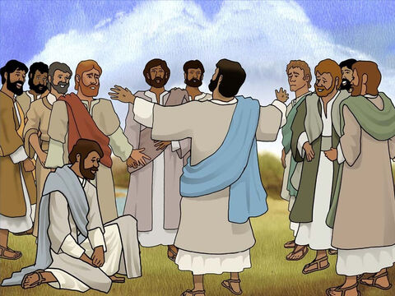
Then Jesus came to them and said, “All authority in heaven and on earth has been given to me.

Slide 32
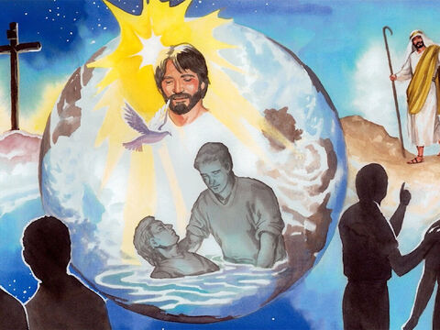
Therefore go and make disciples of all nations, baptizing them in the name of the Father and of the Son and of the Holy Spirit,

Slide 33
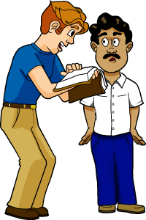
and teaching them to obey everything I have commanded you.

Slide 34
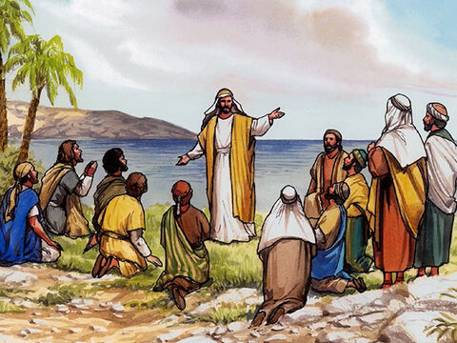
And surely I am with you always, to the very end of the age.

