Slide 1
Dig Site 18
Pilate’s Plea
Matthew 27:11-31

Slide 2
Hide it in your
Matthew 27:22a
DS#18

Slide 3
What shall I do, then,
with Jesus
who is called the Messiah?
Matthew 27:22a
DS #18

Slide 4
The Truth Jesus gives people a choice about how they will respond to Him.

Slide 5
Jesus Before Pilate

Slide 6
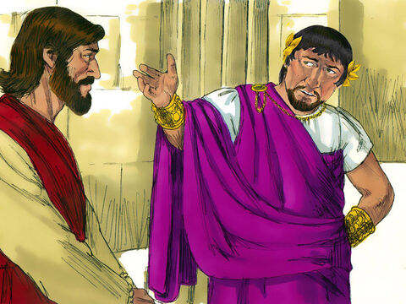
Meanwhile Jesus stood before the governor, and the governor asked him, “Are you the king of the Jews?”

Slide 7
“You have said so,” Jesus replied.

Slide 8
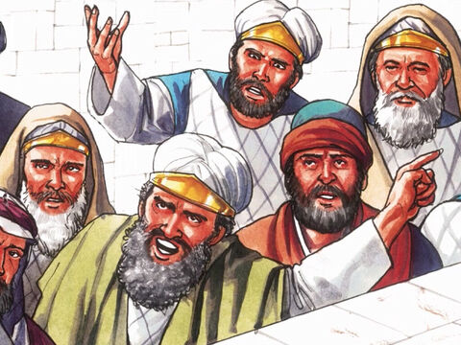
When he was accused by the chief priests and the elders, he gave no answer.

Slide 9
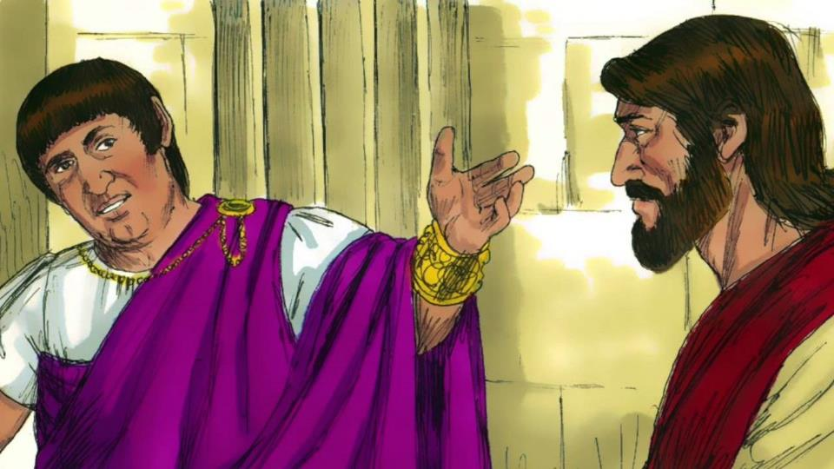
Then Pilate asked him, “Don’t you hear the testimony they are bringing against you?”

Slide 10
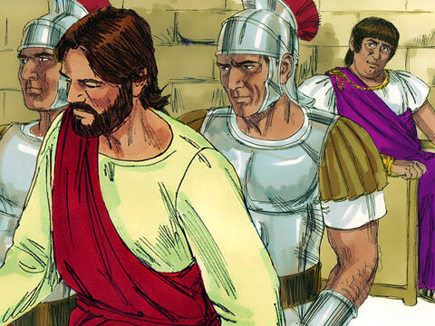
But Jesus made no reply, not even to a single charge—to the great amazement of the governor.

Slide 11
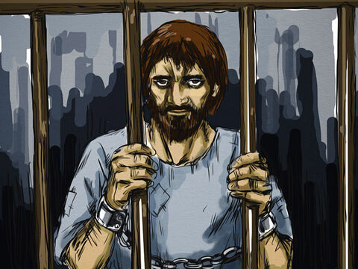
Now it was the governor’s custom at the festival to release a prisoner chosen by the crowd. At that time they had a well-known prisoner whose name was Jesus Barabbas.

Slide 12
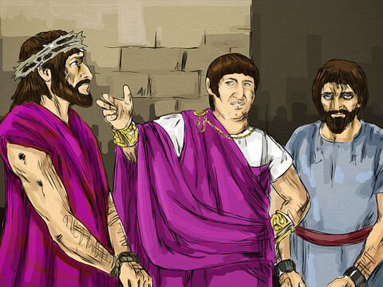
So when the crowd had gathered, Pilate asked them, “Which one do you want me to release to you: Jesus Barabbas, or Jesus who is called the Messiah?” For he knew it was out of self-interest that they had handed Jesus over to him.

Slide 13
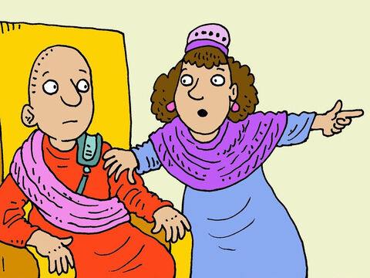
While Pilate was sitting on the judge’s seat, his wife sent him this message: “Don’t have anything to do with that innocent man, for I have suffered a great deal today in a dream because of him.”

Slide 14
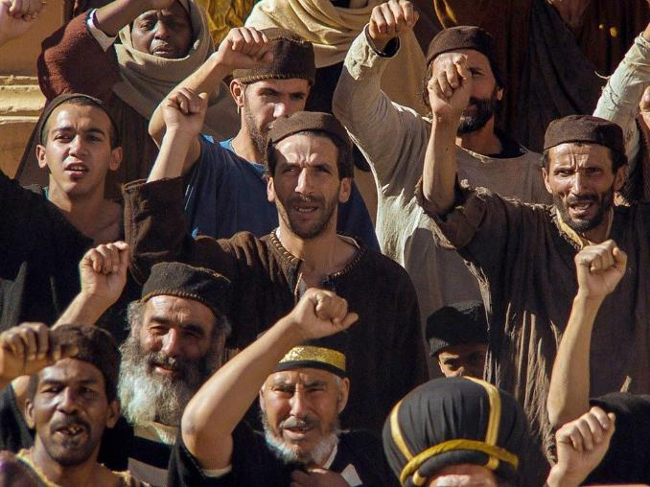
But the chief priests and the elders persuaded the crowd to ask for Barabbas and to have Jesus executed.

Slide 15
“Which of the two do you want me to release to you?” asked the governor. “Barabbas,” they answered.

Slide 16
“What shall I do, then, with Jesus who is called the Messiah?” Pilate asked. They all answered, “Crucify him!”

Slide 17
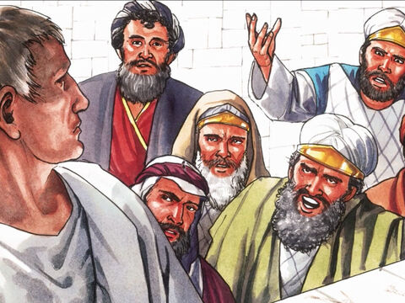
“Why? What crime has he committed?” asked Pilate.
But they shouted all the louder,
“Crucify him!”

Slide 18
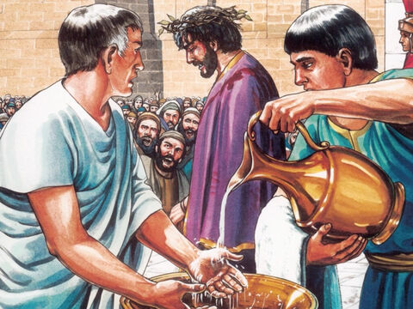
When Pilate saw that he was getting nowhere, but that instead an uproar was starting, he took water and washed his hands in front of the crowd.

Slide 19
“I am innocent of this man’s blood,” he said. “It is your responsibility!”

Slide 20
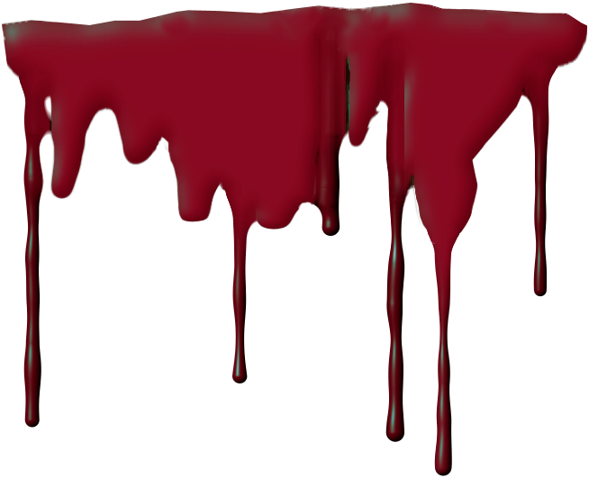
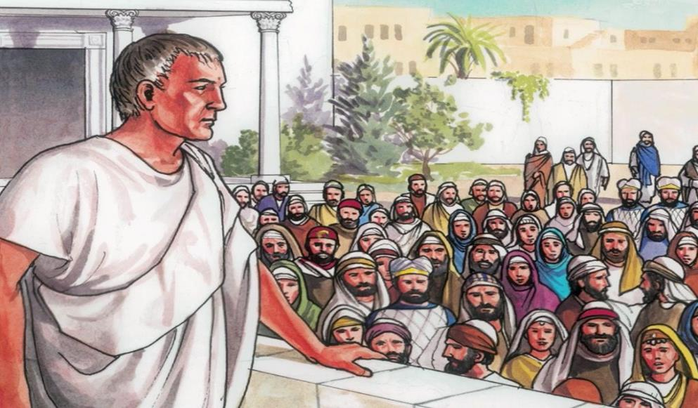
All the people answered, “His blood is on us and on our children!”

Slide 21
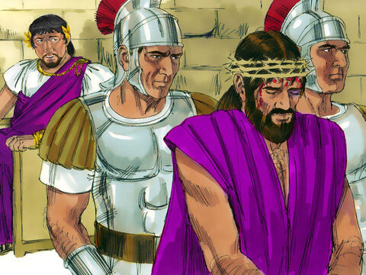
Then he released Barabbas to them. But he had Jesus flogged, and handed him over to be crucified.

Slide 22
The Soldiers Mock Jesus

Slide 23
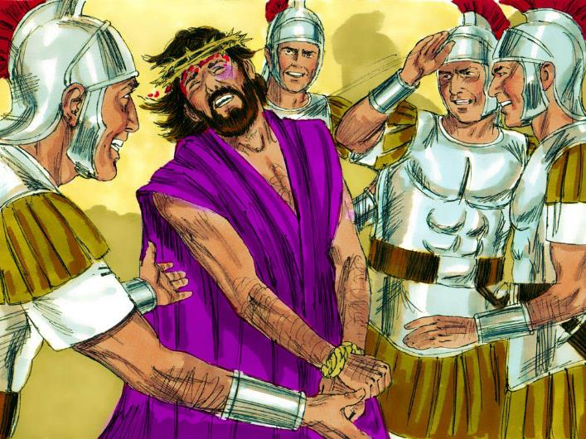
Then the governor’s soldiers took Jesus into the Praetorium and gathered the whole company of soldiers around him.

Slide 24
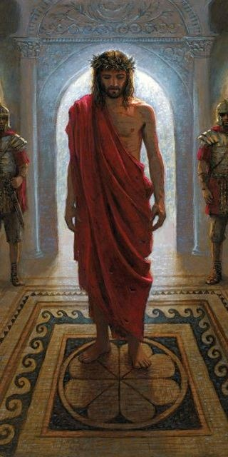
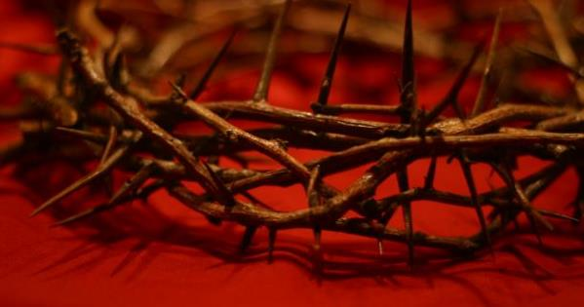
They stripped him and put a scarlet robe on him, and then twisted together a crown of thorns and set it on his head.

Slide 25
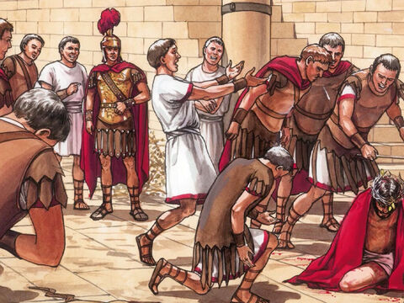
They put a staff in his right hand. Then they knelt in front of him and mocked him. “Hail, king of the Jews!” they said.

Slide 26
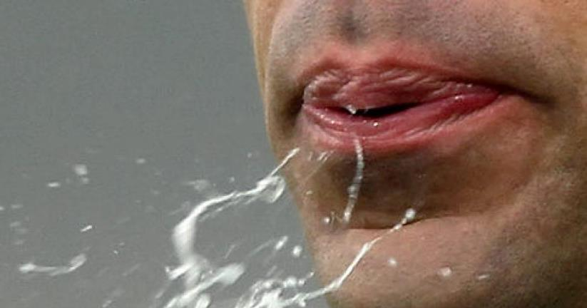
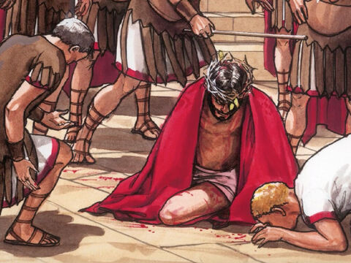
They spit on him, and took the staff and struck him on the head again and again.

Slide 27
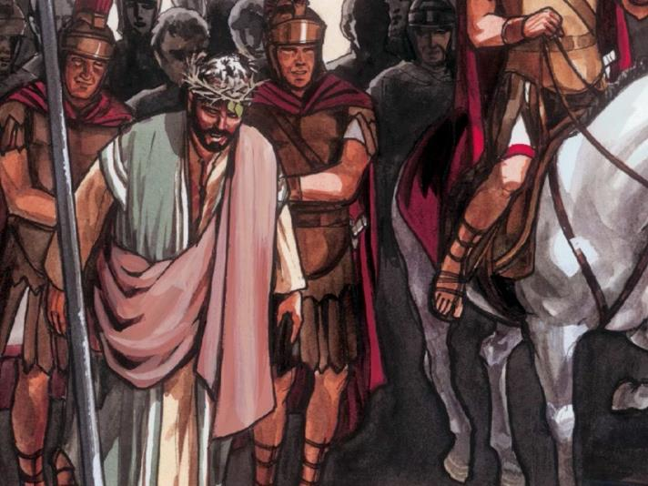
After they had mocked him, they took off the robe and put his own clothes on him. Then they led him away to crucify him.

