Slide 1
King at Last
1 Samuel 31:1-6,
2 Samuel 2:1-17, 3:1, 5:1-5

Slide 2
Memory Verse
Sovereign LORD, you are God! Your covenant is trustworthy, and you have promised these good things to your servant.
2 Samuel 7:28
Lesson #16

Slide 3
The Truth
God does what He says He will do!
Lesson #16

Slide 4
¹Now the Philistines fought against Israel; the Israelites fled before them, and many fell dead on Mount Gilboa.

Slide 5
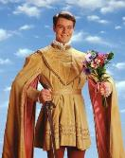
²The Philistines were in hot pursuit of Saul and his sons, and they killed his sons Jonathan, Abinadab and Malki-Shua.

Slide 6

³The fighting grew fierce around Saul, and when the archers overtook him, they wounded him critically.

Slide 7
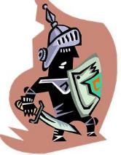
⁴Saul said to his armor-bearer, “Draw your sword and run me through, or these uncircumcised fellows will come and run me through and abuse me.”
But his armor-bearer was terrified and would not do it; so Saul took is own sword and fell on it.

Slide 8
⁵When the armor-bearer saw that Saul was dead, he too fell on his sword and died with him.

Slide 9
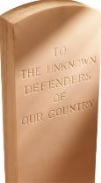
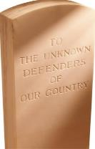
⁶So Saul and his three sons and his armor-bearer and all his men died together that same day.
KING SAUL
Prince
Jon-athan
Prince Abin-adab
Prince
Malki-Shua
Armor-bearer

Slide 10

¹In the course of time, David inquired of the LORD.
“Shall I go up to one of the towns of Judah?” he asked.
The LORD said, “Go up.”
David asked, “Where shall I go?”
“To Hebron,” the LORD answered.

Slide 11

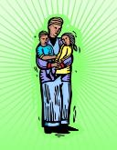
²So David went up there with his two wives, Ahinoam of Jezreel and Abigail, the widow of Nabal of Carmel. ³David also took the men who were with him, each with his family, and they settled in Hebron and its towns.
HEBRON

Slide 12



^{4a}Then the men of Judah came to Hebron, and there they anointed David king over the tribe of Judah.
JUDAH
HEBRON

Slide 13
^{4b}When David was told that it was the men from Jabesh Gilead who had buried Saul, ⁵he sent messengers to them to say to them,
KING SAUL
“The LORD bless you for showing this kindness to Saul your master by burying him.

Slide 14

⁶May the LORD now show you kindness and faithfulness, and I too will show you the same favor because you have done this. ⁷Now then, be strong and brave, for Saul your master is dead, and the people of Judah have anointed me king over them.”
KING SAUL

Slide 15
⁸Meanwhile, Abner son of Ner, the commander of Saul’s army, had taken Ish-Bosheth son of Saul and brought him over to Mahanaim. ⁹He made him king over Gilead, Ashuri and Jezreel, and also over Ephraim, Benjamin and all Israel.
Mahanaim
Abner
Ish-Bosheth
Gilead Ashuri Jezreel Ephraim Benjamin Israel

Slide 16
¹⁰Ish-Bosheth son of Saul was 42 old when he became king over Israel, and he reigned 2 years.
The tribe of Judah, however, remained loyal to David. ¹¹The length of time David was king in Hebron over
Judah was 7 years
and 6 months.
JUDAH
Israel – 2 years
Judah – 7 years & 6 months
40

Slide 17
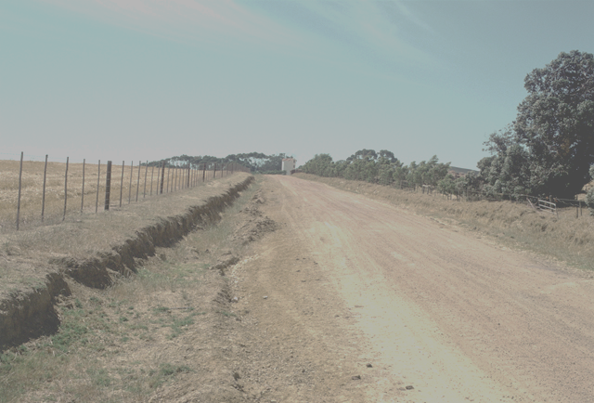
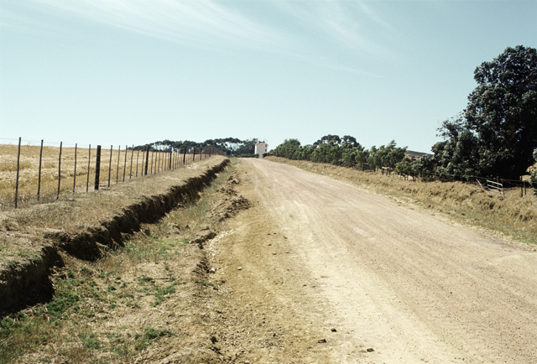
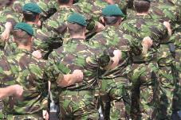
¹²Abner son of Ner, together with the men of Ish-Bosheth son of Saul, left Mahanaim and went to Gibeon.
Gibeon
Mahanaim

Slide 18


¹³Joab son of Zeruiah and David’s men went out and met them at the pool of Gibeon. One group sat down on one side of the pool and one group on the other side.
Abner
Joab

Slide 19
“All right, let them do it,” Joab said.
¹⁴Then Abner said to Joab, “Let’s have some of the young men get up and fight hand to hand in front of us.”
Abner
Joab

Slide 20


¹⁵So they stood up and were counted off — 12 men for Benjamin and
Ish-Bosheth son of Saul, and 12 for David.
for Benjamin & Ish-Bosheth
for David

Slide 21
¹⁶Then each man grabbed his opponent by the head and thrust his dagger into his opponent’s side, and they fell down together. So that place in Gibeon was called Helkath Hazzurim.
Helkath Hazzurim

Slide 22
¹⁷The battle that day was very fierce, and Abner and the Israelites were defeated by David’s men.
Helkath Hazzurim
Abner
VICTORY

Slide 23



¹The war between the house of Saul and the house of David lasted a long time. David grew stronger and stronger, while the house of Saul grew weaker and weaker.
Saul
David

Slide 24
¹All the tribes of Israel came to David at Hebron and said,
“We are your own flesh and blood.
HEBRON
JUDAH

Slide 25
^{2a}In the past, while Saul was king over us, you were the one who led Israel on their military campaigns.
HEBRON
JUDAH

Slide 26
^{2b}And the LORD said to you, ‘You will shepherd my people Israel, and you will become their ruler.’”
HEBRON
JUDAH

Slide 27
³When all the elders of Israel had come to King David at Hebron, the king made a covenant with them at Hebron before the LORD, and they anointed David king over Israel.
HEBRON
JUDAH
ISRAEL

Slide 28
⁴David was 30 years old when he became king, and he reigned 40 years. ⁵In Hebron he reigned over Judah 7 years and 6 months, and in Jerusalem he reigned over all Israel
and Judah 33 years.
30
JUDAH
JUDAH
ISRAEL
Hebron
Jerusalem
+
7 years & 6 months
33 years
= 40 years

