Slide 1
Saul’s Jealousy of David
Samuel 18:1-16, 28-30; 19:1-18

Slide 2
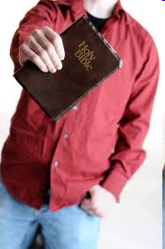
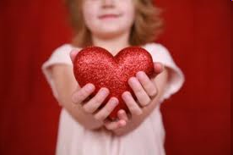
Memory Verse
Galatians 5:26
Let us not become conceited, provoking and envying each other.
Dig Site #12

Slide 3
The Truth
God’s people must not be jealous of others!
Dig Site #12

Slide 4

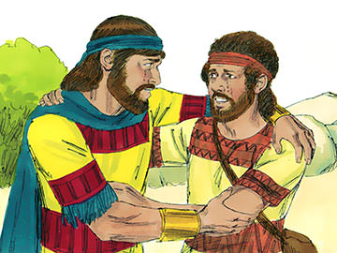
After David had finished talking with Saul, Jonathan became one in spirit with David, and he loved him as himself.
From that day Saul kept David with him and did not let him return home to his family.

Slide 5
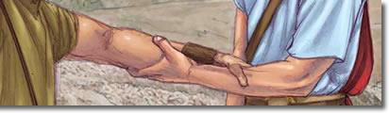
And Jonathan made a covenant with David because he loved him as himself.

Slide 6
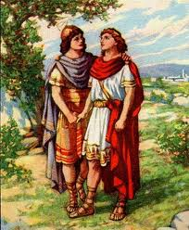
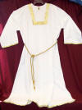
Jonathan took off the robe he was wearing and gave it to David, along with his tunic, and even his sword, his bow and his belt.

Slide 7
Whatever mission Saul sent him on, David was so successful that Saul gave him a high rank in the army. This pleased all the troops, and Saul’s officers as well.
Go David! Way to go!!!

Slide 8
When the men were returning home after David had killed the Philistine, the women came out from all the towns of Israel to meet King Saul with singing and dancing, with joyful songs and with timbrels and lyres.

Slide 9

As they danced, they sang:
“Saul has slain his thousands,
and David his tens of thousands.”

Slide 10

Saul was very angry; this refrain displeased him greatly. “They have credited David with tens of thousands,” he thought, “but me with only thousands. What more can he get but the kingdom?”
I HATE THAT SONG!

Slide 11
And from that time on Saul kept a close eye on David.

Slide 12
The next day an evil spirit from God came forcefully on Saul.

Slide 13
He was prophesying in his house, while David was playing the lyre, as he usually did. Saul had a spear in his hand and he hurled it, saying to himself, “I’ll pin David to the wall.”
But David eluded him twice.

Slide 14

Saul was afraid of David, because the Lord was with David but had departed from Saul. So he sent David away from him and gave him command over a thousand men, and David led the troops in their campaigns.

Slide 15
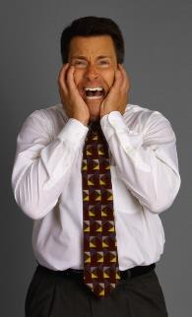
In everything he did he had great success, because the Lord was with him. When Saul saw how successful he was, he was afraid of him.
Go David! Way to go!!!
Oh no!

Slide 16
But all Israel and Judah loved David, because he led them in their campaigns.

Slide 17
When Saul realized that the Lord was with David and that his daughter Michal loved David,

Slide 18

Saul became still more afraid of him, and he remained his enemy the rest of his days.

Slide 19
The Philistine commanders continued to go out to battle, and as often as they did, David met with more success than the rest of Saul’s officers, and his name became well known.

Slide 20
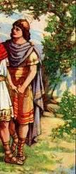
Saul told his son Jonathan and all the attendants to kill David.

Slide 21
But Jonathan had taken a great liking to David and warned him,
My father Saul is looking for a chance to kill you. Be on your guard tomorrow morning; go into hiding and stay there.

Slide 22
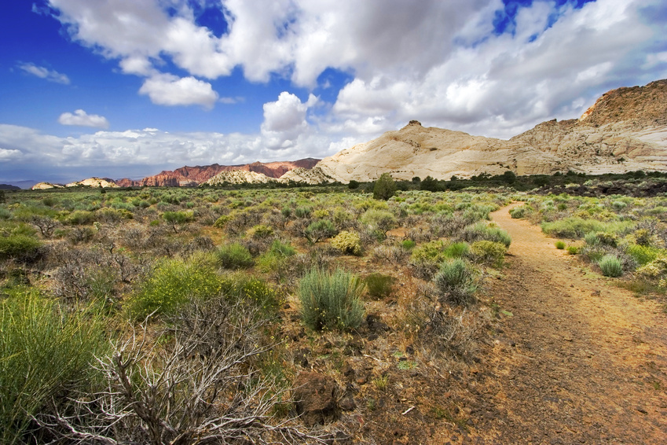
I will go out and stand with my father in the field where you are. I’ll speak to him about you and will tell you what I find out.

Slide 23

Jonathan spoke well of
David to Saul his father
and said to him,
Let not the king do wrong to his servant David; he has not wronged you, and what he has done has benefited you greatly. He took his life in his hands when he killed the Philistine.

Slide 24
The Lord won a great victory for all Israel, and you saw it and were glad. Why then would you do wrong to an innocent man like David by killing him for no reason?
?

Slide 25
Saul listened to Jonathan and took this oath: “As surely as the Lord lives, David will not be put to death.”
So Jonathan called David and told him the whole conversation. He brought him to Saul, and David was with Saul as before.

Slide 26
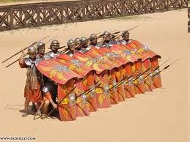
Once more war broke out, and David went out and fought the Philistines. He struck them with such force that they fled before him.

Slide 27
But an evil spirit from the Lord came on Saul as he was sitting in his house with his spear in his hand.

Slide 28
While David was playing the lyre, Saul tried to pin him to the wall with his spear, but David eluded him as Saul drove the spear into the wall.
That night David made good his escape.

Slide 29
Saul sent men to David’s house to watch it and to kill him in the morning. But Michal, David’s wife, warned him, “If you don’t run for your life tonight, tomorrow you’ll be killed.”

Slide 30
So Michal let David down through a window, and he fled and escaped. Then Michal took an idol and laid it on the bed, covering it with a garment and putting some goats’ hair at the head.

Slide 31
When Saul sent the men to capture David, Michal said, “He is ill.”
Sorry! He can’t come!

Slide 32
Then Saul sent the men back to see David and told them, “Bring him up to me in his bed so that I may kill him.”
She tricked
us!
But when the men entered, there was the idol in the bed, and at the head was some goats’ hair.

Slide 33
Saul said to Michal, “Why did you deceive me like this and send my enemy away so that he escaped?”
Michal told him, “He said to me, ‘Let me get away. Why should I kill you?’”
He told me to let him go!
Why??

Slide 34

When David had fled and made his escape, he went to Samuel at Ramah and told him all that Saul had done to him. Then he and Samuel went to Naioth and stayed there.
Saul keeps trying to kill me!

