Slide 1
Hide it in your
But Samuel replied:
“Does the Lord delight in burnt offerings and sacrifices as much as in obeying the Lord?
To obey is better than sacrifice, and to heed is better than the fat of rams.
1 Samuel 15:22
DigSite #8

Slide 2
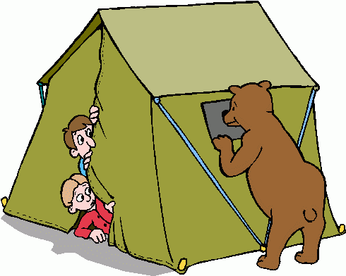
Dig Site 8 Panic in the Camp
1 Samuel 14:1-23

Slide 3
Hide it in your
Your ways,
God are holy.
What god is
as great as our God?
Psalm 77:13
DigSite #4

Slide 4
Hide it in your
Look to the Lord and His strength;
Seek His face always.
Remember the wonders he has done,
His miracles,
And the judgements
He pronounced.
1 Chronicles 16:11-12
DigSite #5

Slide 5
Hide it in your
For God is the King
of all the earth;
sing to him
a psalm of praise.
Psalm 47:7
DigSite #6

Slide 6
Hide it in your
But be sure to fear the Lord
and serve him faithfully
with all your heart;
consider what great things
he has done for you.
1 Samuel 12:24
DigSite #7

Slide 7
Hide it in your
Nothing can hinder
the Lord from saving,
Whether by many
or by few.
1 Samuel 14:6d
DigSite #8

Slide 8
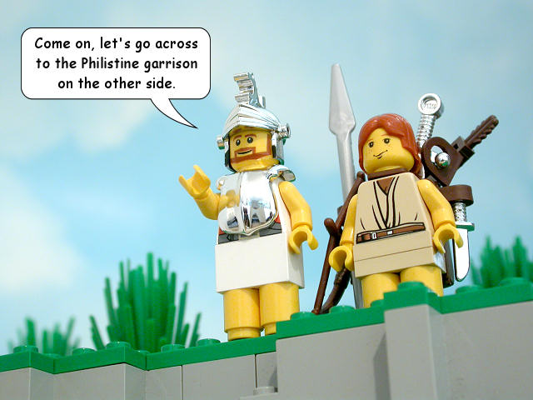
One day Jonathan son of Saul said to his young armor-bearer,
Come, let’s go over to the Philistine outpost on the other side.
But he did not tell his father.

Slide 9
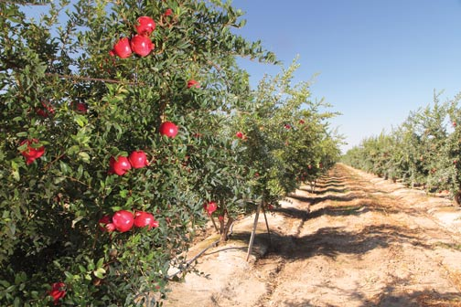
Saul was staying on the outskirts of Gibeah under a pomegranate tree in Migron.

Slide 10
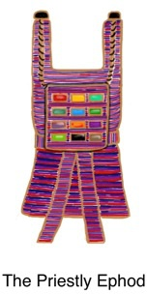
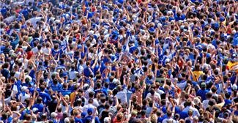
With him were about six hundred men, among whom was Ahijah, who was wearing an ephod.

Slide 11
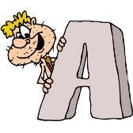
He was a son of Ichabod’s brother Ahitub
HITUB
HIJAH

Slide 12
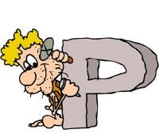
son of Phinehas,
HINEHAS
HITUB
HIJAH

Slide 13
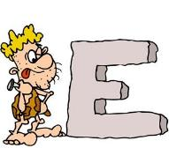
the son of Eli,
the Lord’s priest in Shiloh.
L I
HINEHAS
HITUB
HIJAH

Slide 14
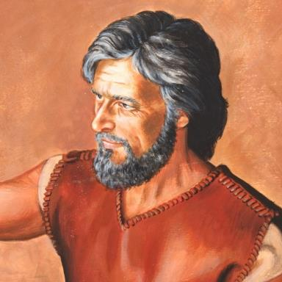
No one was aware that
Jonathan had left.
Who, me?

Slide 15
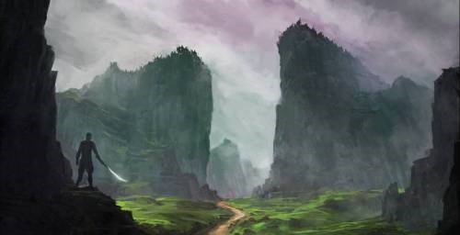
On each side of the pass that Jonathan intended to cross to reach the Philistine outpost was a cliff; one was called Bozez and the other Seneh.
Seneh
Bozez

Slide 16
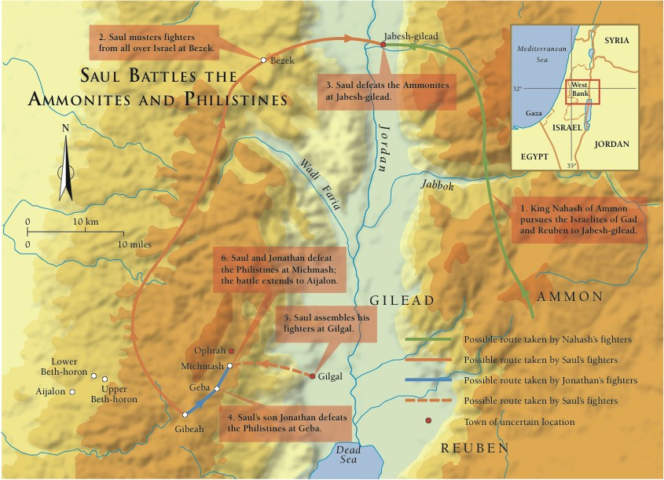
One cliff stood to the north toward Mikmash, the other to the south toward Geba.

Slide 17
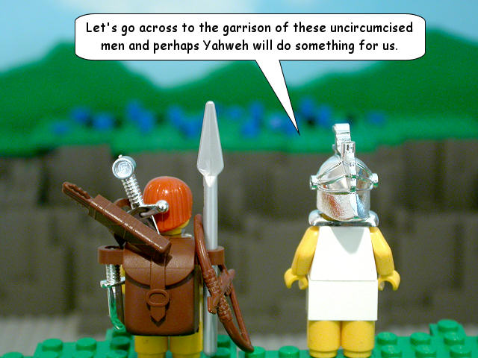
Come, let’s go over to the outpost of those uncircumcised men. Perhaps the Lord will act in our behalf.
Jonathan said to his young armor-bearer,

Slide 18
Jonathan said to his young armor-bearer,
Nothing can hinder
the Lord from saving,
whether by many or by few.

Slide 19
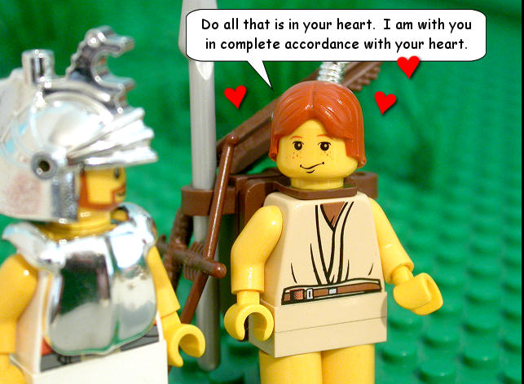
“Do all that you have in mind,” his armor-bearer said. “Go ahead; I am with you heart and soul.”

Slide 20
Jonathan said,
Come on, then;
we will cross over toward them
and let them see us.

Slide 21
Jonathan said,
If they say to us,
‘Wait there until we come to you,’
we will stay where we are
and NOT go up to them.
Come on, then;
we will cross over toward them
and let them see us.

Slide 22
But if they say, ‘Come up to us,’ we will climb up,

Slide 23
But if they say, ‘Come up to us,’ we will climb up,
because that will be our sign that the Lord has given them into our hands.

Slide 24
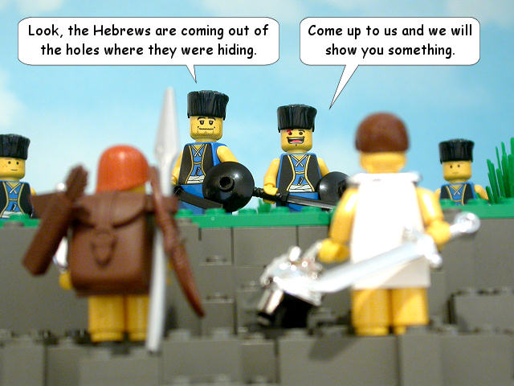
So both of them showed themselves to the Philistine outpost.
Look! The Philistines said. The Hebrews are crawling out of the holes they were hiding in.

Slide 25
The men of the outpost shouted to Jonathan and his armor-bearer,
Come up to us and we’ll teach you a lesson.

Slide 26
So Jonathan said to his armor-bearer,
Climb up after me;

Slide 27
So Jonathan said to his armor-bearer,
the Lord has given them into the hand of Israel.

Slide 28
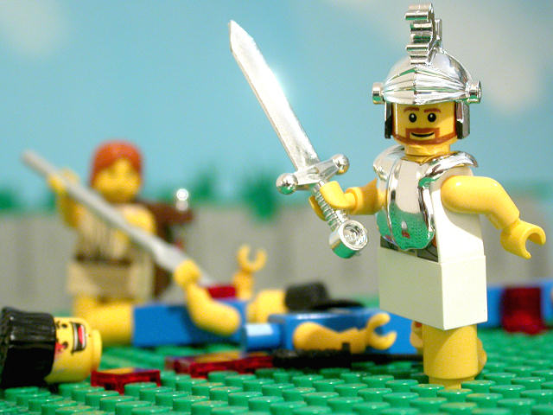
Jonathan climbed up, using his hands and feet, with his armor-bearer right behind him.

Slide 29
The Philistines fell before Jonathan, and his armor-bearer followed and killed behind him.

Slide 30
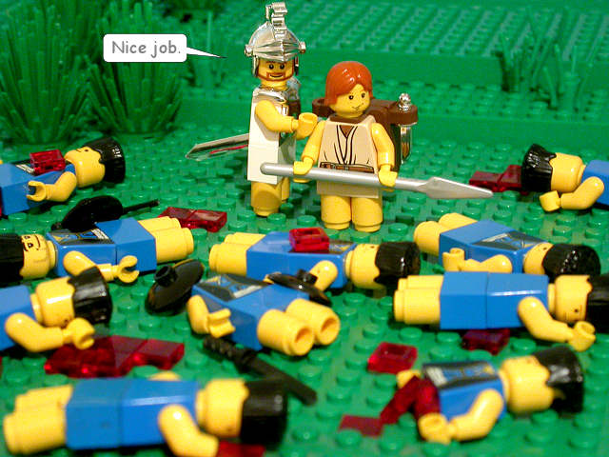
In that first attack Jonathan and his armor-bearer killed some 20 men in an area of about half an acre.

Slide 31
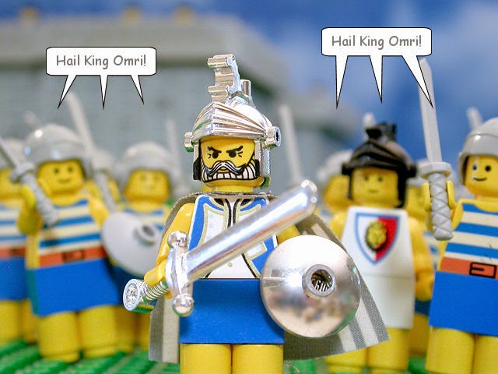
Israel Routes the Philistines

Slide 32
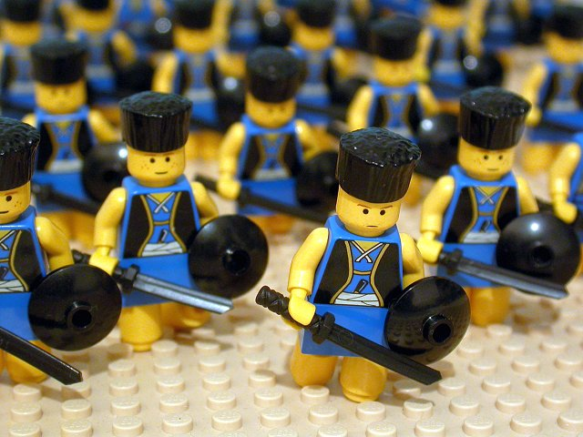
Then panic struck the whole army – those in the camp and field, and those in the outposts and raiding parties—and the ground shook.
It was a panic sent by God.

Slide 33
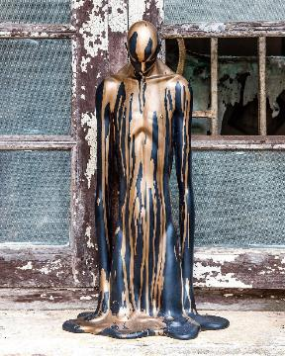
Saul’s lookouts at Gibeah in Benjamin saw the army melting away in all directions.

Slide 34
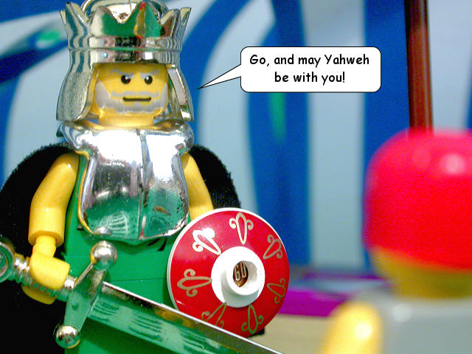
Then Saul said to the men who were with him,
Muster the forces and see who has left us.
When they did, it was Jonathan and his armor-bearer who were not there.

Slide 35
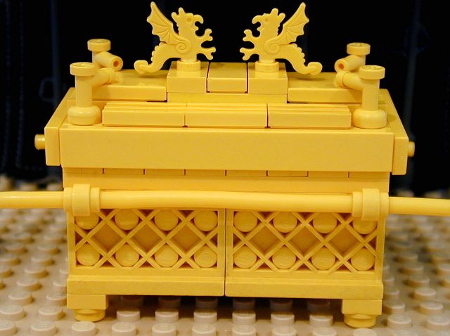
Saul said to Ahijah, “Bring the ark of God.” (At that time it was with the Israelites.)

Slide 36
While Saul was talking to the priest, the tumult in the Philistine camp increased more and more. So Saul said to the priest,

Slide 37
Withdraw your hand.

Slide 38
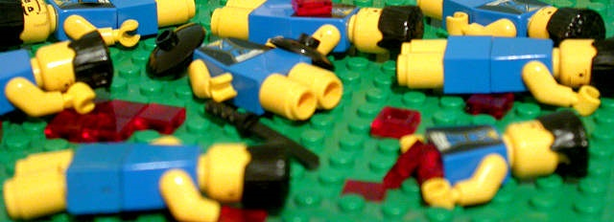
Then Saul and all his men assembled and went to the battle. They found the Philistines in total confusion, striking each other with their swords.

Slide 39
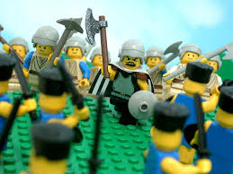
Those Hebrews who had previously been with the Philistines and had gone up with them to their camp went over to the Israelites who were with Saul and Jonathan.

Slide 40
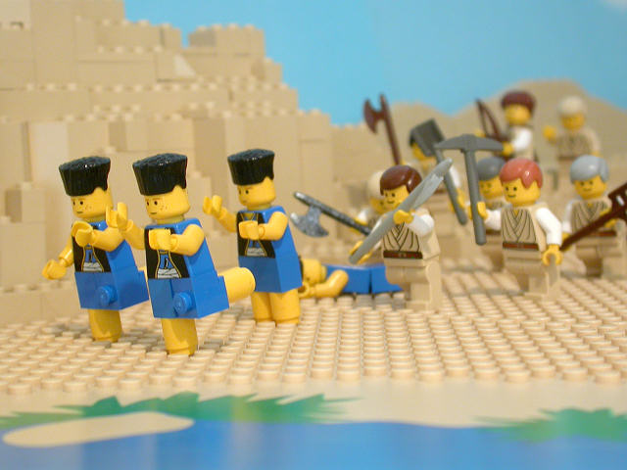
When all the Israelites who had hidden in the hill country of Ephraim heard that the Philistines were on the run, they joined the battle in hot pursuit.

Slide 41
So on that day the Lord saved Israel, and the battle moved on beyond Beth Aven.

