Slide 1
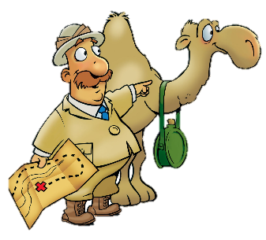
A Big Decision!
Ruth 1:1-22

Slide 2
Faith Words
Commitment
A promise or agreement to do something; to give yourself fully to a person or a cause

Slide 3
The Truth
The choice to follow God changes the direction of our lives.

Slide 4
Memory Verse
“But Ruth replied, ‘Don’t urge me to leave you or to turn back from you. Where you go I will go, and where you stay I will stay. Your people will be my people and your God my God.’”

Slide 5
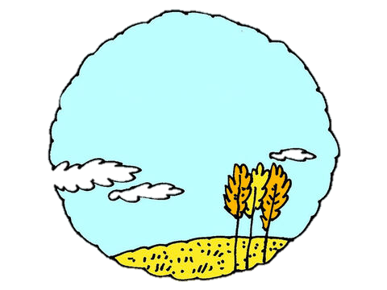
In the days when the judges ruled, there was a famine in the land.
We are so hungry!!!!

Slide 6
So a man from Bethlehem in Judah, together with his wife and two sons, went to live for a while in the country of Moab.

Slide 7
The man’s name was Elimelek, his wife’s name was Naomi, and the names of his two sons were
Mahlon
Kilion

Slide 8
They were Ephrathites from Bethlehem, Judah. And they went to Moab and lived there.

Slide 9
Now Elimelek, Naomi’s husband, died, and she was left with her two sons. They married Moabite women, one named Orpah and the other Ruth
Orpah
&
Ruth

Slide 10
After they had lived there about 10 years, both Mahlon and Kilion also died,
and Naomi was left without her two sons and her husband.

Slide 11
When Naomi heard in Moab that the LORD had come to the aid of his people by providing food for them,
she and her daughters-in-law prepared to return home from there.

Slide 12
With her two daughters-in-law she left the place where she had been living
and set out on the road that would take them back to the land of Judah.

Slide 13
Then Naomi said to her two daughters-in-law,
“Go back, each of you, to your mother’s home. May the LORD show you kindness, as you have shown kindness to your dead husbands and to me. May the LORD grant that each of you will find rest in the home of another husband.”

Slide 14
Then she kissed them goodbye and they wept aloud and said to her,
“We will go back with you to your people.”

Slide 15
But Naomi said,
“Return home, my daughters. Why would you come with me? Am I going to have any more sons, who could become your husbands?

Slide 16
“Return home, my daughters; I am too old to have another husband. Even if I thought there was still hope for me—even if I had a husband tonight and then gave birth to sons—would you wait until they grew up? Would you remain unmarried for them?

Slide 17
No, my daughters. It is more bitter for me than for you, because the LORD’S hand has turned against me!”
At this they wept aloud again. Then Orpah kissed her mother-in-law goodbye,
but Ruth clung to her.

Slide 18
Naomi said,
“Look, your sister-in-law is going back to her people and her gods. Go back with her.”
But Ruth replied,
“Don’t urge me to leave you or to turn back from you. Where you go I will go, and where you stay I will stay. Your people will be my people and your God my God. Where you die I will die, and there I will be buried.”

Slide 19
“May the LORD deal with me, be it ever so severely, if even death separates you and me.”

Slide 20
When Naomi realized that Ruth was determined to go with her, she stopped urging her.
So the two women went on until they came to Bethlehem.

Slide 21
When they arrived in Bethlehem, the whole town was stirred because of them, and the women exclaimed,

Slide 22
“Can this be Naomi?”

Slide 23
She told them
“Don’t call me Naomi, call me Mara, because the Almighty has made my life very bitter. I went away full, but the LORD has brought me back empty. Why call me Naomi? The LORD has afflicted me; the Almighty has brought misfortune upon me.”
Mara=Bitter

Slide 24
So Naomi returned from Moab accompanied by Ruth the Moabite, her daughter-in-law, arriving in Bethlehem as the barley harvest was beginning.

