Slide 1
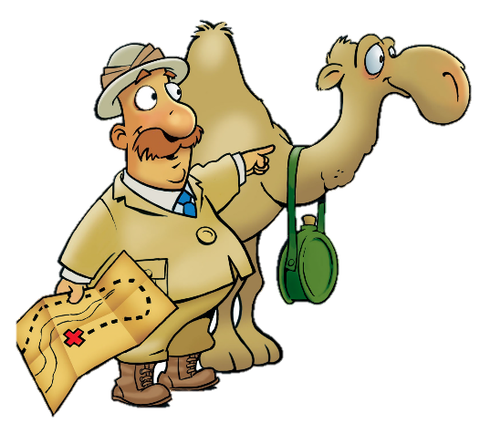
The Bee and the Thunderbolt
Judges 4:1-24

Slide 2
Faith Words
God’s Power
Power that is greater and stronger than anyone or anything.
God can do all things.

Slide 3
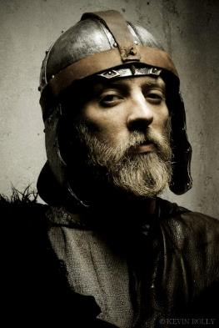
People
Deborah (Bee)
Judge & Prophet
Jabin,
Canaanite king
Sisera
Army Commander

Slide 4
People
Barak (Thunderbolt)
Israelite commander
Jael
Wife of Heber & who killed Sisera

Slide 5
Memory Verse
“I know that You can do all things; no purpose of Yours can be thwarted.”

Slide 6
Again the Israelites did evil in the eyes of the LORD, now that Ehud was dead.

Slide 7
So the LORD sold them into the hands of Jabin king of Canaan, who reigned in Hazor.

Slide 8
The commander of Jabin’s army was Sisera, who had 900 iron chariots.
900 Chariots!

Slide 9
Sisera cruelly oppressed the Israelites for 20 years, and “they cried to the LORD for help!”
HELP LORD!!

Slide 10
Deborah, a prophet, the wife of Lappidoth, was leading Israel at that time. She held court under the Palm of Deborah.

Slide 11
The Israelites went up to her to have their disputes decided.

Slide 12
Deborah sent for Barak, who lived in Naphtali. She said,
“The LORD, the God of Israel commands you: Go take with you 10,000 men of Naphtali and Zebulun and lead them up to Mount Tabor.”

Slide 13
Deborah said God would lead Sisera, his chariots, and troops to the Kishon River and give him into Barak’s hands.
God is going to give them into your hands.

Slide 14
Barak said,
“If you go with me, I will go; but if you don’t go with me, I won’t go.”

Slide 15
Deborah said,
“Certainly I will go with you, but because of the course you are taking the honor will not be yours, for the LORD will deliver Sisera into the hands of a woman.”

Slide 16
Deborah and Barak went to Kedesh, where he summoned over 10,000 men.
10,000 men

Slide 17
Sisera learned that Barak had gone to Mount Tabor. Sisera summoned “all his men and his 900 chariots.”
900 Chariots!

Slide 18
Deborah said to Barak, “Go! This is the day the LORD has given Sisera into your hands. Has not the LORD gone ahead of you?”

Slide 19
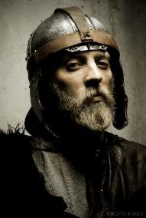
Barak and his 10,000 men went down to Mount Tabor. The LORD routed Sisera and all his chariots and army by the sword. Sisera ran away.

Slide 20
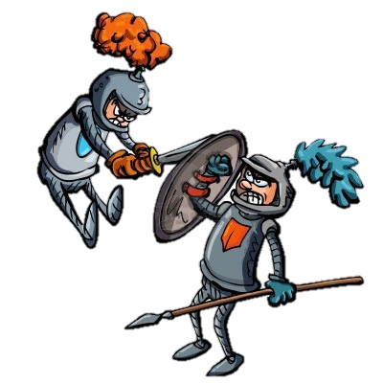
Barak pursued the chariots and army as far as Harosheth Haggoyim, and all Sisera’s troops fell by the sword;
not a man was left.

Slide 21
Sisera fled to the tent of Jael, wife of Heber the Kenite. Jael met Sisera and said,
“Come, my lord, come right in. Don’t be afraid.”

Slide 22
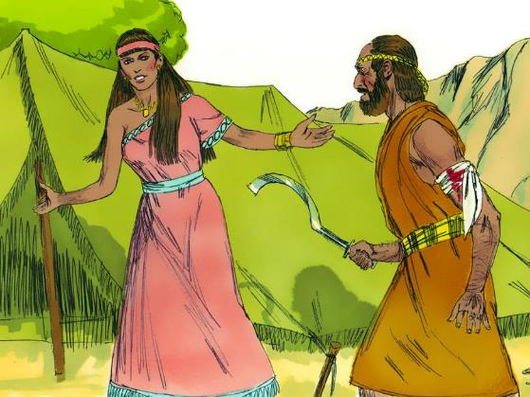
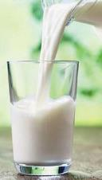
So he entered her tent, and she covered him with a blanket. Sisera said,
”I am thirsty. Please give me some water.”
She opened a skin of milk and gave him a drink and covered him up.

Slide 23
“Stand in the doorway of the tent, if someone comes by and asks you , “Is anyone in there? Say No.”

Slide 24
When Sisera fell asleep, Jael drove a tent peg through his temple into the ground, and he died.

Slide 25
Barak came by in pursuit of Sisera. Jael brought him into her tent. Barak saw that Sisera was dead.

Slide 26
On that day God subdued Jabin king of Canaan before the Israelites. The hand of the Israelites pressed harder and harder against Jabin king of Canaan until they destroyed him.

Slide 27
God makes possible what seems totally impossible!

