Slide 1
Lesson #11
Joshua Says Farewell
Joshua 23:1–16; 24:14-32

Slide 2
The Truth
God calls His people to remain faithful to Him always!

Slide 3
Memory Verse
‘“Now fear the Lord and serve him with all faithfulness.”’
-Joshua 24:14a

Slide 4
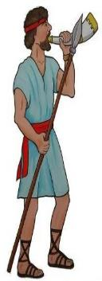
Joshua says
Farewell

Slide 5

^{1a}After a long time had passed and the LORD had given Israel rest from all their enemies around them,

Slide 6

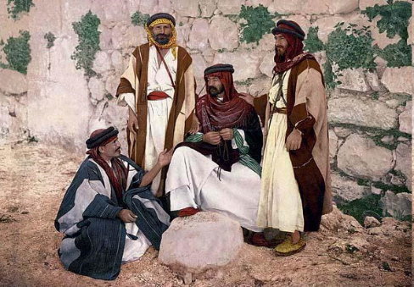
^{1b}Joshua, by then a very old man ^{2a}summoned all Israel—their elders, leaders, judges and officials—and said to them: I am very old.

Slide 7

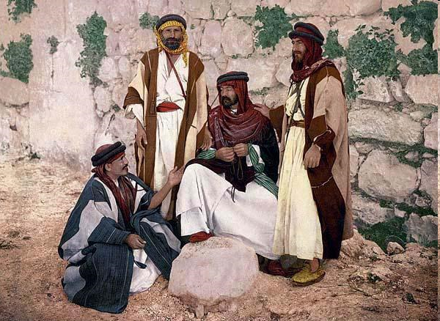
³You yourselves have seen everything
the LORD your God has done to all these
nations for your sake;
it was the LORD your
God who fought for you.

Slide 8
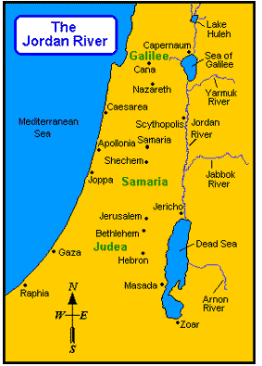
⁴Remember how I have allotted as an inheritance for your tribes all the land of the nations that remain—the nations I conquered—between the Jordan and the Mediterranean Sea in the west.

Slide 9
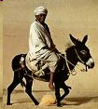
⁵The LORD your God himself will push* them out for your sake. He will drive them out before you, and you will take possession of their land, as the LORD your God promised you.

Slide 10
⁶Be very strong; be careful to obey all that is written in the Book of the Law of Moses, without turning aside to the* right or to the left.

Slide 11
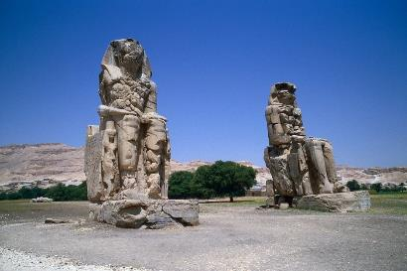
⁷Do not associate with these nations that remain among you;
do not invoke the names of their gods or swear by them. You must not serve them or bow down to them.
⁸But you are to hold fast to the LORD your God, as you have until now.

Slide 12
⁹The LORD has driven out* before you great and powerful nations; to this day no one has been able to withstand you.

Slide 13
¹⁰One of you routs a thousand, because the LORD your God fights for you, just as he promised.
+ GOD = more than 1000!

Slide 14
¹¹So be very careful to
love the LORD your God.

Slide 15

¹²But if you turn away and ally yourselves with the survivors of these nations that remain among you and if you intermarry with them and associate with them,
^{13a}then you will be sure that the LORD your God will no longer drive
out these nations before you.

Slide 16
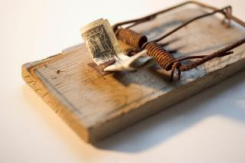
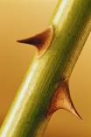
^{13b}Instead, they will become snares and traps for you, whips on your backs and thorns in your eyes, until you perish from this good land, which the LORD your God has given you.

Slide 17
^{14a}Now I am about to go the way of all the earth.
JOSHUA

Slide 18

^{14b}You know with all your heart and soul that not one of all the good promises the LORD your God gave you has failed. Every promise has been fulfilled; not one
has failed.

Slide 19
¹⁵But just as all the good things the LORD your God has promised you have come to you, so he will bring on you all the evil things he has threatened, until the Lord your God has destroyed you* from this good land he has given you.

Slide 20
¹⁶If you violate the covenant of the LORD your God, which he commanded you, and go and serve other gods and bow down to them…
the LORD's anger will burn against you, and you will quickly perish* from the good land he has given you.
ISRAEL

Slide 21

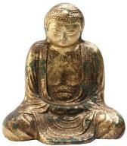
¹⁴Now fear the LORD and serve him with all faithfulness. Throw away the gods your ancestors worshiped beyond the Euphrates River and in Egypt, and serve the LORD.

Slide 22
^{15a}But if serving the LORD seems undesirable to you, then choose* for yourselves this day whom you will serve, whether the gods your ancestors served beyond the Euphrates, or the gods of
the Amorites, in whose
land you are living.
? ? ?

Slide 23
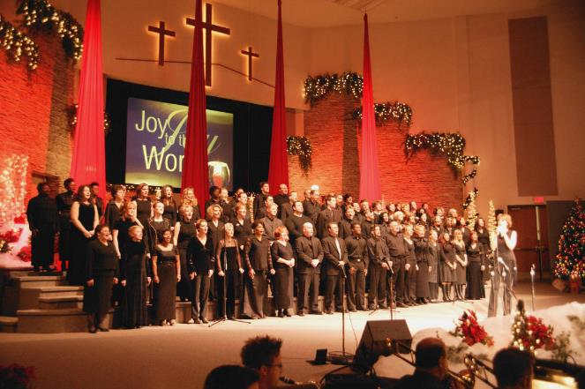
^{15b}But as for me and
my household,
we will serve the LORD.

Slide 24
¹⁶Then the people answered, "Far be it from us to forsake the LORD to serve other gods!
^{17a}It was the LORD our God himself who brought us and our parents up out of Egypt,
from that land of slavery,
and performed those great signs before our eyes.

Slide 25
^{17b}He protected us on our entire journey and among all the nations throughout which we traveled.

Slide 26
¹⁸And the LORD drove* out before us all the nations,
including the Amorites,
who lived in the land. We too will serve the LORD, because he is our God.

Slide 27

¹⁹Then Joshua said to the people,
You are not able to serve the LORD.
He is a holy God; he is a jealous God. He
will not forgive your rebellion and your sins.
²⁰If you forsake the LORD and serve foreign gods, he will turn and bring disaster on you
and make an end of you, after he has
been good to you.
²¹But the people said to Joshua,
No! We will serve the LORD.

Slide 28
²²Then Joshua said
You are witnesses against yourselves
that you have chosen
to serve the LORD.
Yes, we are witnesses,
they replied.

Slide 29
²³Now then, throw away the foreign gods that are among you and yield your hearts to the LORD, the God of Israel.
²⁴And the people said to Joshua,
We will serve the LORD our God
and obey him.

Slide 30
²⁵On that day Joshua made a covenant for the people, and there at Shechem he reaffirmed for them decrees and laws. ^{26a}And Joshua recorded these things in the Book of the Law of God.
Law of
God

Slide 31
^{26b}Then he took a large stone and set it up there under the oak near the holy place of the LORD.

Slide 32
²⁷See!" he said to all the people. "This stone will be a witness against us.
It has heard all the words the LORD has said to us. It will be a witness against
you if you are
untrue
to your God.

Slide 33
²⁸Then Joshua dismissed the people, each to their own inheritance.

Slide 34
²⁹After these things,
Joshua son of Nun,
the servant of the LORD,
died at the age of 110.
³⁰And they buried* him in the land of his inheritance, at Timnath Serah
in the hill country of Ephraim,
north of Mount Gaash.
JOSHUA
110

Slide 35
³¹Israel served the LORD throughout the lifetime of Joshua and of the elders who outlived him and who had experienced everything the LORD had done for Israel.

Slide 36
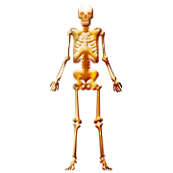
³²And Joseph's bones, which the Israelites had brought up from Egypt, were buried* at
Shechem in the tract
of land that Jacob
bought for a hundred pieces of silver from the sons of Hamor,
the father of Shechem. This became the inheritance of
Joseph's descendants.
JOSEPH

