Slide 1
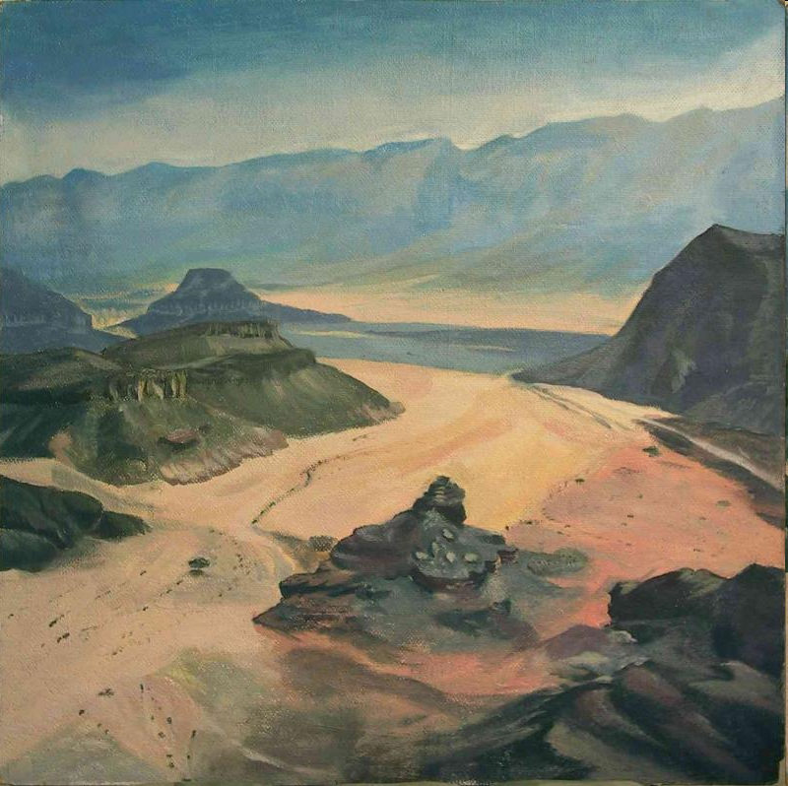
Dig Site 8
Joshua
9:1- 10:15

Slide 2

The Truth:
God honors us when we keep our word!

Slide 3
Memory Verse
Psalm 25:10
“All the ways of the Lord are loving and faithful
toward those who keep the demands of his covenant.”
#8

Slide 4
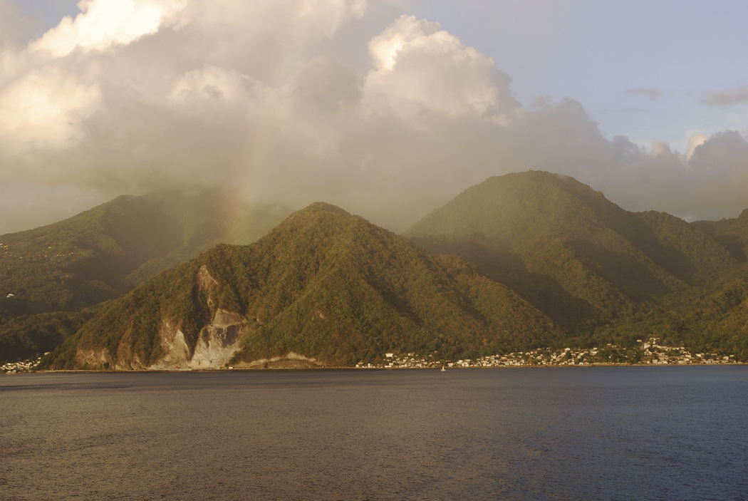
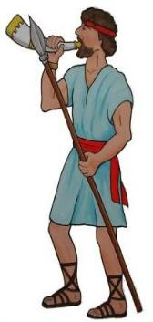


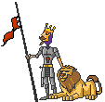
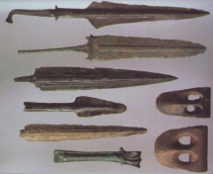

Now when all the kings west of the Jordan heard about these things--*
-- they came together to wage war against Joshua and Israel.
the kings in the hill country, in the western foothills, and along the entire coast of the Mediterranean Sea as far as Lebanon
(the kings of the Hittites, Amorites, Canaanites, Perizzites, Hivites and
Jebusites)
Jos. 9: 1-2
Real Canaanite weapons from: www.bible-archaeology.info/war.htm

Slide 5




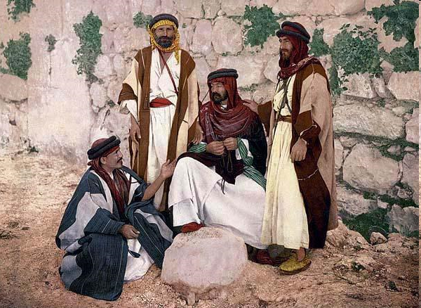


However …
when the people of Gibeon heard what Joshua had done to Jericho and Ai,
Uh oh, that crumbled wall….
Gibeon
Jos.9:3

Slide 6






they resorted to a ruse:
(a trick)
Gibeon

Slide 7
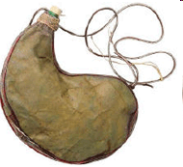

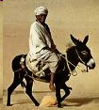


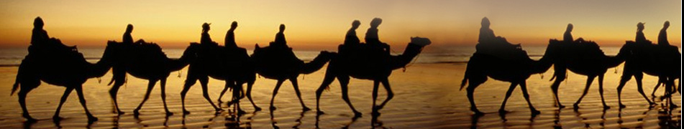
They went as a delegation whose donkeys were loaded with worn-out sacks and old wineskins, cracked and mended.
They put worn and patched sandals on their feet and wore old clothes. All the bread of their food supply was dry and moldy.
Jos. 9:4b-5

Slide 8


Then they went to Joshua in the camp at Gilgal and said to him and the Israelites,
"We have come from a distant country;
make a treaty with us."
TREATY
Jos. 9:6
(a treaty is an agreement to promise to have peace)

Slide 9



The Israelites said to the Hivites,
"But perhaps you live near us, so how can we make a treaty with you?"
Israelites
Hivites
Jos.9:7

Slide 10



"We are
your servants,"
they said to Joshua.
But Joshua asked, "Who are you and where do you come from?"
Jos.9:9

Slide 11


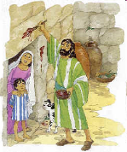

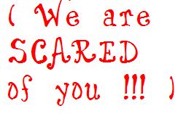
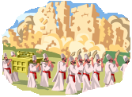
They answered: "Your servants have come from a very distant country because of the fame of the Lord your God. For we have heard reports of him: all that he did in Egypt, and all that he did to the two kings of the Amorites east of the Jordan--Sihon king of Heshbon, and Og king of Bashan, who reigned in Ashtaroth.”
Jos. 9:9-10

Slide 12
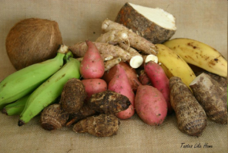
And our elders and all those living in our country said to us, 'Take provisions for your journey; go and meet them and say to them,
"We are your servants; make a treaty with us." '
Jos.9:11

Slide 13
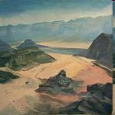

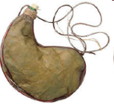




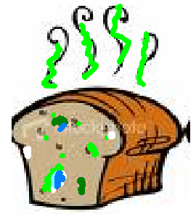


“This bread of ours was warm when we packed it at home on the day we left to come to you. But now see how dry and moldy it is.
And these wineskins that we filled were new, but see how cracked they are. And our clothes and sandals are worn out by the
YUCK!!!!
Very Long Journey"
Jos. 9:12-13

Slide 14
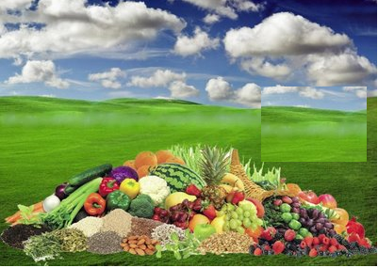
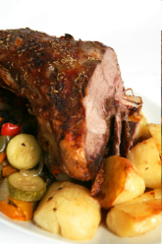

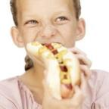
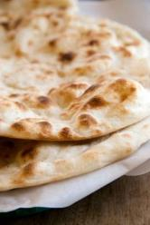
The Israelites
sampled their provisions…
Jos.9:14

Slide 15
…but
did not inquire
of the Lord.
Jos.9:14

Slide 16


Then Joshua made a treaty of peace with them to let them live,
and the leaders of
the assembly ratified it
by oath.
Jos.9:15

Slide 17


Three days after they made the treaty with the Gibeonites,
the Israelites heard that
they were neighbors, living near them.
Gibeon Kephirah
Beeroth Kiriath
Jearim
So the Israelites set out and on the third day came to their cities: Gibeon, Kephirah, Beeroth and Kiriath Jearim.
Jos.9:16-17

Slide 18



But the Israelites did not attack them, because the leaders of the assembly had sworn an oath to them by the Lord, the God of Israel.
The whole assembly grumbled against the leaders, but all the leaders answered, "We have given them our oath by the Lord, the God of Israel, and we cannot touch them now.
No!
We promised!!
Let’s get ’em!!
Jos.9:18,19

Slide 19

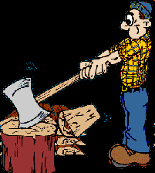


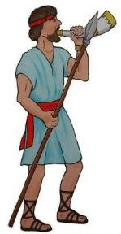
This is what we will do to them: We will let them live, so that God’s wrath will not fall on us for breaking the oath we swore to them."
They continued, "Let them live, but let them be woodcutters and water carriers in the service of the whole assembly." So the leaders' promise to them was kept.
Woodcutters and water carriers are servants.
Jos.9:20,21

Slide 20
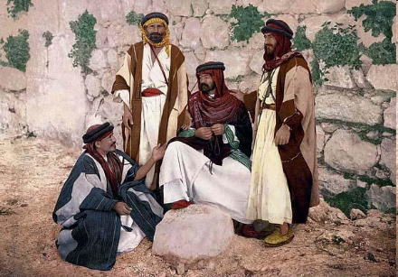

Then Joshua summoned the Gibeonites and said, "Why did you deceive us by saying, 'We live a long way from you,' while actually you live near us?
Liar, liar, pants on fire!!
Jos.9:22

Slide 21
Curse
You are now under a curse: You will never be released from service as
woodcutters and water carriers
for the house of my God."
Jos.9:23

Slide 22
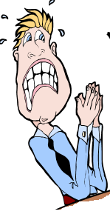

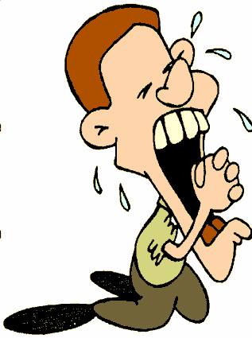
They answered Joshua, "Your servants were clearly told how the Lord your God had commanded his servant Moses to give you the whole land and to wipe out all its inhabitants from before you.
So we feared for our lives
because of you,
and that is why we did this.
We are now in your hands.
Do to us whatever seems
good and right to you."
Jos.9:24-25

Slide 23


So Joshua saved them from the Israelites, and they did not kill them.
Jos.9:26

Slide 24
That day he made the Gibeonites woodcutters and water carriers for the assembly, to provide for the needs of the altar of the Lord at the place the Lord would choose. And that is what they are to this day.
Jos.9:27
Jos.9:23

Slide 25

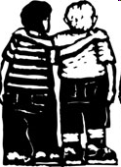

Now Adoni-Zedek king of Jerusalem heard that
Joshua had taken Ai and totally destroyed it, doing to Ai and its king as he had done to Jericho and its king,
and that the people of Gibeon had made a treaty of peace with Israel and had become their allies.
Gibeon
Israel
Jos.10:1

Slide 26

He and his people were very much alarmed at this, because Gibeon was an important city, like one of the royal cities; it was larger than Ai, and all its men were good fighters.
Jos.10:2

Slide 27
So Adoni-Zedek king of Jerusalem appealed to Hoham king of Hebron, Piram king of Jarmuth, Japhia king of Lachish and Debir king of Eglon.
"Come up and help me attack Gibeon," he said, "because it has made peace with Joshua and the Israelites."
Adoni-Zedek
Hoham
Jos.10:3-4

Slide 28

Then the five kings of the Amorites--the kings of Jerusalem, Hebron, Jarmuth, Lachish and Eglon--joined forces.
They moved up with all their troops and took up positions against Gibeon and attacked it.
Jos.10:5
To Gibeon

Slide 29

The Gibeonites then sent word to
Joshua in the camp at Gilgal:
"Do not abandon your servants. Come up to us quickly and save us! Help us, because all the Amorite kings from the hill country have
joined forces against us."
Israelites
Gibeon
Jos.10:6

Slide 30

So Joshua marched up from Gilgal with his entire army,
including all the best fighting men.
Jos. 10:7

Slide 31



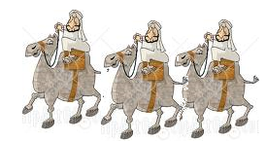
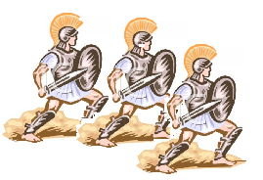
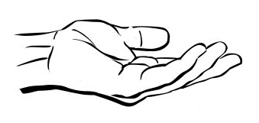
The Lord said to Joshua,
"Do not be afraid of them; I have given them into your hand. Not one of them will be able to withstand you."
Joshua 10:8

Slide 32

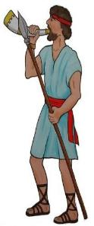
After an all-night march from Gilgal, Joshua took them by surprise.
Jos.10:9

Slide 33
The Lord threw them into confusion before Israel, so Joshua and the Israelites defeated them completely at Gibeon. Israel pursued them along the road going up to Beth Horon and cut them down all the way to Azekah and Makkedah.
Jos.10:10

Slide 34





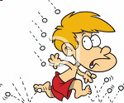
As they fled before Israel on the road down from Beth Horon to Azekah, the Lord hurled large hailstones down on them, and more of them died from the hail than were killed by the
swords of the Israelites.
Jos.10:11

Slide 35
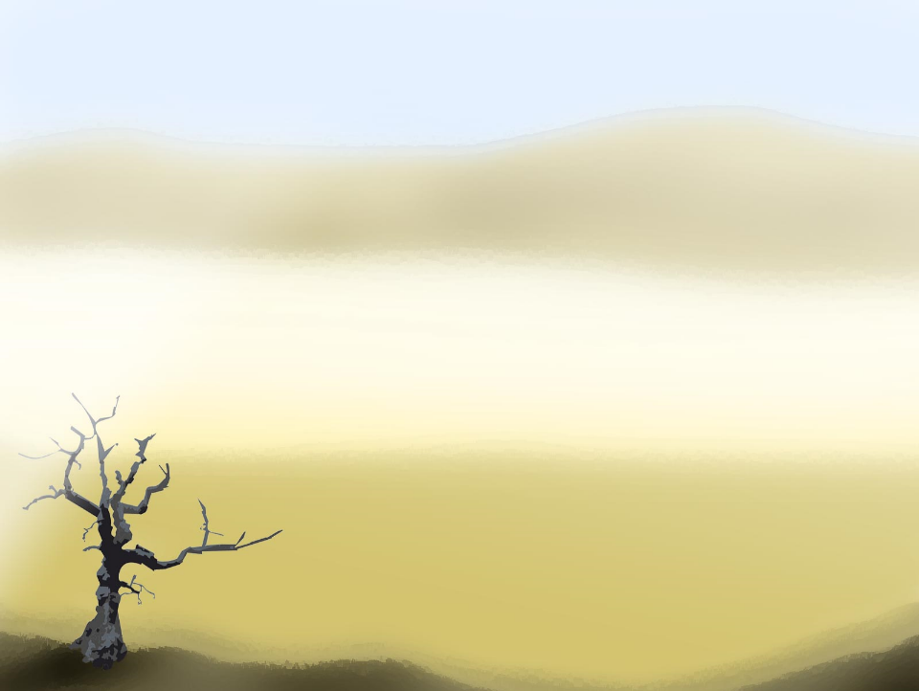

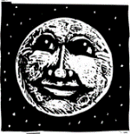
Joshua 10:12
On the day the Lord
gave the Amorites over
to Israel, Joshua said to the Lord in the presence of Israel:
“Sun, stand still over Gibeon, and you, moon, over the
Valley of Aijalon."

Slide 36
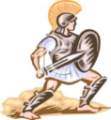


Joshua 10:13
So the sun stood still,* and the moon stopped, till the nation avenged itself on its enemies, as it is written in the Book of Jashar. The sun stopped in the middle of the sky and delayed going down about a full day.

Slide 37
There has never been a
day like it before or since,
a day when the Lord listened to a human being. Surely the Lord was fighting for Israel!
Jos.10:14-15

Slide 38
Then Joshua returned with all Israel
to the camp at Gilgal.
Jos.10:15

